Slide 1

GLOBAL
Macarons
MARKET REPORT 2024
Global,Regional,CountryAnalysis

Slide 2

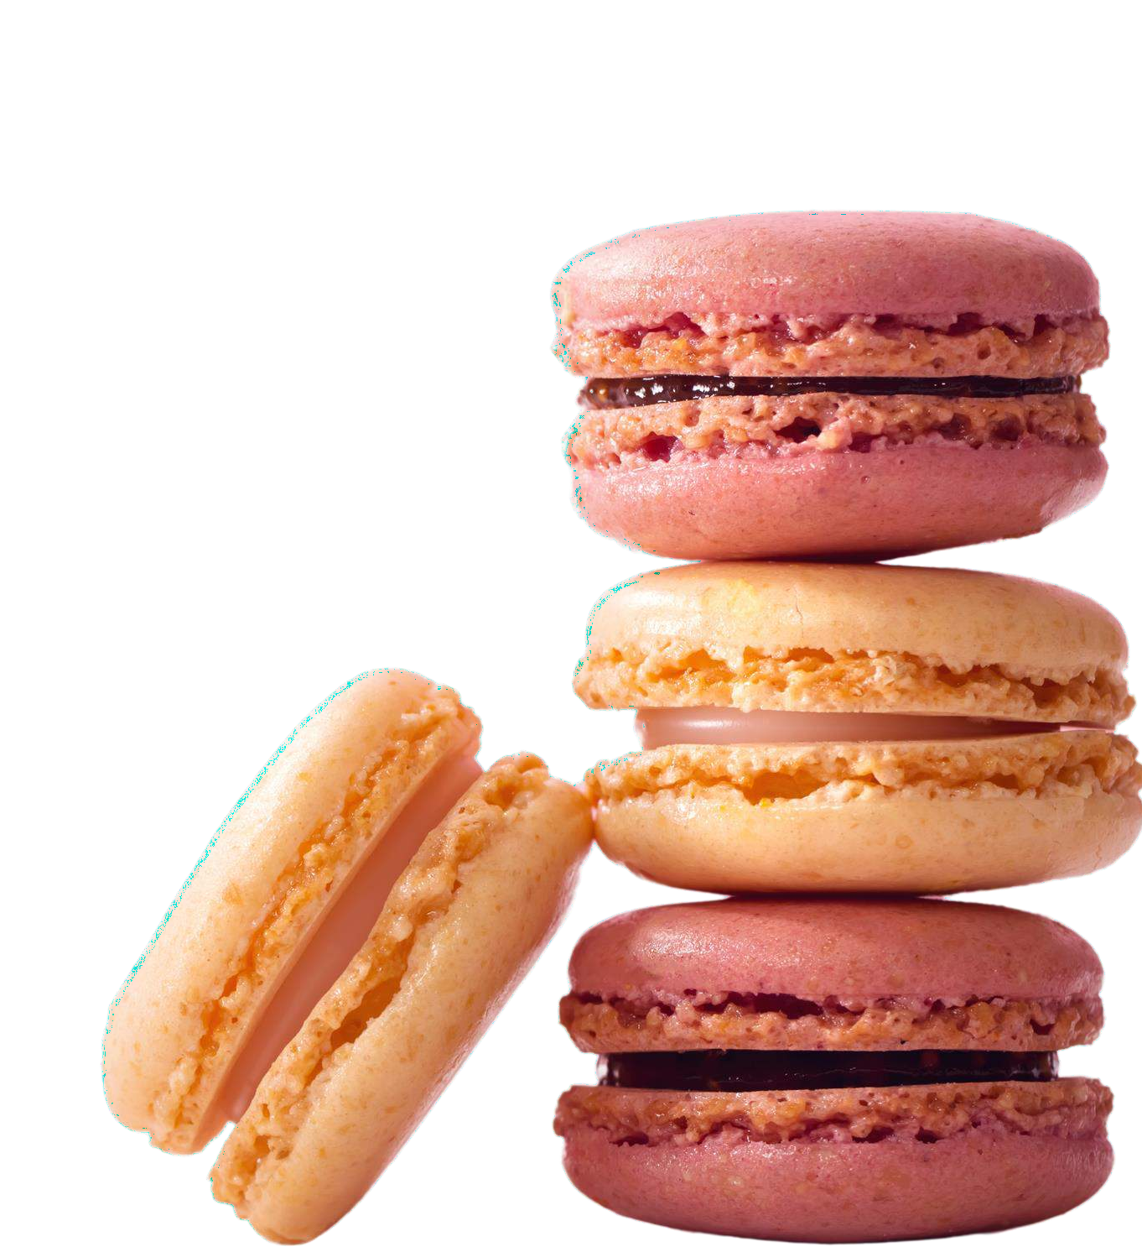


INTRODUCTION

Slide 3


KEY INSIGHTS
MARKET SIZE
USD 758.9 billion
2023
20₋23
CAGR 6.5%
2030

Slide 4
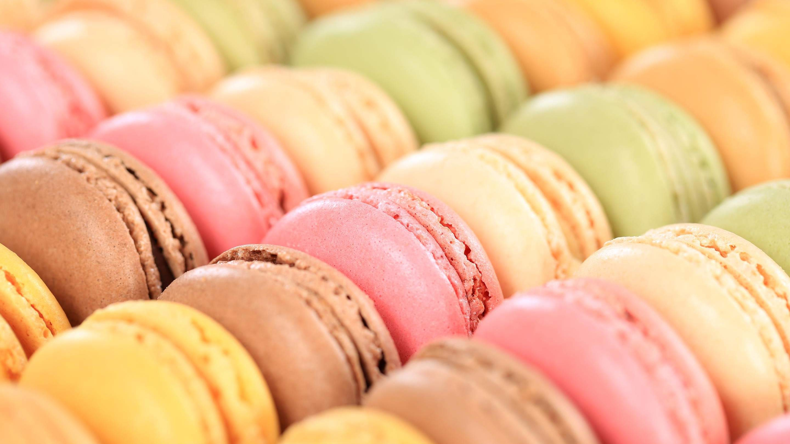
REVENUE MARKET SHARE BY SEGMENTS 2022
Basic
Chocolate
Strawberry
Lemon
Lavender Coconut
Type Segment
Economy
Premium
Luxury
Price Range
Supermarkets/Hypermarkets
Convenience Stores
Independent Retailers
Online Sales
Application Segment
Box
Pouch
Tub
Packaging Industry
Vanilla
Raspberry
Pistachio
Salted Caramel
Flavor Industry

Slide 5
Global Macarons Market Revenue share for 2022
Europe 38%

Slide 6






Slide 7

AUTHOR'S PERSPECTIVE
The Global Macarons Market is witnessing significant growth in the near future.
A mainstay in many bakeries and patisseries, chocolate macarons are frequently seen as a traditional option and a safe bet.
Fresh macarons, which are frequently personalized, can be delivered right to consumers' doorsteps thanks to safe packing and effective delivery services.
Business-to-business (B2B) transactions in the macaron market serve the needs of companies who want to include these delicious delicacies in their products, expanding the market's clientele.
Raspberry macarons are a popular option for people who like their macarons to have a harmony of tart and sweet flavors since they offer a fruity and refreshing twist.
Superior ingredients, handcrafted preparation, and beautiful presentation are frequently what define these macarons.

Slide 8








KEY PLAYERS

Slide 9


Contact us
For Full Report
COGNITIVE MARKET RESEARCH
Tel: + 1 312 - 376 - 8303 | + 44 020 - 8123 - 0732
India: ( + 91 ) 983 - 496 - 8611
sales@ cognitivemarketresearch. com
Access the Full Report : http://tinyurl.com/2dde7wbb
Please visit our website:
https://www.cognitivemarketresearch.com

