Slide 1

GLOBAL LYCHEE
MARKET REPORT
2024
Global,Regional,CountryAnalysis

Slide 2
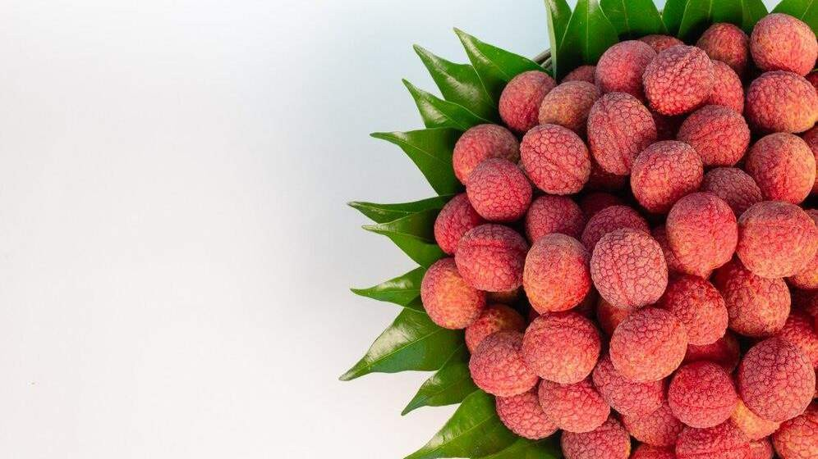
INTRODUCTION
The lychee market is experiencing growth due to several factors. Increasing consumer awareness of the fruit's health benefits and its unique, sweet-tasting flesh is driving demand. Additionally, the expansion of lychee cultivation in various regions has increased the availability of fresh Lychee. The fruit's versatility, used in various culinary applications, further contributes to its rising popularity. Export opportunities and favorable trade conditions have also boosted lychee production, making it a sought-after commodity in both domestic and international markets.

Slide 3


KEY INSIGHTS
MARKET SIZE
USD 7.2 billion
2023
20₋23
CAGR 6.0%
2030

Slide 4
REVENUE MARKET SHARE BY SEGMENTS 2022
Dry Litchi
Fresh Litchi
Type Segment
Application Segment
Online Sales
Offline Retail

Slide 5

Global Lychee Market Revenue share for 2022
Asia Pacific

Slide 6






Slide 7

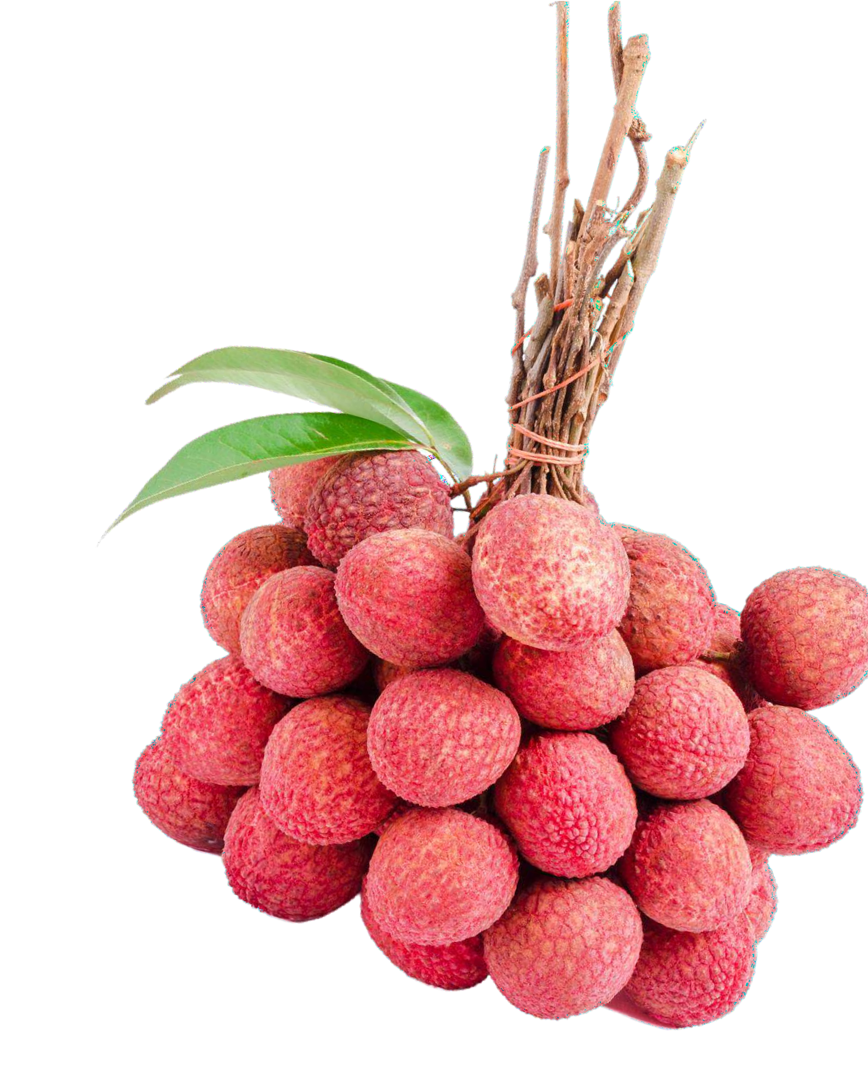
AUTHOR'S PERSPECTIVE
The Global Lychee Market is witnessing significant growth in the near future.
Consumers are increasingly seeking fresh, natural, and healthy food options. Fresh Lychee, with its juicy, sweet,
and unique flavor, is gaining popularity among health- conscious consumers.
The convenience of online platforms, where consumers can purchase fresh Lychee with ease and have it delivered to
their doorstep, has become increasingly attractive.
In 2023, the Dry Litchi segment accounted for noticeable share of global Lychee Market and is projected to experience significant growth in the near future.
The Online Sales segment is expected to expand at the significant CAGR retaining position throughout the forecast period.

Slide 8











KEY PLAYERS

Slide 9


Contact us
For Full Report
COGNITIVE MARKET RESEARCH
Tel: + 1 312 - 376 - 8303 | + 44 020 - 8123 - 0732
India: ( + 91 ) 983 - 496 - 8611
sales@ cognitivemarketresearch. com
Access the Full Report : http://tinyurl.com/4k5rsa78
Please visit our website:
https://www.cognitivemarketresearch.com

