Slide 1

GLOBAL
LUXURY WINE
MARKET REPORT
2024
Global,Regional,CountryAnalysis

Slide 2
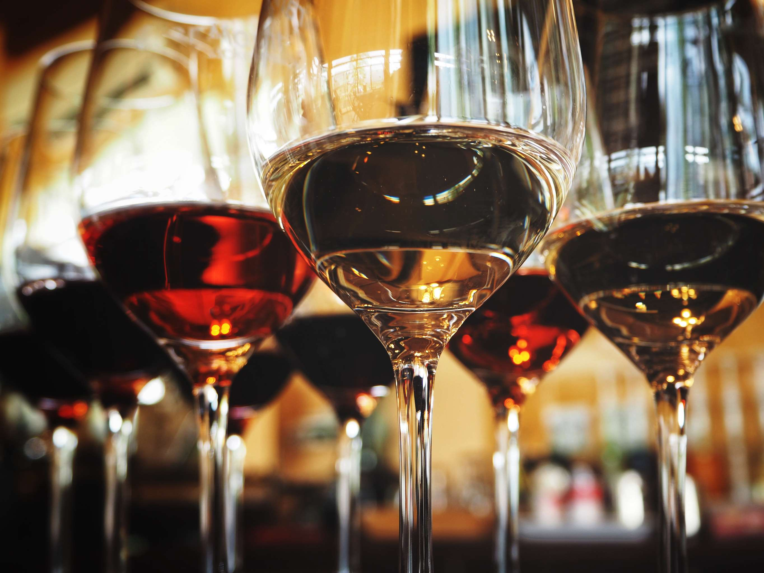
INTRODUCTION
The luxury wine market encompasses exclusive, high-quality wines crafted with precision, often from prestigious vineyards and limited production, targeting discerning consumers seeking elevated sensory experiences and rare vintages in the world of oenology. This niche market focuses on delivering exceptional taste, distinctive terroir, and a sense of exclusivity, appealing to wine enthusiasts who appreciate the finest vinicultural offerings. The luxury wine market's robust growth is fueled by rising consumer affluence and a premiumization trend, driving demand for sophisticated and exclusive wine offerings. Winemakers respond with limited-edition blends, meeting the demand for unique experiences and propelling market growth. Concurrently, evolving consumer tastes, influenced by global culinary exploration, drive demand for distinctive wine offerings. Winemakers emphasize terroir and varietals, creating a symbiotic relationship that fuels further market growth.

Slide 3


KEY INSIGHTS
MARKET SIZE
USD 170.8 billion
2023
CAGR
7.0%
2023- 2030

Slide 4

REVENUE MARKET SHARE BY SEGMENTS 2022
  Red Wine
  White Wine
  Rosa Wine
  Sparkling Wine
  Fortified Wine
  Business-to-Business
  Business-to-Consumer
Type Segment
Distribution Channel
  Wholesale
  Retail Stores
  Department Stores
  Online Retailers
  Specialty Stores
  Duty-Free Shops
  Glass
  Plastic
  Metal
  Ceramic
Application Segment
Bottle Material

Slide 5

Global Luxury Wine Market Revenue share for 2024
North America

Slide 6

Symbiotic Dance of Evolving Palates and Innovation Reshaping the Luxury Wine Market
Drivers
On-Premise Sales Restrictions to Restrict the Luxury Wine Market
Restraints

Slide 7

AUTHOR'S PERSPECTIVE
  The Global Luxury Wine Market is witnessing significant growth in the near future.
  Sparkling Wine as a frontrunner in growth, diversifying the luxury wine landscape and reflecting an increasing inclination towards effervescent and celebratory options among discerning consumers.
  Simultaneously, the business-to-business (B2B) distribution segment emerges as the fastest-growing category, fueled by a rising demand from restaurants, hotels, and specialty retailers.
  Simultaneously, the business-to-business (B2B) distribution segment emerges as the fastest-growing category, fueled by a rising demand from restaurants, hotels, and specialty retailers.

Slide 8











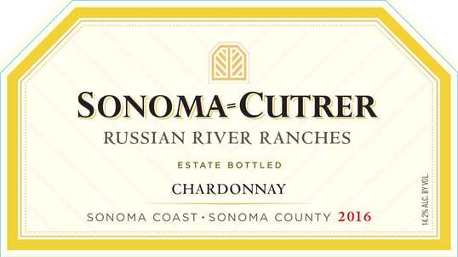

KEY PLAYERS

Slide 9


For Full Report
Contact us
COGNITIVE MARKET RESEARCH
Tel: +1 312-376-8303 | +44 020-8123-0732
India: (+91) 983-496-8611
sales@cognitivemarketresearch.com
Access the Full Report : http://tinyurl.com/3nfmeck3
Please visit our website:
https://www.cognitivemarketresearch.com

