Slide 1
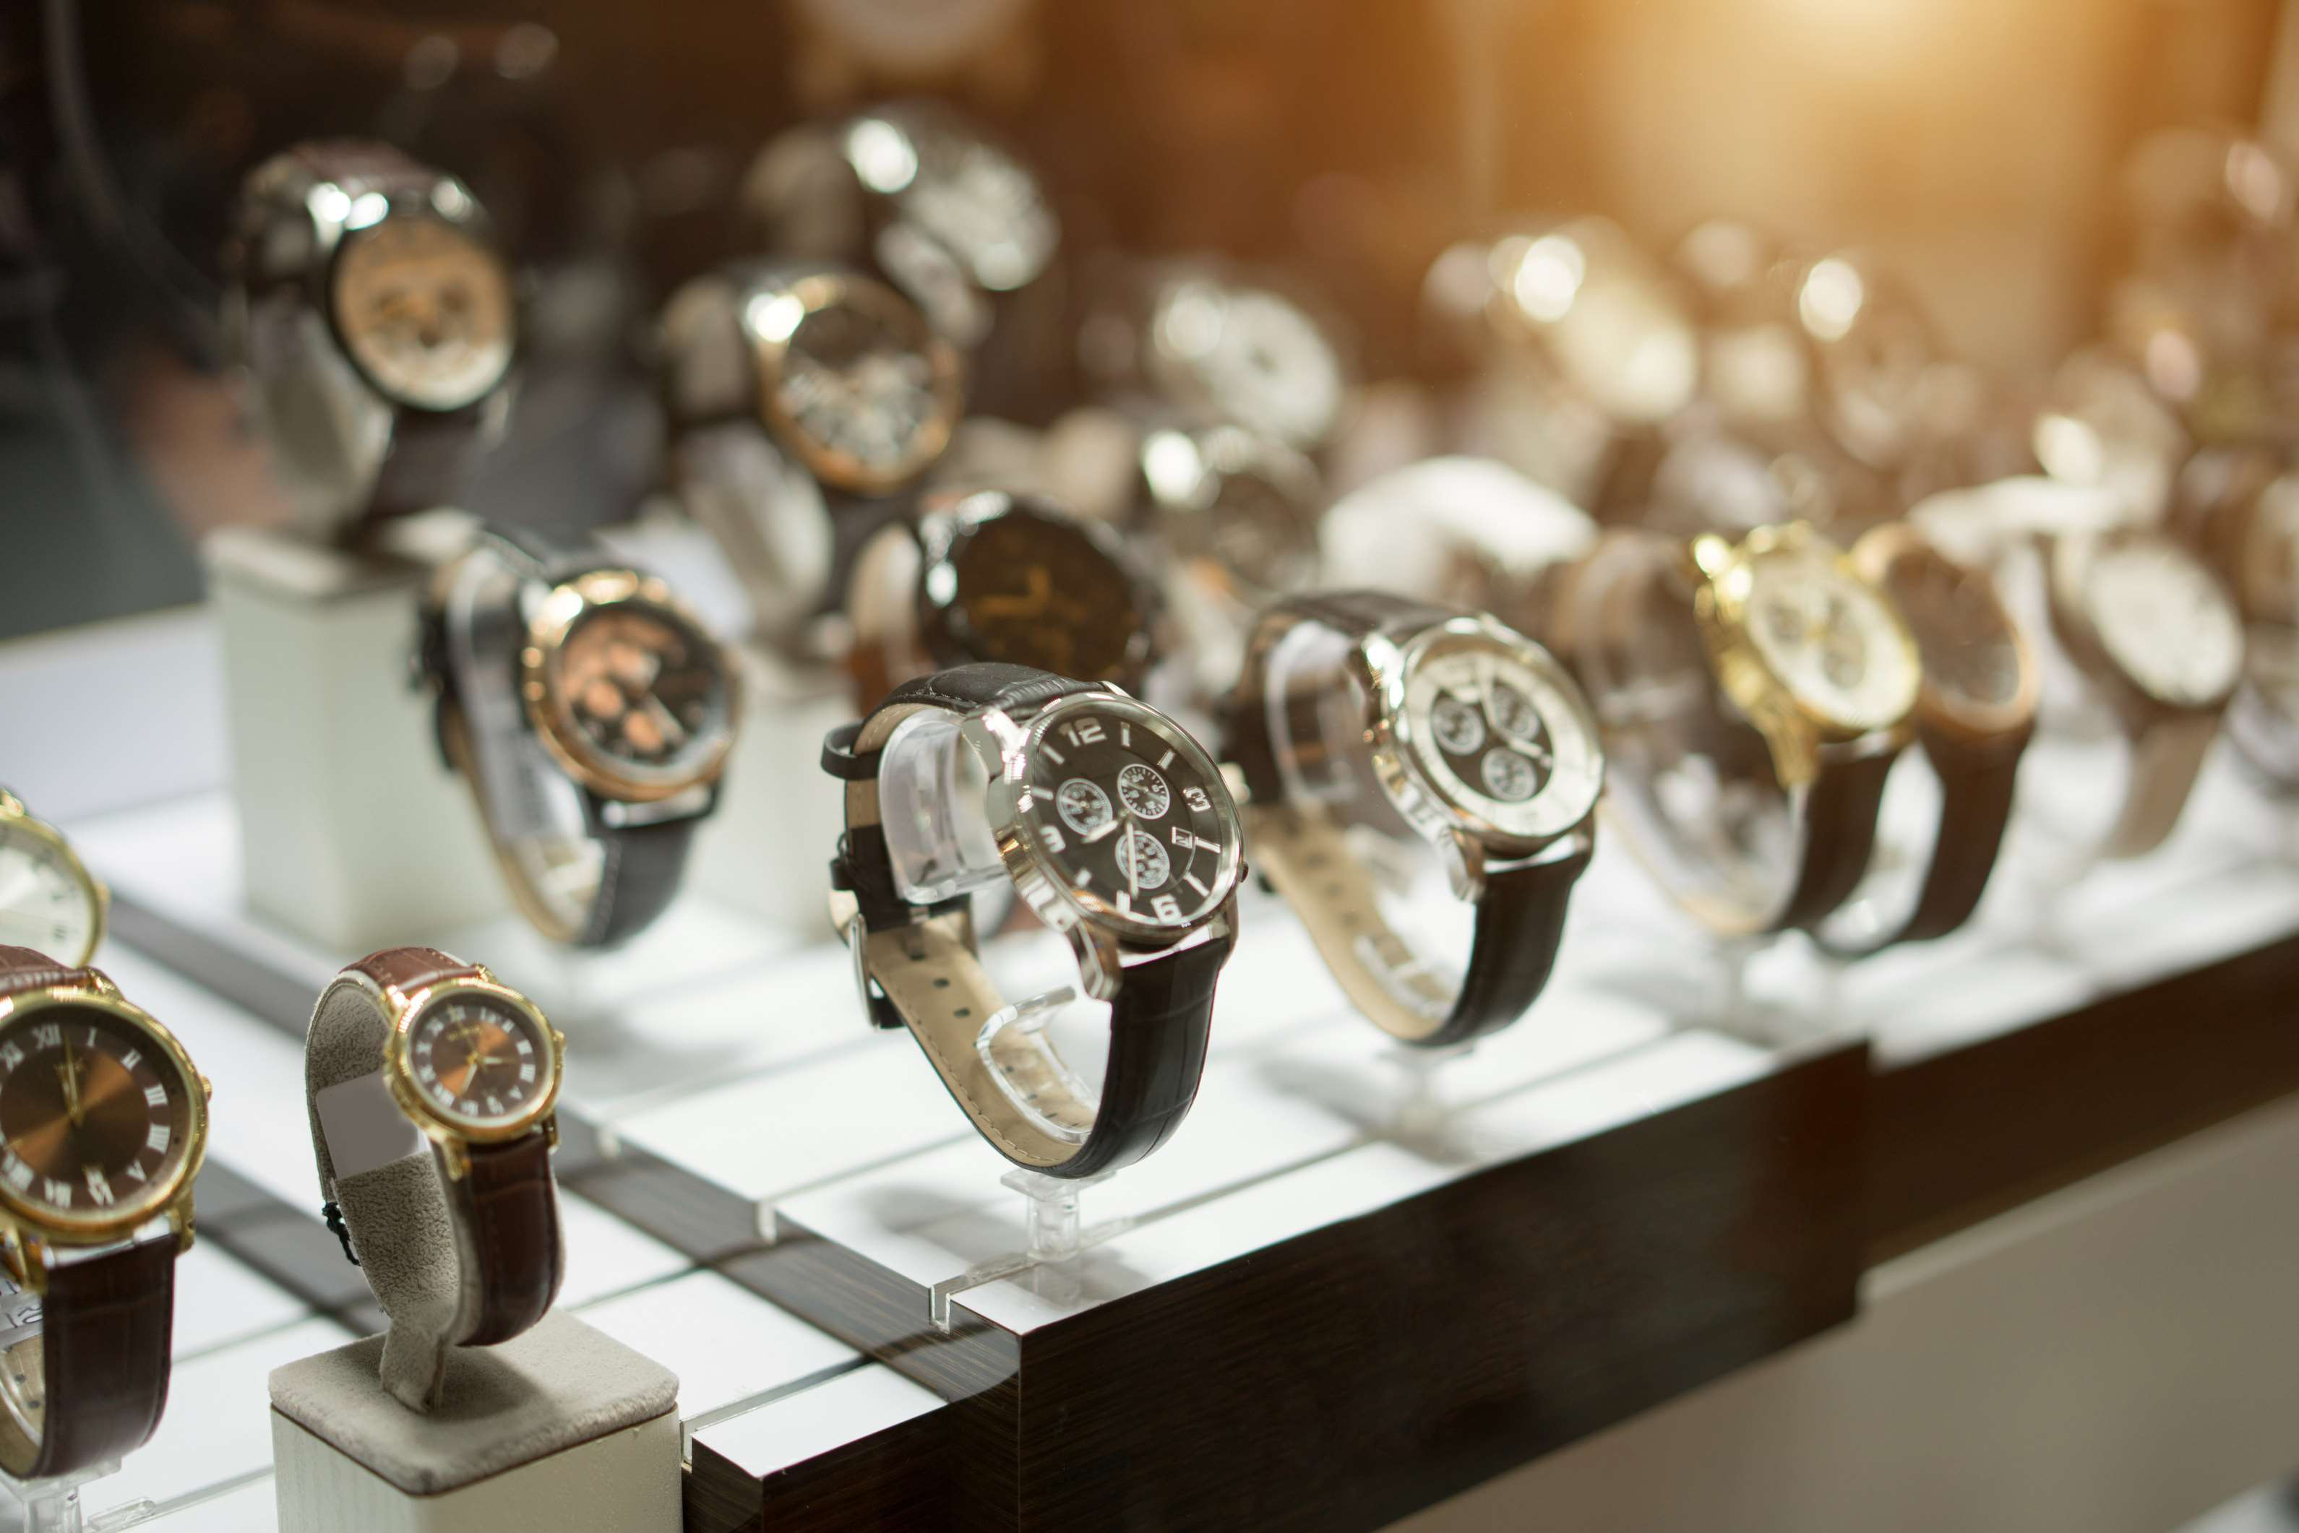
GLOBAL
LUXURY WATCHES
MARKET REPORT
2024
Global,Regional,CountryAnalysis

Slide 2
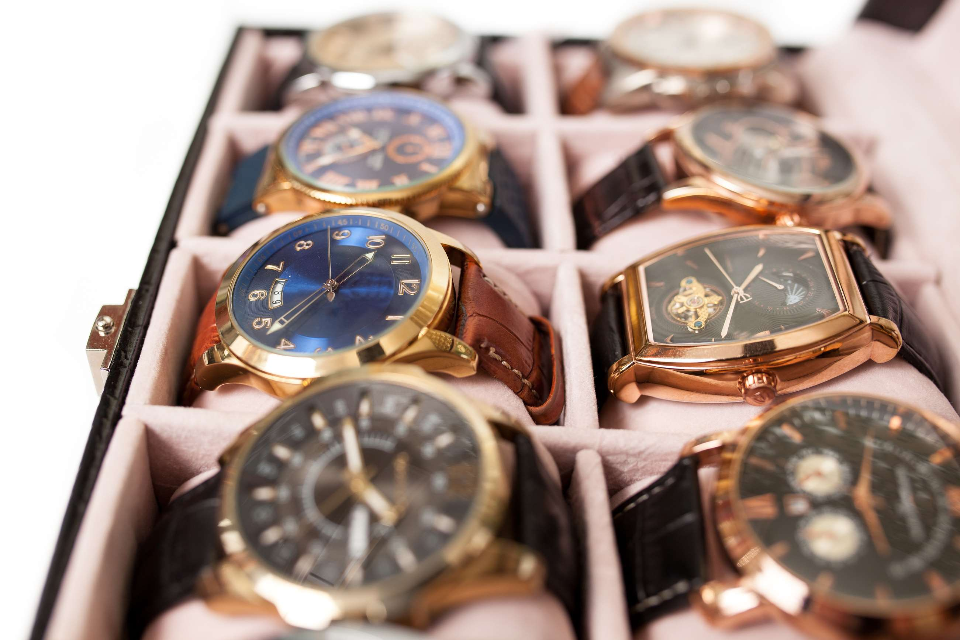
INTRODUCTION
The luxury watches market encompasses the production, distribution, and sale of high-end timepieces characterized by exceptional craftsmanship, prestigious brand identity, and often exclusive designs. These watches are sought after for their quality, precision, and status-symbol appeal. The global luxury watch market is increasing the number of affluent individuals globally, which is expected to drive market growth. Additionally, the growing trend of customization and personalization in luxury watches is expected to drive market growth. The market is driven by the desire for brand recognition and the prestige of owning luxury watches. Established luxury watch brands with a long history and a strong reputation have a competitive advantage in capturing consumer demand. These strategies help key players capture a significant market share and compete in the dynamic Luxury Watches market.

Slide 3
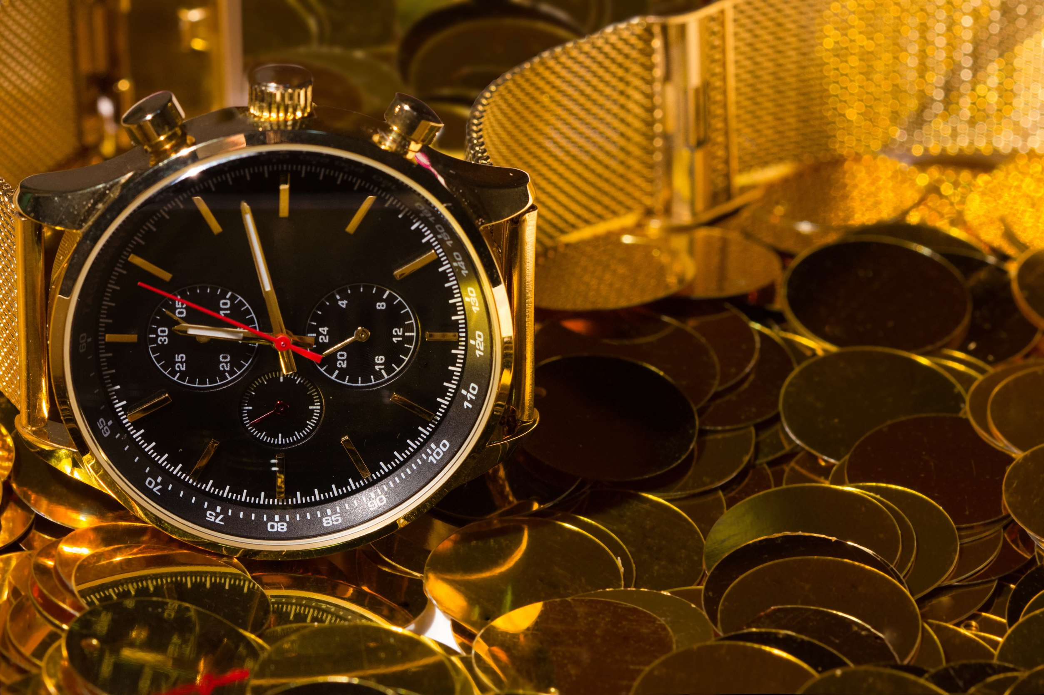

KEY INSIGHTS
MARKET SIZE
USD 43.6 billion
2023
CAGR
5.50%
2023- 2030

Slide 4
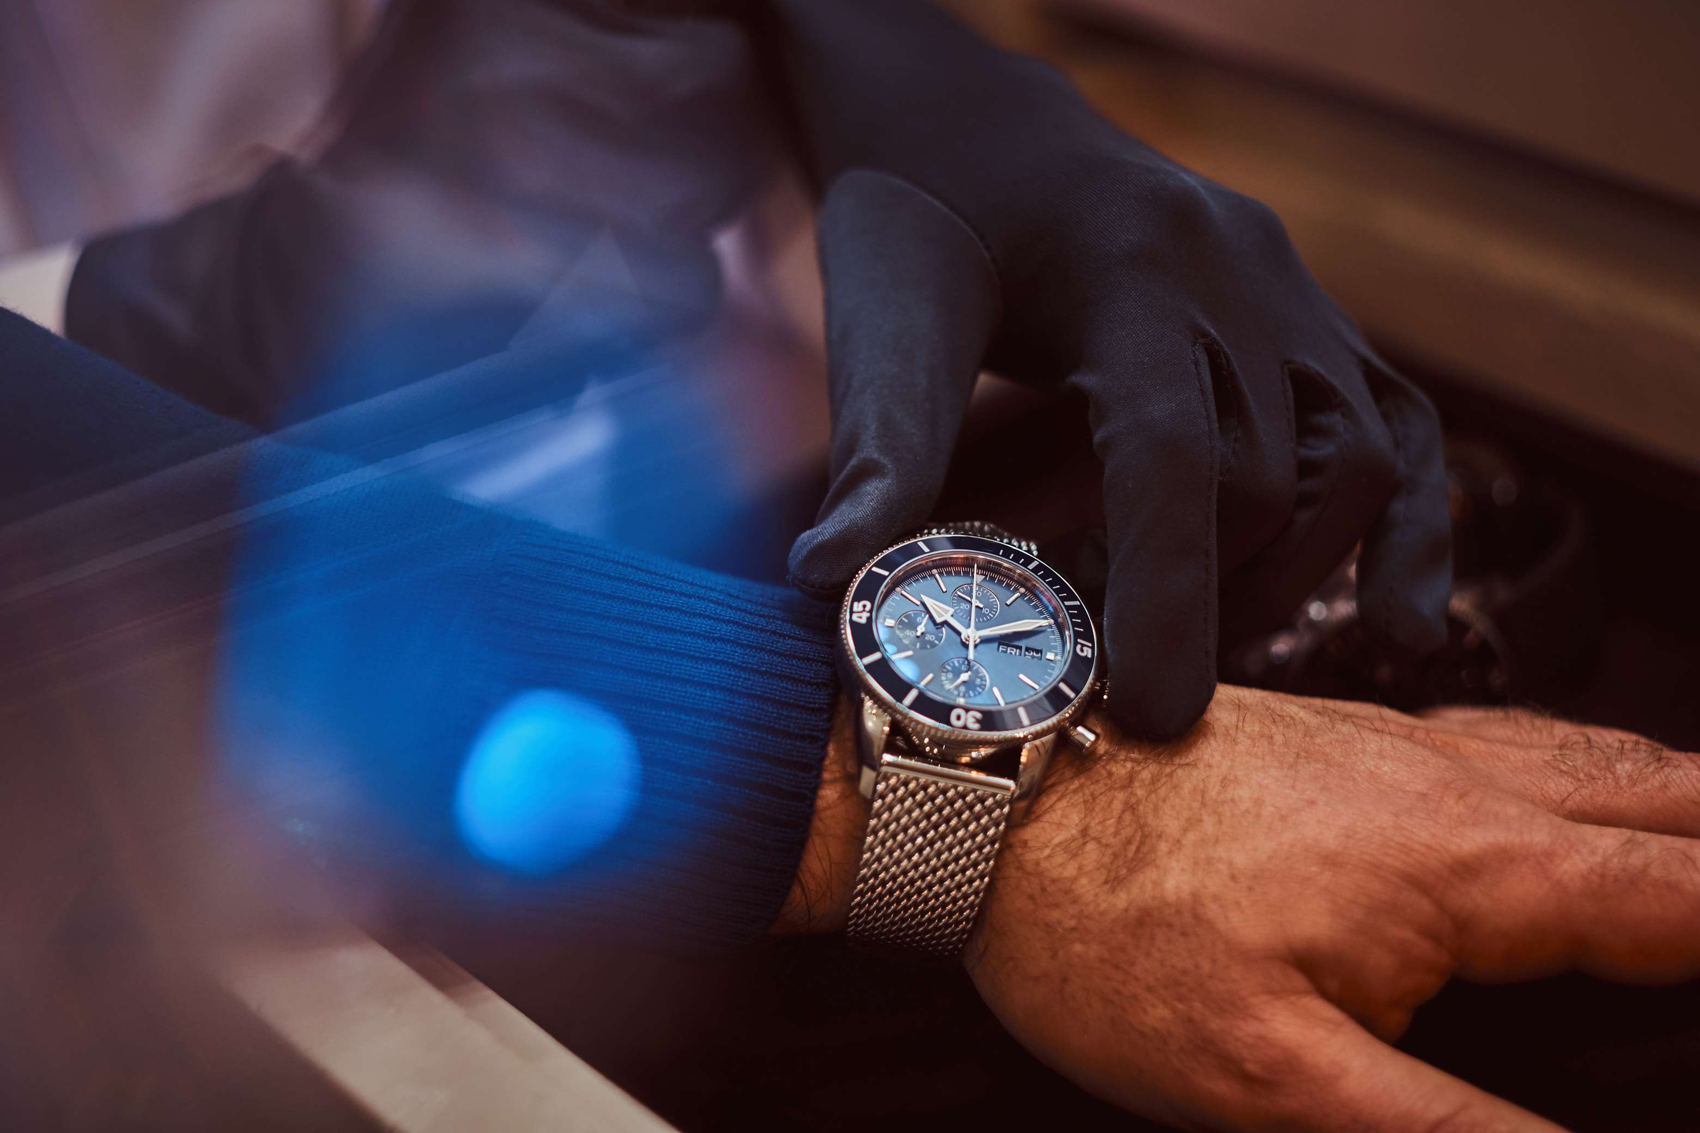
REVENUE MARKET SHARE BY SEGMENTS 2022
  Mechanical Quartz
  Others
Product Type Segment
  Online Distribution Sales
  Offline Distribution Sales
Distribution Channel
  Women’s Luxury Watches
  Men’s Luxury Watches
Gender Type Segment

Slide 5

Global Luxury Watches Market Revenue share for 2024
Asia Pacific
38%

Slide 6
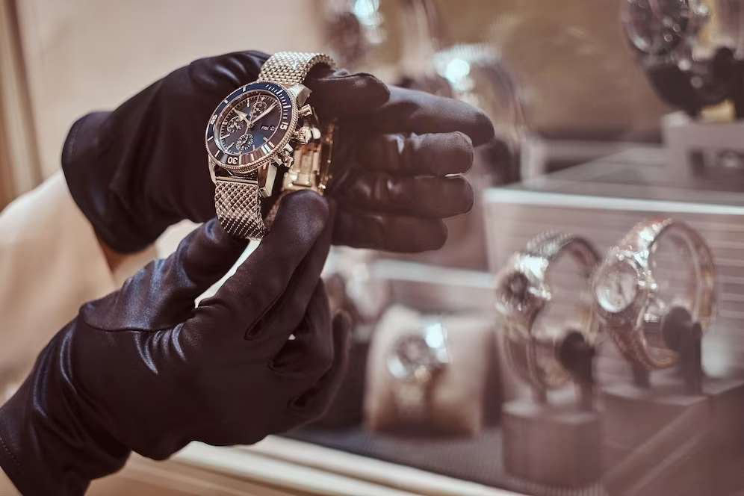
Growing Affluent Consumer Base to Propel Market Growth
Drivers
Targeting only the wealthy section of the Population to Restrict Market Growth
Restraints

Slide 7
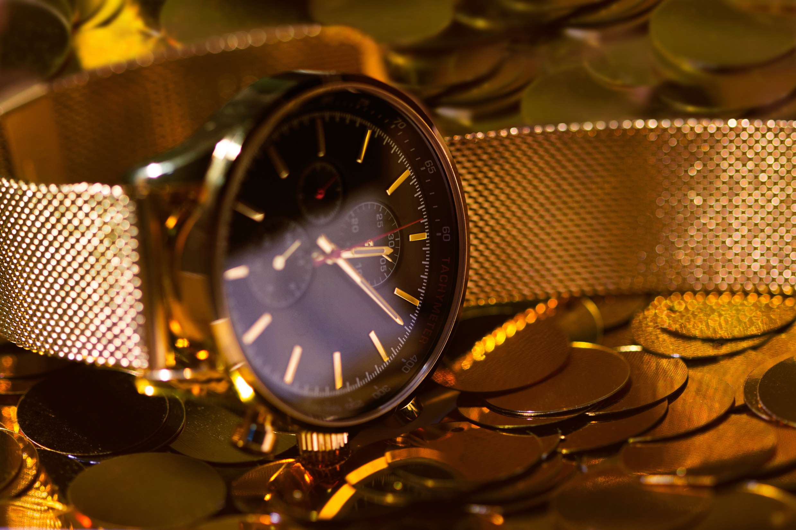
AUTHOR'S PERSPECTIVE
  The Global Luxury Watches Market is witnessing significant growth in the near future.
  The market's segmentation acknowledges the coexistence of traditional craftsmanship and modern innovations, allowing watchmakers to address diverse consumer needs and preferences.
  Elegance and intricate designs characterize women's luxury watches and often incorporate precious materials like diamonds and gemstones.
  E-commerce platforms provide an immersive shopping experience, enabling customers to explore and purchase luxury watches from the comfort of their homes.

Slide 8


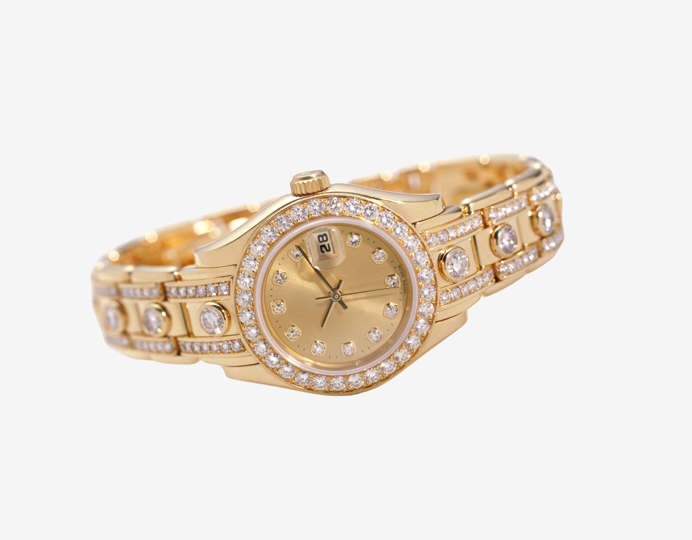









KEY PLAYERS

Slide 9


For Full Report
Contact us
COGNITIVE MARKET RESEARCH
Tel: +1 312-376-8303 | +44 020-8123-0732
India: (+91) 983-496-8611
sales@cognitivemarketresearch.com
Access the Full Report : https://tinyurl.com/y5u83p7z
Please visit our website:
https://www.cognitivemarketresearch.com

