Slide 1

GLOBAL
LUXURY SUNGLASS
MARKET REPORT 2024
Global,Regional,CountryAnalysis

Slide 2

INTRODUCTION
Luxury sunglasses refers to high-end eyewear crafted from premium materials, often designed by prestigious fashion brands. These sunglasses feature stylish designs and associated with a certain level of exclusivity and brand prestige. Key players in the luxury sunglasses market employ diverse strategies to maintain a competitive edge, including product innovation, strategic partnerships, and global expansion. Innovations in design, material, and technology enhance product appeal. Collaborations with fashion influencers and celebrities amplify brand visibility. Expanding into emerging markets capitalizes on growing consumer bases. Collectively, these strategies bolster market presence and cater to evolving consumer preferences, driving sustained growth in the dynamic luxury sunglasses industry.

Slide 3
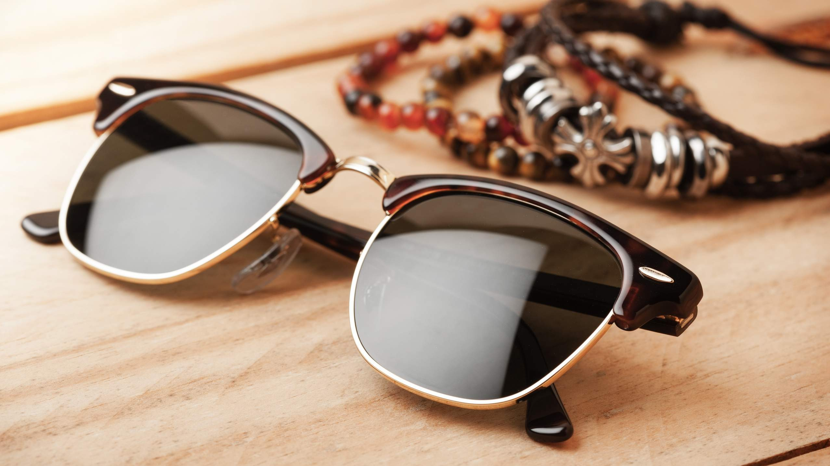

KEY INSIGHTS
MARKET SIZE
USD 4.9 billion
2023
CAGR 5.90%
20₋23
2030

Slide 4
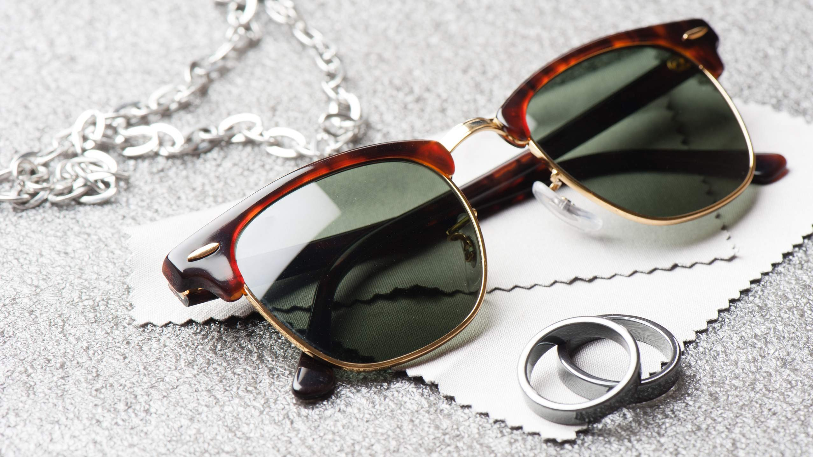
REVENUE MARKET SHARE BY SEGMENTS 2022
Polarized
Non- Polarized
Type Segment
Male Female Unisex
End User Segment
Acetate Metal Injected
Frame Material Segment
Supermarkets Hypermarkets Speciality Stores Convenience Stores Online Stores
Distribution Channel

Slide 5
Global Luxury Sunglass Market Revenue share for 2022
Europe 38%

Slide 6
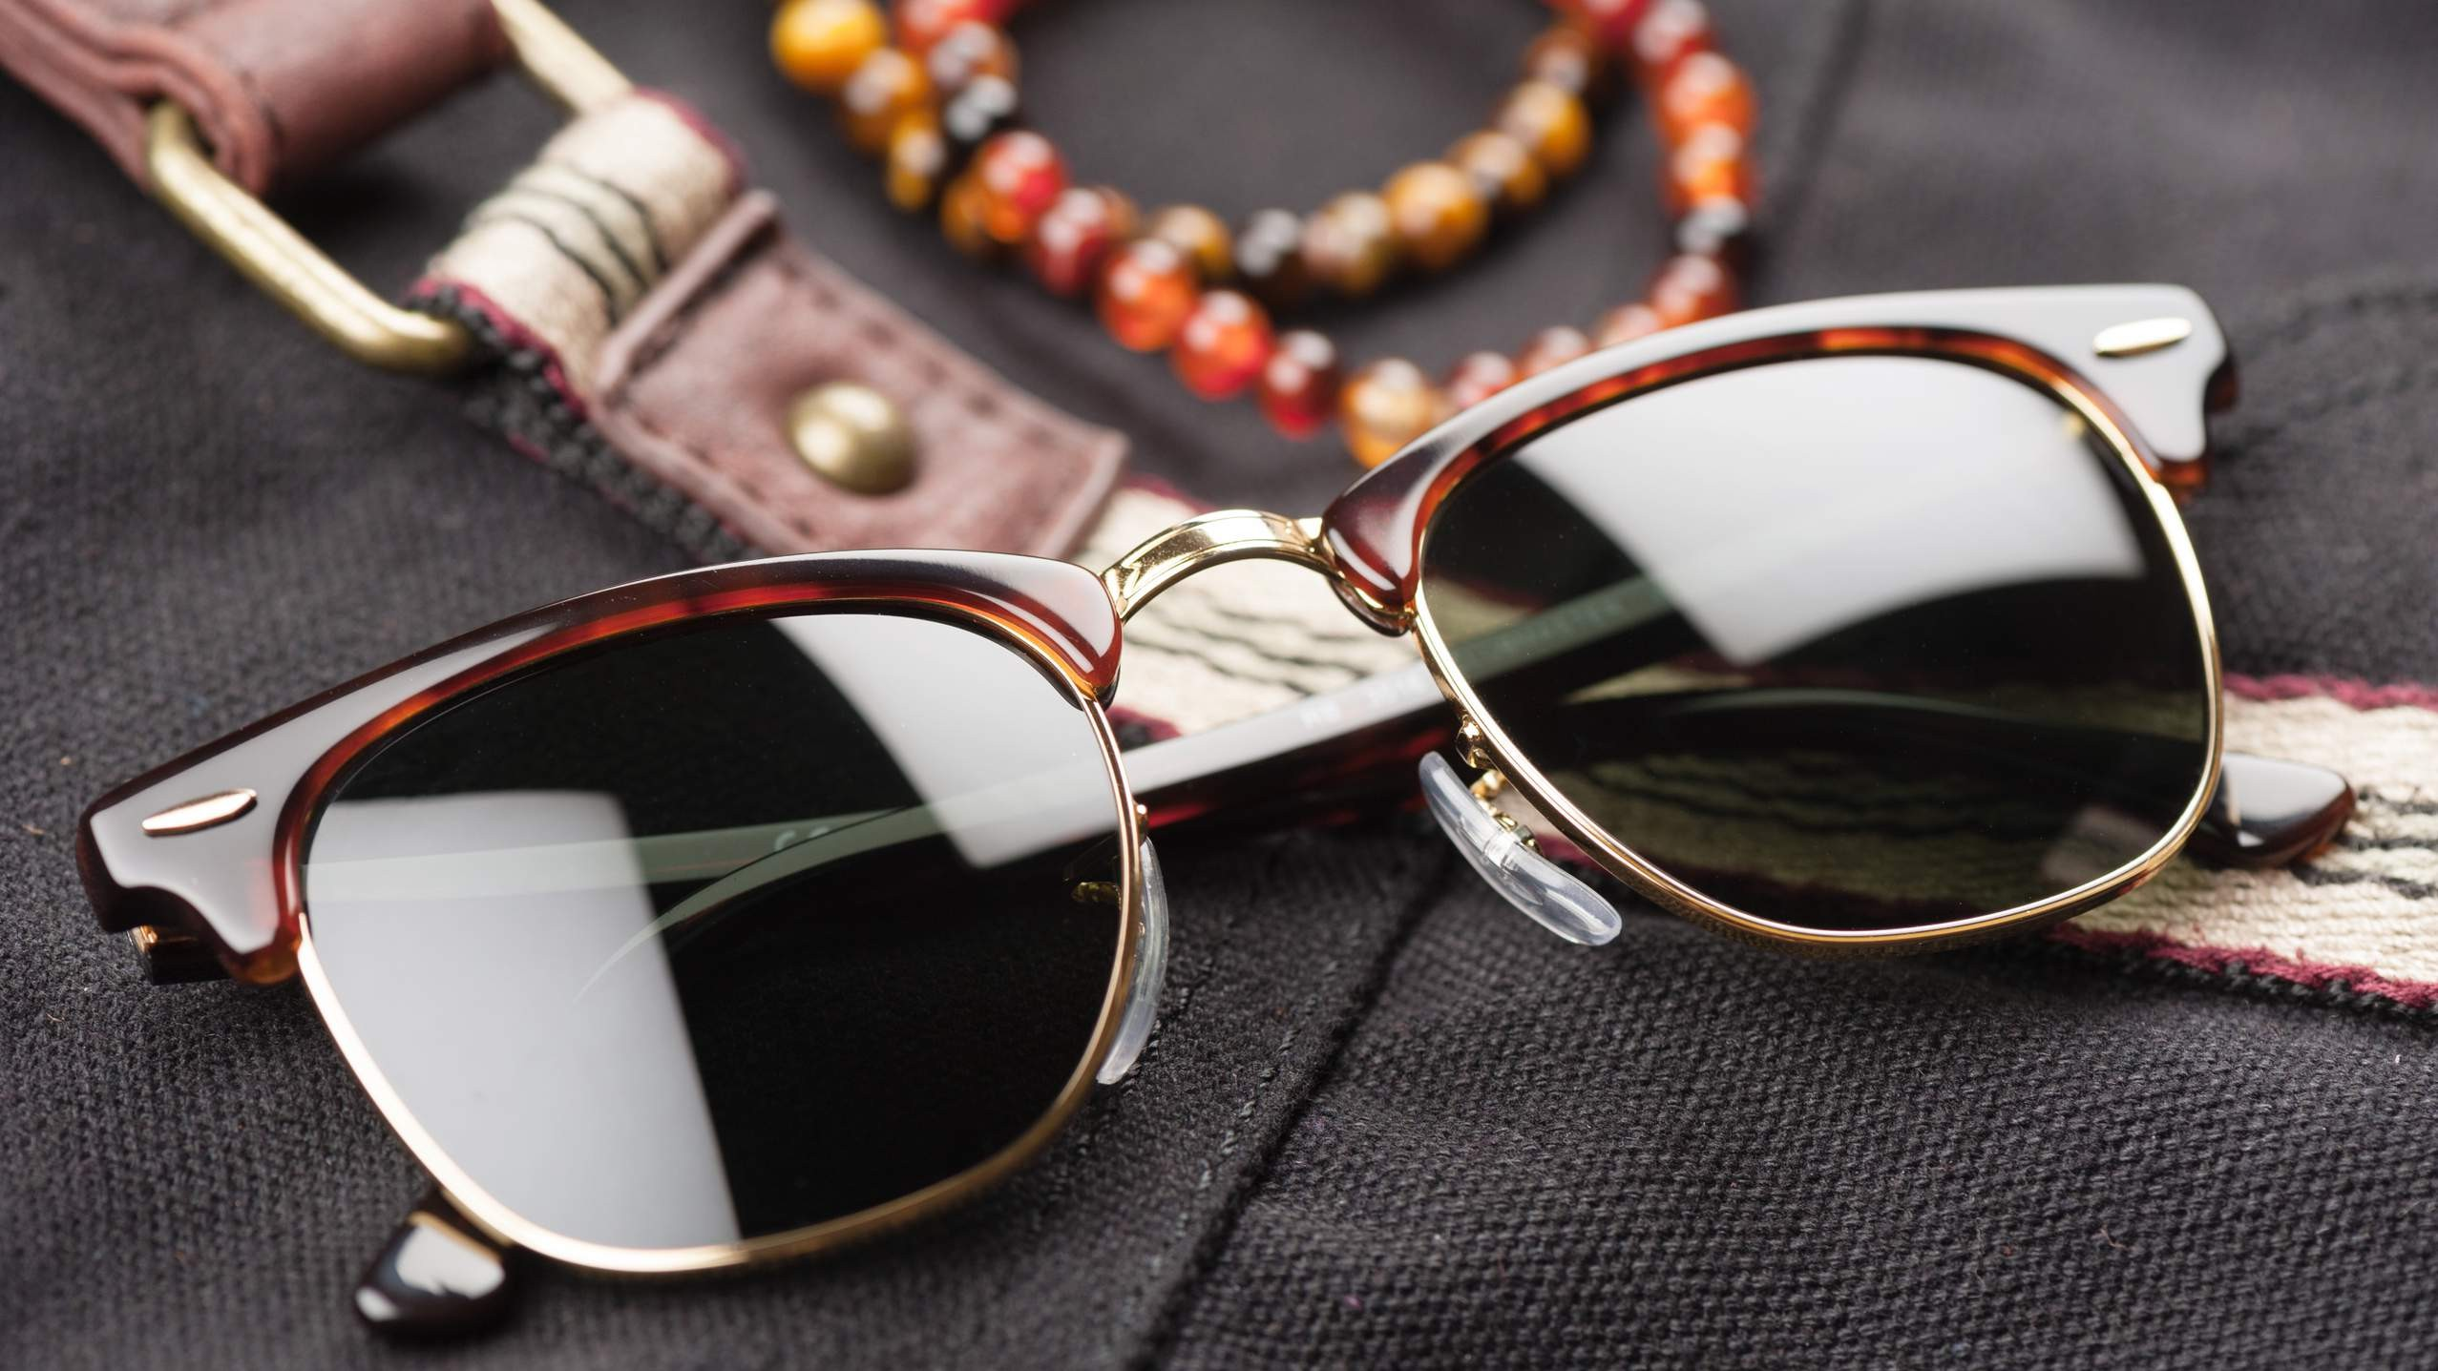

Growing Number of E- Commerce and Online Retail Stores to Propel Market Growth
Drivers
Competition from Non- Luxury Brands to Restrict Market Growth
Restraints

Slide 7
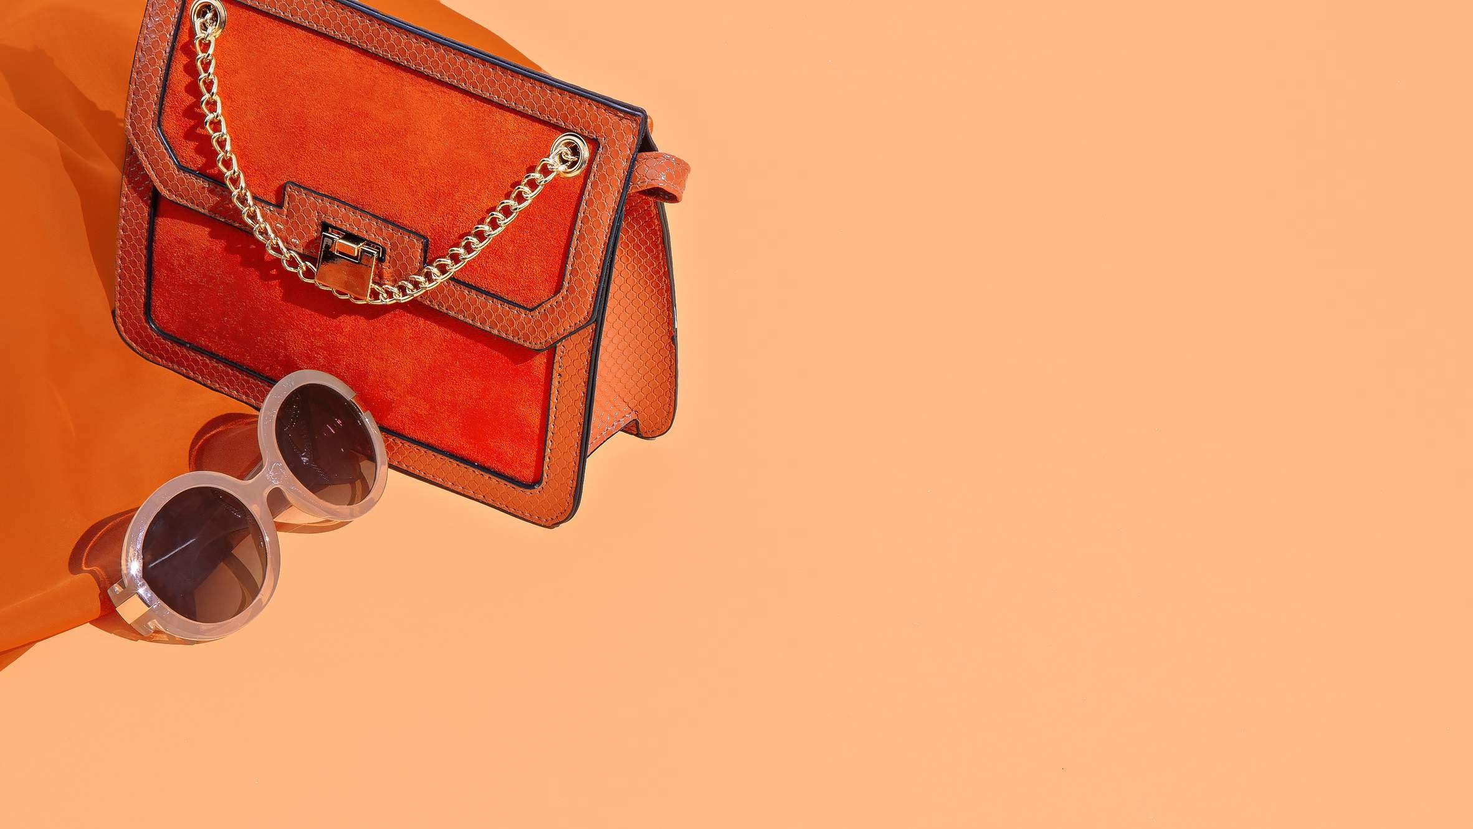
AUTHOR'S PERSPECTIVE
The Global Luxury Sunglass Market is witnessing significant growth in the near future.
Polarized sunglasses are the fastest-growing category over the forecast period due to minimizing glare and enhancing visual clarity; polarized sunglasses combine cutting-edge technology with a touch of luxury.
Influencers and celebrities often drive trends, amplifying the appeal of luxury eyewear among female consumers.
Brands like Ray-Ban and Gucci are at the forefront of this trend, incorporating acetate in their collections.
Convenience stores are the fastest-growing category over the forecast period, redefining the shopping experience by incorporating luxury sunglasses into their offerings.

Slide 8

KEY PLAYERS

Slide 9


Contact us
For Full Report
COGNITIVE MARKET RESEARCH
Tel: + 1 312 - 376 - 8303 | + 44 020 - 8123 - 0732
India: ( + 91 ) 983 - 496 - 8611
sales@ cognitivemarketresearch. com
Access the Full Report : http://tinyurl.com/yjufk654
Please visit our website:
https://www.cognitivemarketresearch.com

