Slide 1
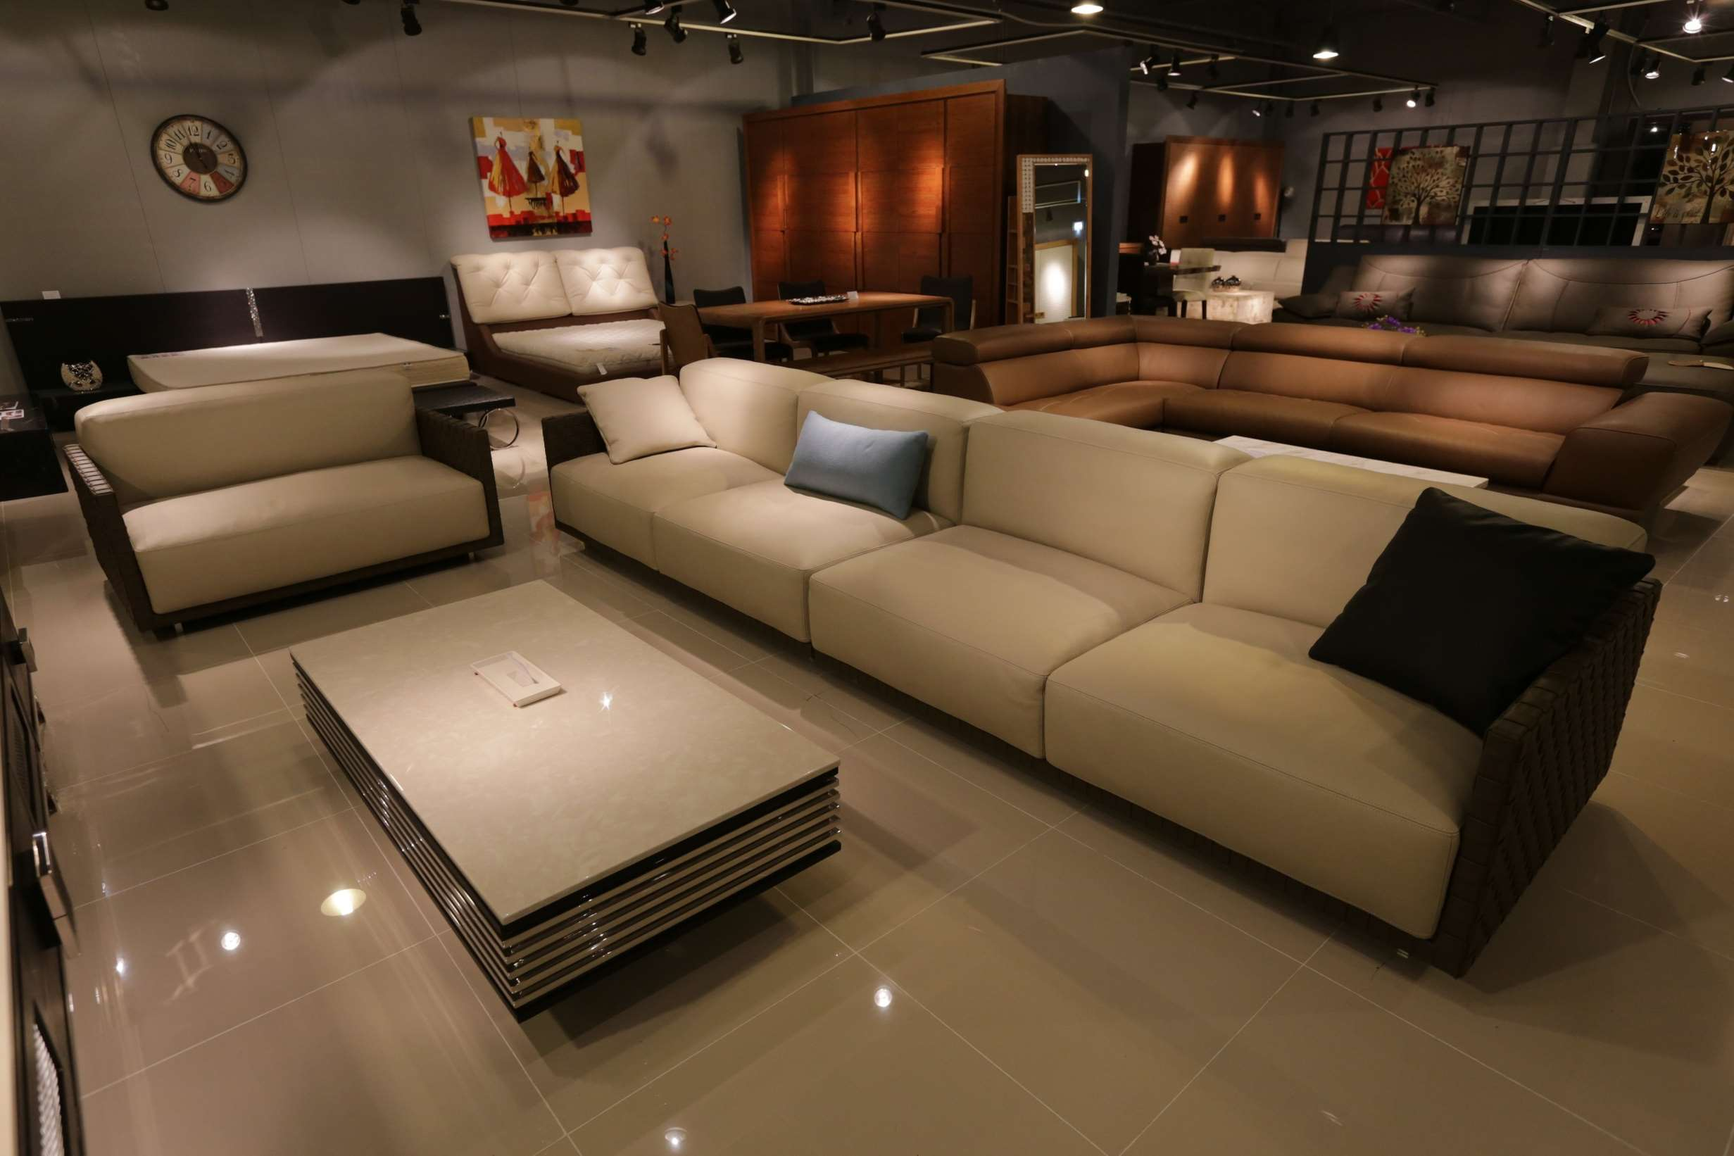
GLOBAL
LUXURY SOFA
MARKET REPORT
2024
Global,Regional,CountryAnalysis

Slide 2
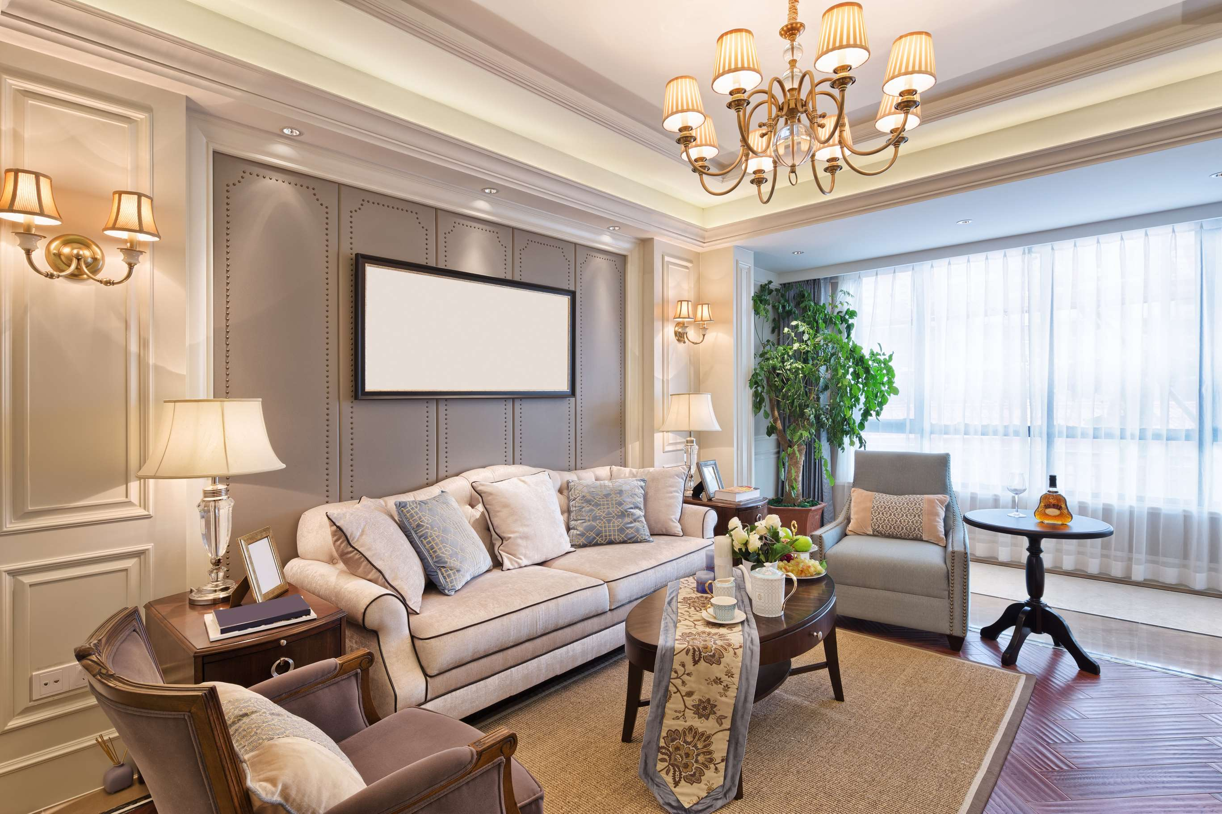
INTRODUCTION
Luxury sofas represent high-end, premium seating furniture crafted with exquisite materials, sophisticated designs, and superior craftsmanship to offer unparalleled comfort and aesthetic appeal, elevating the overall ambiance of upscale interiors. The Luxury Sofa market experiences substantial growth as consumers' rising affluence and growing disposable incomes drive the demand for premium furnishings. This cause-and-effect dynamic materializes as individuals attain higher levels of financial prosperity, leading to an increased penchant for opulent home decor. The surge in home renovations, coupled with evolving interior design trends, is a significant driver for the market. Consumers increasingly invest in upgrading their living spaces, emphasizing luxurious and aesthetically pleasing furniture. Manufacturers respond with innovative designs, premium materials, and features, aligning with the evolving lifestyles and preferences of affluent consumers.

Slide 3
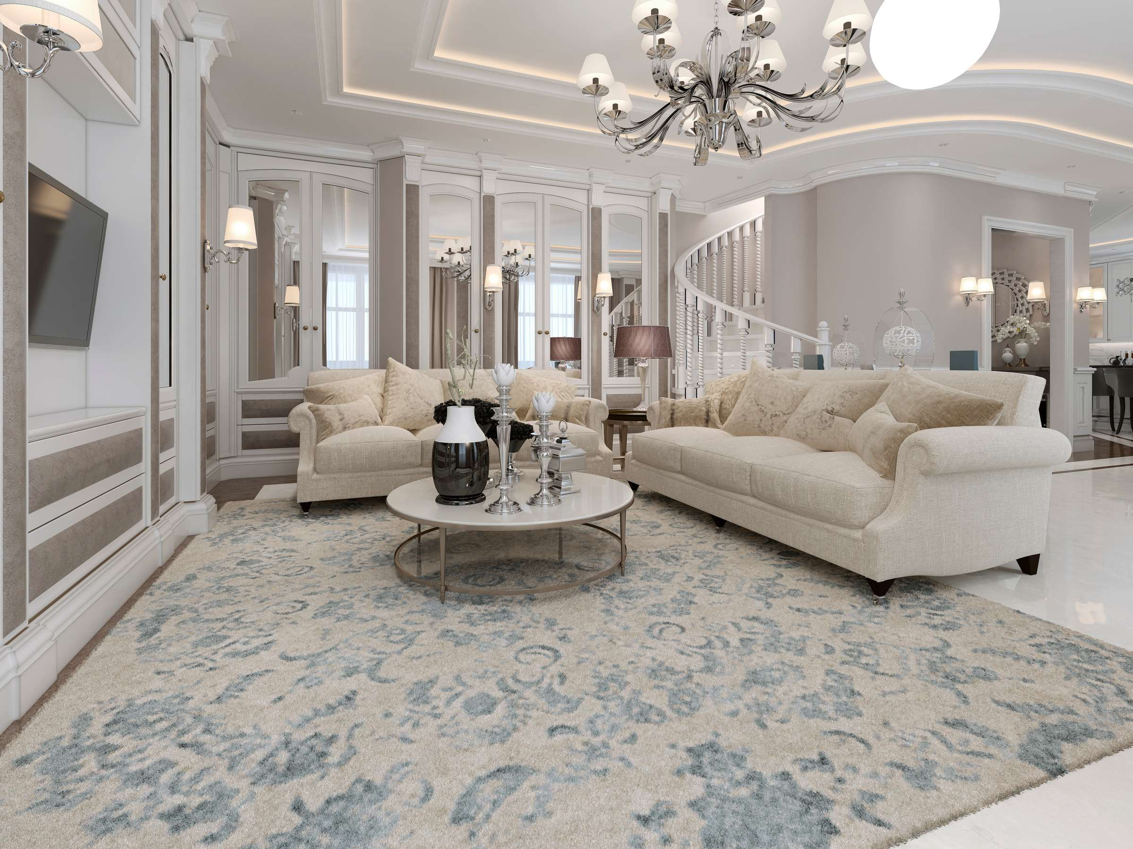

KEY INSIGHTS
CAGR
6.8%
2023- 2030

Slide 4
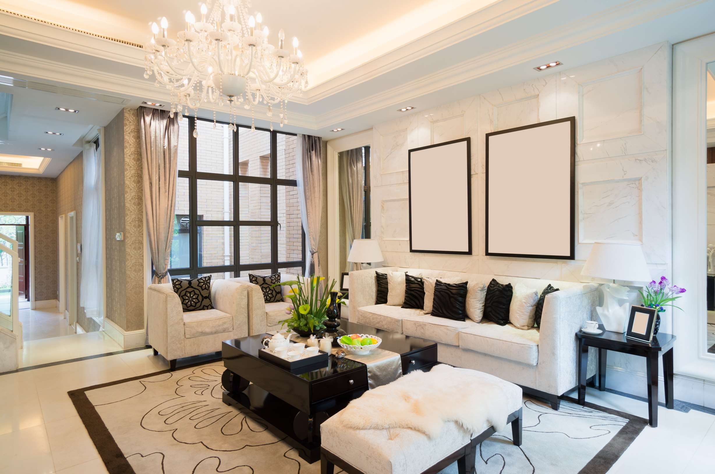
REVENUE MARKET SHARE BY SEGMENTS 2022
  Leather Sofa
  Fabric Sofa
Type Segment
  Household
  Commercial
Application Segment

Slide 5

Global Luxury Sofa Market Revenue share for 2024
North America

Slide 6
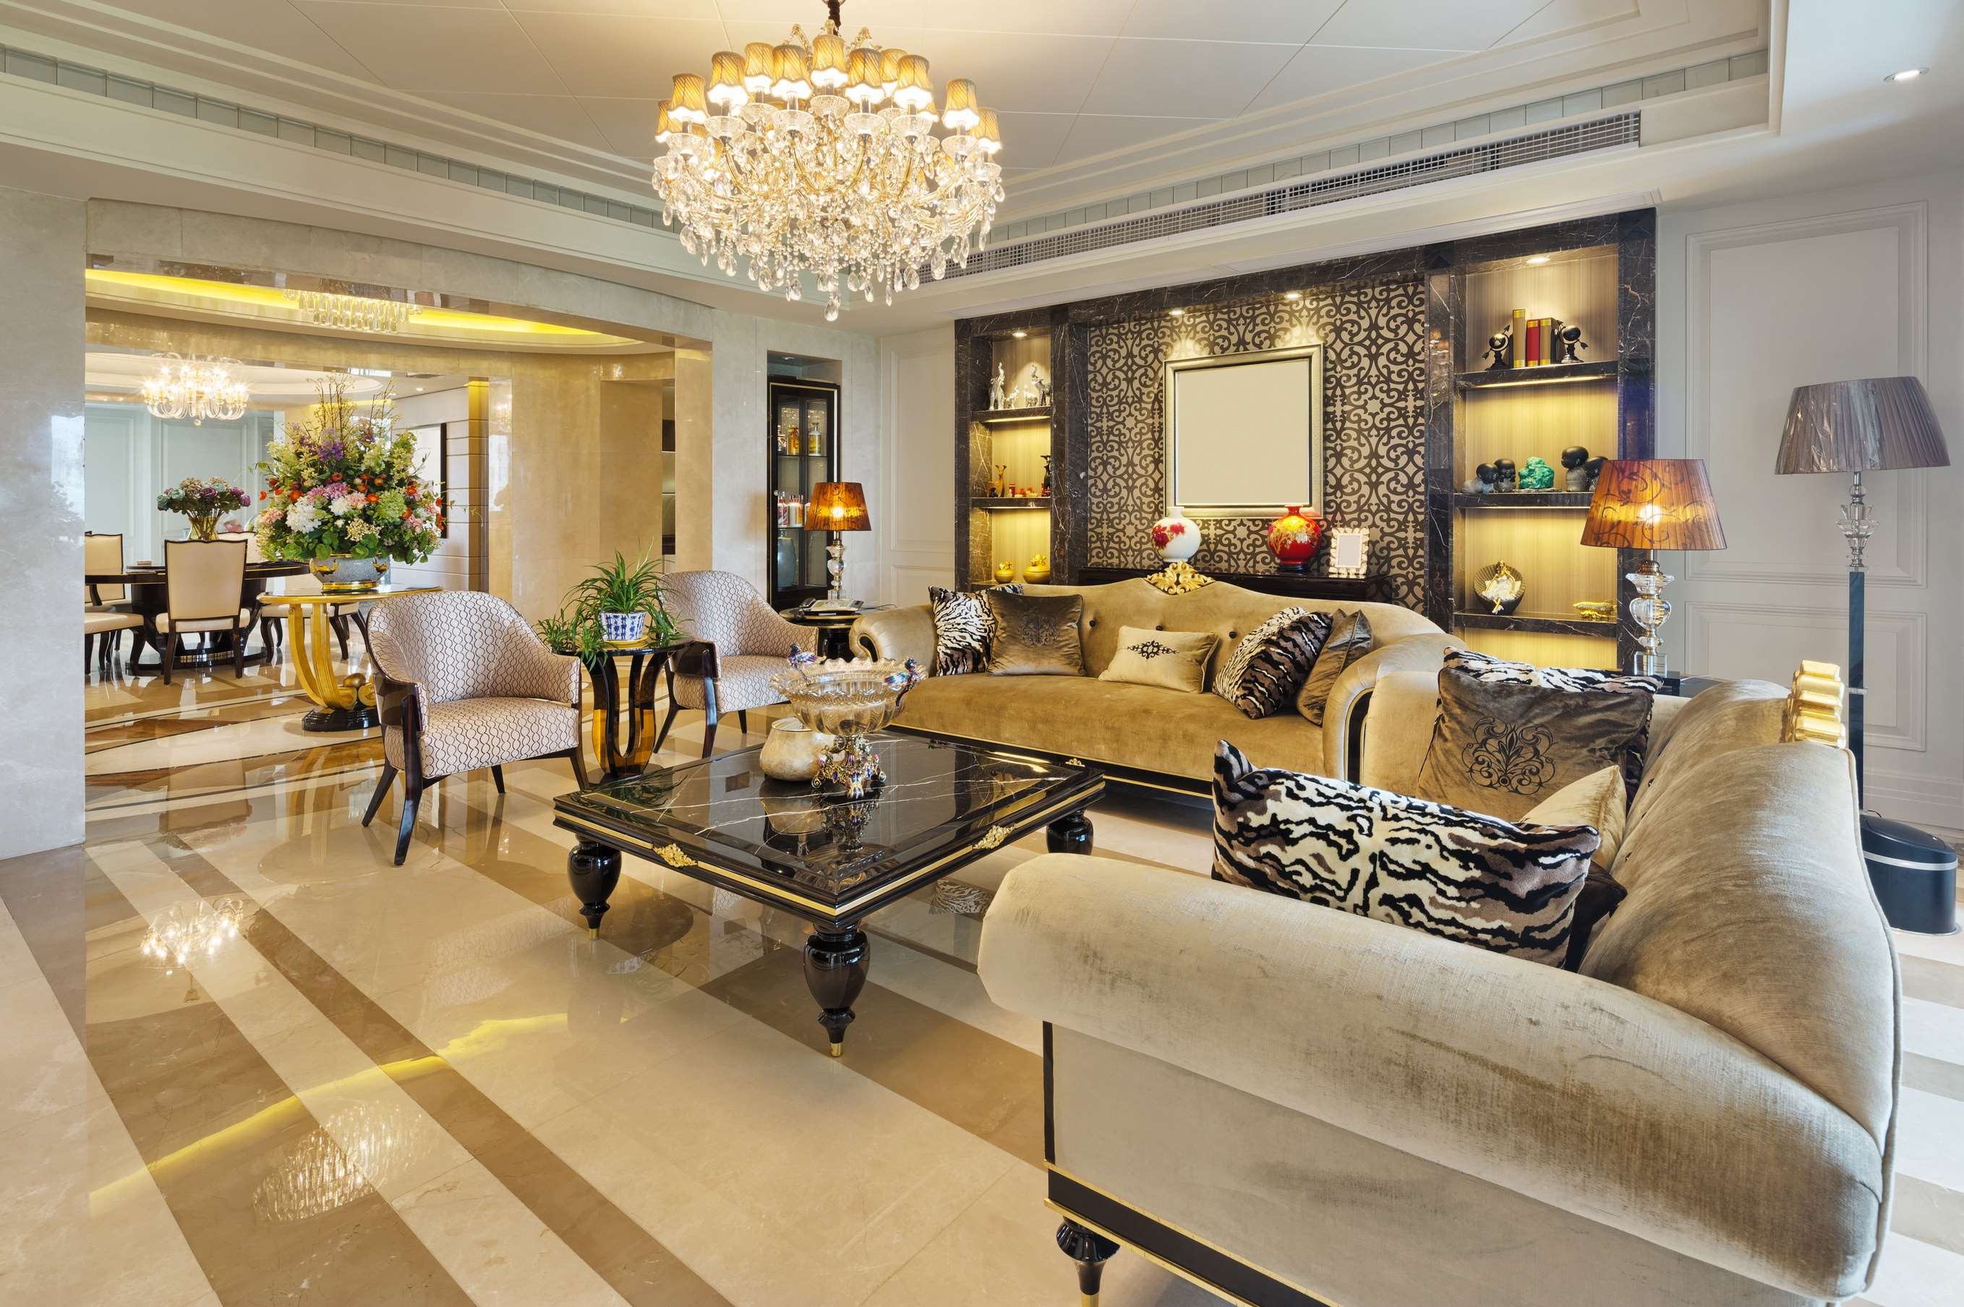
Rising Affluence and Disposable Incomes Fuel the Resounding Growth of the Luxury Sofa Market
Drivers
Global Supply Chain and Manufacturing Disruptions Unraveling Challenges in the Luxury Sofa Market
Restraints

Slide 7
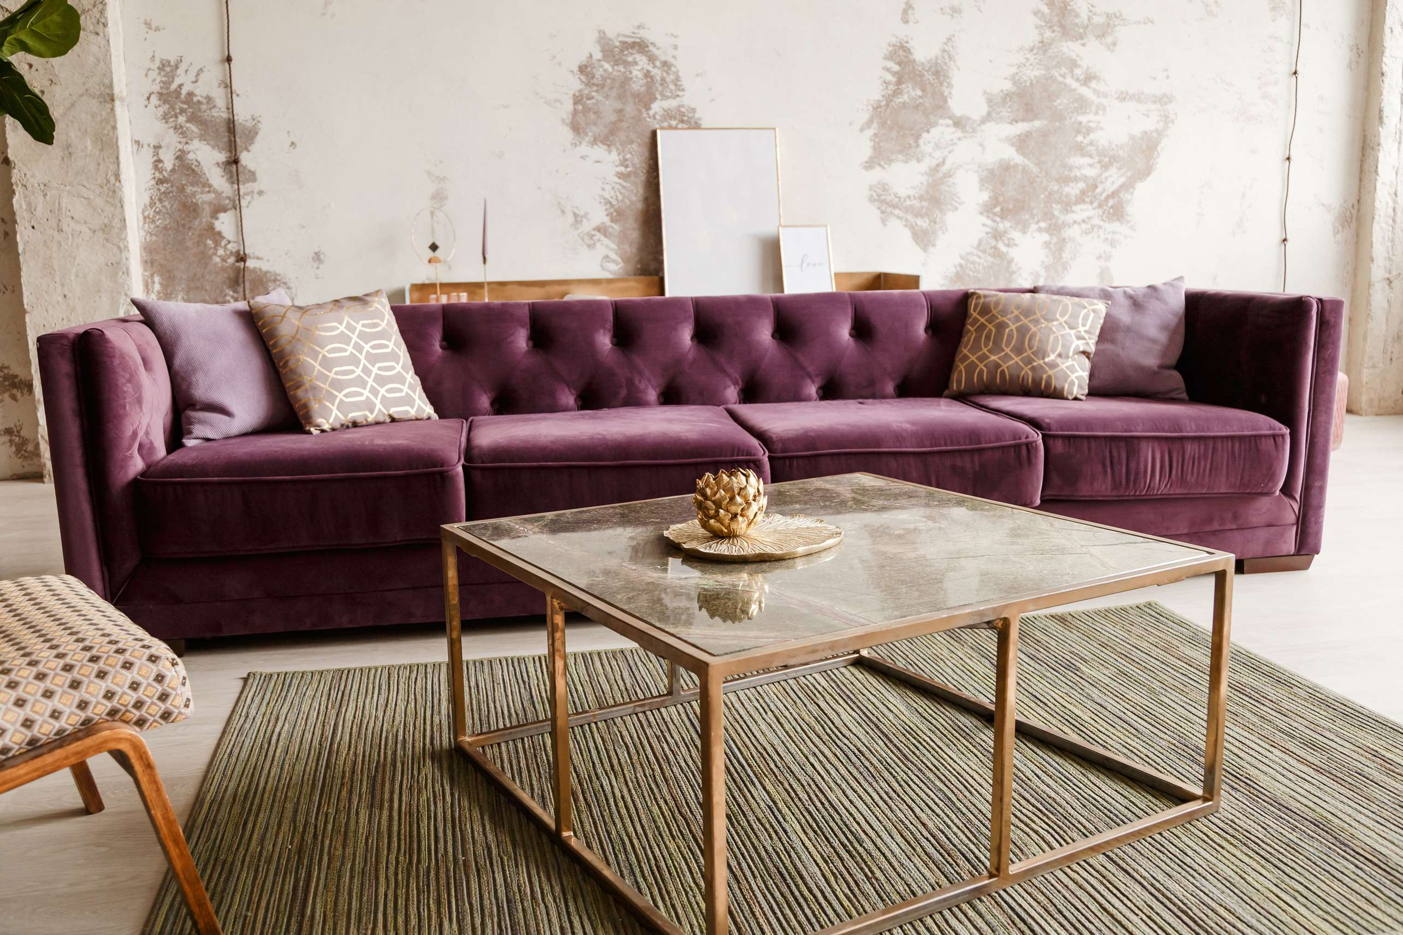
AUTHOR'S PERSPECTIVE
  The Global Luxury Sofa Market is witnessing significant growth in the near future.
  Fabric sofas have emerged as the fastest-growing category in the Luxury Sofa market, experiencing a notable surge in demand.
  Fabric Sofas appeal to a growing segment of consumers who prioritize a blend of style, versatility, and plush aesthetics in their home decor choices.
  The surge in demand for upscale and premium furnishings in commercial spaces, including offices, hotels, and other public areas, contributes to the rapid expansion of the Luxury Sofa market in the commercial segment.

Slide 8
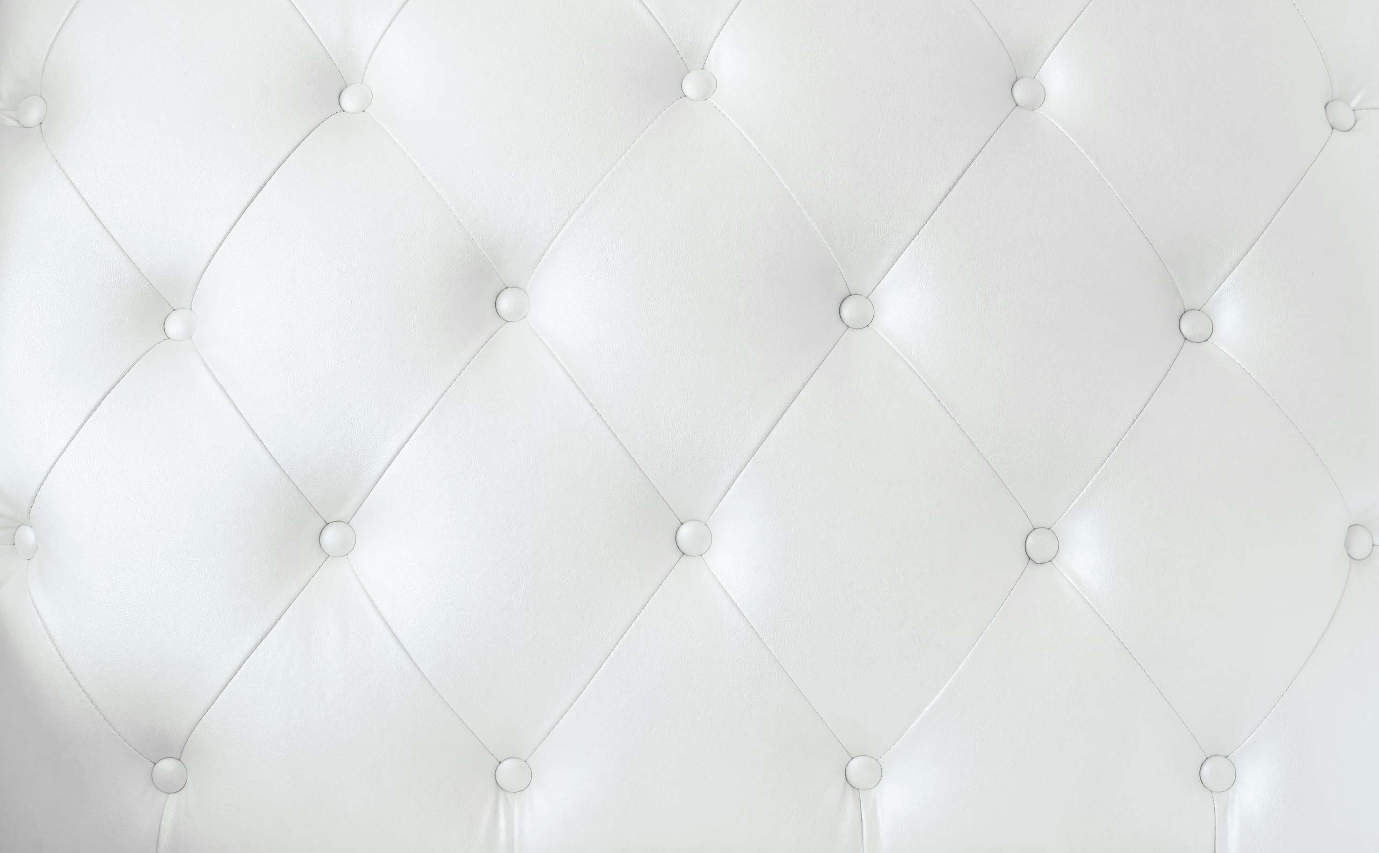











KEY PLAYERS

Slide 9


For Full Report
Contact us
COGNITIVE MARKET RESEARCH
Tel: +1 312-376-8303 | +44 020-8123-0732
India: (+91) 983-496-8611
sales@cognitivemarketresearch.com
Access the Full Report : http://tinyurl.com/3s53favn
Please visit our website:
https://www.cognitivemarketresearch.com

