Slide 1
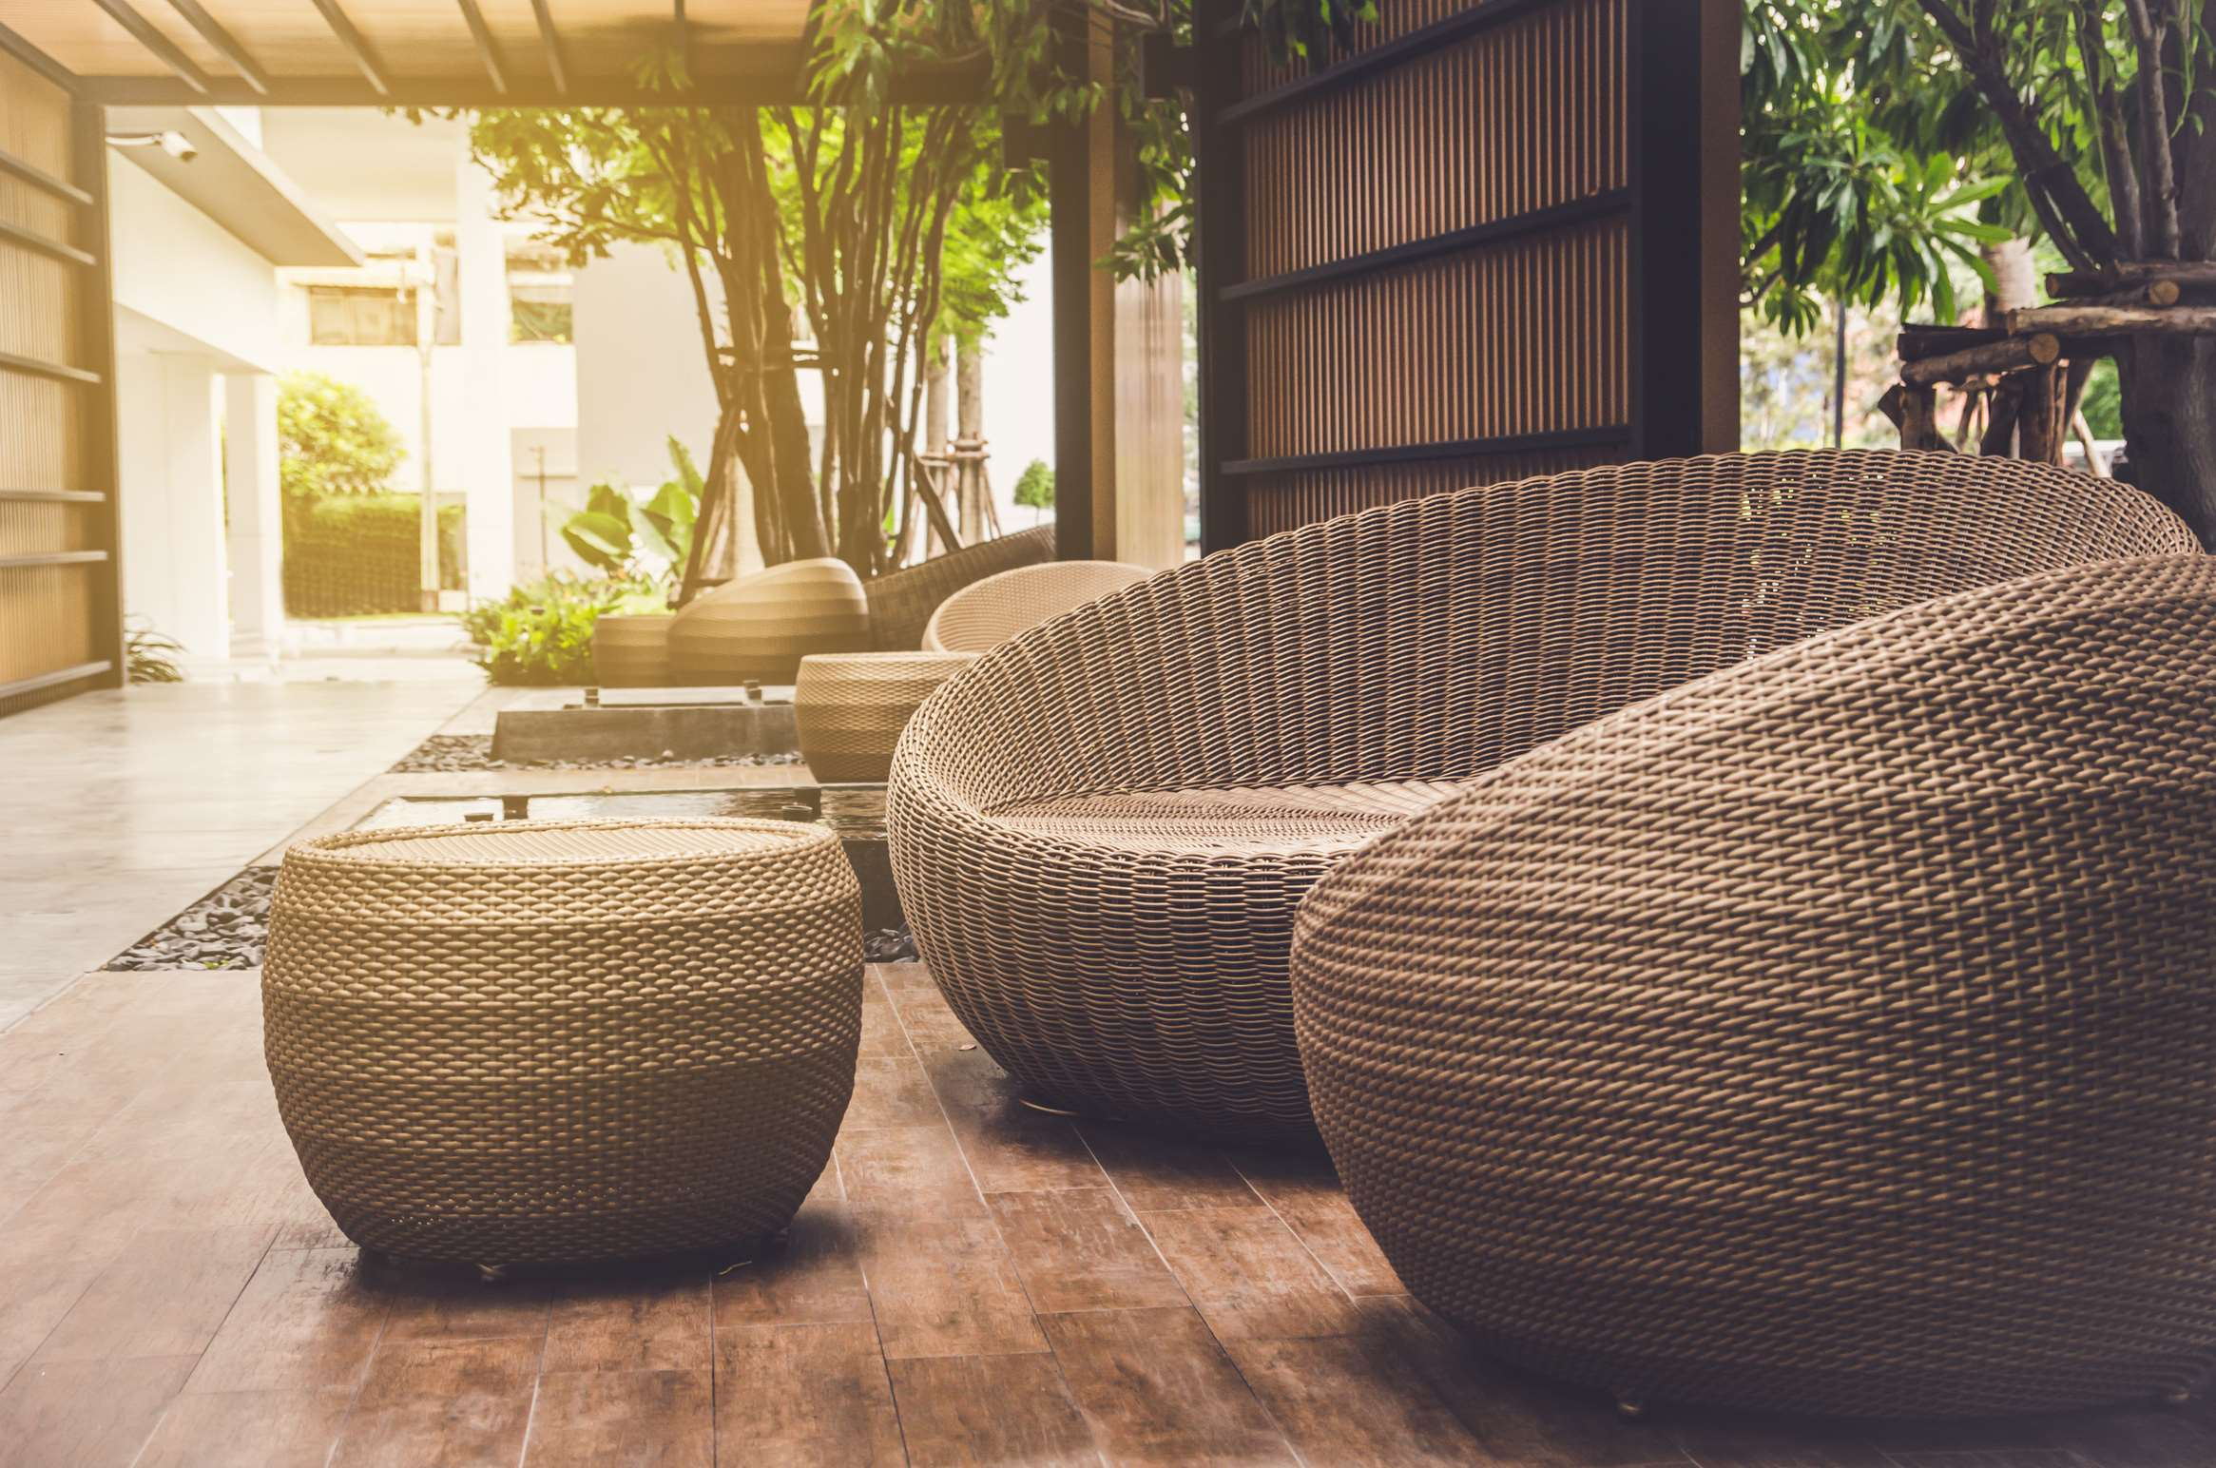
GLOBAL
LUXURY OUTDOOR FURNITURE
MARKET REPORT
2024
Global,Regional,CountryAnalysis

Slide 2
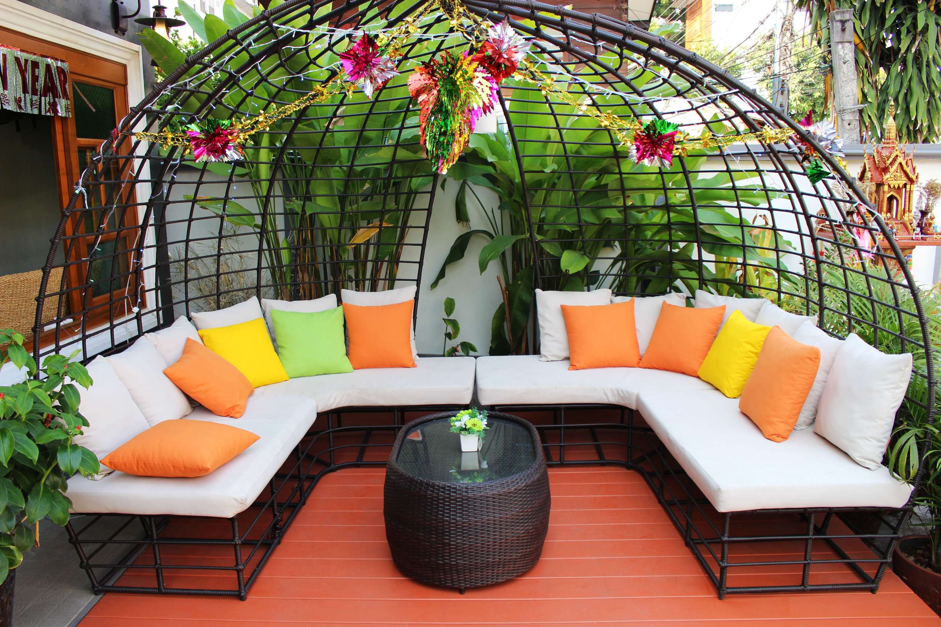
INTRODUCTION
Luxury outdoor furniture is a type of movable furniture that is crafted by skilled artisans using high-quality materials such as metal, wood, glass, and plastic. These furniture pieces are designed with great attention to detail and are meant to add aesthetic value to various establishments, including hotels, offices, and outdoor areas. The growth of the luxury outdoor furniture market is mainly attributed to the increasing demand for outdoor spaces in restaurants, hotels, and other establishments. Additionally, the rising real estate industry has also contributed to the growth of this market. The changing lifestyles and higher living standards of individuals, along with increased disposable income, have led to a greater preference for luxury items that serve as a status symbol and enhance the value of a space.

Slide 3
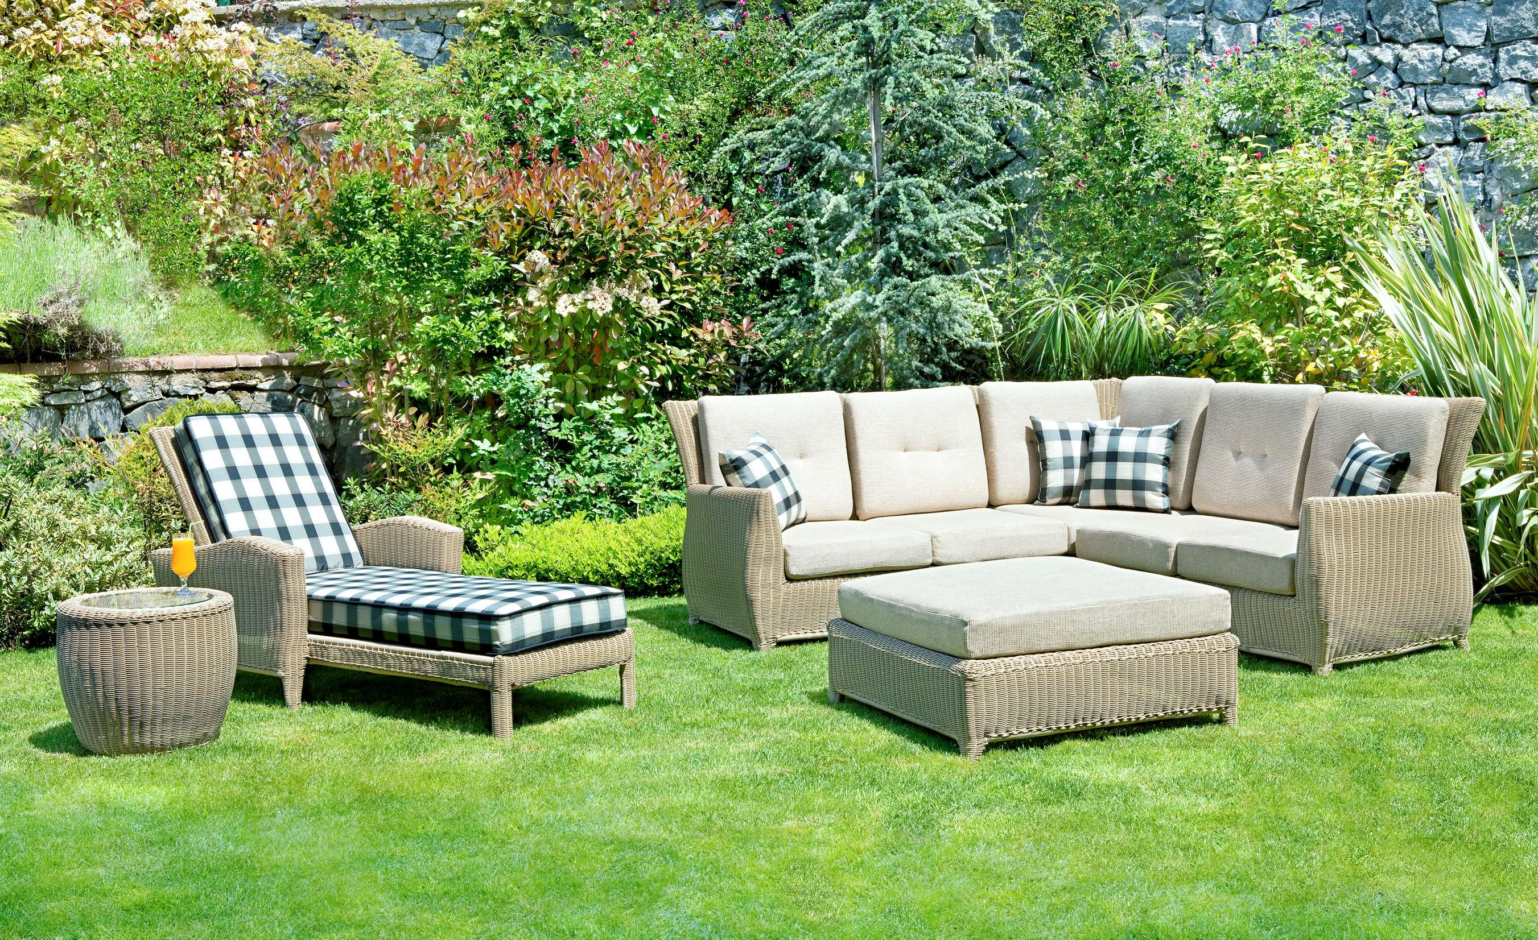

KEY INSIGHTS
MARKET SIZE
USD 1.9 billion
2023
CAGR
5.0%
2023- 2030

Slide 4
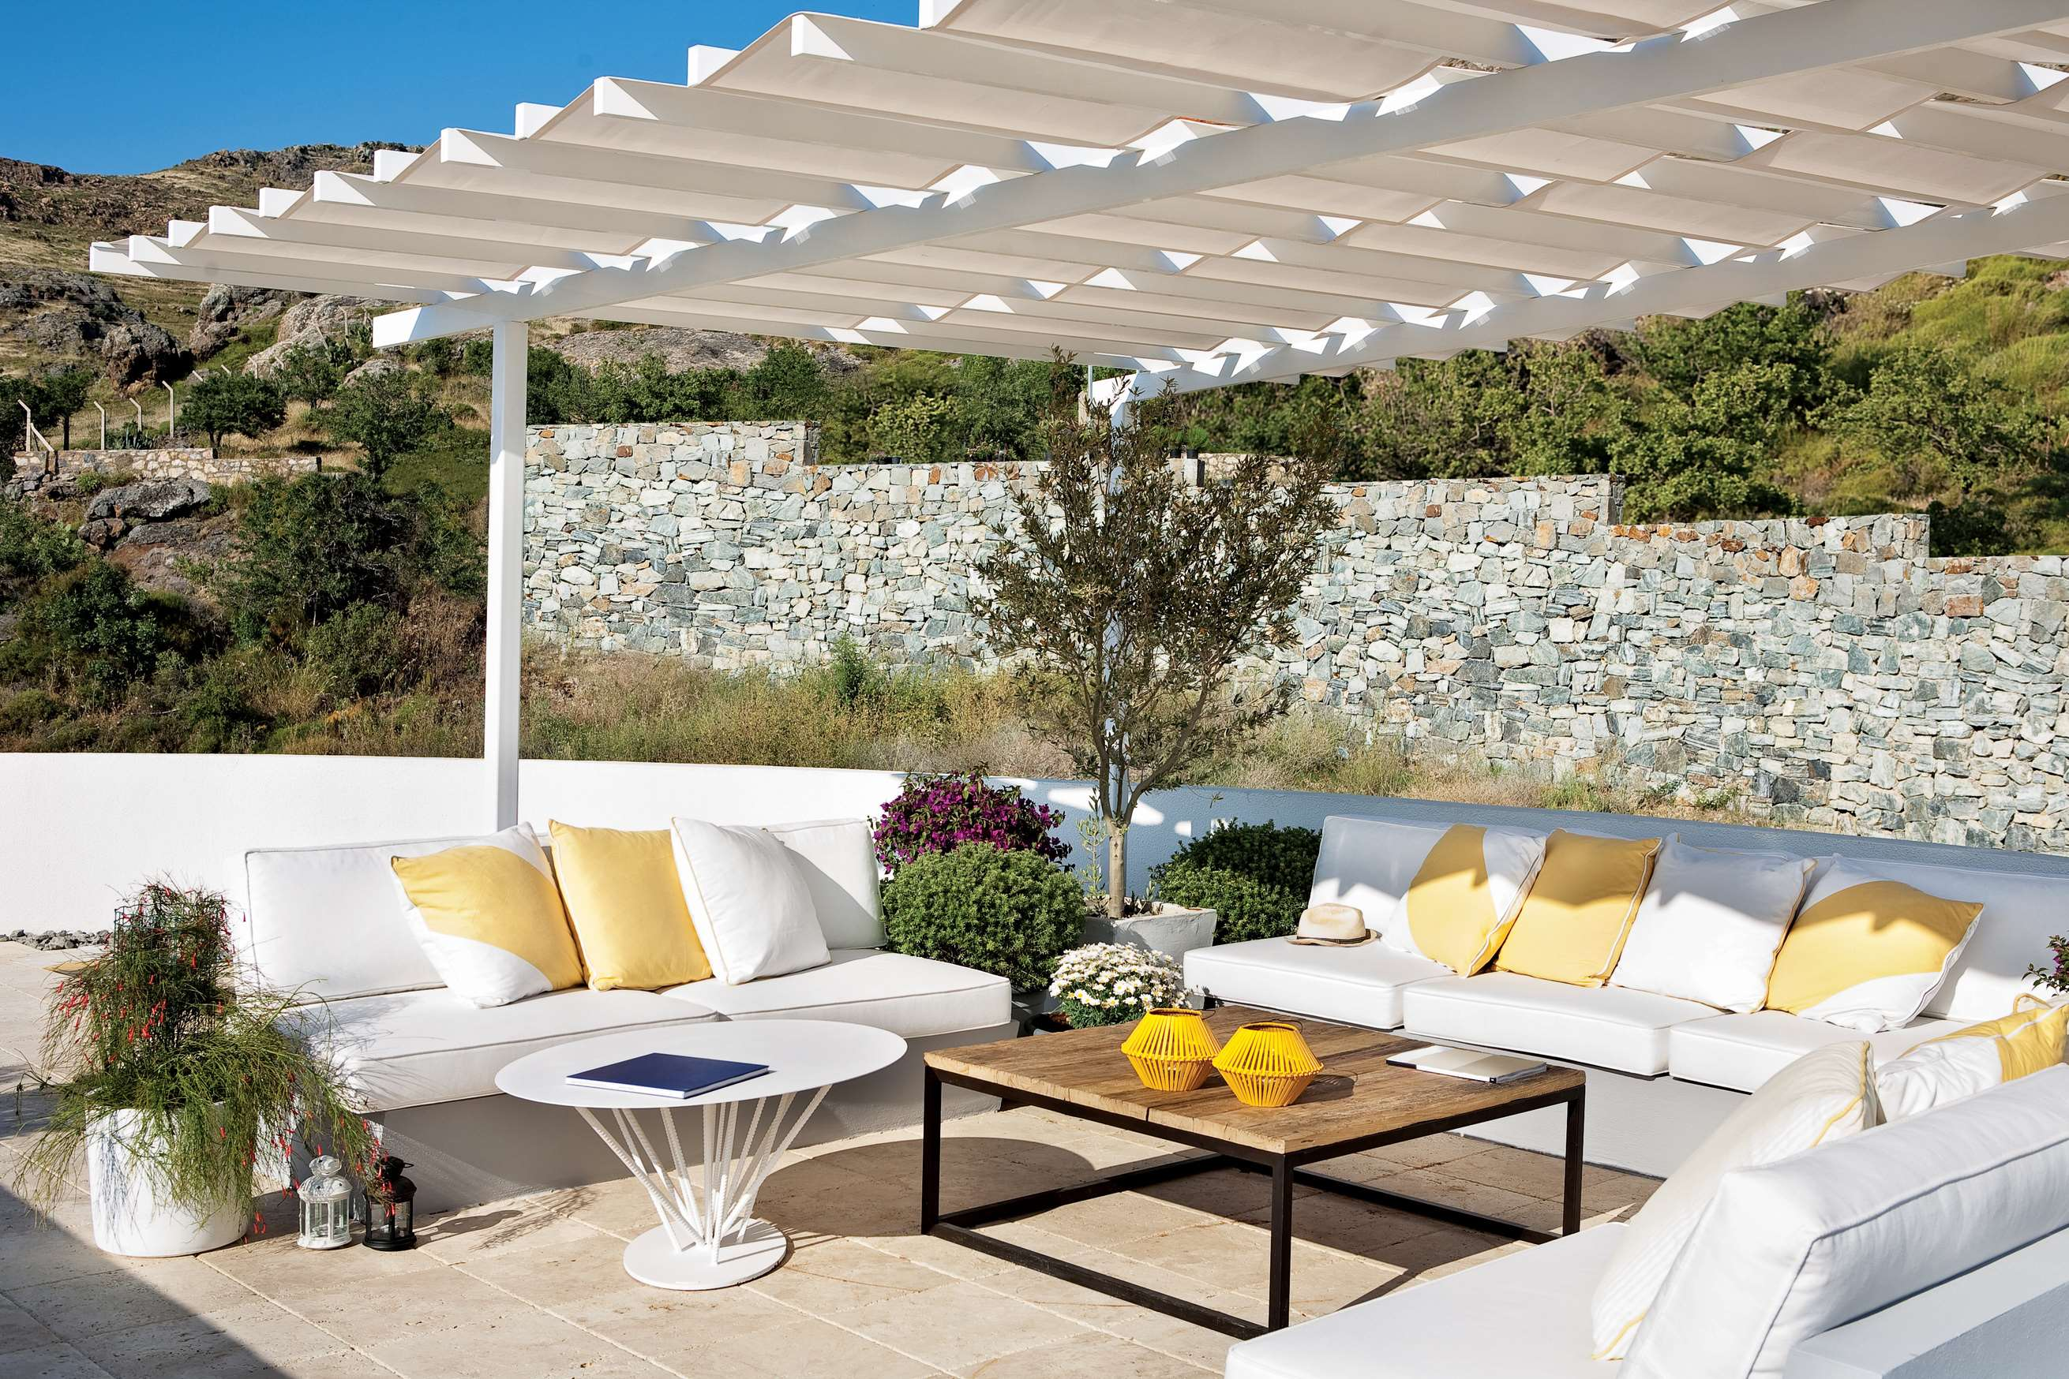
REVENUE MARKET SHARE BY SEGMENTS 2022
  Sofas & Seatings
  Chairs & Stools
  Side Tables & Dining Tables
  Wood
  Metal
  Others
Type Segment
Material Segment
  Specialty Stores
  Hypermarkets & Supermarkets
  Online Stores
  Households
  Hotels & Restaurants
  Offices
End-User Segment
Distribution Channel

Slide 5

Global Luxury Outdoor Furniture Market Revenue share for 2024
North America
40%

Slide 6
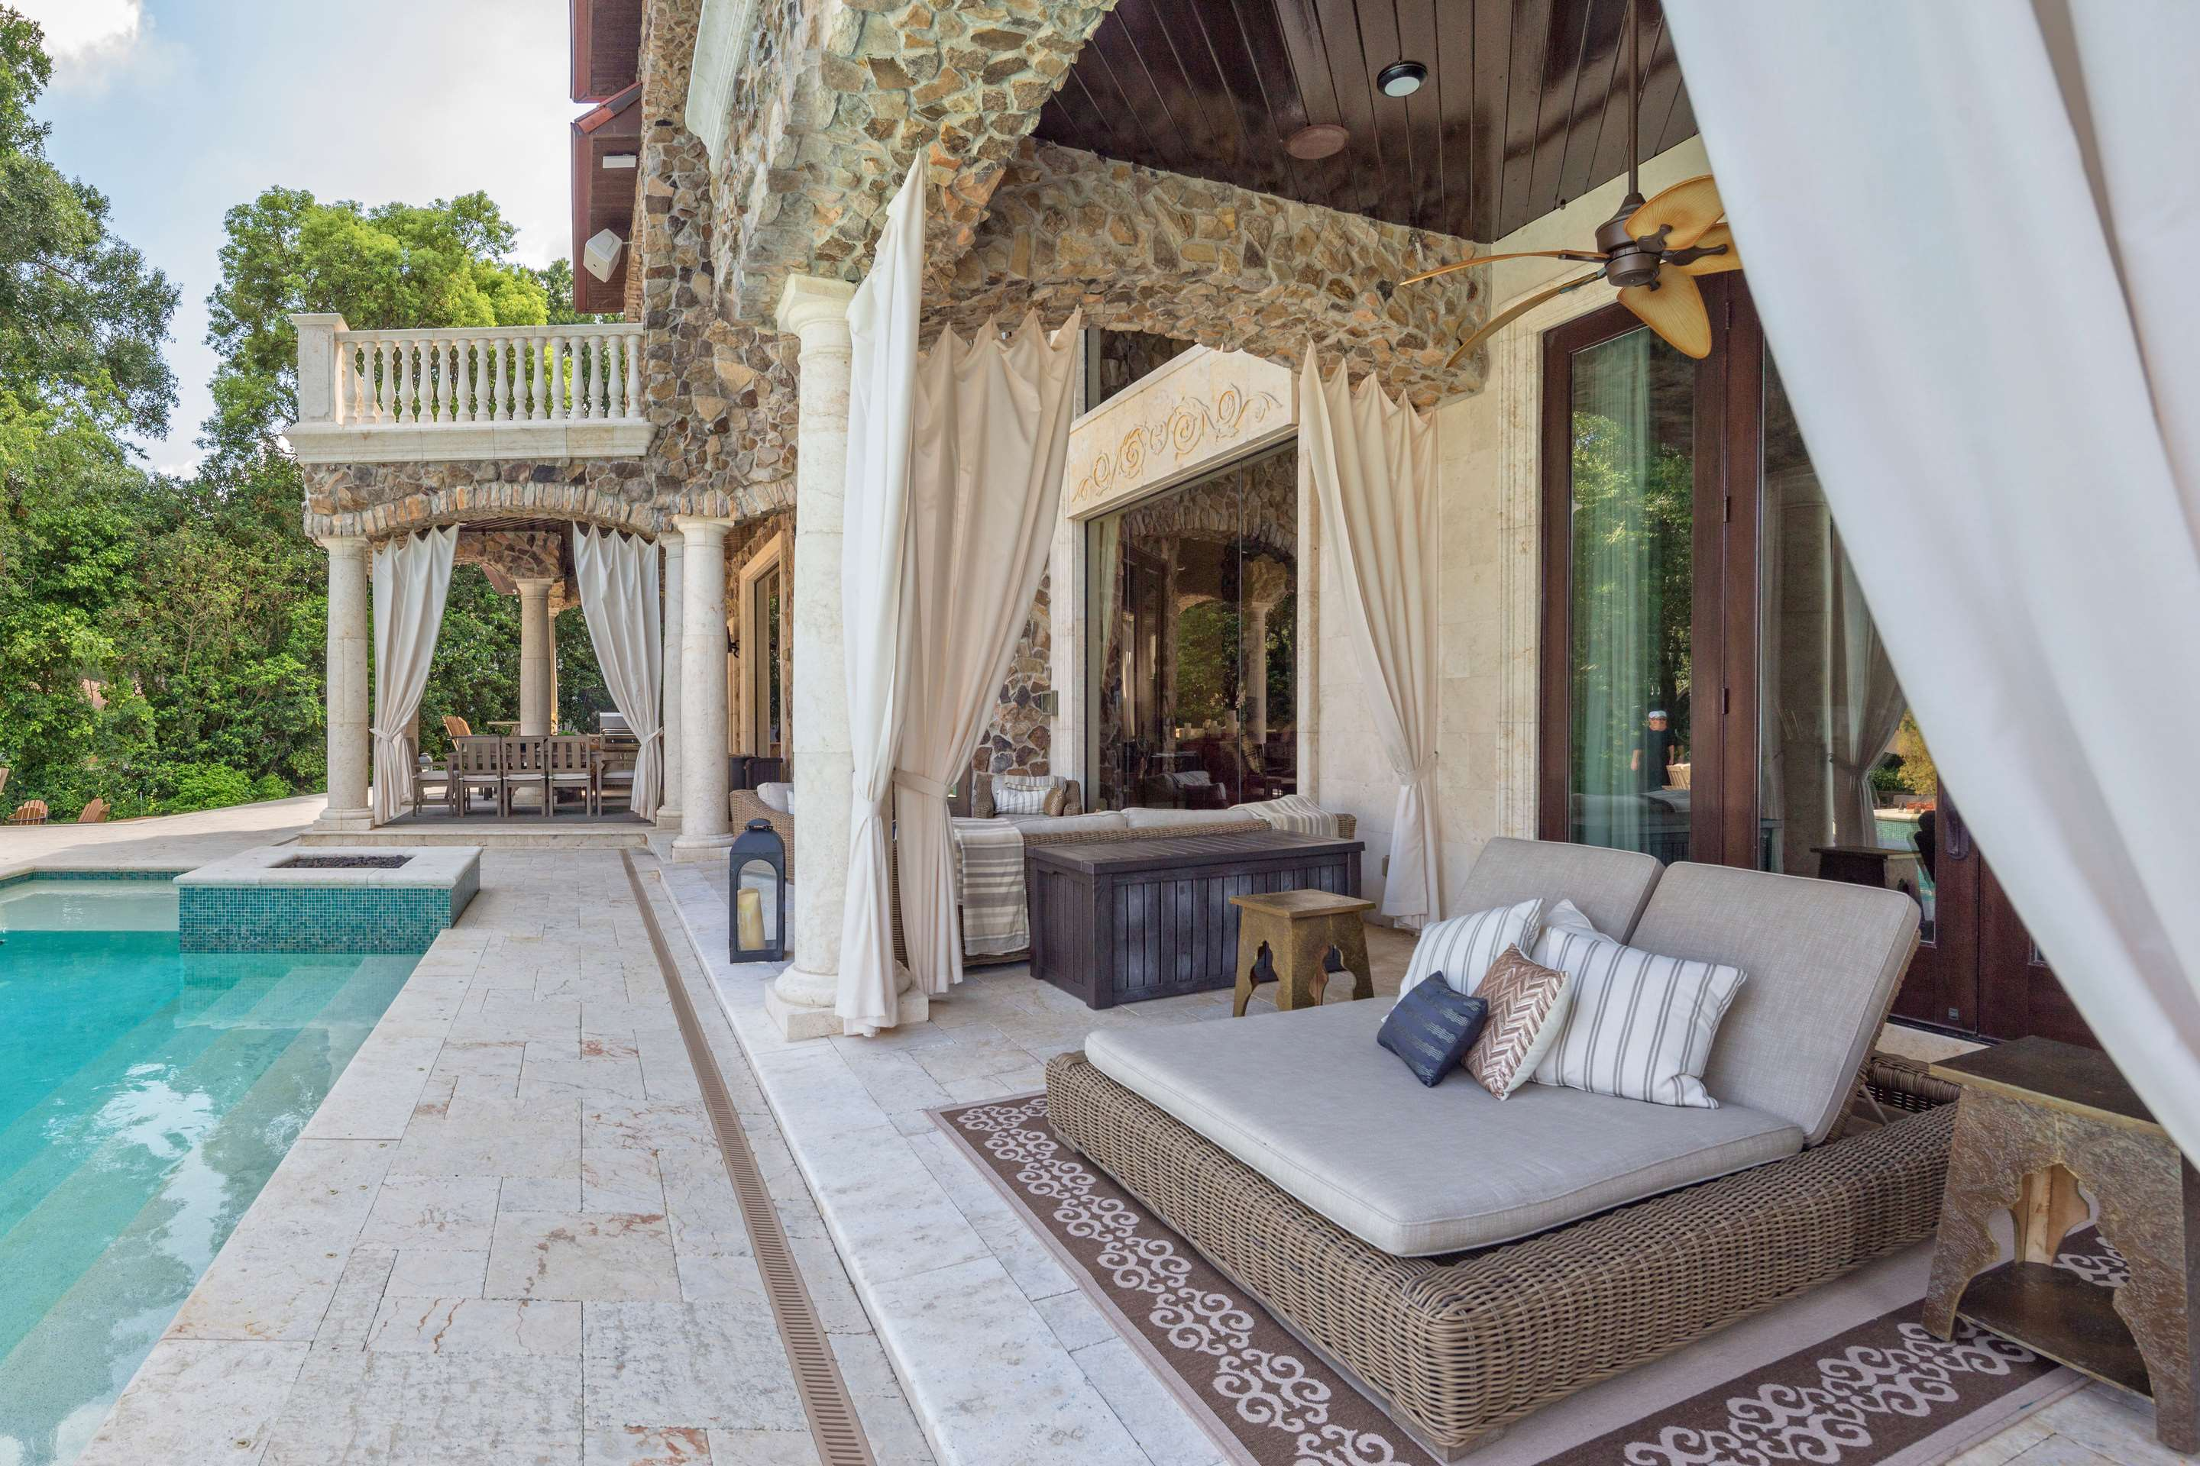
Rise in Disposable Income & Growing Popularity of Online Sales to Propel Market Growth
Drivers
High Costs, Limited Availability of Skilled Artisans, and Competition from Alternative Materials to Restrict Market Growth
Restraints

Slide 7
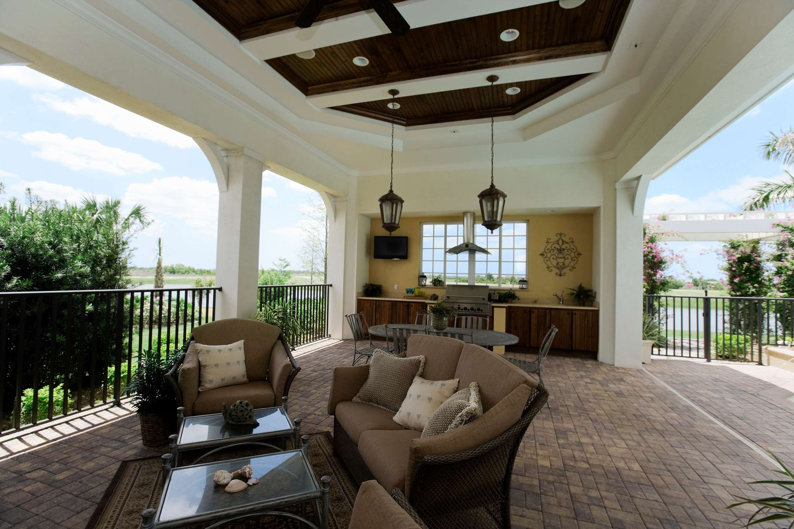
AUTHOR'S PERSPECTIVE
  The Global Luxury Outdoor Furniture Market is witnessing significant growth in the near future.
  Chairs & Stools is the fastest-growing category over the forecast period. It is expected to see strong growth in the coming years due to the increasing demand for stylish and comfortable outdoor seating options.
  Luxury outdoor furniture is seen as a way to enhance the guest experience and differentiate the hotel or restaurant from competitors.
  Wood outdoor furniture is often associated with luxury and sophistication, making it a popular choice among consumers looking for upscale outdoor furniture options.

Slide 8
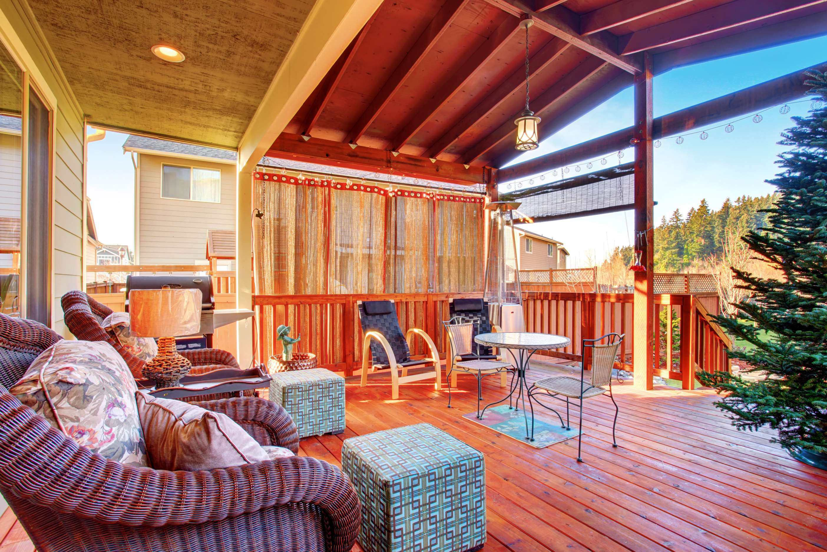









KEY PLAYERS

Slide 9


For Full Report
Contact us
COGNITIVE MARKET RESEARCH
Tel: +1 312-376-8303 | +44 020-8123-0732
India: (+91) 983-496-8611
sales@cognitivemarketresearch.com
Access the Full Report : https://tinyurl.com/2t5uzp2c
Please visit our website:
https://www.cognitivemarketresearch.com

