Slide 1

GLOBAL
LUXURY NICHE PERFUME
MARKET REPORT 2024
Global,Regional,CountryAnalysis

Slide 2

INTRODUCTION
Luxury niche perfumes are one-of-a-kind, in-house fragrances made on a limited scale. It is also referred to as artisan fragrances. These are the scents that are both luxurious and highly aestheticized. Each of the luxury niche perfumes is created using only the finest quality components and adheres to stringent industry standards.

Slide 3


KEY INSIGHTS
MARKET SIZE
USD 259.03 Million
2022
FORECAST
$4,084.41 Million
2029
CAGR
11.29%
2023- 2030

Slide 4

REVENUE MARKET SHARE BY SEGMENTS 2022
Parfum or De Parfum
USD 1,497.18 Million
Type analysis
Men
USD 1,464.38 Million
By End Use
Distribution Channel
Direct Channel
USD 2,619.90 Million

Slide 5

Global Luxury Niche Perfume Market Revenue share for 2022
North America

Slide 6

Increase in demand for high-end lifestyles and luxury products
Drivers
Restraints
Limited target reach

Slide 7

AUTHOR'S PERSPECTIVE
  The Global Luxury Niche Perfume Market revenue in 2017: USD 1,586.53 Million
  Parfum or De Parfum held for largest share of total revenue generated in 2020
  Men held maximum share of Luxury Niche Perfume market in 2020
  Direct Channel held maximum share of Luxury Niche Perfume market in 2020
  Offline held maximum share of Luxury Niche Perfume market in 2020
  Increase in demand for high-end lifestyles and Luxury products drives the growth of the luxury niche perfume market
  Rising inclination toward personalized and intimate fragrances stimulated the growth of the luxury niche perfume market
  Limited target reach could hamper the growth of the luxury niche perfume market
  Changing trends in the niche perfume market provide numerous growth opportunities for the growth of the luxury niche perfume market

Slide 8








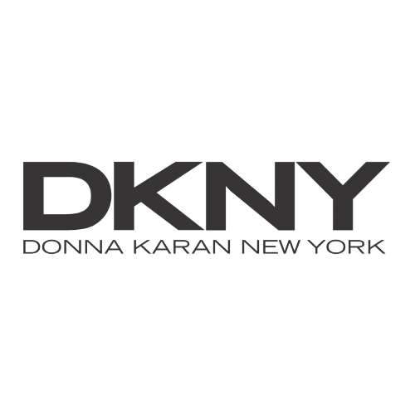


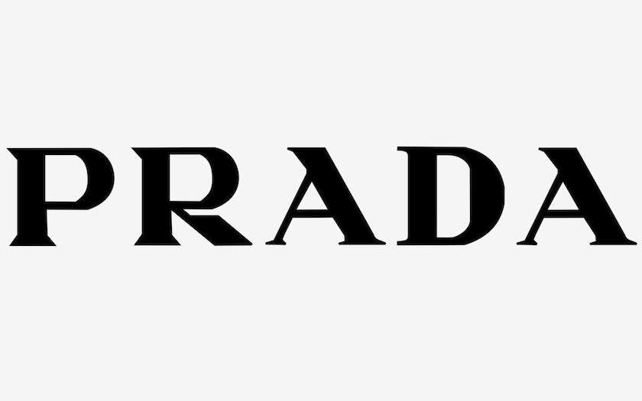




KEY PLAYERS

Slide 9


For Full Report
Contact us
COGNITIVE MARKET RESEARCH
Tel: +1 312-376-8303 | +44 020-8123-0732
India: (+91) 983-496-8611
sales@cognitivemarketresearch.com
Access the Full Report : https://tinyurl.com/3vf9nsdu
Please visit our website:
https://www.cognitivemarketresearch.com

