Slide 1
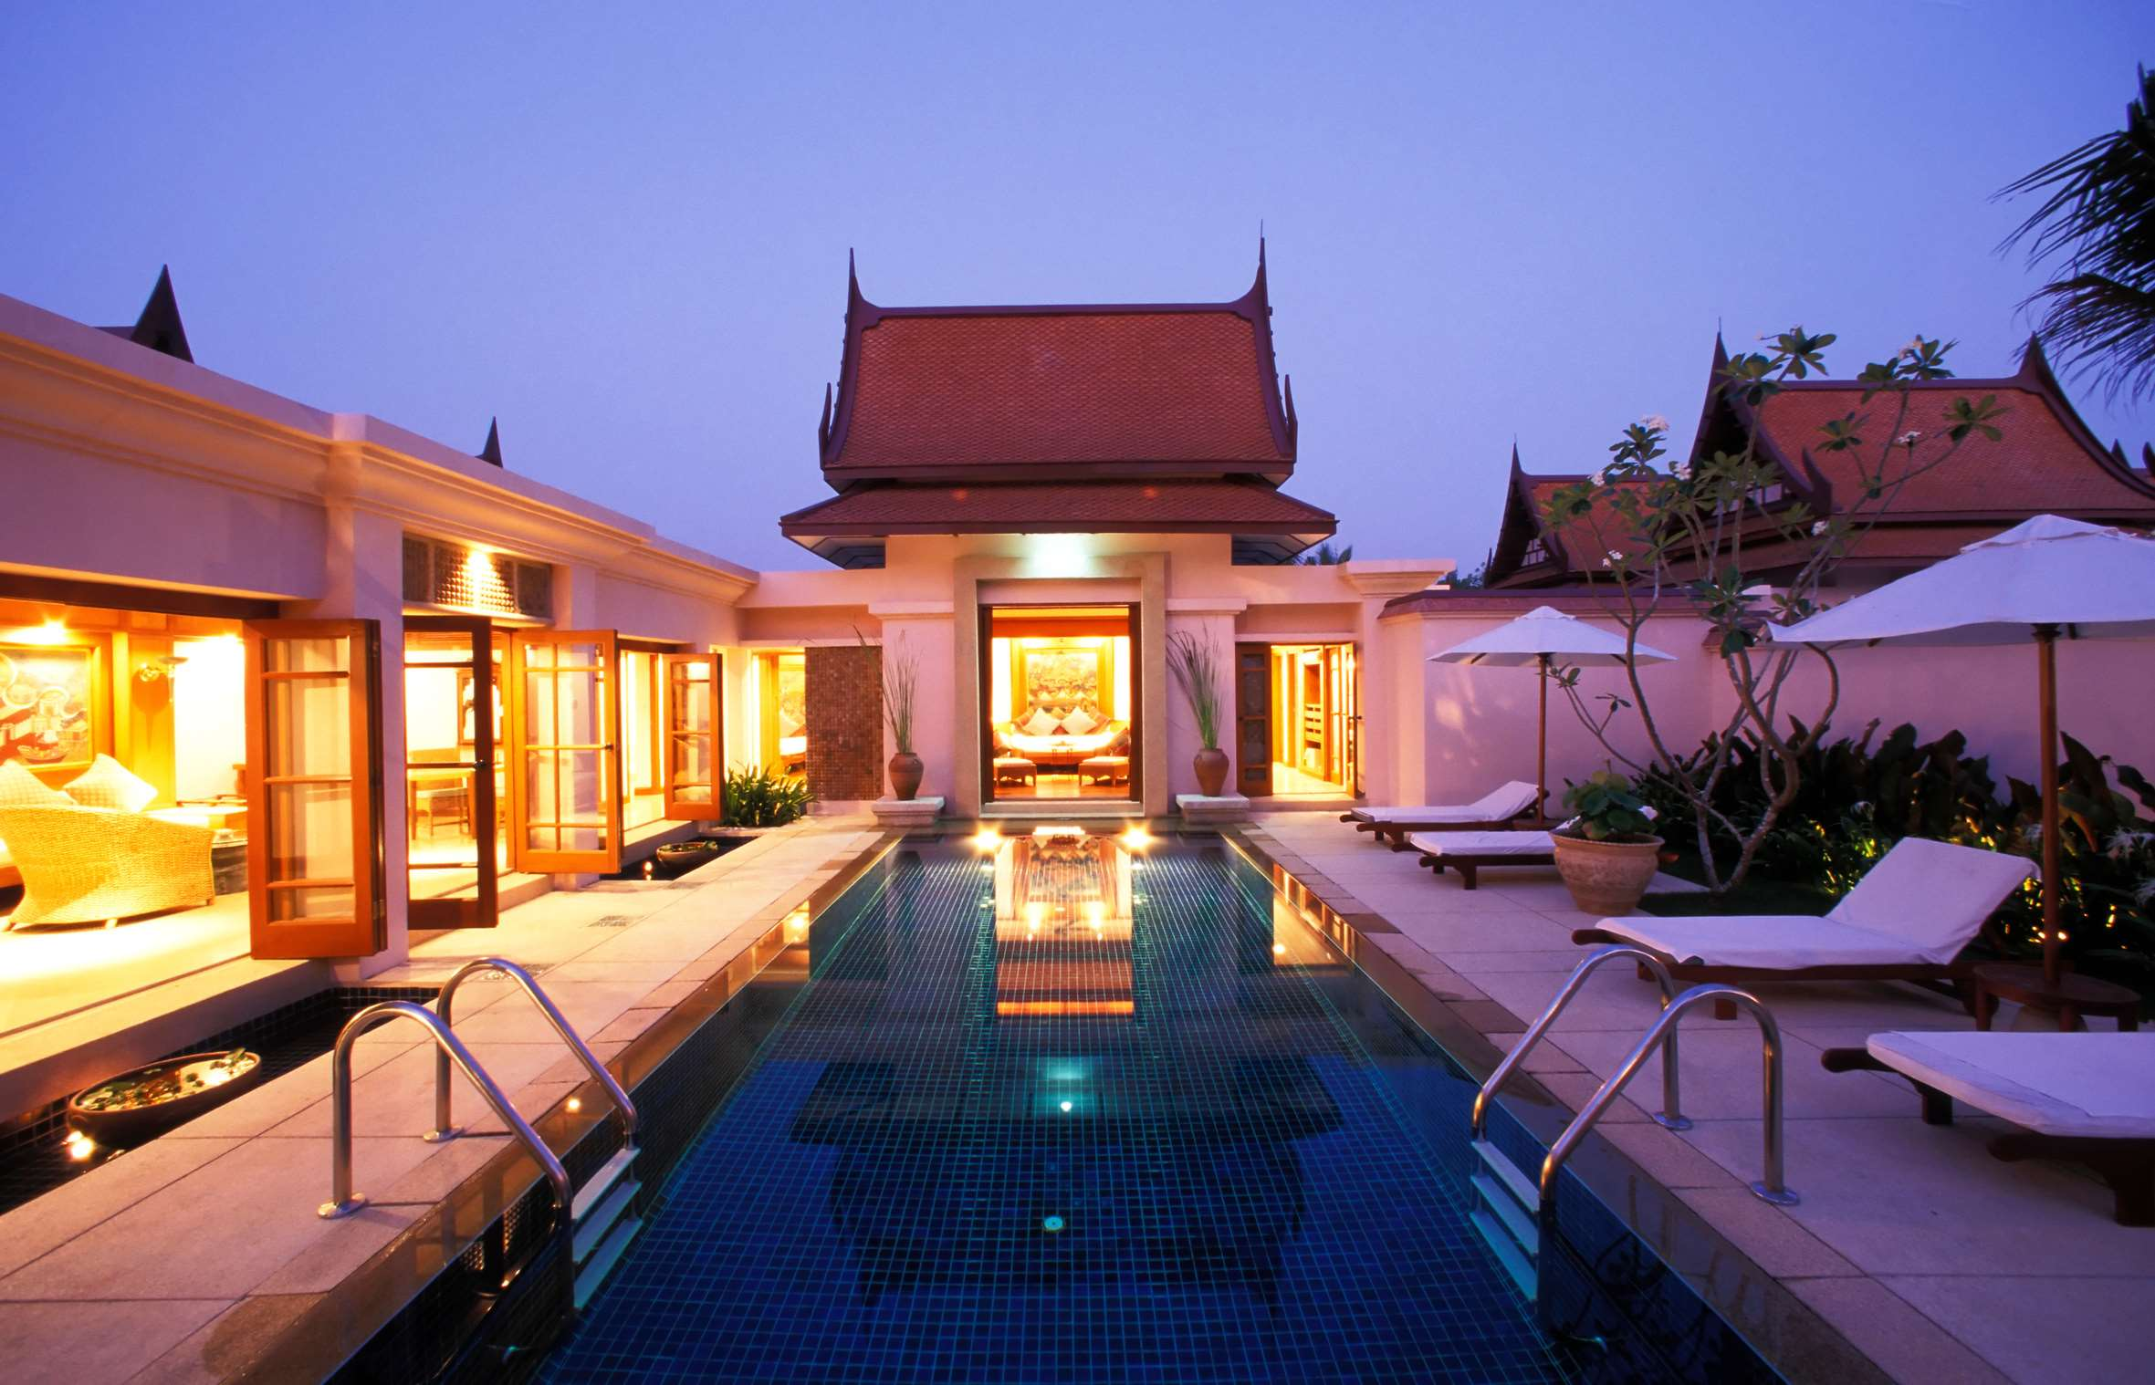
GLOBAL
LUXURY HOTEL
MARKET REPORT
2024
Global,Regional,CountryAnalysis

Slide 2
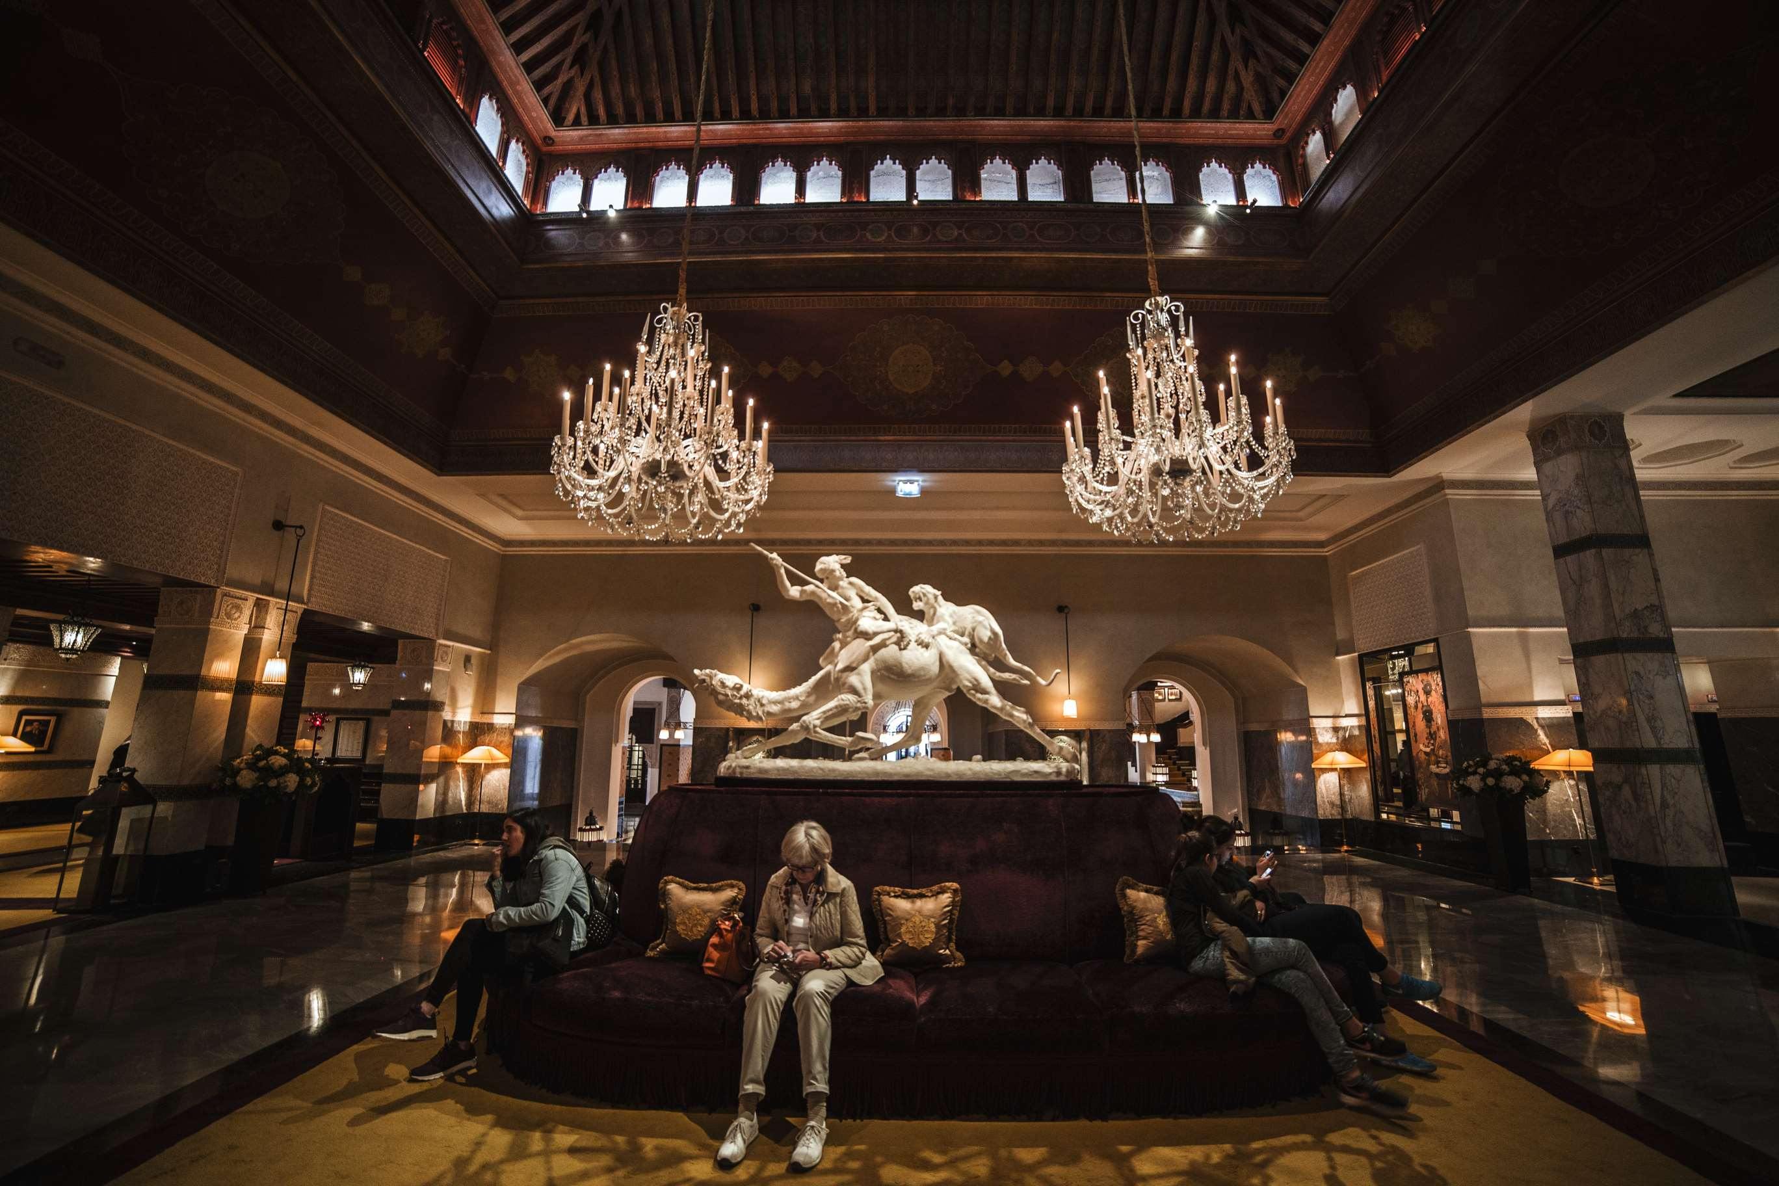
INTRODUCTION
The global luxury hotel market refers to the sector within the hospitality industry that caters to high-end clientele, providing upscale accommodations, premium amenities, and personalized services. It emphasizes luxury, exclusivity, and a superior guest experience. In confluence with this, the experience is often complemented by premium concierge services, including personalized itinerary planning and priority reservations for in-house dining and spa facilities. Another market driver is the growing trend in experiential travel, where affluent travelers are willing to pay a premium for rooms that offer unique moments or direct access to exclusive events or locations. These strategies help key players capture a significant market share and stay competitive in the dynamic luxury hotel market.

Slide 3
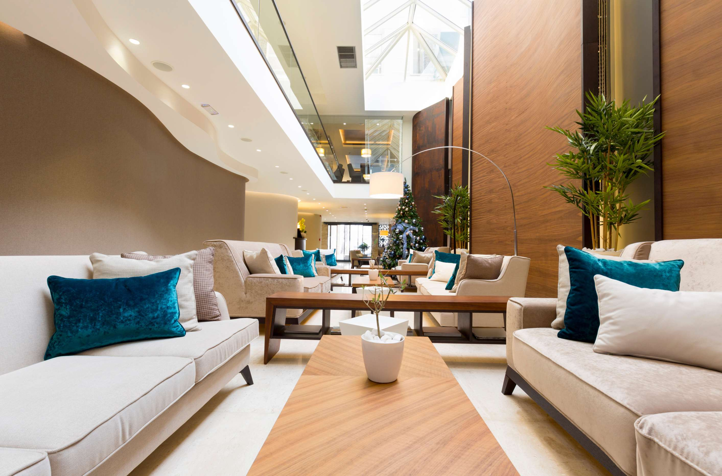

KEY INSIGHTS
MARKET SIZE
USD 130.8 billion
2023
CAGR
11.80%
2023- 2030

Slide 4
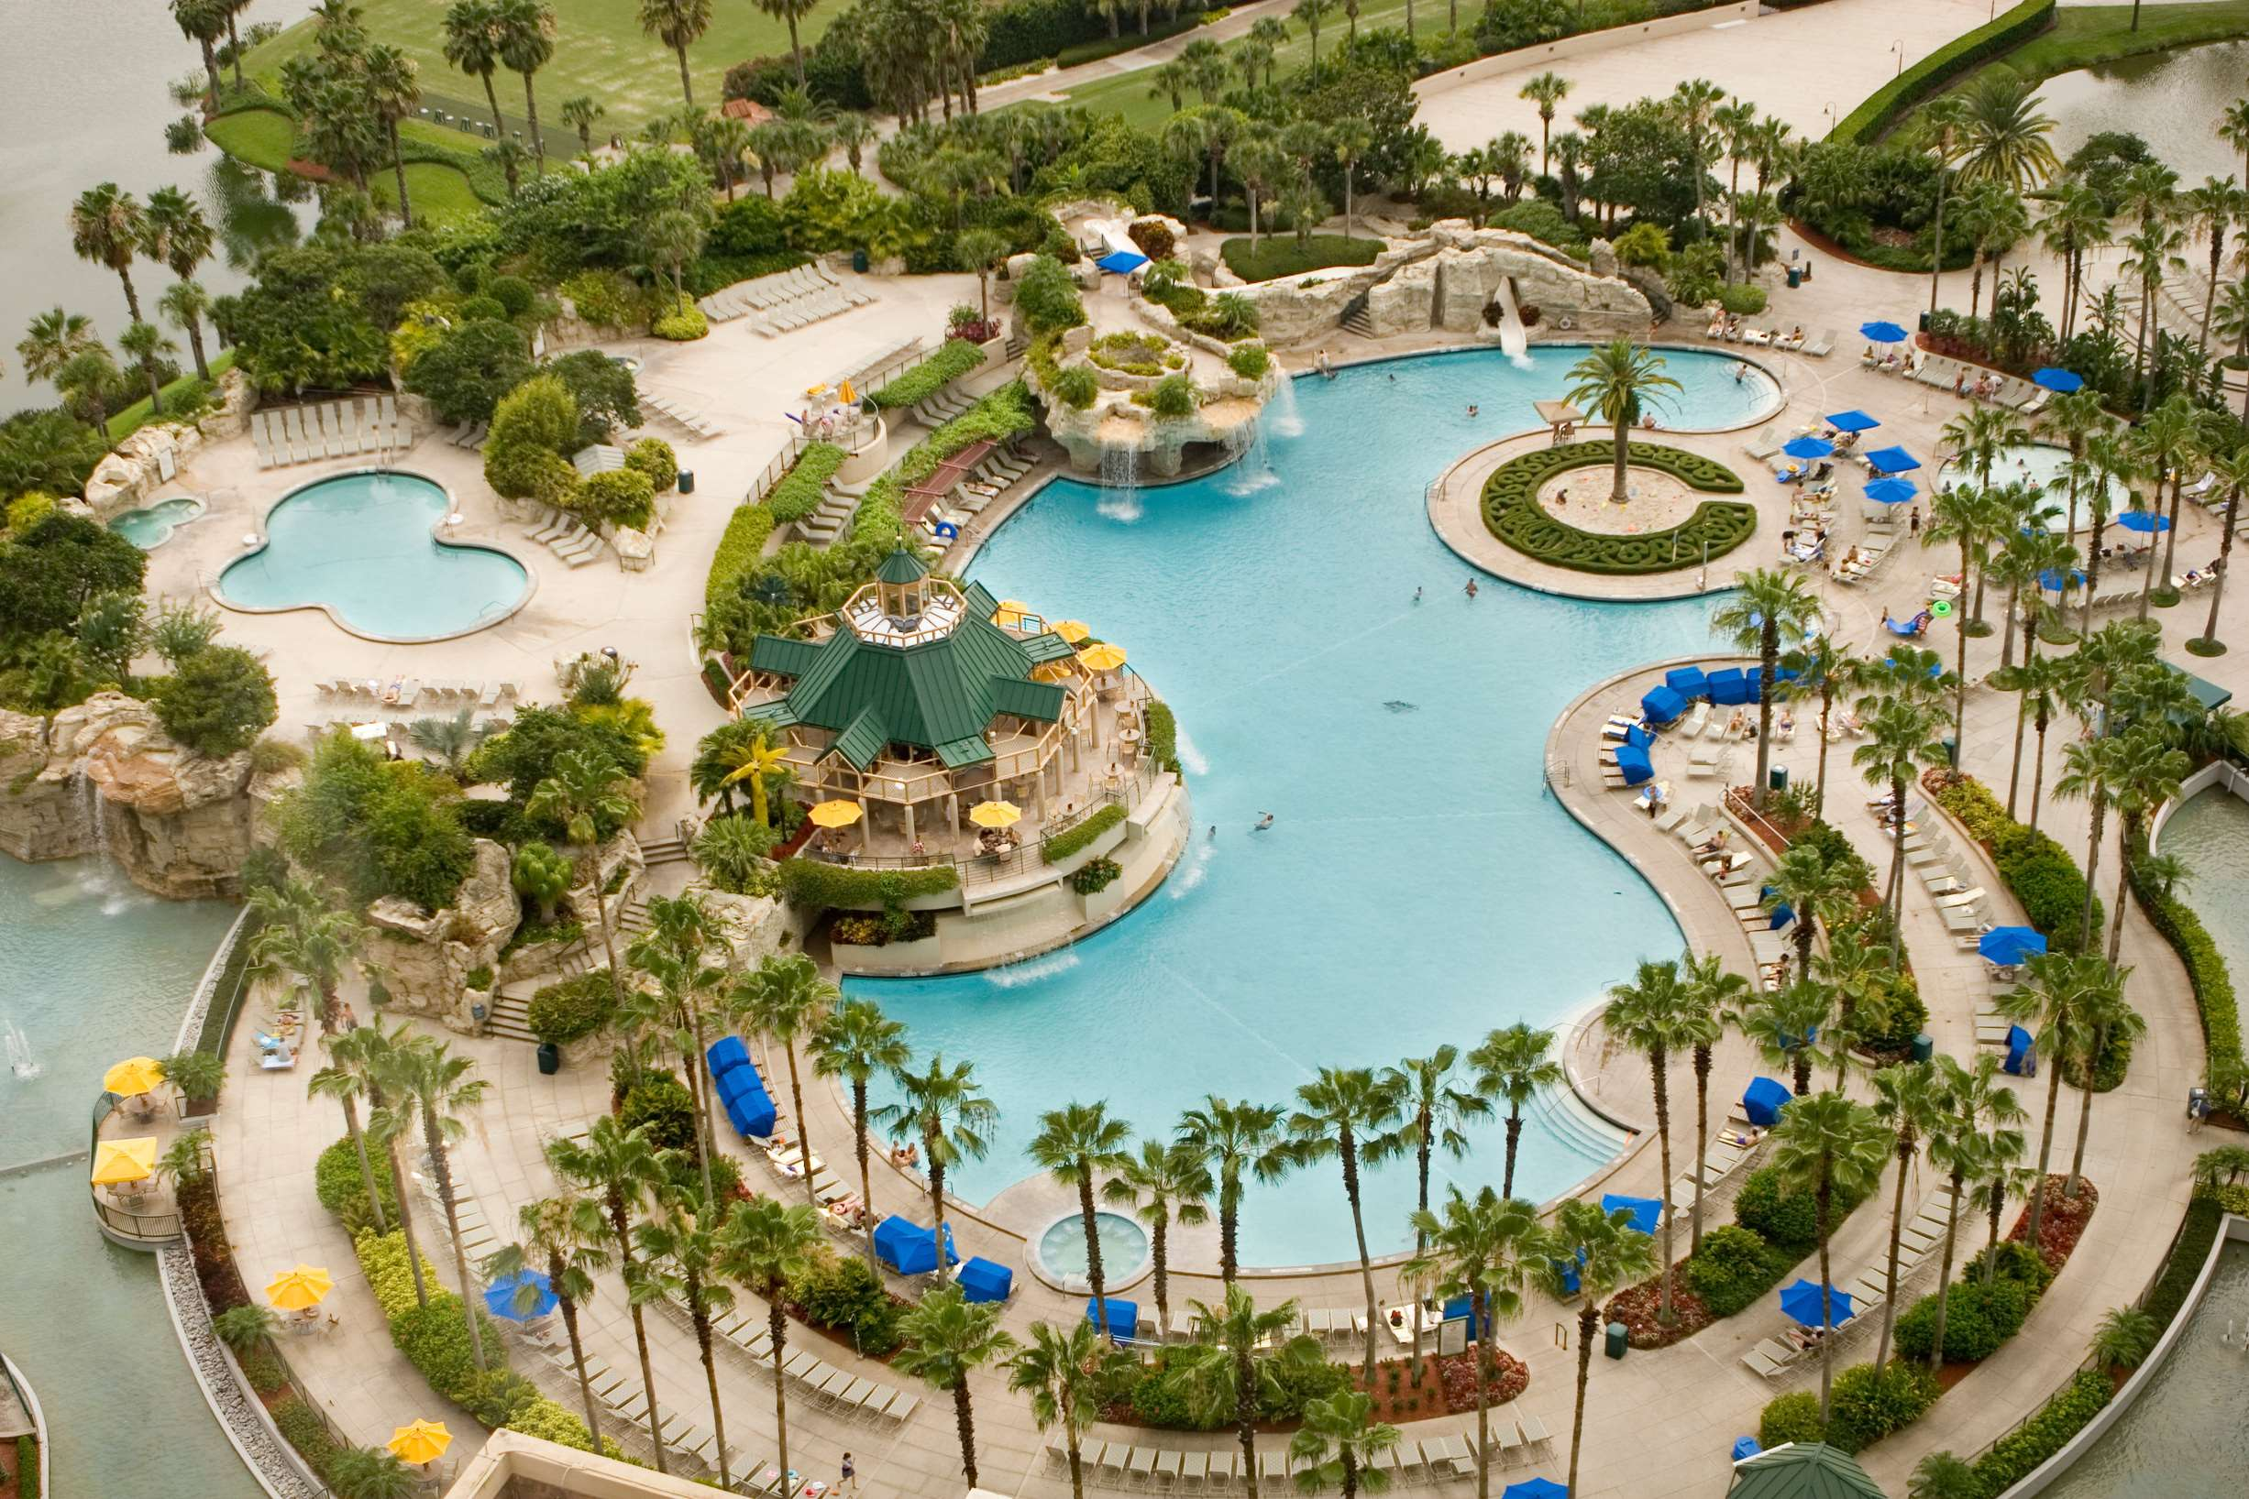
REVENUE MARKET SHARE BY SEGMENTS 2022
  Business Hotels
  Airport Hotels
  Suite Hotels
  Resorts
Type Segment
  Chain
  Independent
Category Type Segment
  Luxury
  Upper-upscale
  Upscale
Room Type Segment

Slide 5

Global Luxury Hotel Market Revenue share for 2024
North America
40%

Slide 6
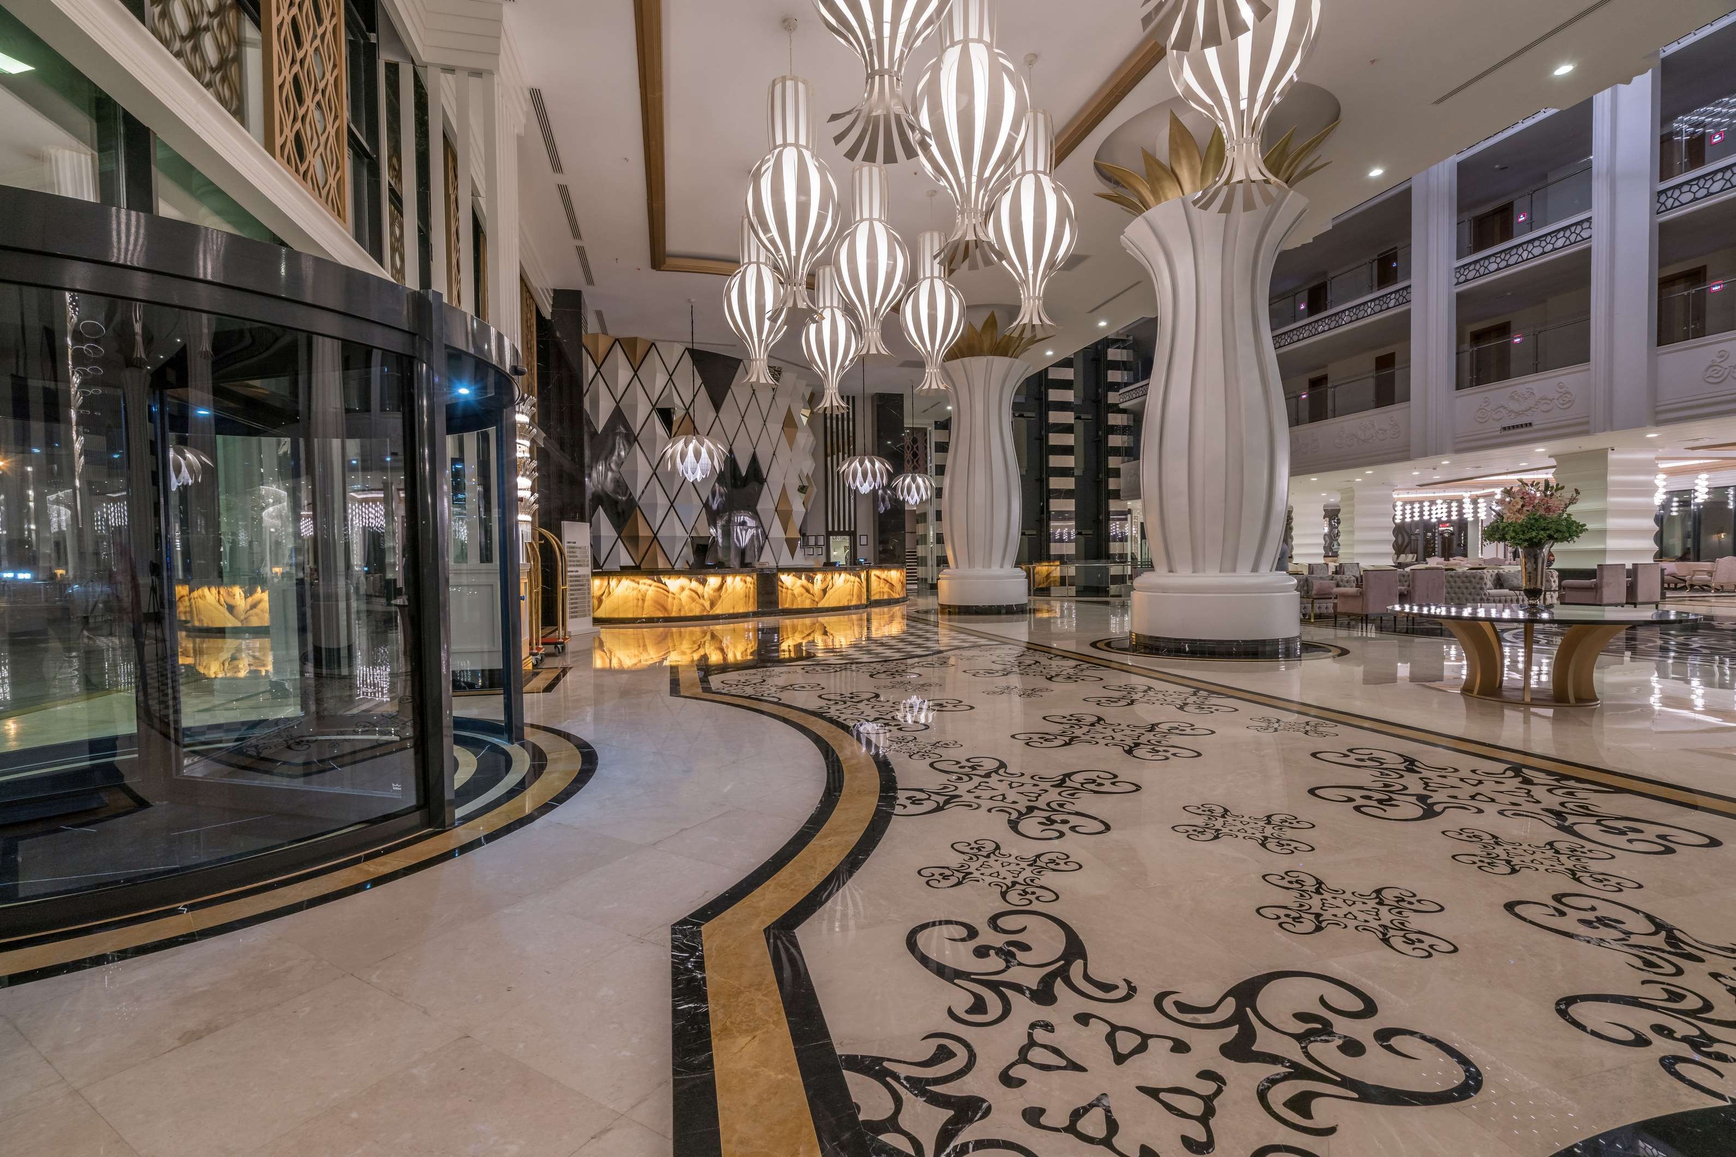
Evolving Consumer Preferences for Personalized Experiences to Propel Market Growth
Drivers
Emergence of Accommodation-Sharing Facilities at Lower Prices to Restrict Market Growth
Restraints

Slide 7
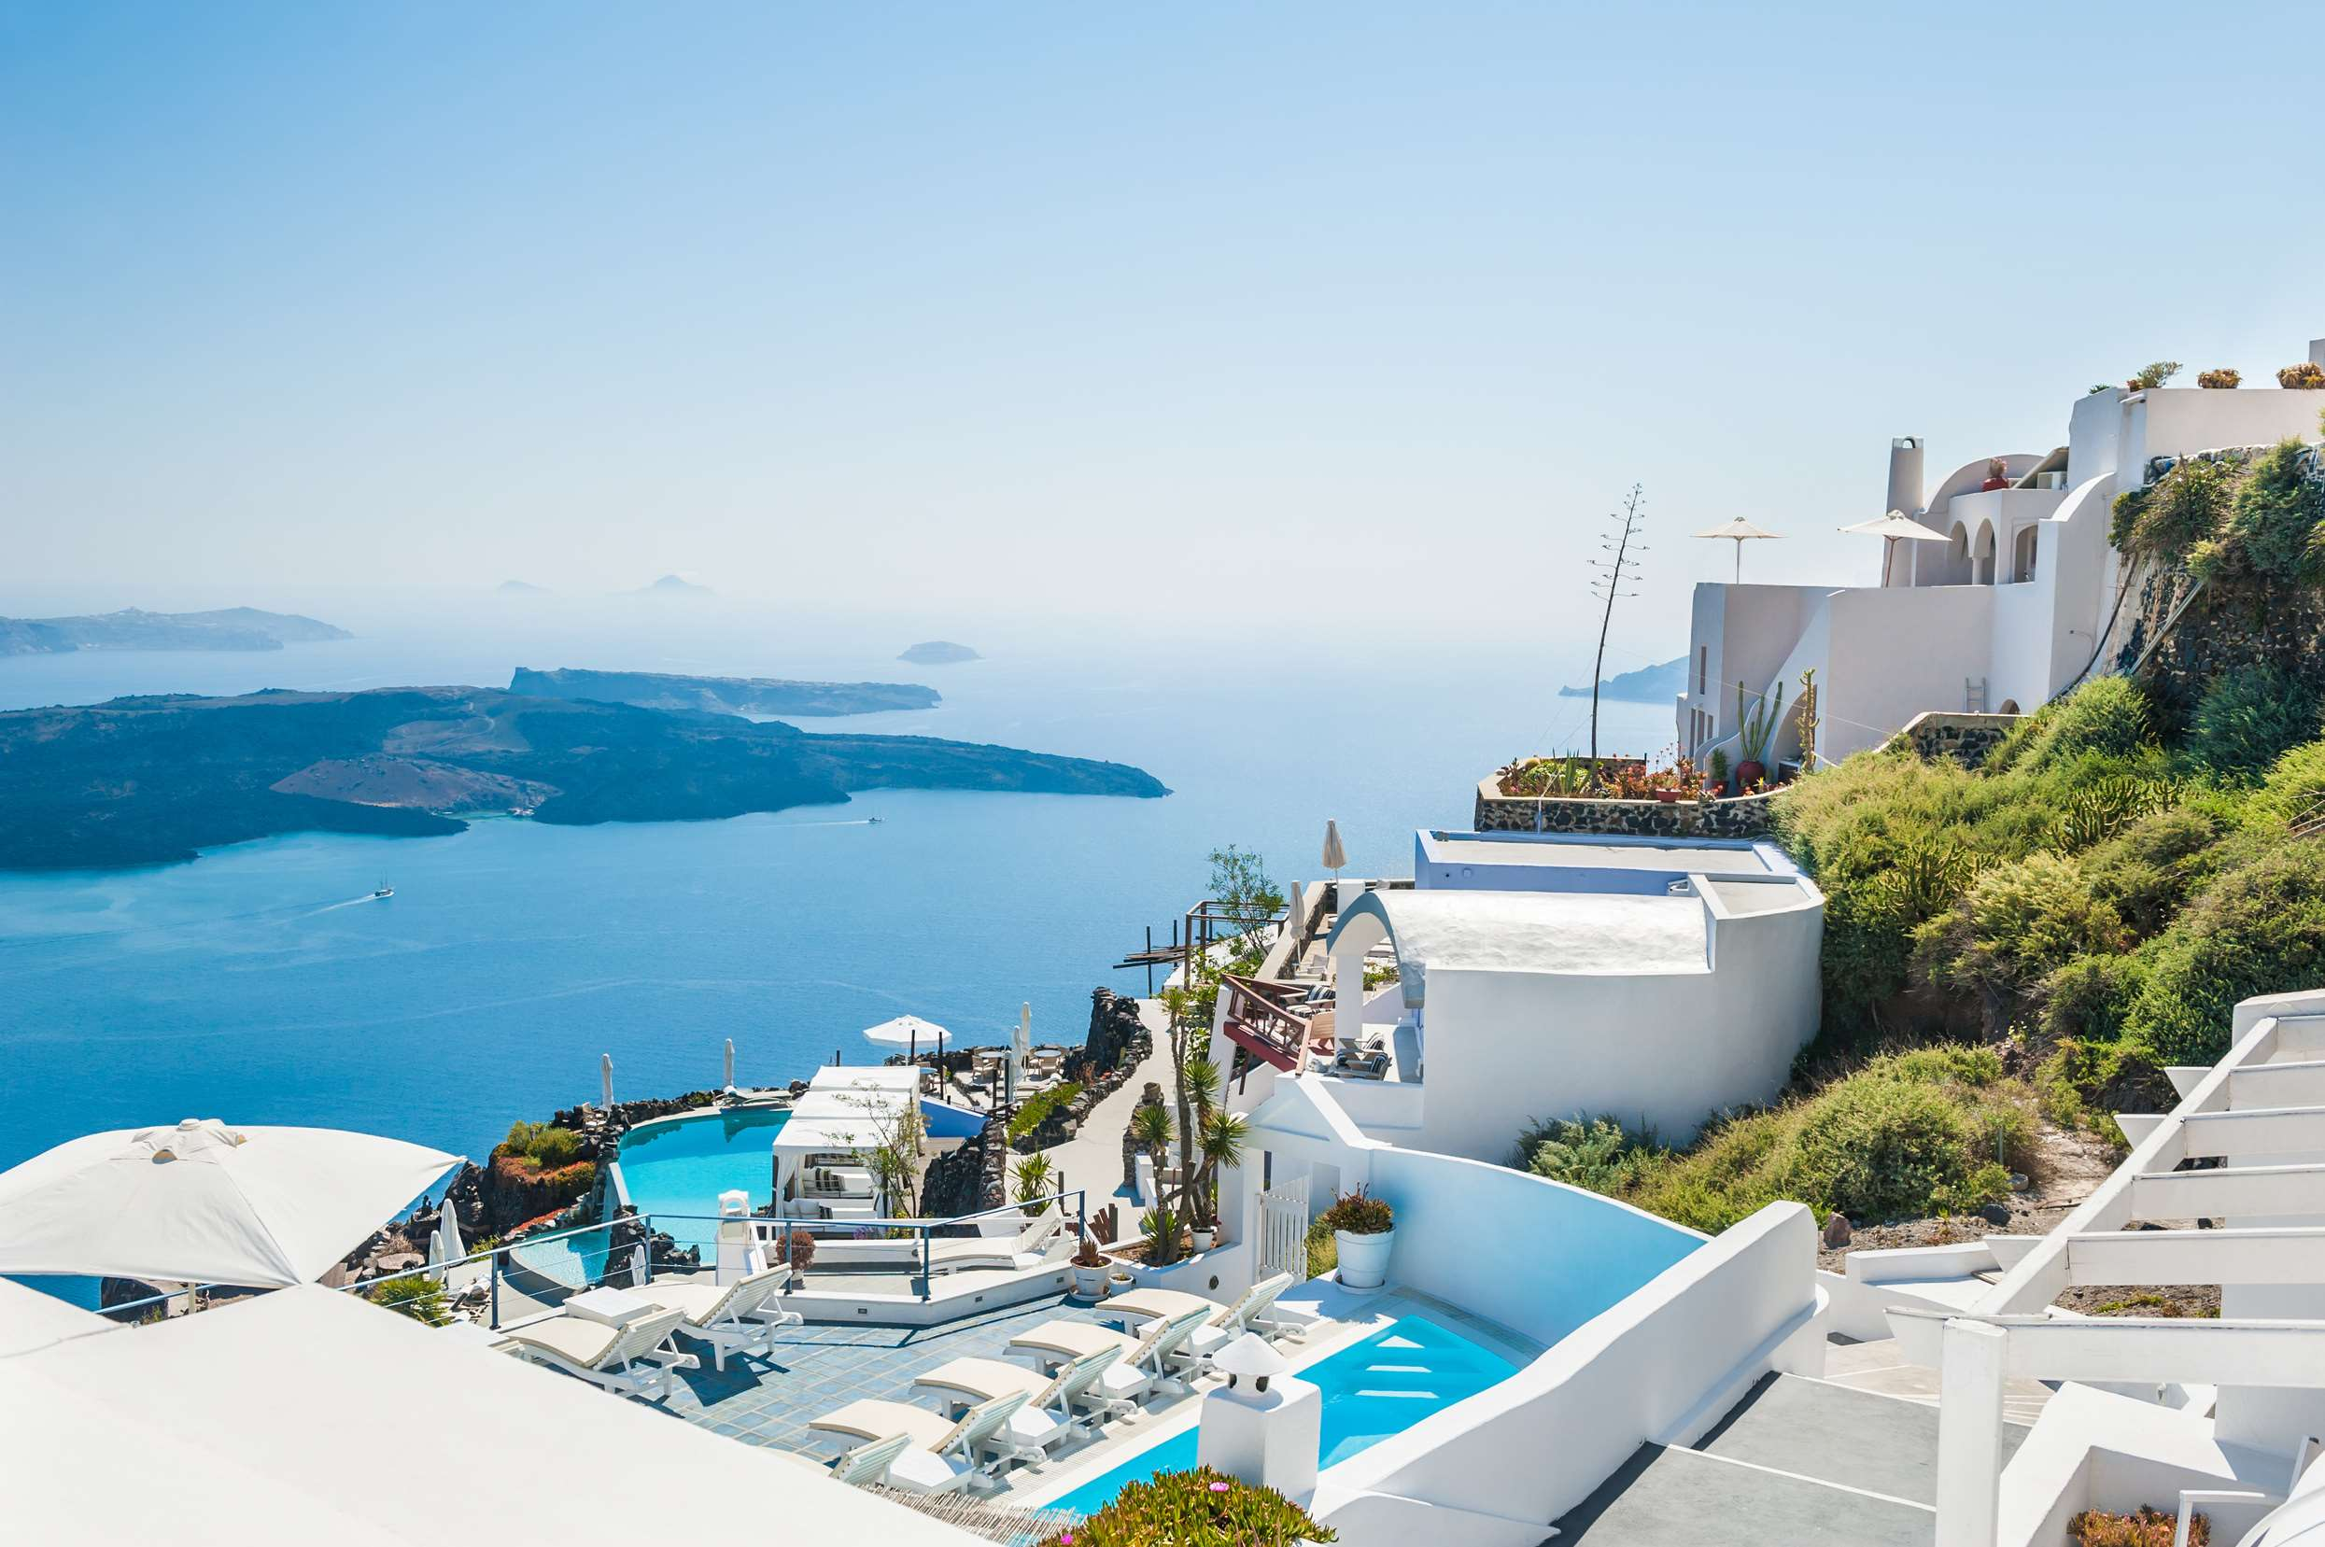
AUTHOR'S PERSPECTIVE
  The Global Luxury Hotel Market is witnessing significant growth in the near future.
  Business hotels focus on creating a seamless blend of luxury and functionality to cater to the demands of the discerning business clientele.
  Airport hotels cater to both business and leisure travelers who prioritize seamless connectivity to flights and value-added services.
  Lavish accommodations, top-tier dining experiences, and personalized, high-touch services characterize luxury hotels.
  Independent luxury hotels showcase individuality, distinctive design, and a focus on bespoke services, appealing to travelers seeking a more authentic and exclusive stay.

Slide 8
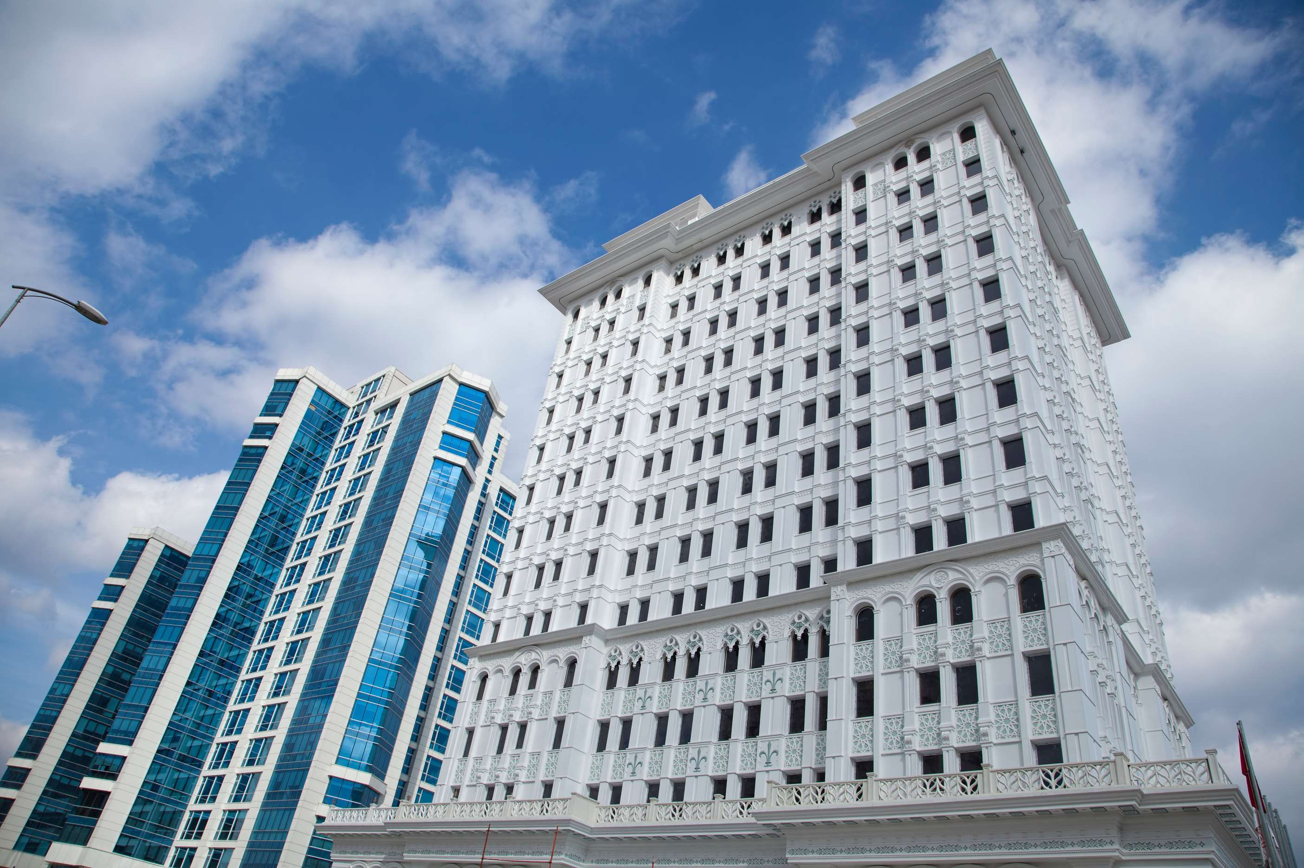






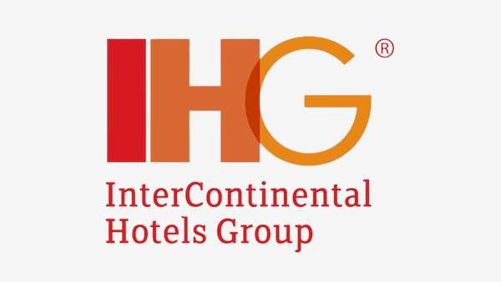



KEY PLAYERS

Slide 9


For Full Report
Contact us
COGNITIVE MARKET RESEARCH
Tel: +1 312-376-8303 | +44 020-8123-0732
India: (+91) 983-496-8611
sales@cognitivemarketresearch.com
Access the Full Report : https://tinyurl.com/2s3fca8a
Please visit our website:
https://www.cognitivemarketresearch.com

