Slide 1
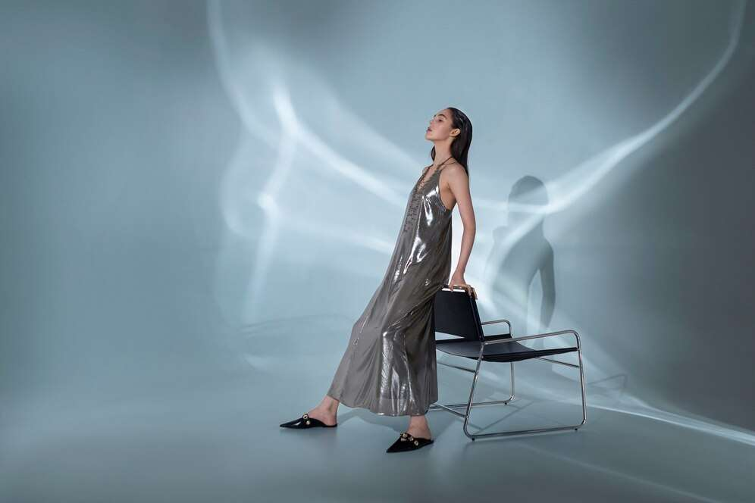
GLOBAL
LUXURY FASHION
MARKET REPORT
2024
Global,Regional,CountryAnalysis

Slide 2
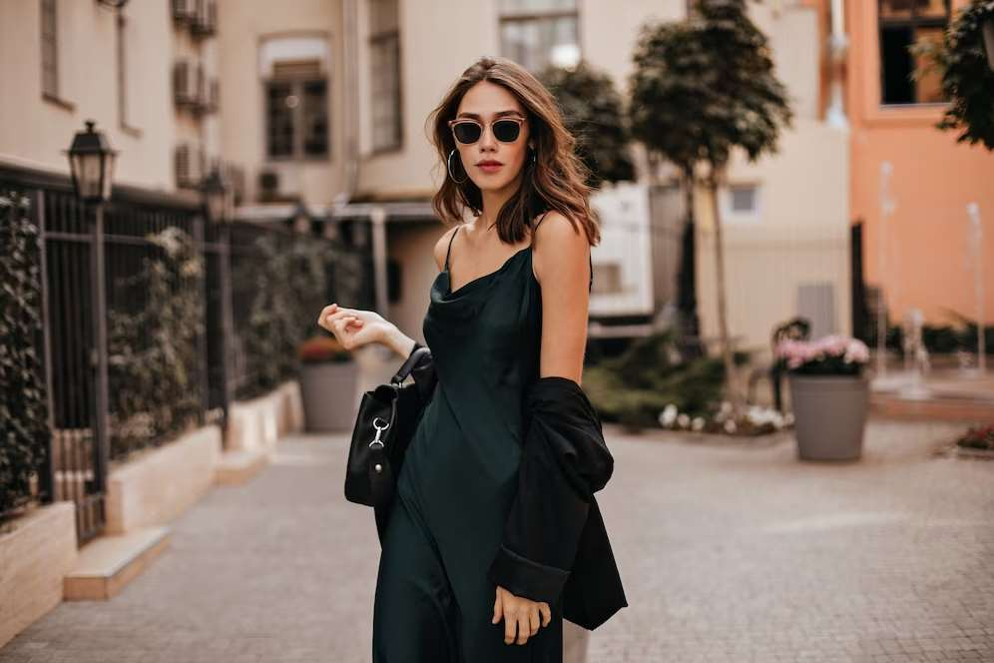
INTRODUCTION
Luxury fashions are known for their iconic designs, exceptional quality, and impeccable craftsmanship that often become synonymous with the brand itself. Key players in the luxury fashion market employ various strategies to maintain and enhance their market presence. These strategies include social media promotions and celebrity endorsements to boost the market growth, increasing communication between consumers and key players through social media, rise in affluent customers, aspiration for exclusivity and uniqueness, branding and brand equity ,e-commerce etc. Luxury fashion transcends trends and provides a sense of exclusivity and indulgence to its discerning clientele. These strategies help key players capture a significant market share and remain competitive in the dynamic luxury fashion market.

Slide 3
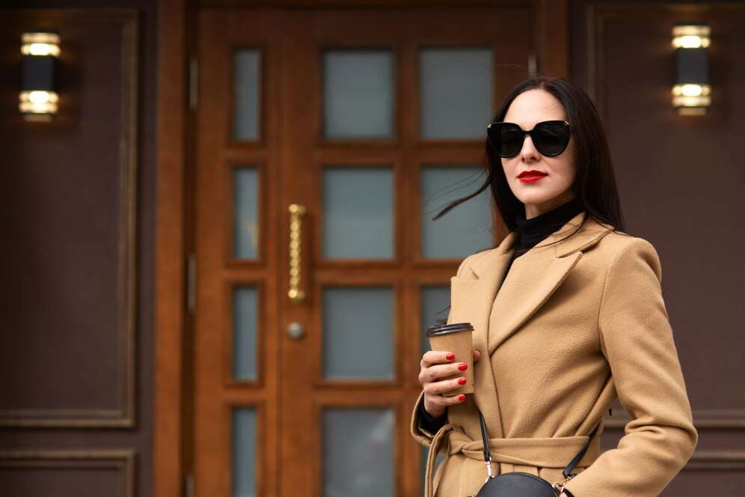

KEY INSIGHTS
MARKET SIZE
USD 104.5 billion
2023
CAGR
6.50%
2023- 2030

Slide 4

REVENUE MARKET SHARE BY SEGMENTS 2022
  Apparel
  Jewellery
  Others
Product Type Segment
  Retail
  Wholesale
Distribution Channel
  Women
  Men
  Children
End-User Segment
  Mono Brand Stores
  Specialty Stores
  Departmental Stores
  Off-Prices Stores
  Airports
Sales Channel
  Gen X
  Millennials
  Gen Z
  Baby Boomer
  Silent Gen
Generation Segment

Slide 5
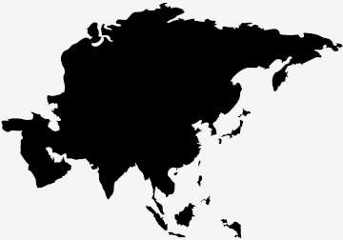
Global Luxury Fashion Market Revenue share for 2024
Asia Pacific
35%

Slide 6
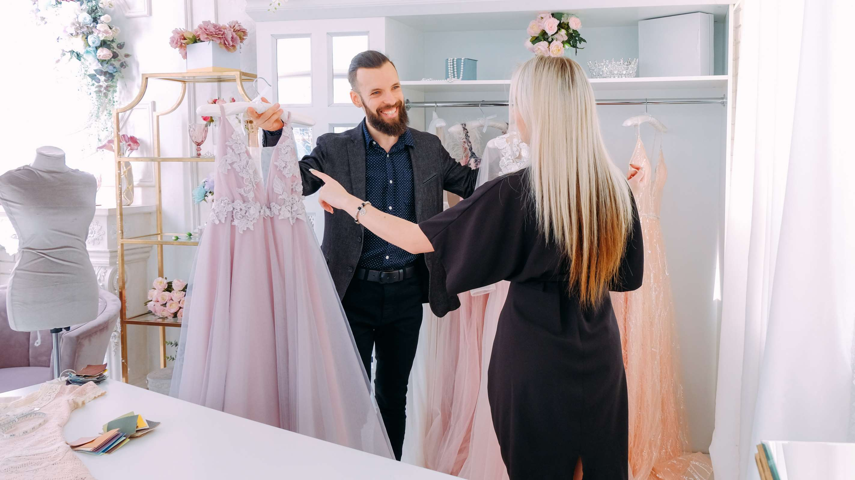
Aspiration for Exclusivity and Uniqueness to Propel Market Growth
Drivers
Availability of Second-Hand Luxury Products to Restrict Market Growth
Restraints

Slide 7
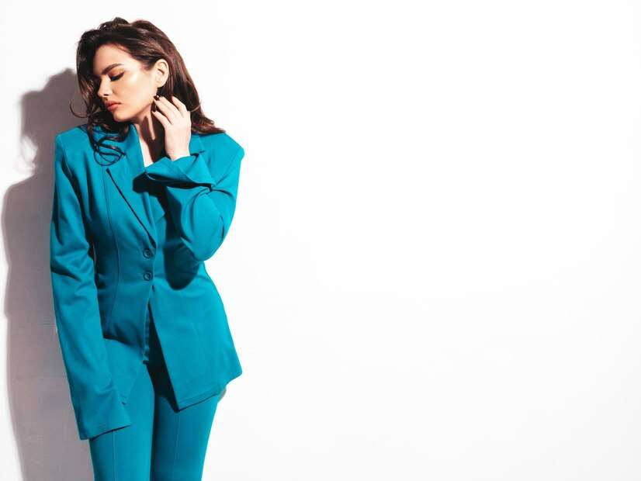
AUTHOR'S PERSPECTIVE
  The Global Luxury Fashion Market is witnessing significant growth in the near future.
  Jewellery is the fastest-growing category over the forecast period due to encompasses a dazzling array of pieces, from intricately designed necklaces and bracelets to exquisite rings and earrings.
  Women's demand for high-quality, unique design drives the innovation and creativity within the luxury fashion industry.
  Gen Z are the fastest-growing category over the forecast period as the Gen Z values experiential and socially conscious aspects of luxury fashion.
  Gen Z's influence on the luxury market is marked by a demand for inclusivity, sustainability, and digital connectivity.

Slide 8




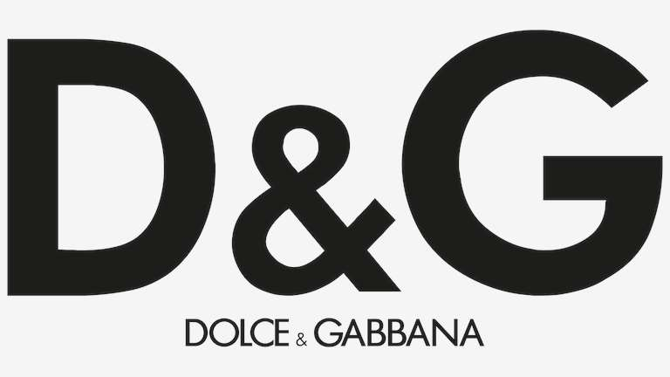

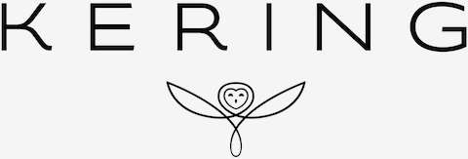

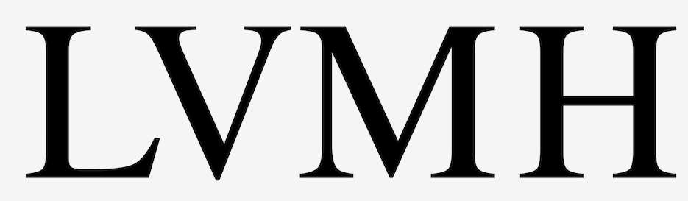

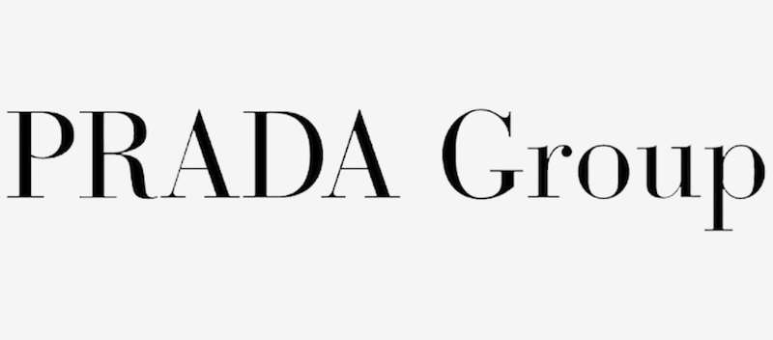
KEY PLAYERS

Slide 9


For Full Report
Contact us
COGNITIVE MARKET RESEARCH
Tel: +1 312-376-8303 | +44 020-8123-0732
India: (+91) 983-496-8611
sales@cognitivemarketresearch.com
Access the Full Report : https://tinyurl.com/4sw6nxe3
Please visit our website:
https://www.cognitivemarketresearch.com

