Slide 1
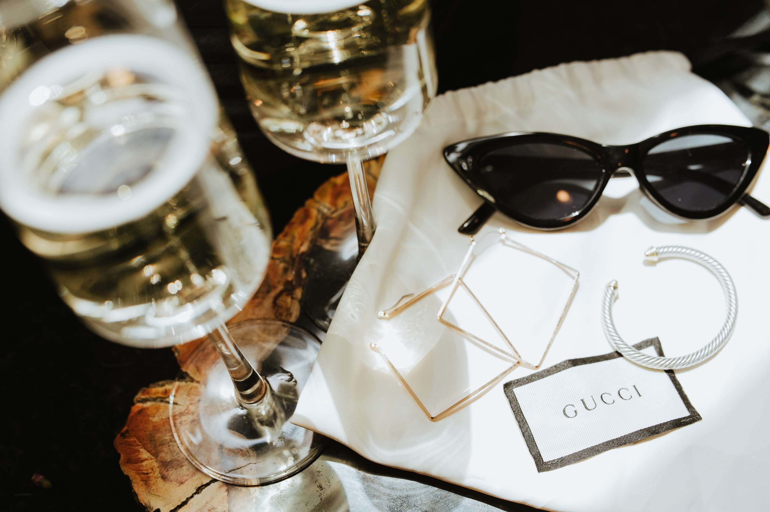
GLOBAL
LUXURY EYEGLASSES
MARKET REPORT
2024
Global,Regional,CountryAnalysis

Slide 2

INTRODUCTION
The market for luxury eyeglasses is the segment of the eyewear business that specializes in high-end, designer, and premium frames. Targeting customers who are prepared to spend more for luxury and status, these spectacles are usually distinguished by their exceptional quality, exquisite craftsmanship, and distinctive design. The luxury eyeglasses market is growing due to several factors, including increasing consumer disposable income, a rising emphasis on fashion and personal style, and the perception of eyeglasses as both a functional accessory and a status symbol. Luxury eyewear brands offer innovative designs, premium materials, and superior craftsmanship, attracting consumers who value exclusivity and brand prestige. Additionally, the growing awareness of eye health and the integration of advanced technologies, such as blue-light blocking features, contribute to the market's expansion as consumers seek both style and functionality in their eyewear choices.

Slide 3


KEY INSIGHTS
CAGR
5.0%
2023- 2030

Slide 4

REVENUE MARKET SHARE BY SEGMENTS 2022
  PCB Drills
  PCB Routers
  PCB End Mills
Type Segment
  Communications
  Computer
  Consumer Electronics
  Automotive Electronics
  Industrial and Medical
  Military and Aerospace
Application Segment

Slide 5

Global Luxury Eyeglasses Market Revenue share for 2024
North America
40%

Slide 6

Growing Disposable Income to Propel Market Growth
Drivers
Increasing Economic Uncertainties to Restrict Market Growth
Restraints

Slide 7
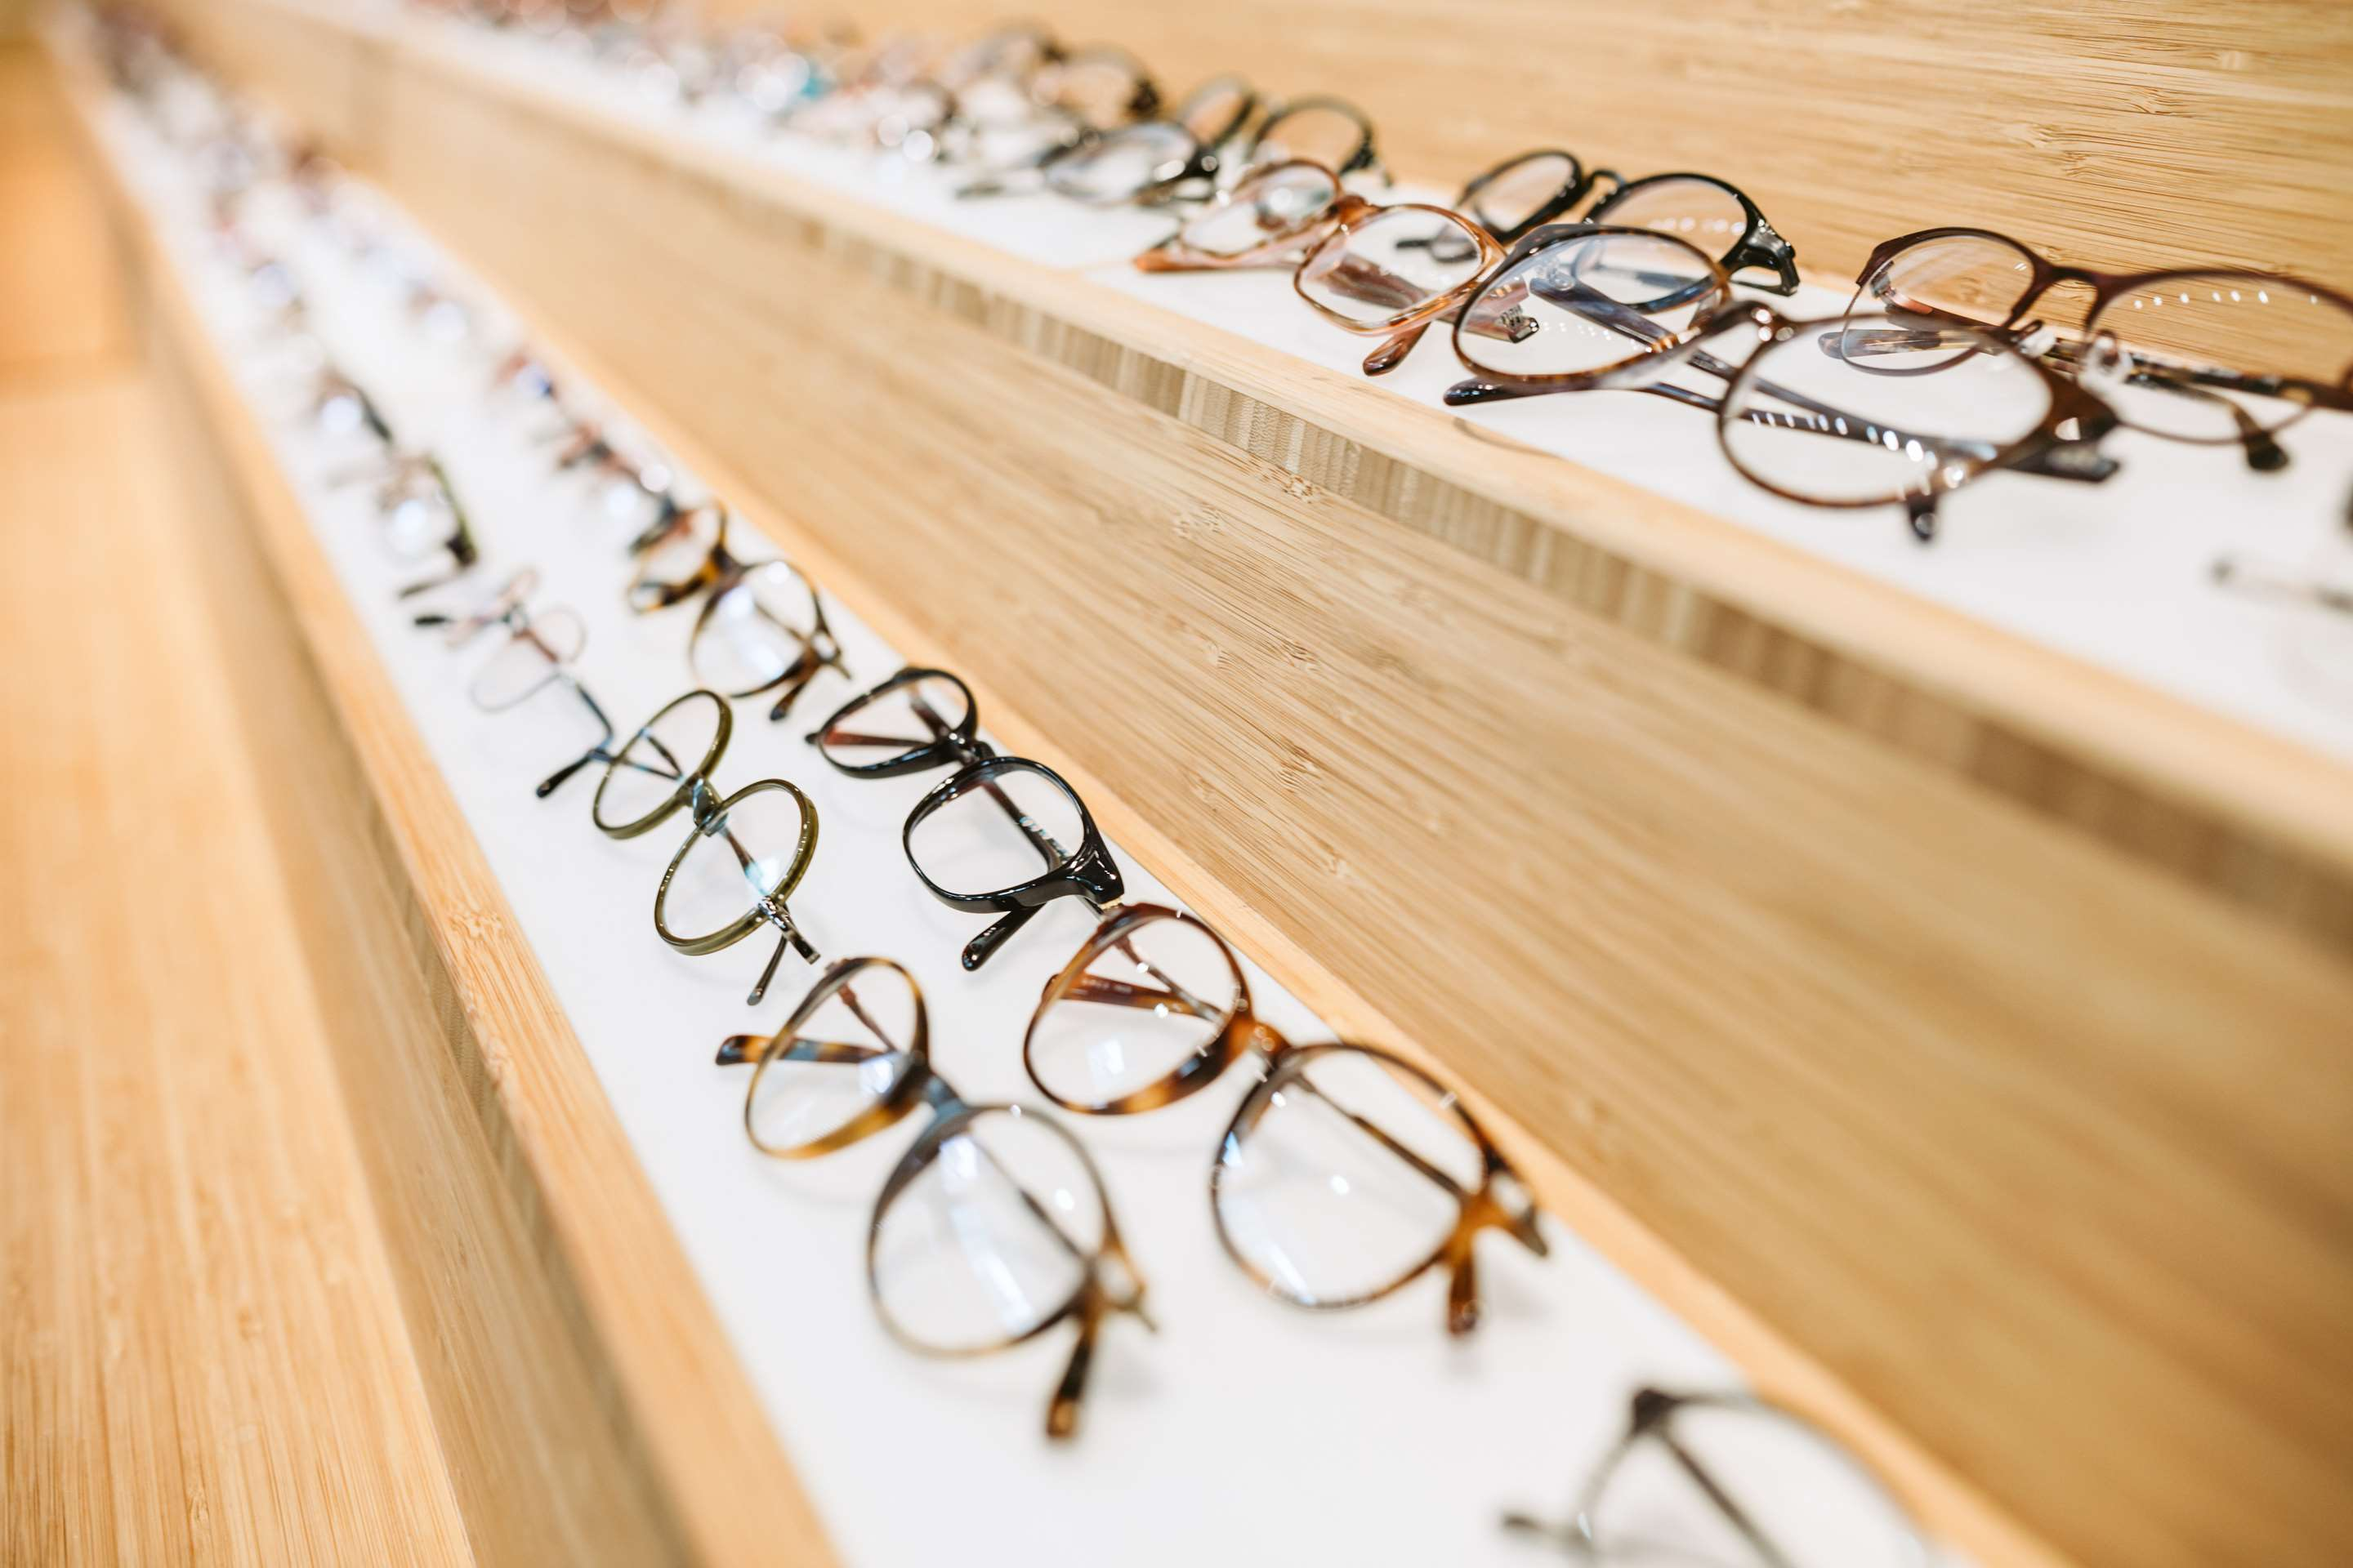
AUTHOR'S PERSPECTIVE
  The Global Luxury Eyeglasses Market is witnessing significant growth in the near future.
  Modern luxury eyewear features intricate designs with sharp corners and curves, demanding tools with superior cutting capabilities.
  PCB drills offer superior precision and accuracy, crucial for creating the tiny holes needed to mount delicate components in luxury eyeglasses.
  Luxury eyeglasses that offer precise vision correction and advanced UV protection address both functional and aesthetic needs, appealing to a broader consumer base.

Slide 8



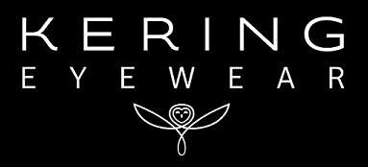
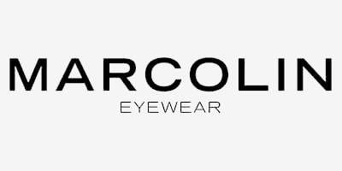
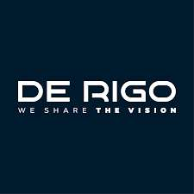
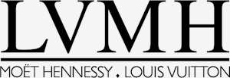
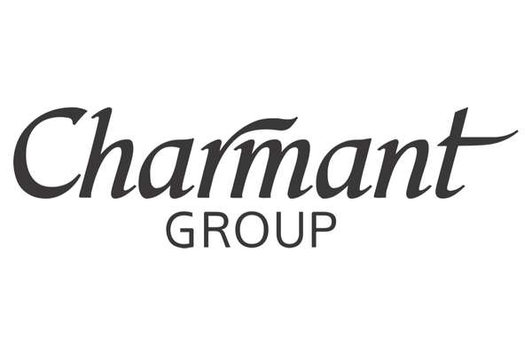

KEY PLAYERS

Slide 9


For Full Report
Contact us
COGNITIVE MARKET RESEARCH
Tel: +1 312-376-8303 | +44 020-8123-0732
India: (+91) 983-496-8611
sales@cognitivemarketresearch.com
Access the Full Report : https://tinyurl.com/29kt888e
Please visit our website:
https://www.cognitivemarketresearch.com

