Slide 1

GLOBAL
LUXURY EYE CREAM
MARKET REPORT
2024
Global,Regional,CountryAnalysis

Slide 2

INTRODUCTION
A luxury eye cream is a high-end skincare product designed for the delicate eye, addressing concerns like fine lines and dark circles with premium ingredients and advanced formulations. The luxury eye cream market thrives on substantial growth influenced by social media and celebrity endorsements. As influencers showcase skincare routines on platforms like Instagram and YouTube, consumers desire products associated with luminous skin, driving market expansion. This phenomenon, fueled by celebrity-driven trends, underscores the profound impact of social media culture on luxury eye cream demand.

Slide 3
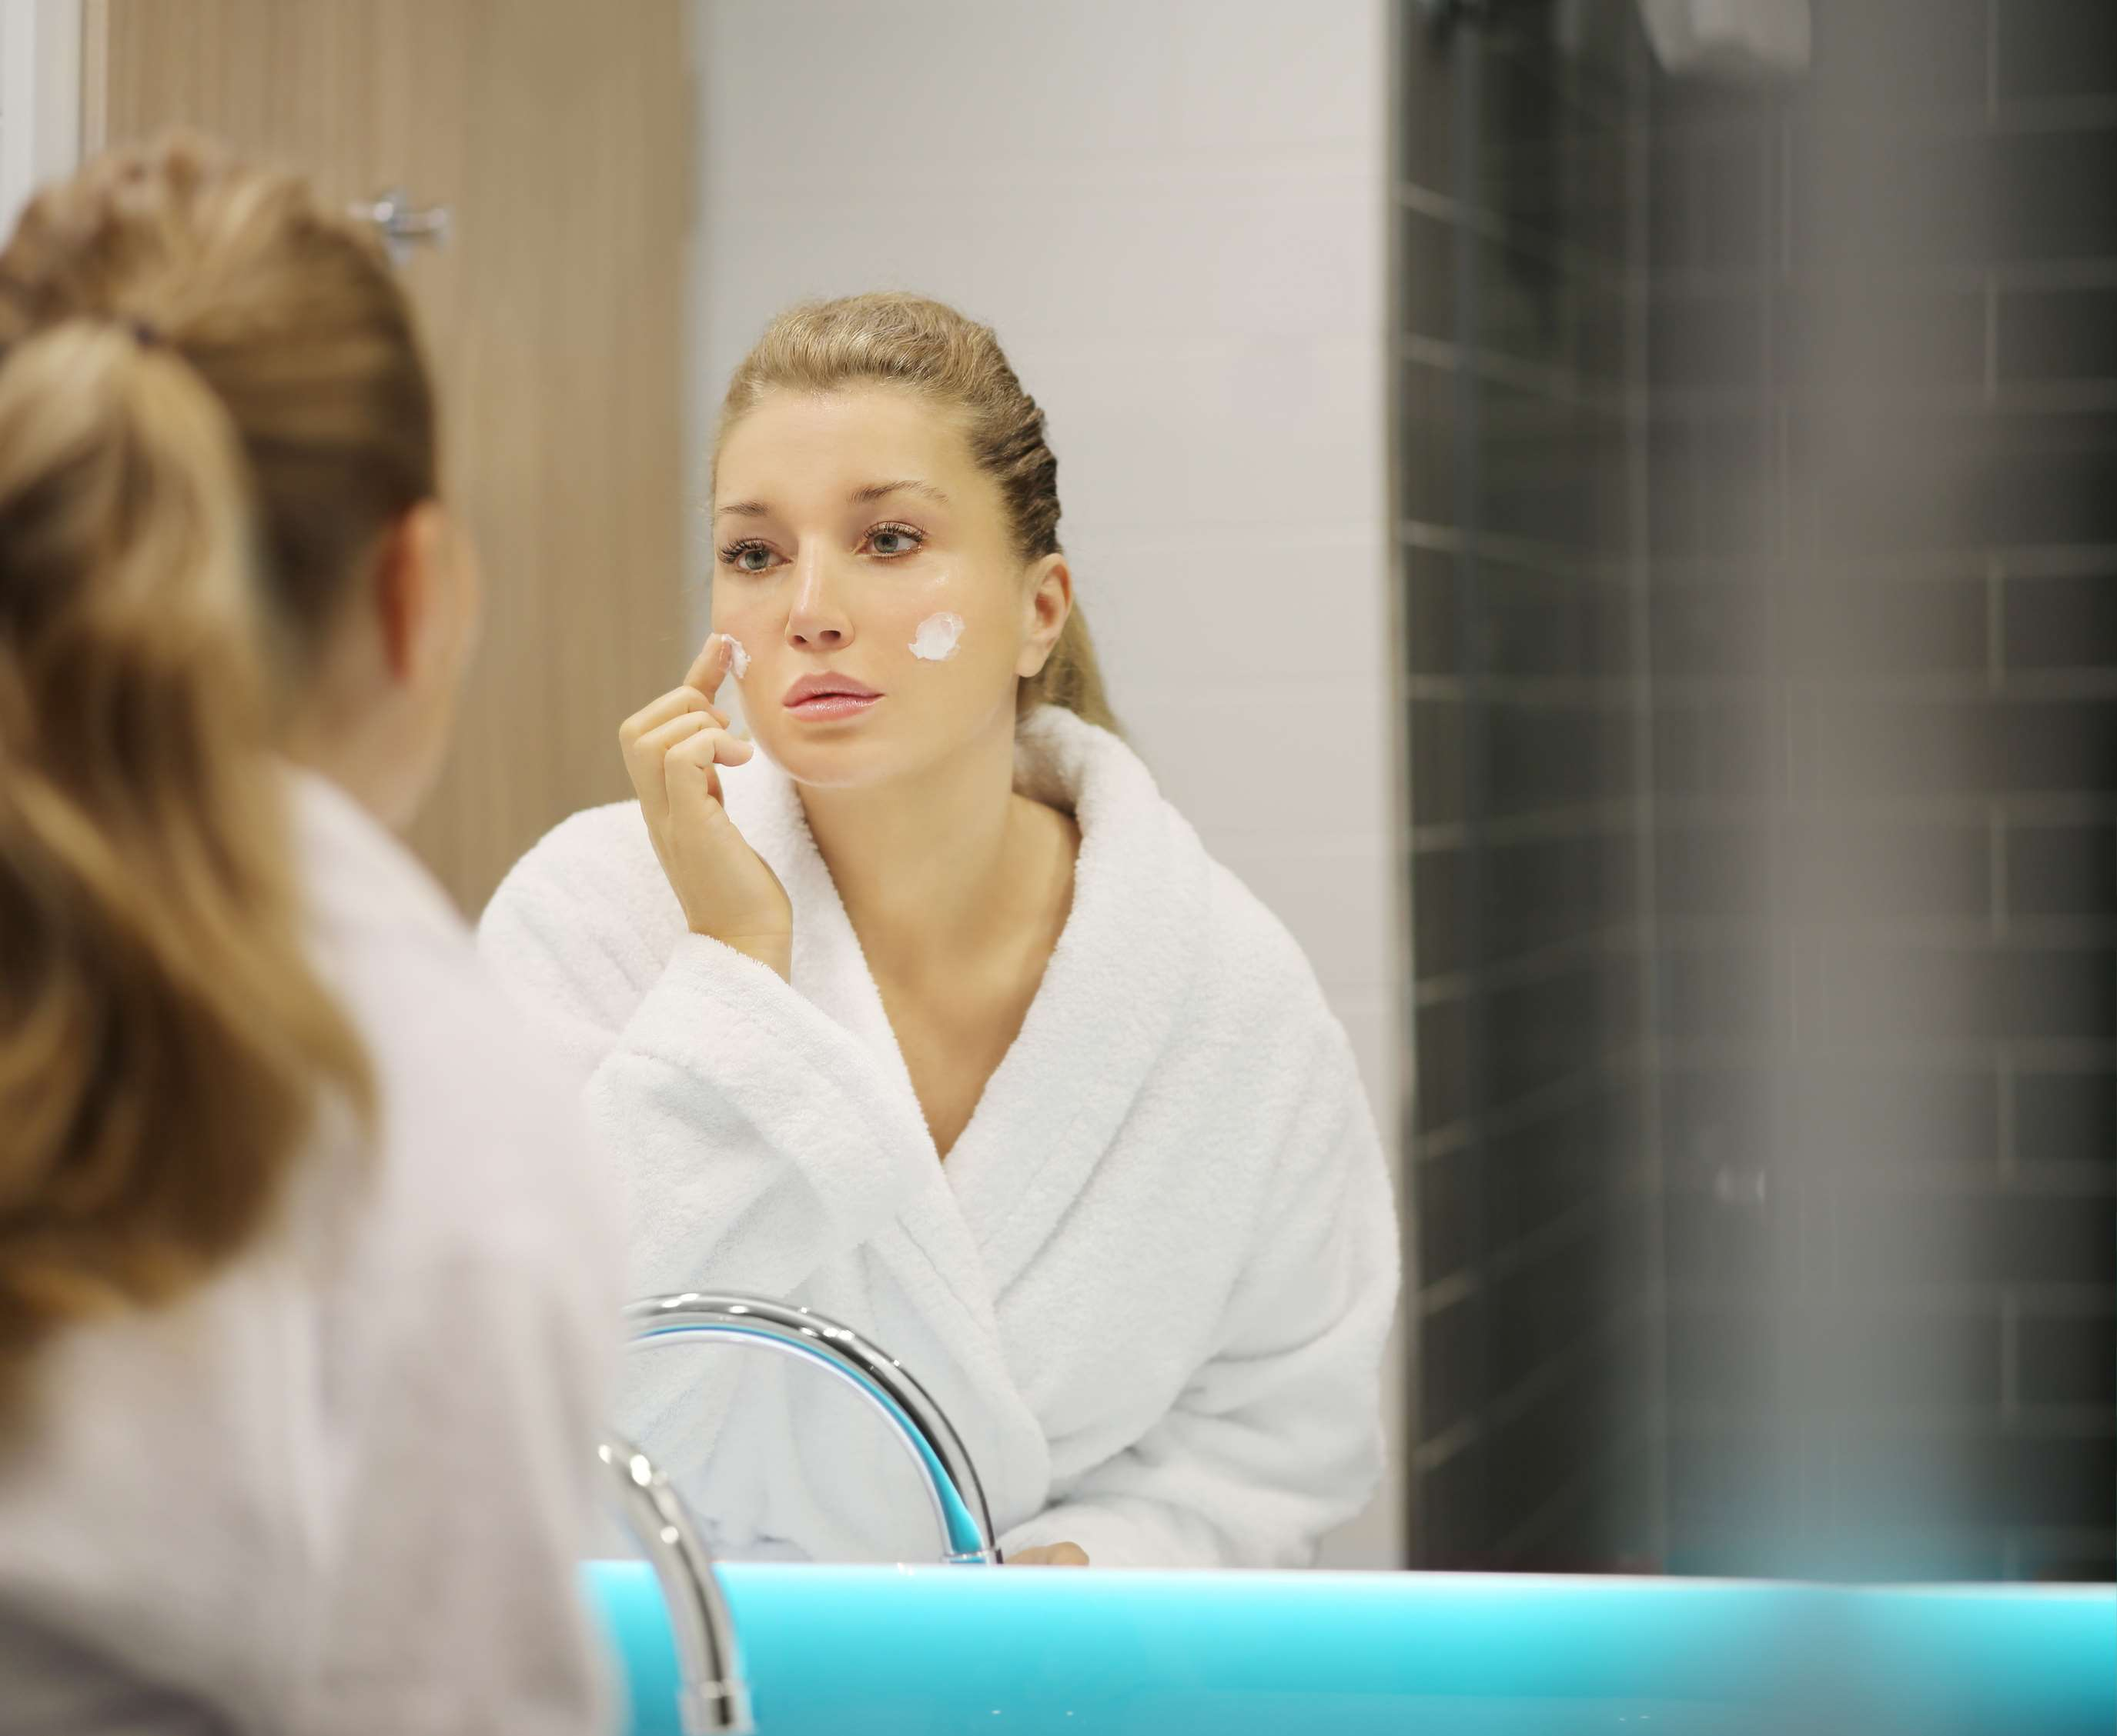

KEY INSIGHTS
CAGR
5.3%
2024- 2031

Slide 4

REVENUE MARKET SHARE BY SEGMENTS 2022
  Moisturizing Eye Cream
  Firming Eye Cream
  Anti-Aging Eye Cream
  Anti-Allergy Eye Cream
  Brightening Eye Cream
  De-puffing Eye Cream
  Online
  Offline
Type Segment
Distribution Channel
  Youth
  Middle Aged
  Elderly
  High
  Medium
  Low
Application Segment
Price Range Segment

Slide 5

Global Luxury Eye Cream Market Revenue share for 2024
North America

Slide 6

Influential Surge of Luxury Eye Cream Demand via Social Media Endorsements
Drivers
Challenges in the Luxury Eye Cream Industry Due to Market Saturation and Intense Competition
Restraints

Slide 7

AUTHOR'S PERSPECTIVE
  The Global Luxury Eye Cream Market is witnessing significant growth in the near future.
  Anti-ageing eye creams often incorporate cutting-edge technologies and potent ingredients to reduce wrinkles, fine lines, and puffiness, making them the leading choice among discerning consumers in the luxury skincare segment.
  While online distribution dominates, the offline segment is the fastest-growing category in the Luxury Eye Cream marke
  In 2023, the Moisturizing Eye Cream segment accounted for noticeable share of global Luxury Eye Cream Market and is projected to experience significant growth in the near future.
  The Youth segment is expected to expand at the significant CAGR retaining position throughout the forecast period.

Slide 8













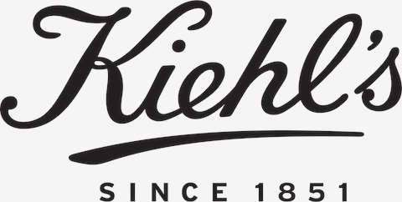



KEY PLAYERS

Slide 9


For Full Report
Contact us
COGNITIVE MARKET RESEARCH
Tel: +1 312-376-8303 | +44 020-8123-0732
India: (+91) 983-496-8611
sales@cognitivemarketresearch.com
Access the Full Report : http://tinyurl.com/44zyu29v
Please visit our website:
https://www.cognitivemarketresearch.com

