Slide 1
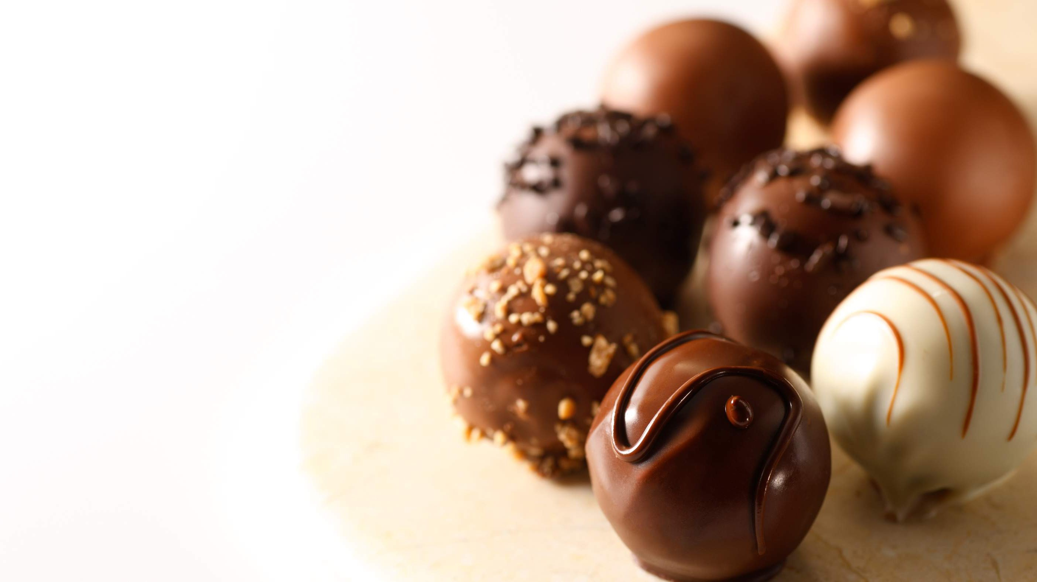
GLOBAL
LUXURY CHOCOLATE MARKET REPORT 2024
Global,Regional,CountryAnalysis

Slide 2
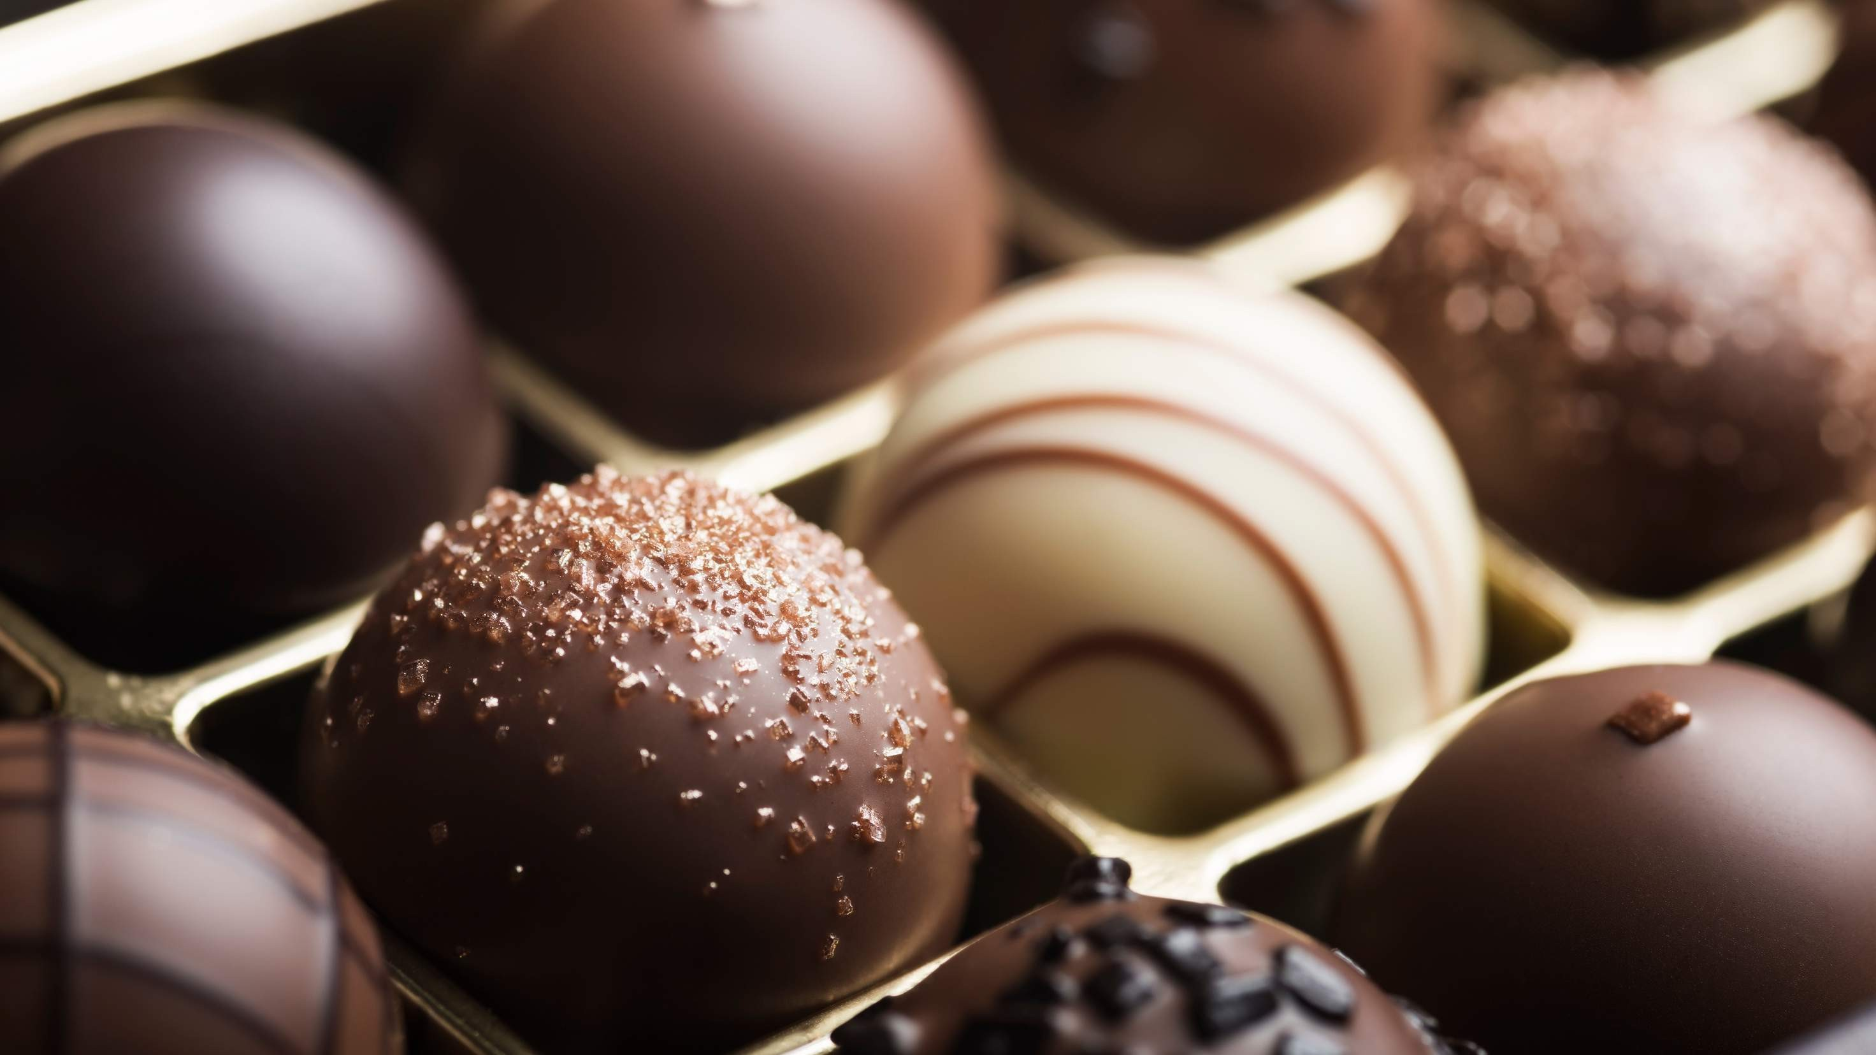
INTRODUCTION
The luxury chocolate market comprises premium chocolates crafted with meticulous attention to quality, using high-grade ingredients and artisanal techniques. These chocolates target discerning consumers seeking an elevated and indulgent cocoa experience characterized by unique flavors, superior craftsmanship, and exquisite packaging. In the health-conscious era, the luxury chocolate market sees a surge in demand for premium dark chocolates. Consumers, prioritizing well-being, are drawn to these chocolates for health benefits and rich antioxidants, reflecting a shift where indulgence harmonizes with health- conscious choices. Thriving on innovation and experiential marketing, the market enhances consumer engagement through unique flavors and artistic presentations, capturing attention with limited-edition releases, meeting desires for novel experiences, and propelling growth through distinctive luxury chocolate products.

Slide 3
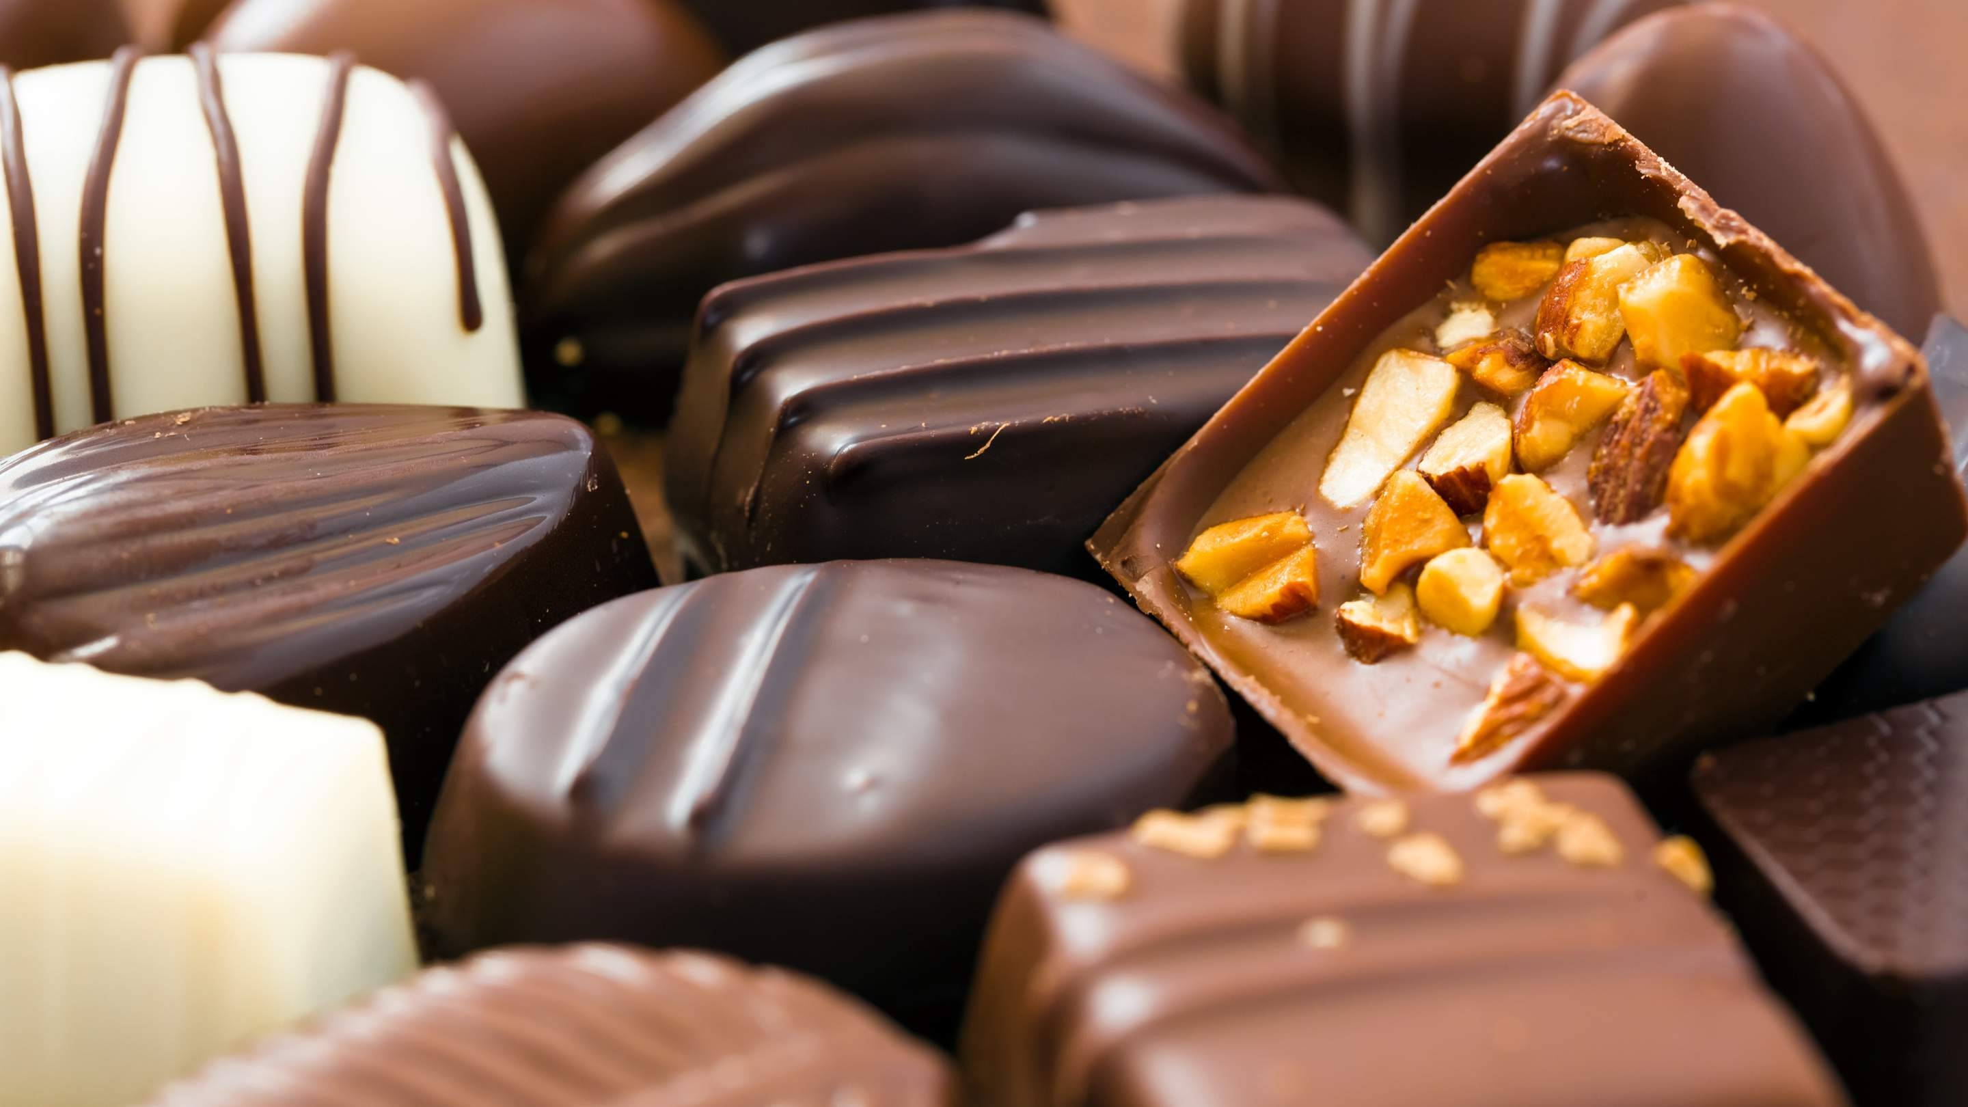

KEY INSIGHTS
MARKET SIZE
USD 30.5 billion
2030
2023
CAGR 8.9%
-
2030

Slide 4
REVENUE MARKET SHARE BY SEGMENTS 2022
Normal Skin Sensitive Skin Oily Skin
Dry Skin Combination Skin
Type Segment
Men Women
Application Segment

Slide 5
Global Luxury Chocolate Market Revenue share for 2022
Europe

Slide 6
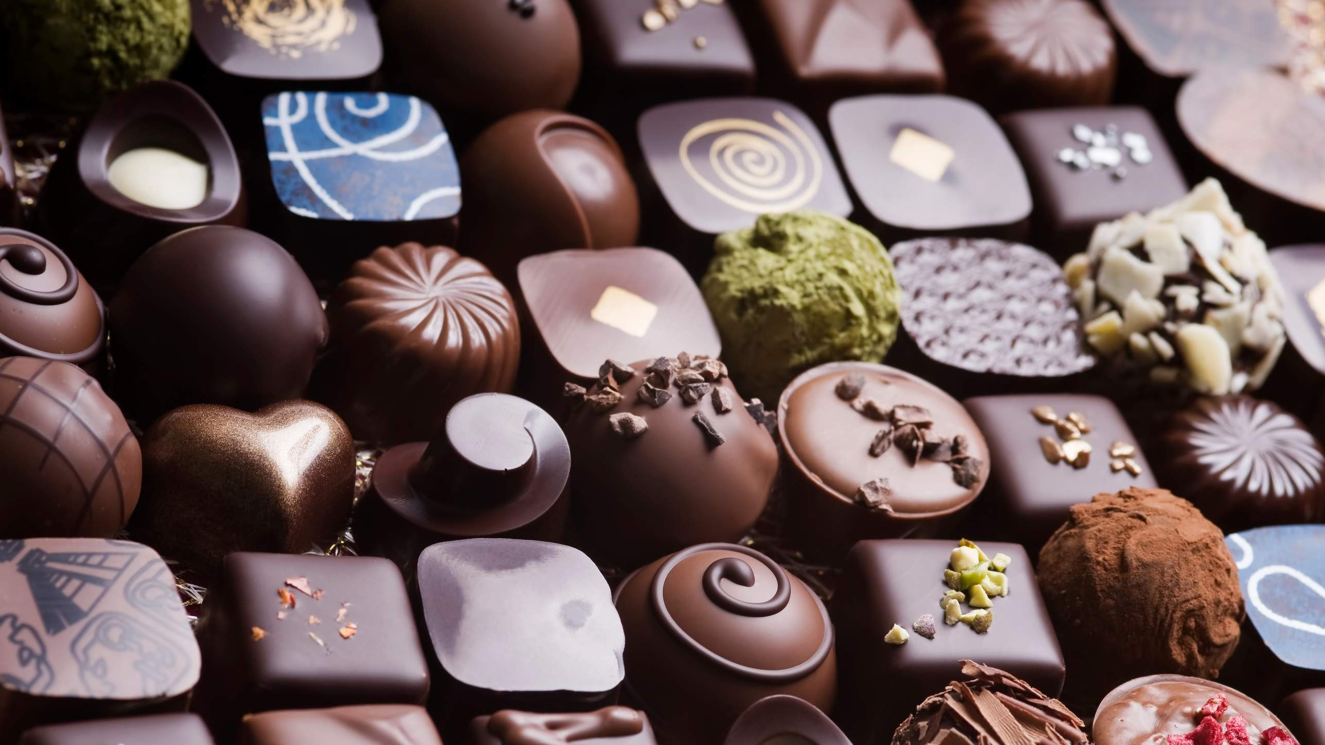
Navigating Health- Conscious Trends in the Luxury Chocolate Market
Drivers
Challenge to Luxury Chocolate Market Availability and Production Capacities
Restraints

Slide 7

AUTHOR'S PERSPECTIVE
The Global Luxury Chocolate Market is witnessing significant growth in the near future.
The popularity of luxury chocolate products tailored for normal skin reflects the widespread appeal and versatility of offerings targeted at maintaining overall skin health.
Products formulated to address sensitivity issues while providing indulgence have gained traction, making sensitive skin a dynamic and evolving segment in the luxury chocolate market.
Chocolatiers are strategically innovating by introducing bold flavours, masculine packaging, and marketing campaigns tailored to male preferences.

Slide 8
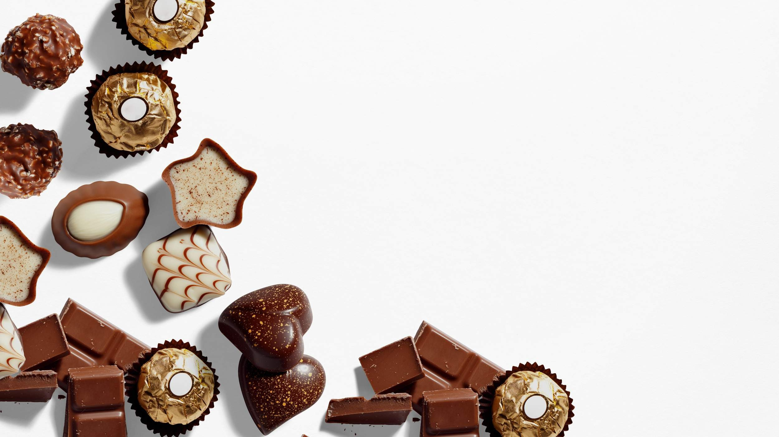
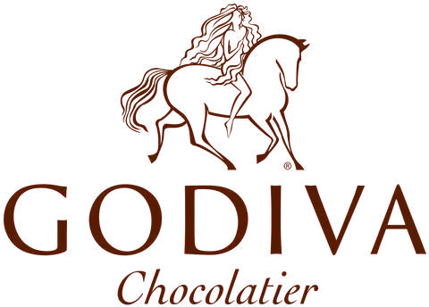









KEY PLAYERS

Slide 9


Contact us
For Full Report
COGNITIVE MARKET RESEARCH
Tel: + 1 312 - 376 - 8303 | + 44 020 - 8123 - 0732
India: ( + 91 ) 983 - 496 - 8611
sales@ cognitivemarketresearch. com
Access the Full Report : http://tinyurl.com/yc2kfves
Please visit our website:
https://www.cognitivemarketresearch.com

