Slide 1
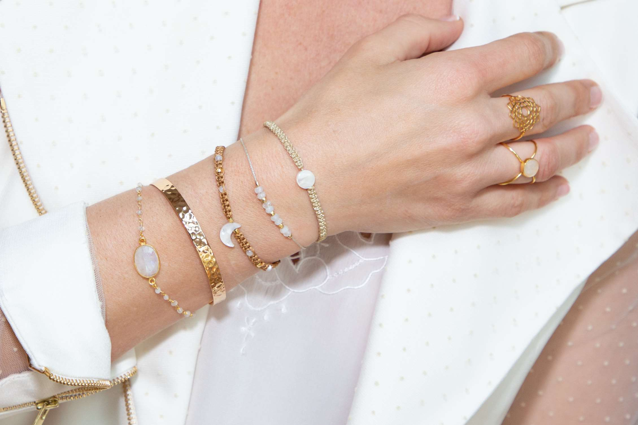
GLOBAL
LUXURY BRACELETS
MARKET REPORT
2024
Global,Regional,CountryAnalysis

Slide 2
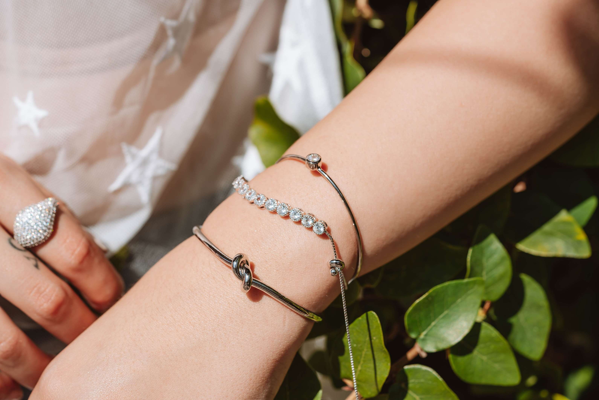
INTRODUCTION
The global luxury bracelets market refers to the industry involved in the design, production, and retail of high-end, prestigious wrist adornments, often crafted from premium materials and associated with luxury brands or exclusive craftsmanship. The increasing tendency towards luxurious goods, the growth and enlargement of the jewelry industry, and the rise in fashion jewelry are some of the factors in the luxury jewelry market. Increasing consumer preference for branded jewelry has further encouraged producers to encourage large-scale accessibility to different ranges of luxury jewelry in the market. The rise in television marketing and the use of ornaments create significant and profitable growth opportunities in the luxury jewelry market in the long run. These strategies help key players capture a significant market share and compete in the dynamic Luxury Bracelets market.

Slide 3
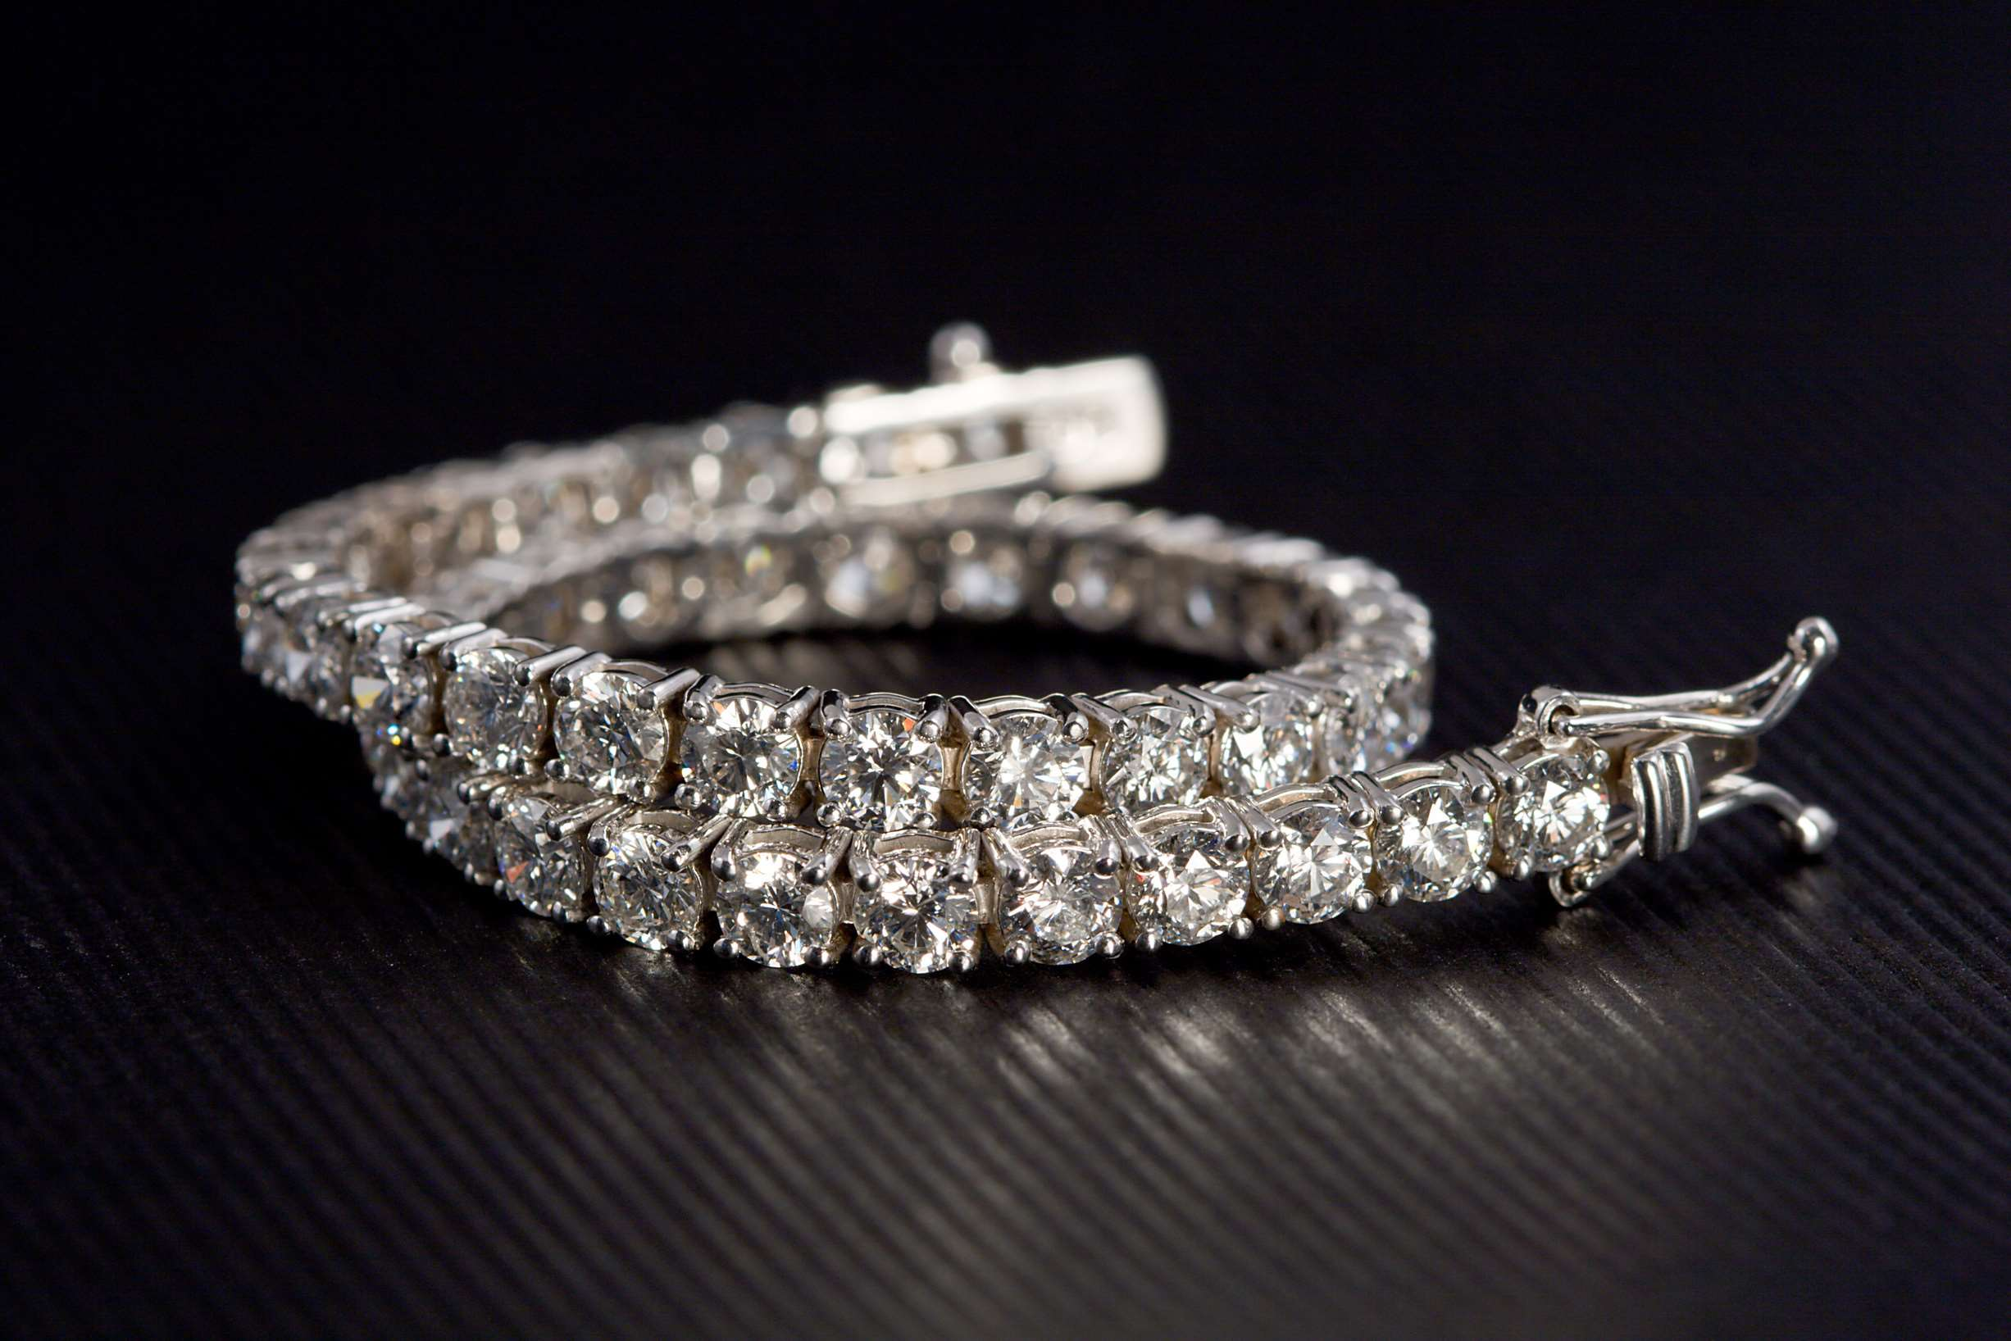

KEY INSIGHTS
CAGR
8.00%
2023- 2030

Slide 4
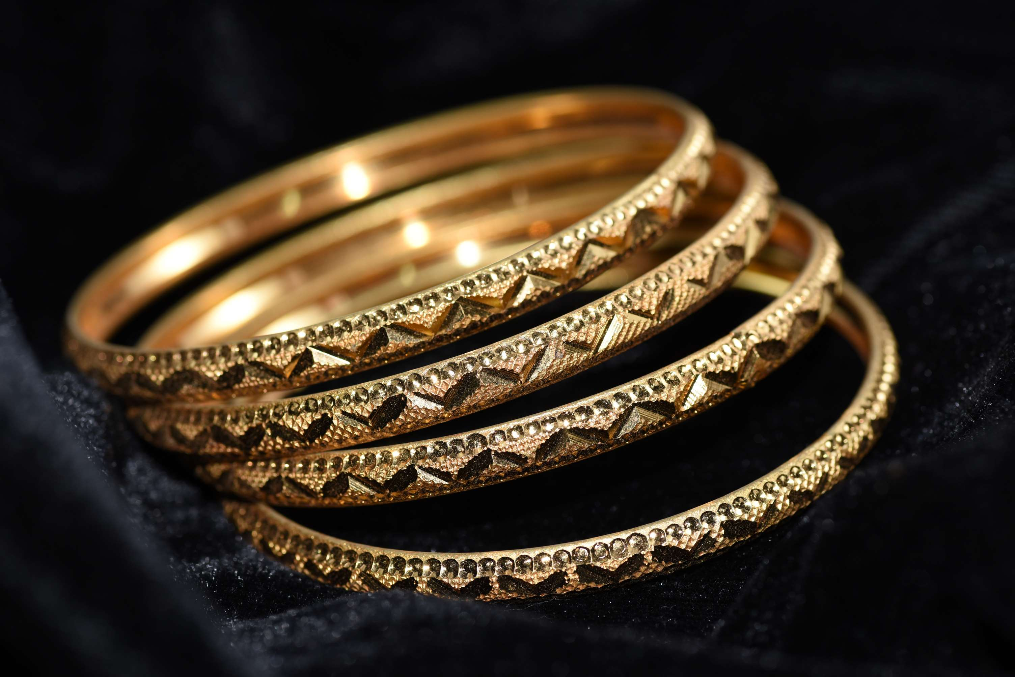
REVENUE MARKET SHARE BY SEGMENTS 2022
  Golden
  Silver
  Diamond
  Others
Product Type Segment
  Boutique
  Online Retailers
  Others
Application Segment

Slide 5

Global Luxury Bracelets Market Revenue share for 2024
North America
38%

Slide 6
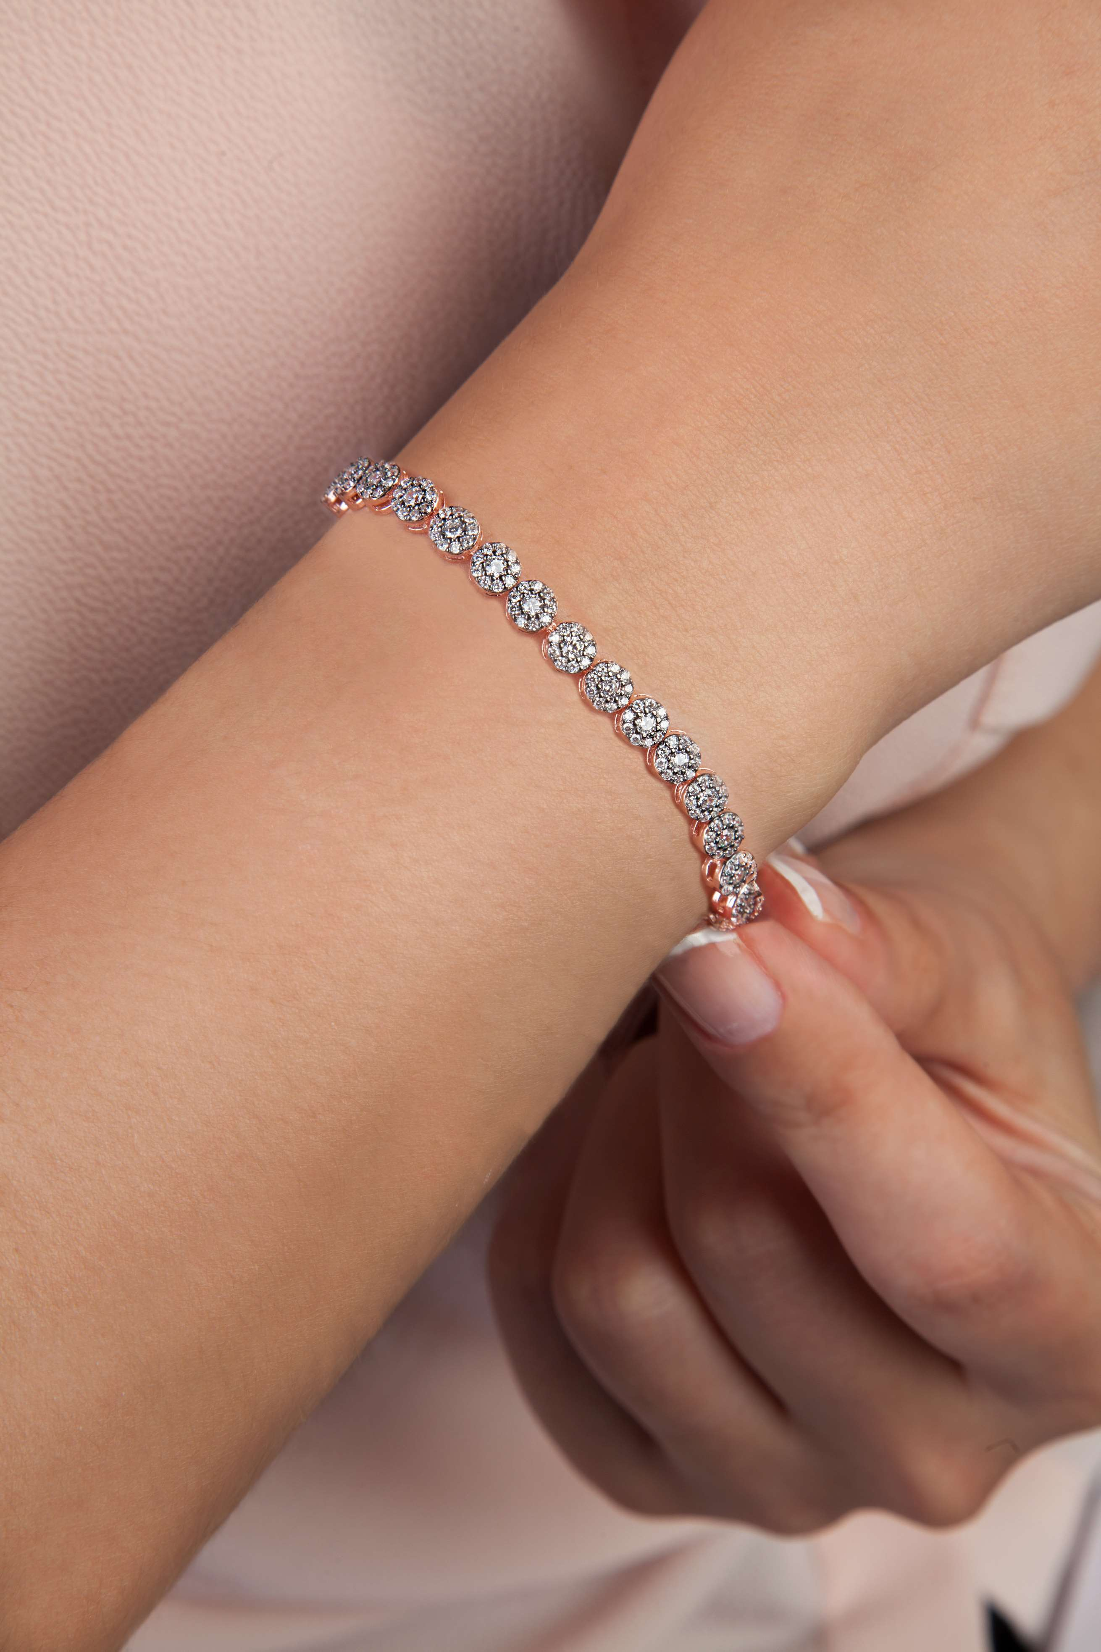
Increasing Modernization, Westernization to Propel Market Growth
Drivers
Expanding the Impact of Online Media to Restrict Market Growth
Restraints

Slide 7
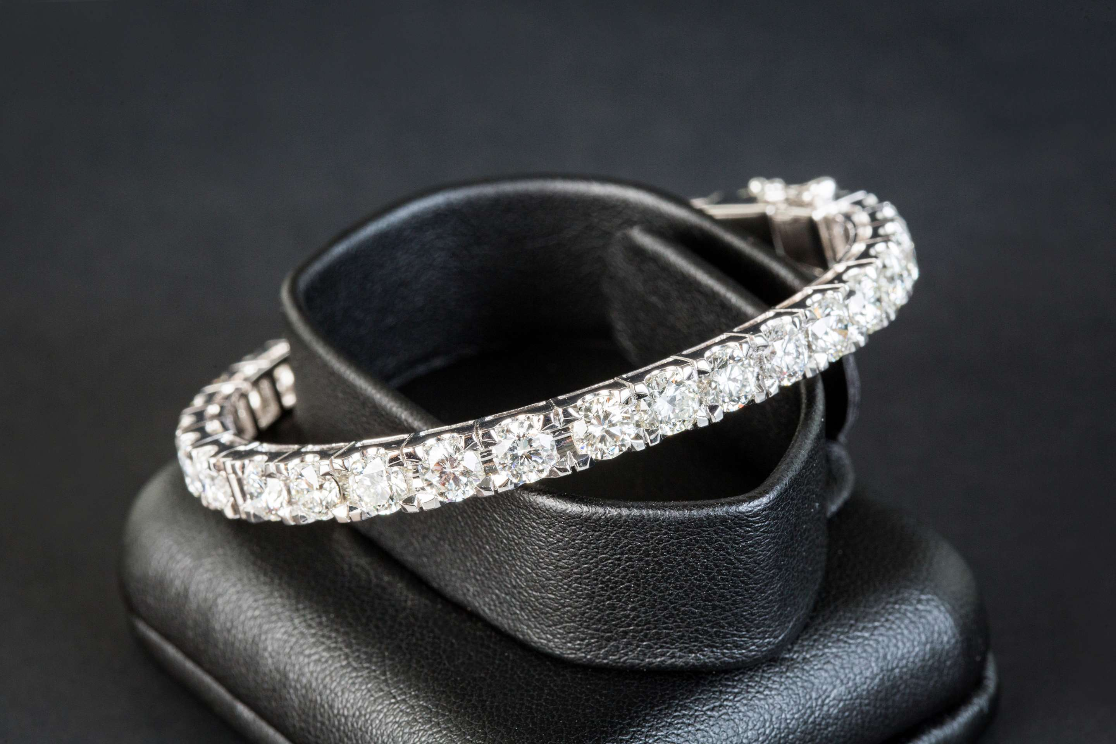
AUTHOR'S PERSPECTIVE
  The Global Luxury Bracelets Market is witnessing significant growth in the near future.
  Silver bracelets cater to individuals who appreciate modern and versatile designs without compromising on quality.
  The silver segment often includes contemporary styles, minimalist designs, and innovative craftsmanship, making it more accessible to a diverse range of consumers.
  Boutiques offer a personalized and immersive shopping experience, allowing customers to interact with the product physically and benefit from expert assistance.

Slide 8

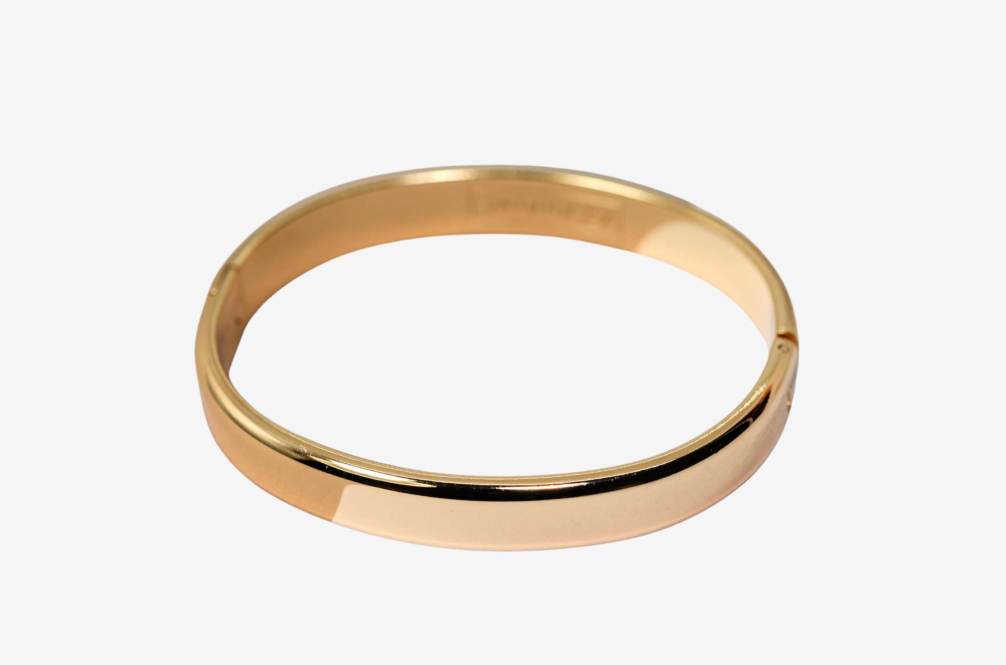








KEY PLAYERS

Slide 9


For Full Report
Contact us
COGNITIVE MARKET RESEARCH
Tel: +1 312-376-8303 | +44 020-8123-0732
India: (+91) 983-496-8611
sales@cognitivemarketresearch.com
Access the Full Report : https://tinyurl.com/4hd36s2u
Please visit our website:
https://www.cognitivemarketresearch.com

