Slide 1
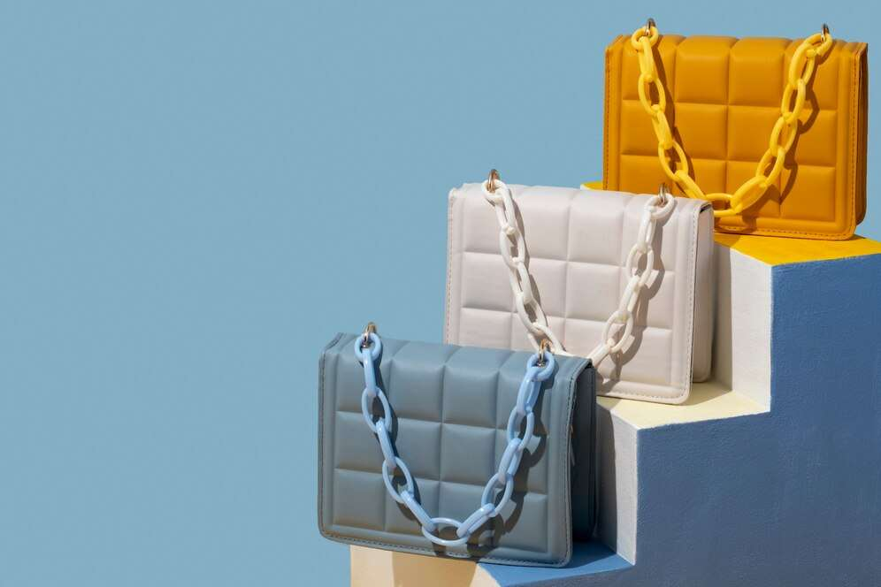

LUXURY BAG
MARKET REPORT
2024
Qualitative Analysis + Quantitative Analysis

Slide 2
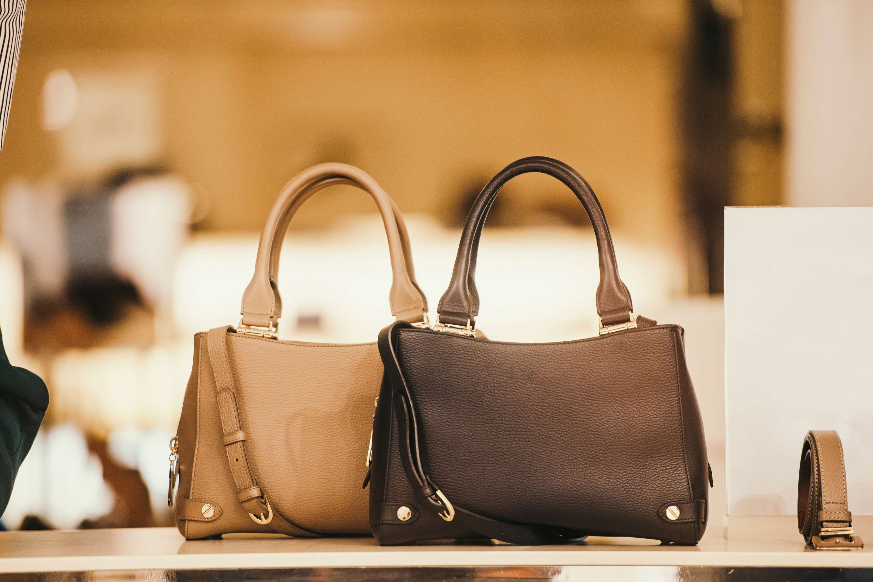
INTRODUCTION
Luxury bags epitomize exclusivity, craftsmanship, and status, embodying the pinnacle of fashion and sophistication. These meticulously crafted accessories are distinguished by premium materials such as fine leathers, exotic skins, and high-quality hardware. Renowned luxury brands meticulously design and produce each bag, often incorporating intricate detailing and iconic motifs. Luxury bags are not merely functional items but symbols of prestige and taste, coveted by discerning consumers worldwide. With timeless elegance and enduring appeal, they transcend trends, becoming timeless investments and heirloom pieces. The luxury bag market thrives on rarity, impeccable design, and the allure of owning a piece of fashion history.

Slide 3
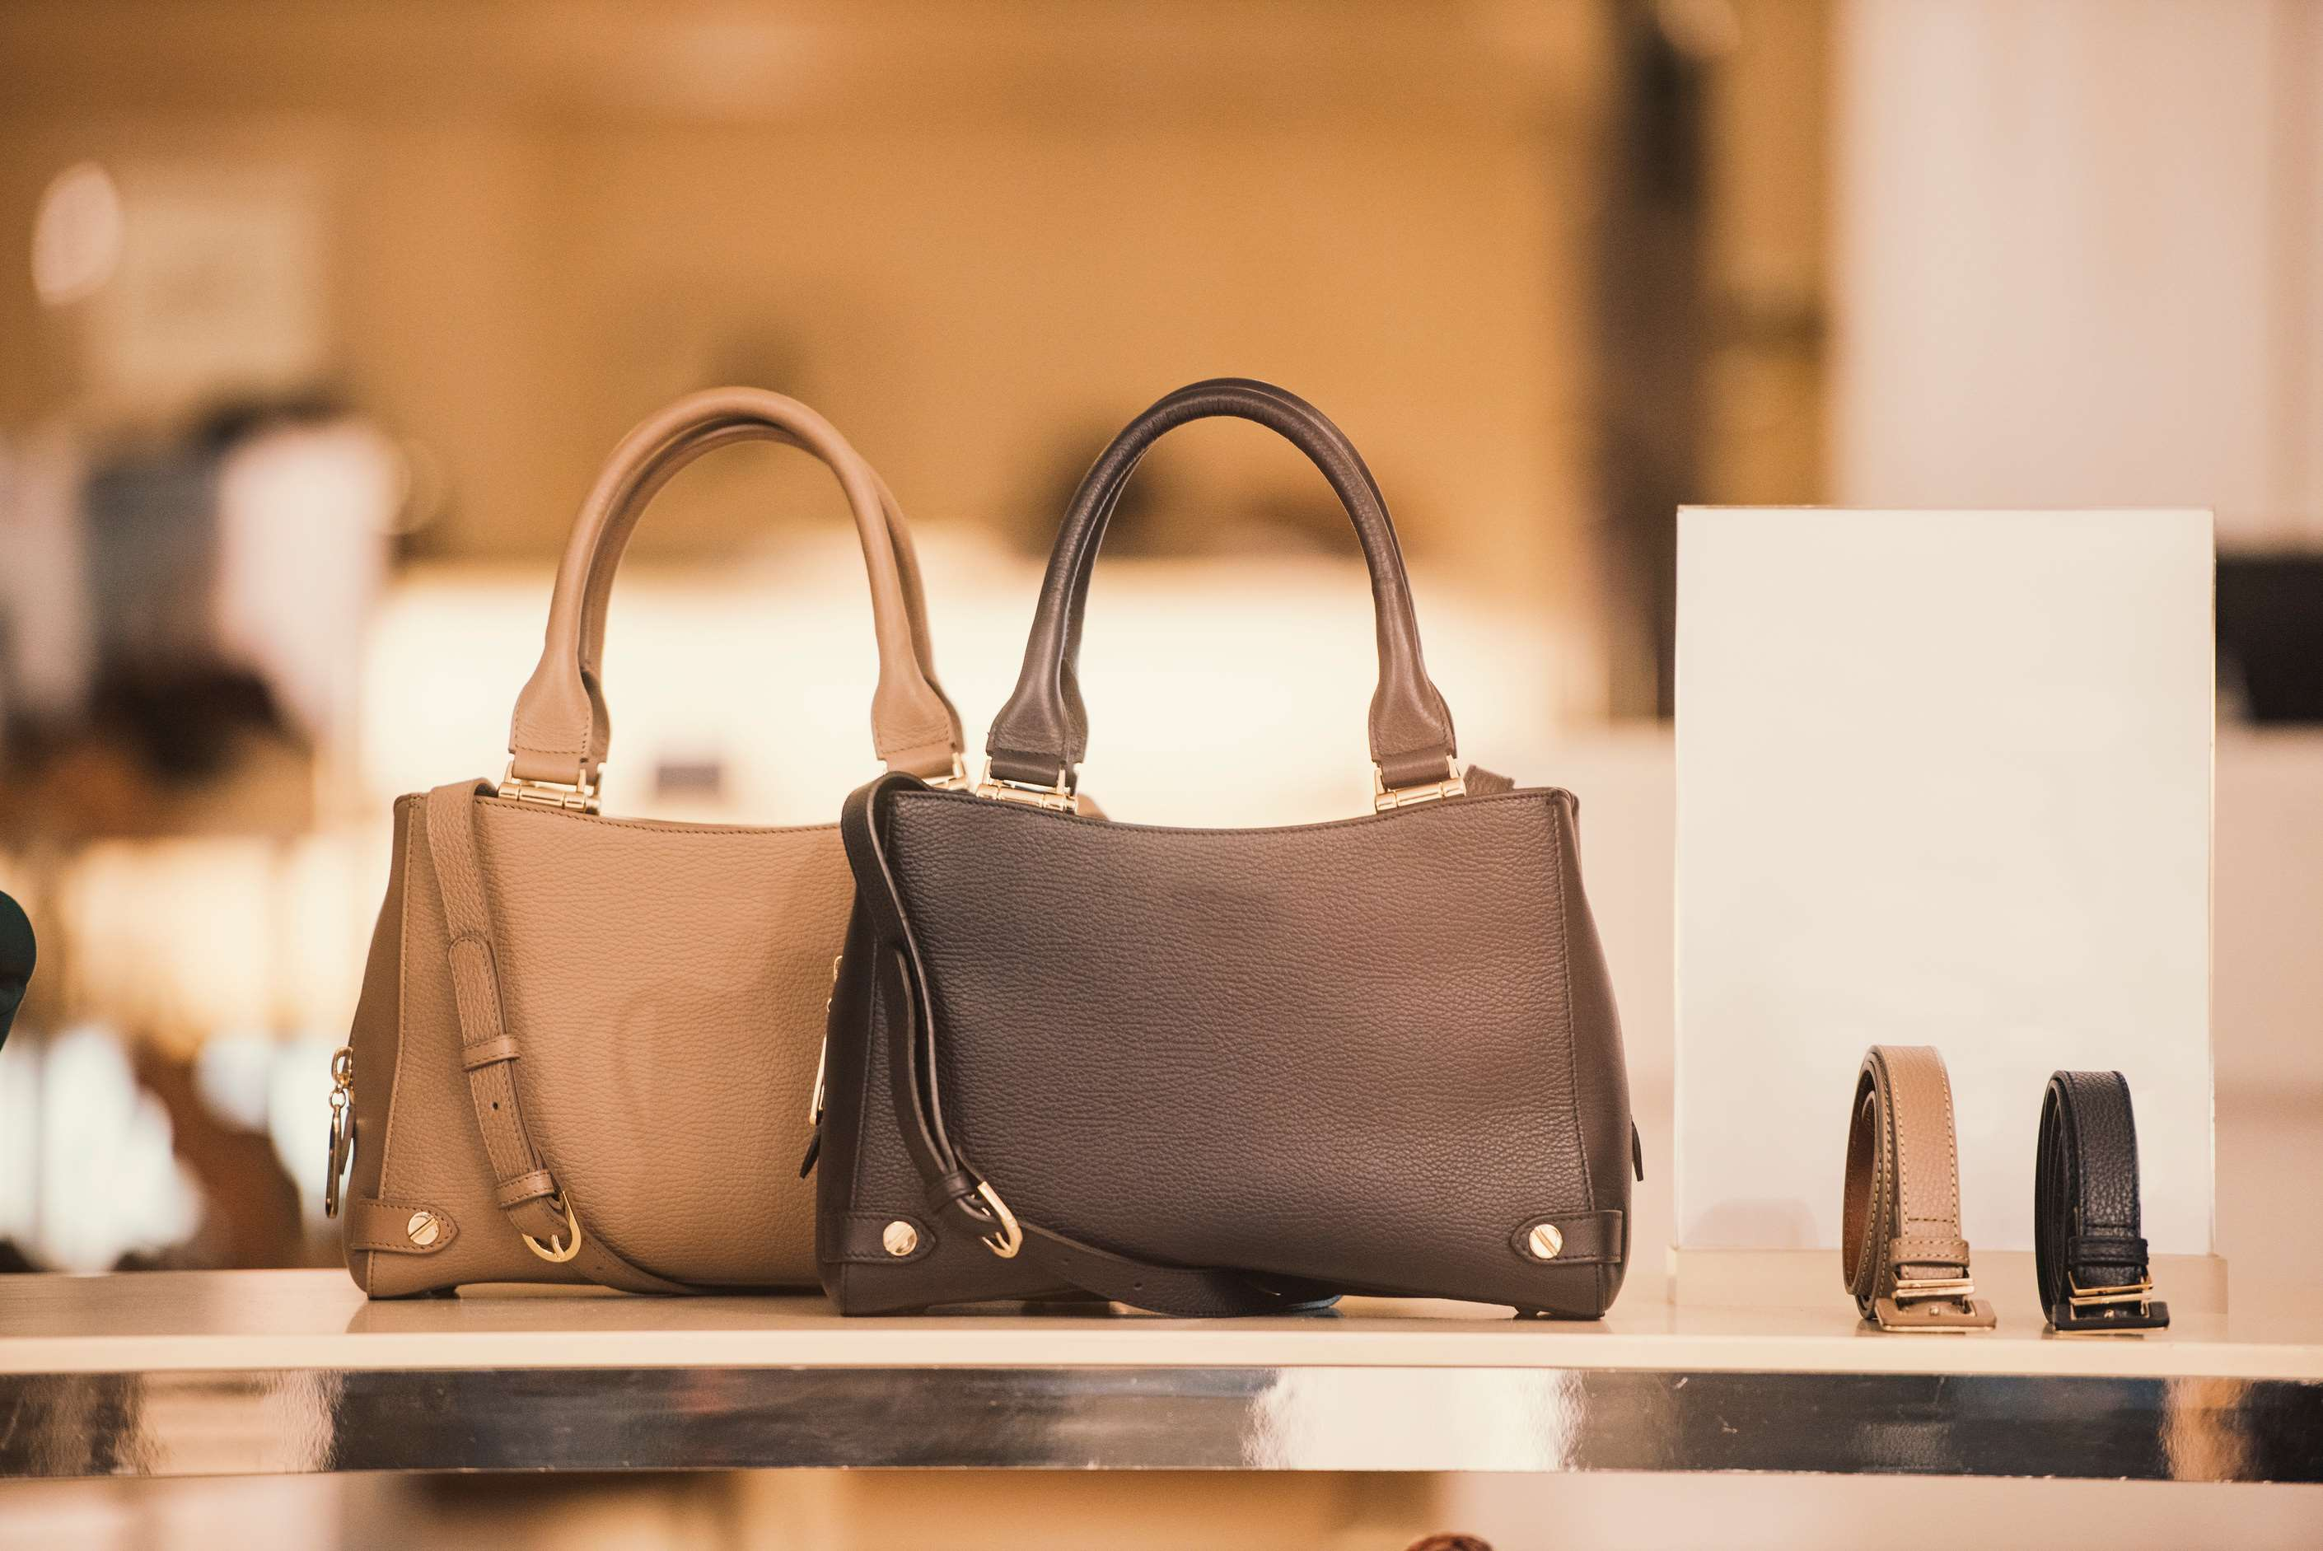

KEY INSIGHTS
MARKET SIZE
USD 23514.2 million
2024
CAGR
8.80%
2024- 2031

Slide 4

REVENUE MARKET SHARE BY SEGMENTS 2024
  Handbag
  Shoulder Bags
  Satchel Bags
  Tote Bags
  Hobo Bags
  Men Luxury Bag
  Women Luxury Bag
  Unisex Luxury Bag
End User Segment
Type Segment
  Leather Luxury Bag
  Nylon Luxury Bag
  Cotton Luxury Bag
  Synthetic Luxury Bag
  Duty Free Stores
  Online Stores
  Hypermarkets
  Specialty Stores
Material Type Segment
Distribution Channel

Slide 5

North America
40%
North America Luxury Bag
Market Revenue share for 2024 is 40%

Slide 6
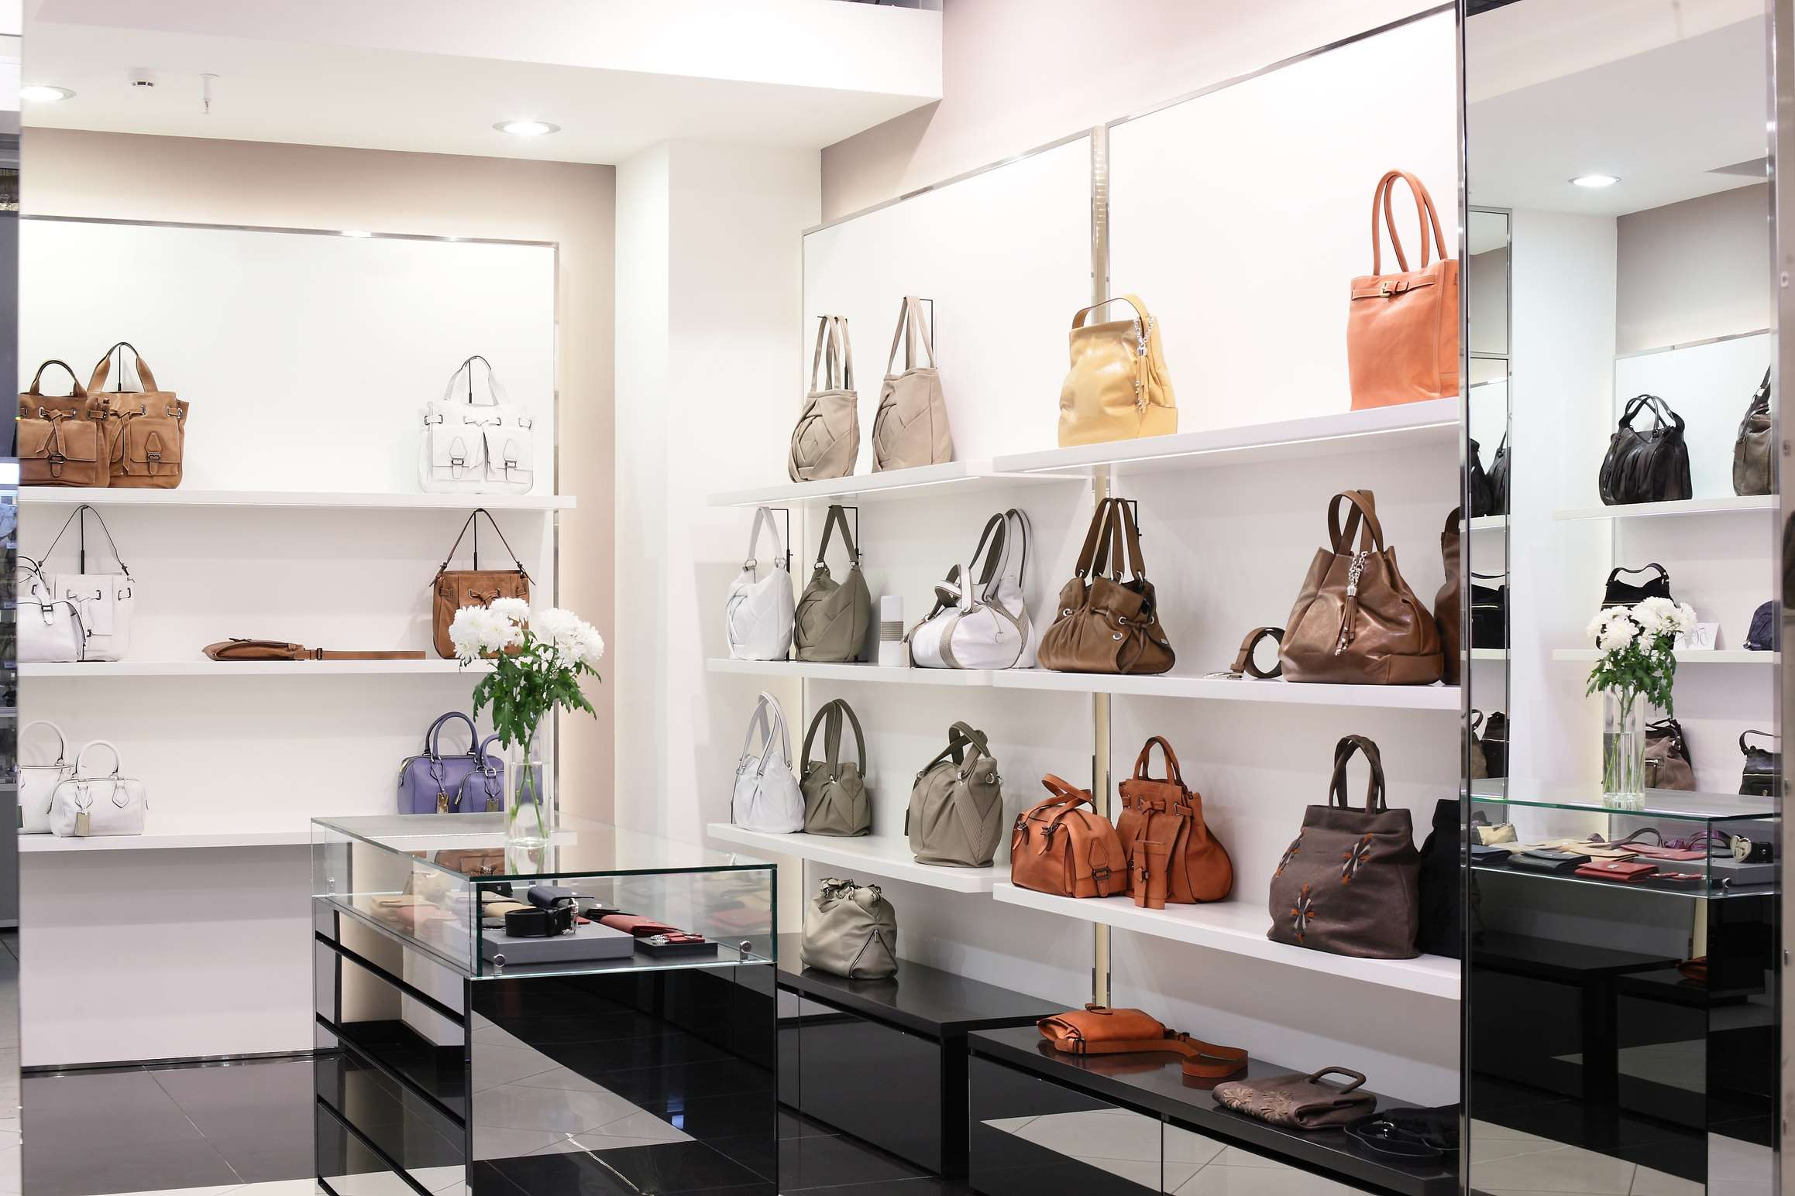
  Shifting Consumer Preferences Towards Evolving Fashion Trends to Increase Sales
  Growth of Online Retail to Propel the Market Growth
Drivers
Rampant Counterfeiting and Exclusivity of Luxury Brands to Limit the Sales
Restraints

Slide 7
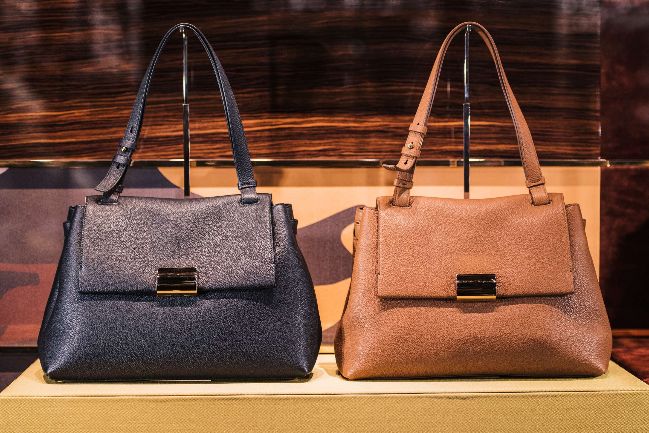
AUTHOR'S PERSPECTIVE
  The global luxury bag market will expand significantly by 8.80% CAGR between 2024 to 2031.
  The sales of handbags are poised to increase due to their timeless appeal, versatility, and status-symbol significance, coupled with evolving fashion trends and expanding consumer demographics embracing luxury accessories.
  The sales of leather luxury bags are expected to rise owing to their enduring quality, timeless elegance, and enduring appeal, attracting discerning consumers seeking premium craftsmanship and enduring sophistication.

Slide 8
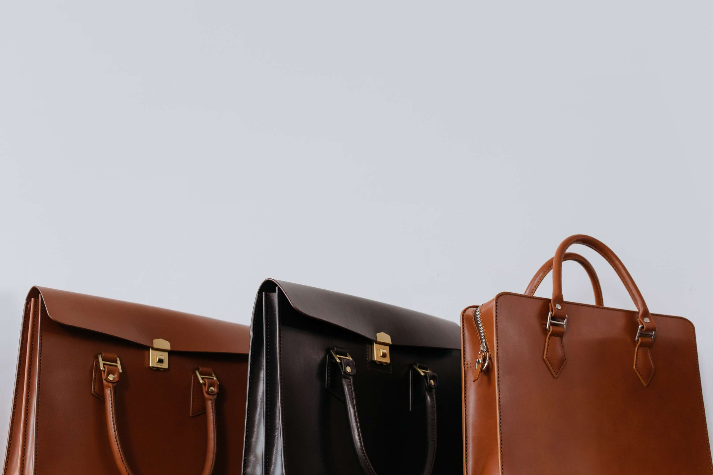








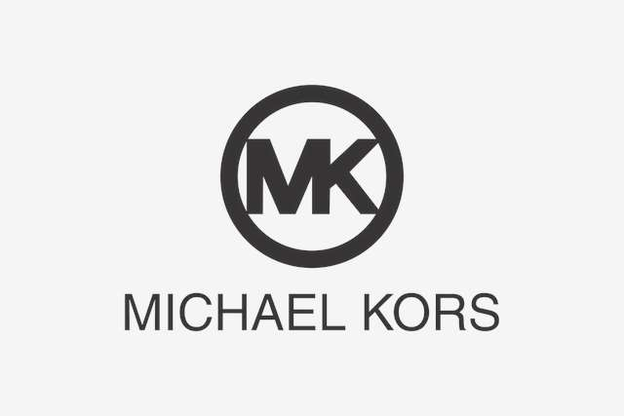
KEY PLAYERS

Slide 9


For Full Report
Contact us
COGNITIVE MARKET RESEARCH
Tel: +1 312-376-8303 | +44 020-8123-0732
India: (+91) 983-496-8611
sales@cognitivemarketresearch.com
Access the Full Report : https://tinyurl.com/52jfnka8
Please visit our website:
https://www.cognitivemarketresearch.com

