Slide 1
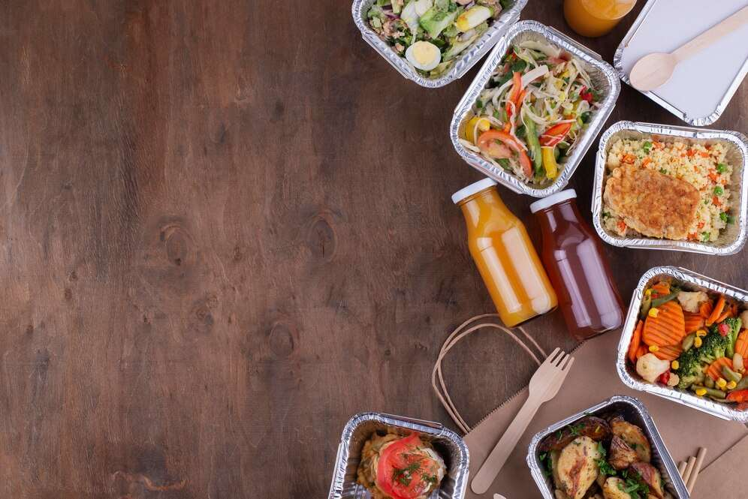
GLOBAL
LUNCH TAKEOUT
MARKET REPORT
2024
Global,Regional,CountryAnalysis

Slide 2
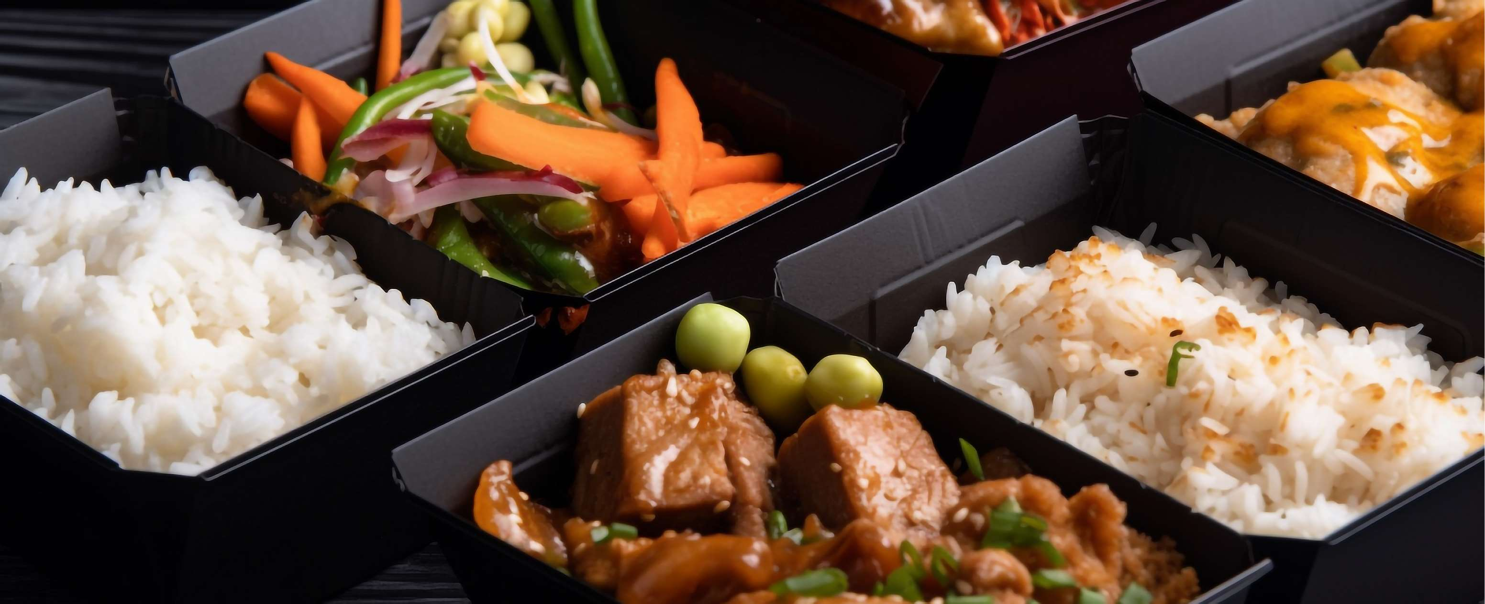
INTRODUCTION
The increasing value of convenience, the rise in busier lifestyles, the rise of mobile applications and online platforms for ordering food, shifting consumer preferences, modern work schedules and busier lifestyles, the rise in the variety of options and cuisines for consumers, rising marketing campaigns and promotions, growing concerns about safety and hygiene, innovations in technology and growing awareness of environmental issues are the major factors bolstering the growth of the lunch takeout market.

Slide 3
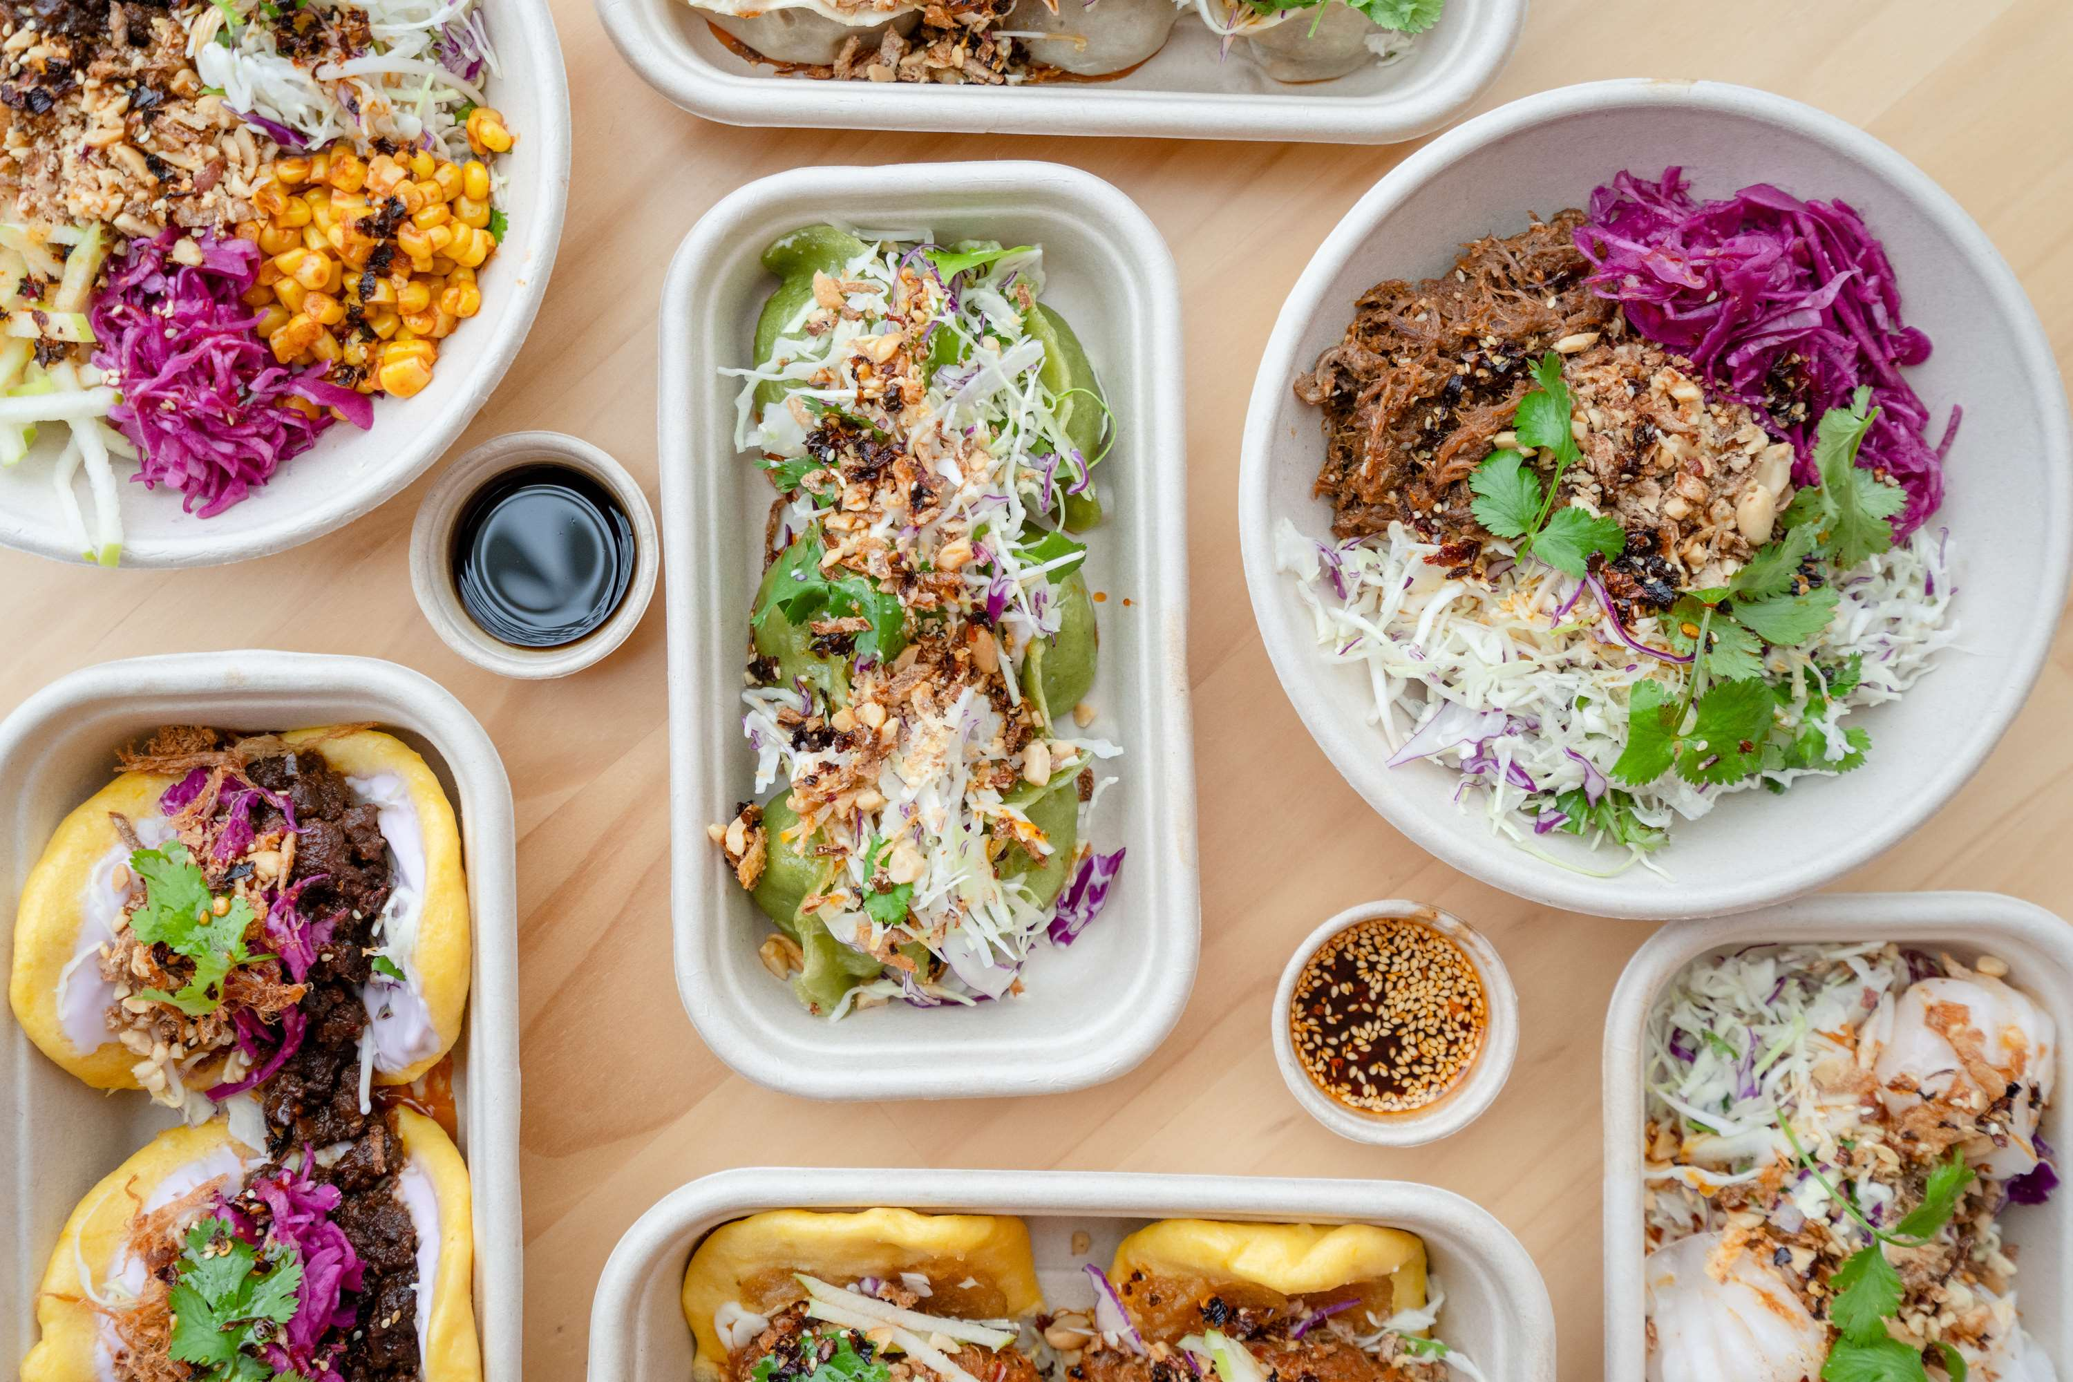

KEY INSIGHTS
MARKET SIZE
USD 216.8 billion
2023
CAGR
6.20%
2023- 2030

Slide 4
REVENUE MARKET SHARE BY SEGMENTS 2022
  Cash
  Debit Cards
  Credit Cards
  Digital Wallets
  Electronic Bank Transfers
Type Segment
  Vegetarian
  Non-Vegetarian
  Vegan
Nature Segment
  Quick Service Restaurant
  Full Serviced Restaurant
  Cafes & Bars
  Street Food
Application Segment
Purchase Model Segment
  Direct-to-Customer
  Platform-to-Customer
  Chinese Cuisine
  Indian Cuisine
  Japanese Cuisine
  Italian Cuisine
  Mediterranean Cuisine
  Mexican Cuisine
  Turkish Cuisine
Product Type Segment

Slide 5

Global Lunch Takeout Market Revenue share for 2024
North America
40%

Slide 6
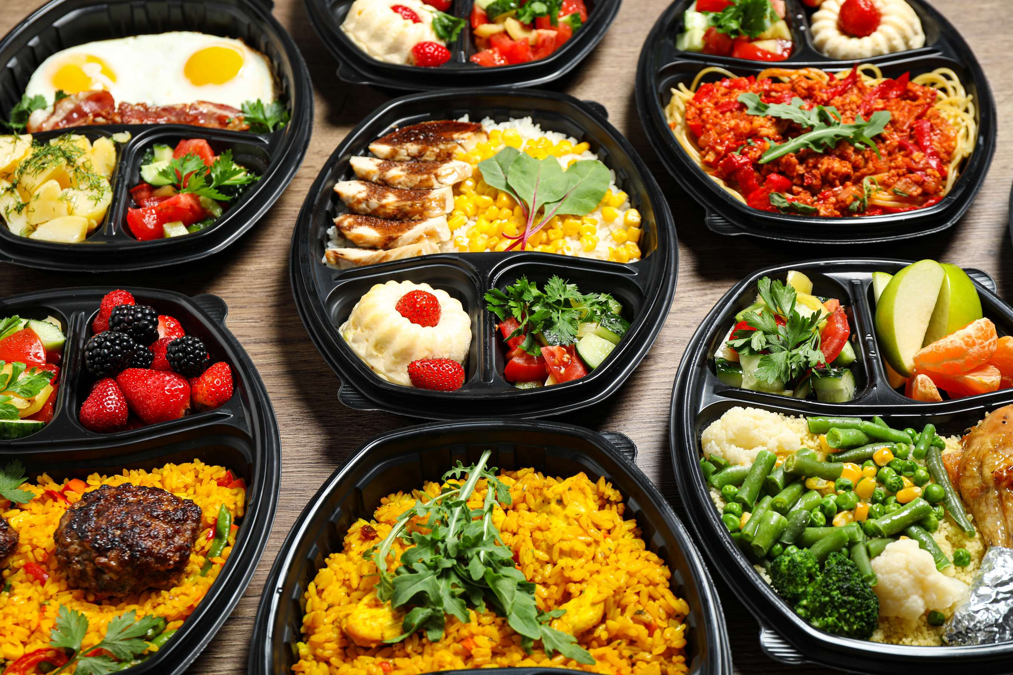
Recent Digital Advancements to Propel Market Growth
Drivers
Difficulty in Maintaining Quality Standards to Restrict Market Growth
Restraints

Slide 7

AUTHOR'S PERSPECTIVE
  Debit cards allow customers to make transactions securely and efficiently without needing physical currency.
  Characterized by savory flavors, diverse dishes, and iconic items such as noodles and dim sum, its popularity stems from its widespread appeal and versatility in catering to various tastes.
  Indian cuisine is the fastest-growing category over the forecast period. It is known for its rich and aromatic spices and offers a vibrant array of dishes, including curries, biryanis, and tandoori specialties.
  The fastest-growing category over the forecast period is non-vegetarian, which includes consumers who eat meat, poultry, and seafood.
  The platform-to-customer is the fastest-growing category over the forecast period.

Slide 8









KEY PLAYERS

Slide 9


For Full Report
Contact us
COGNITIVE MARKET RESEARCH
Tel: +1 312-376-8303 | +44 020-8123-0732
India: (+91) 983-496-8611
sales@cognitivemarketresearch.com
Access the Full Report : https://tinyurl.com/69j33u48
Please visit our website:
https://www.cognitivemarketresearch.com

