Slide 1
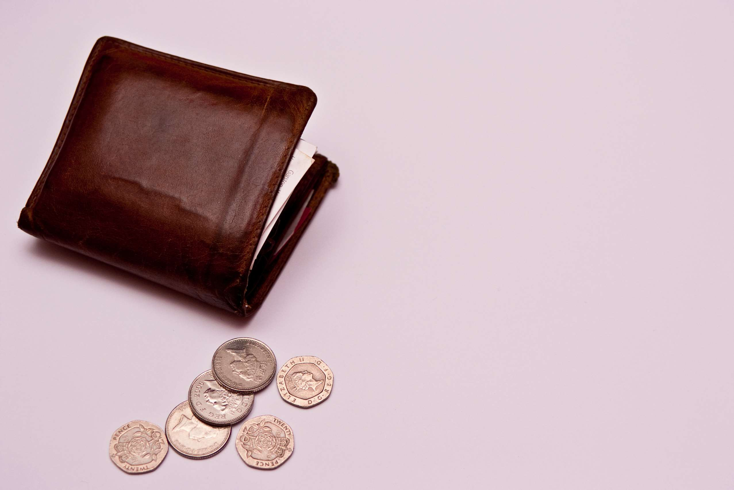
GLOBAL
LEATHER WALLET
MARKET REPORT
2024
Global,Regional,CountryAnalysis

Slide 2
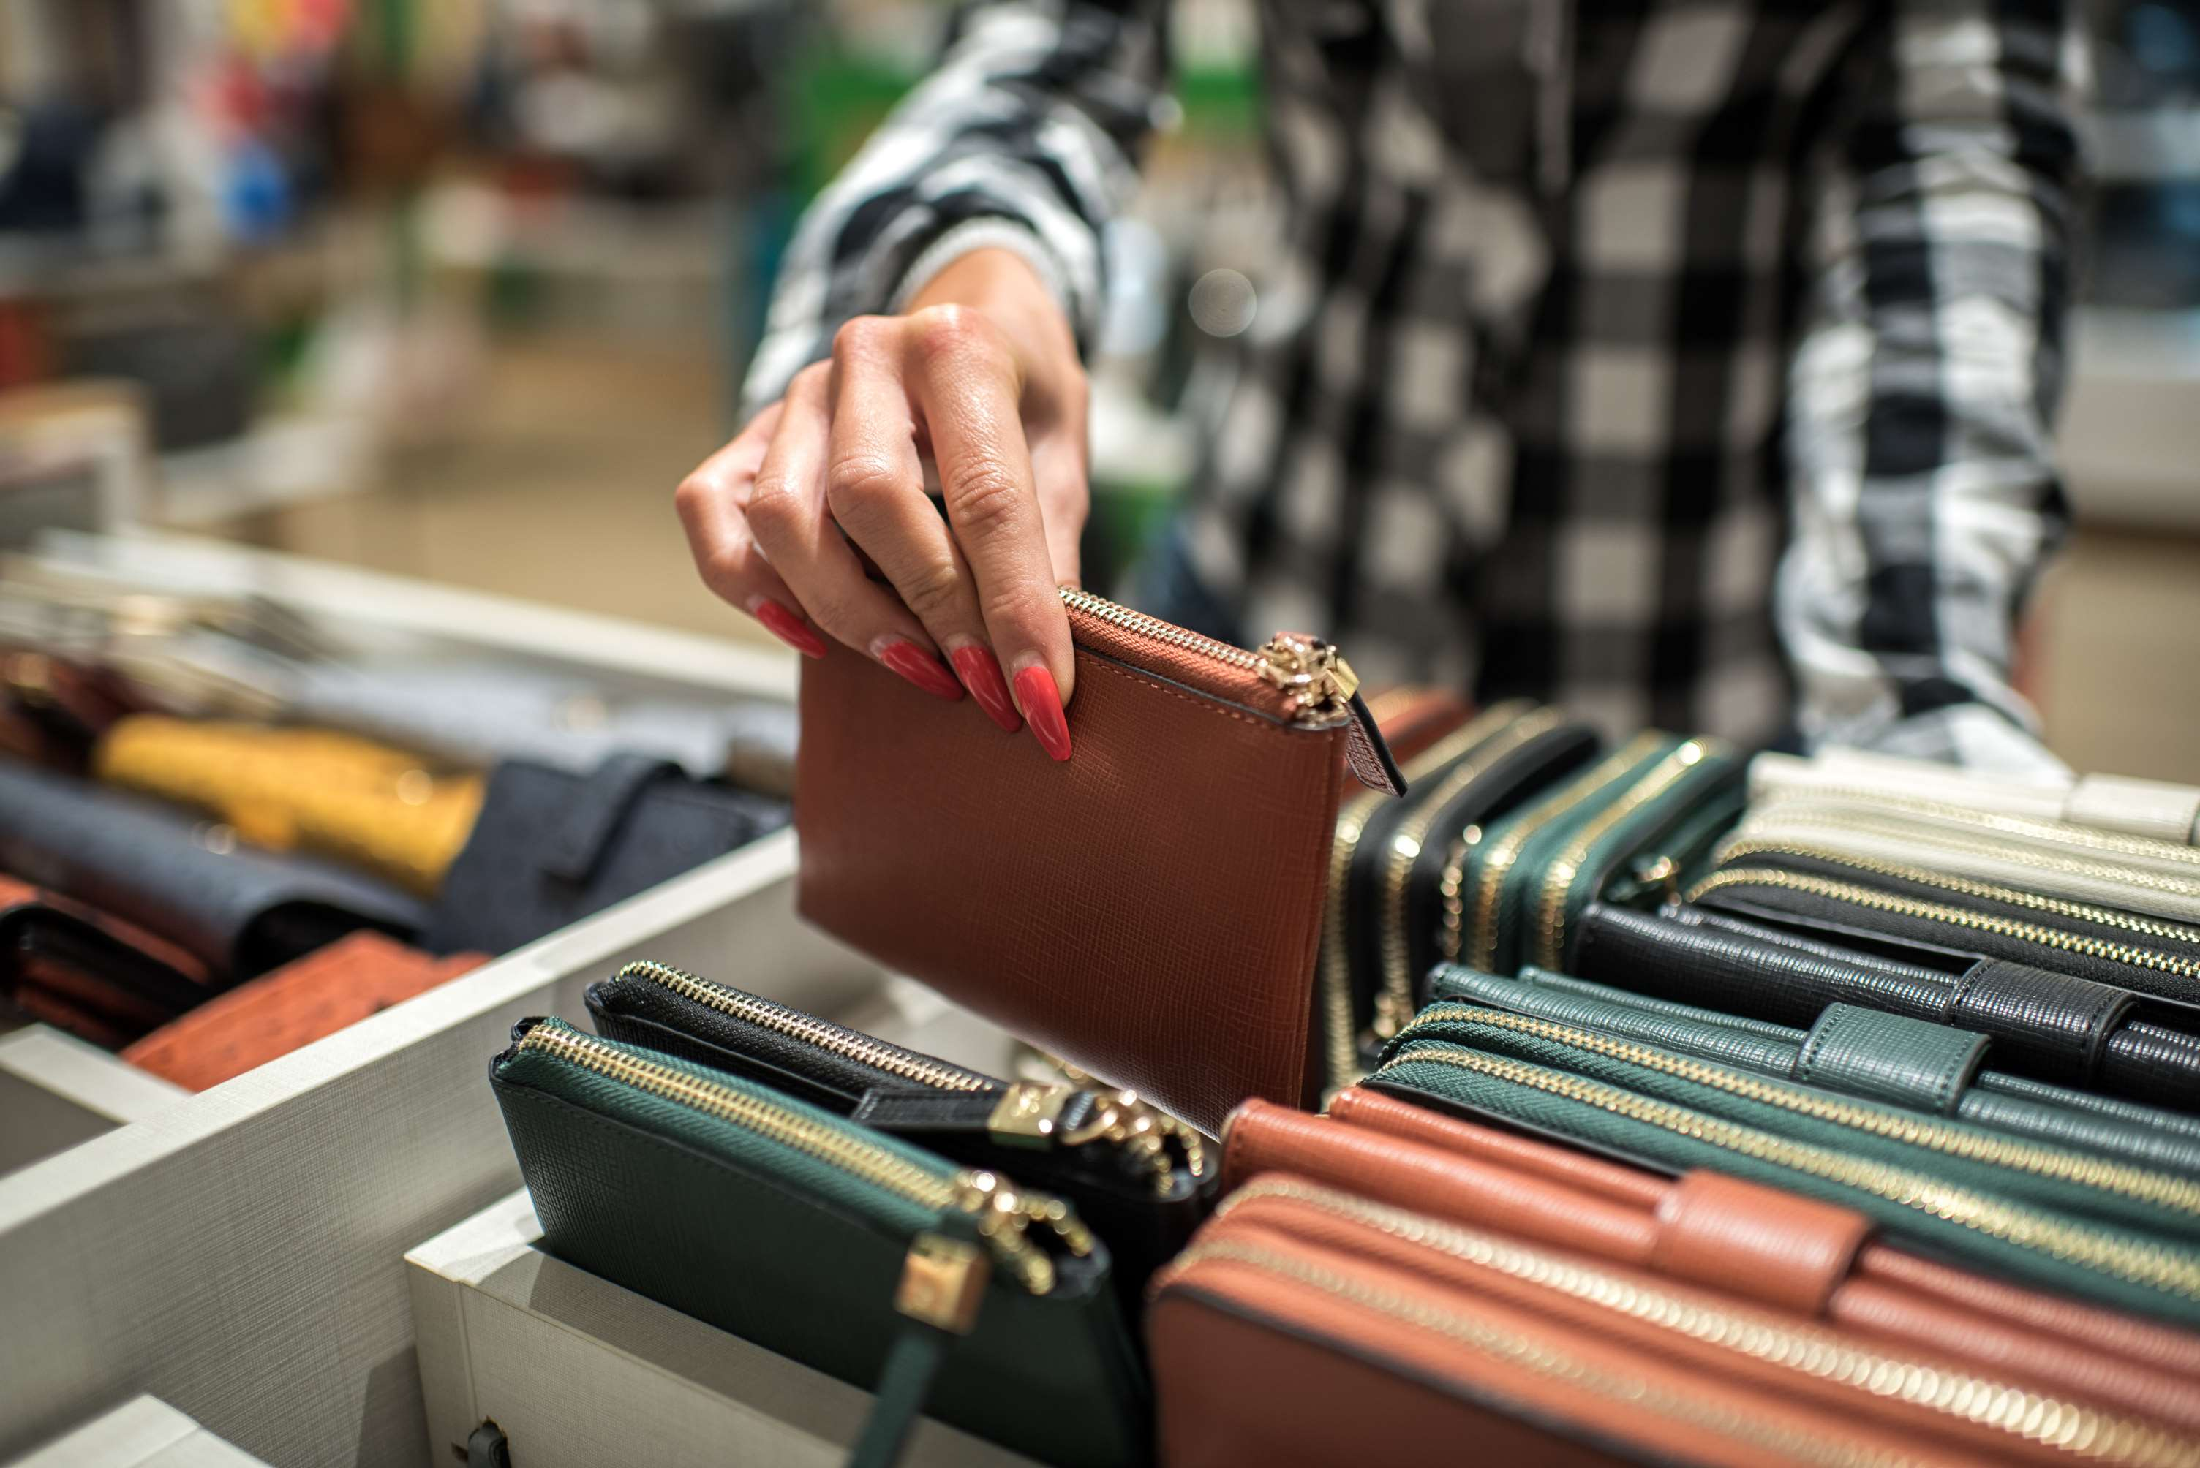
INTRODUCTION
A leather wallet functions as a small, flat container for storing personal items, money, credit cards, and identification papers like a driver's license. They are the perfect accessory for everyday use because they come in a variety of patterns and designs. The market is driven by the expanding fashion trend, as well as the increasing acceptance of leather wallets in the corporate population worldwide. Leather wallets have grown increasingly popular as a fashion statement, particularly among millennials. Furthermore, increased demand for leather wallets among the younger generation is expected to give abundant chances for market growth throughout the forecast period. In addition, increased demand for leather wallets among working women internationally is expected to generate a number of opportunities for market advancement.

Slide 3
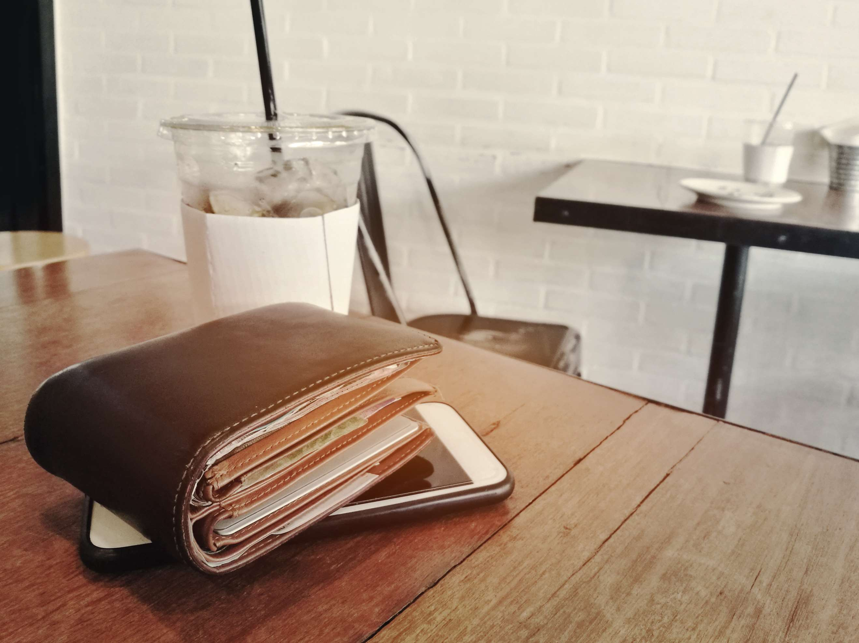

KEY INSIGHTS
CAGR
9.50%
2023- 2030

Slide 4
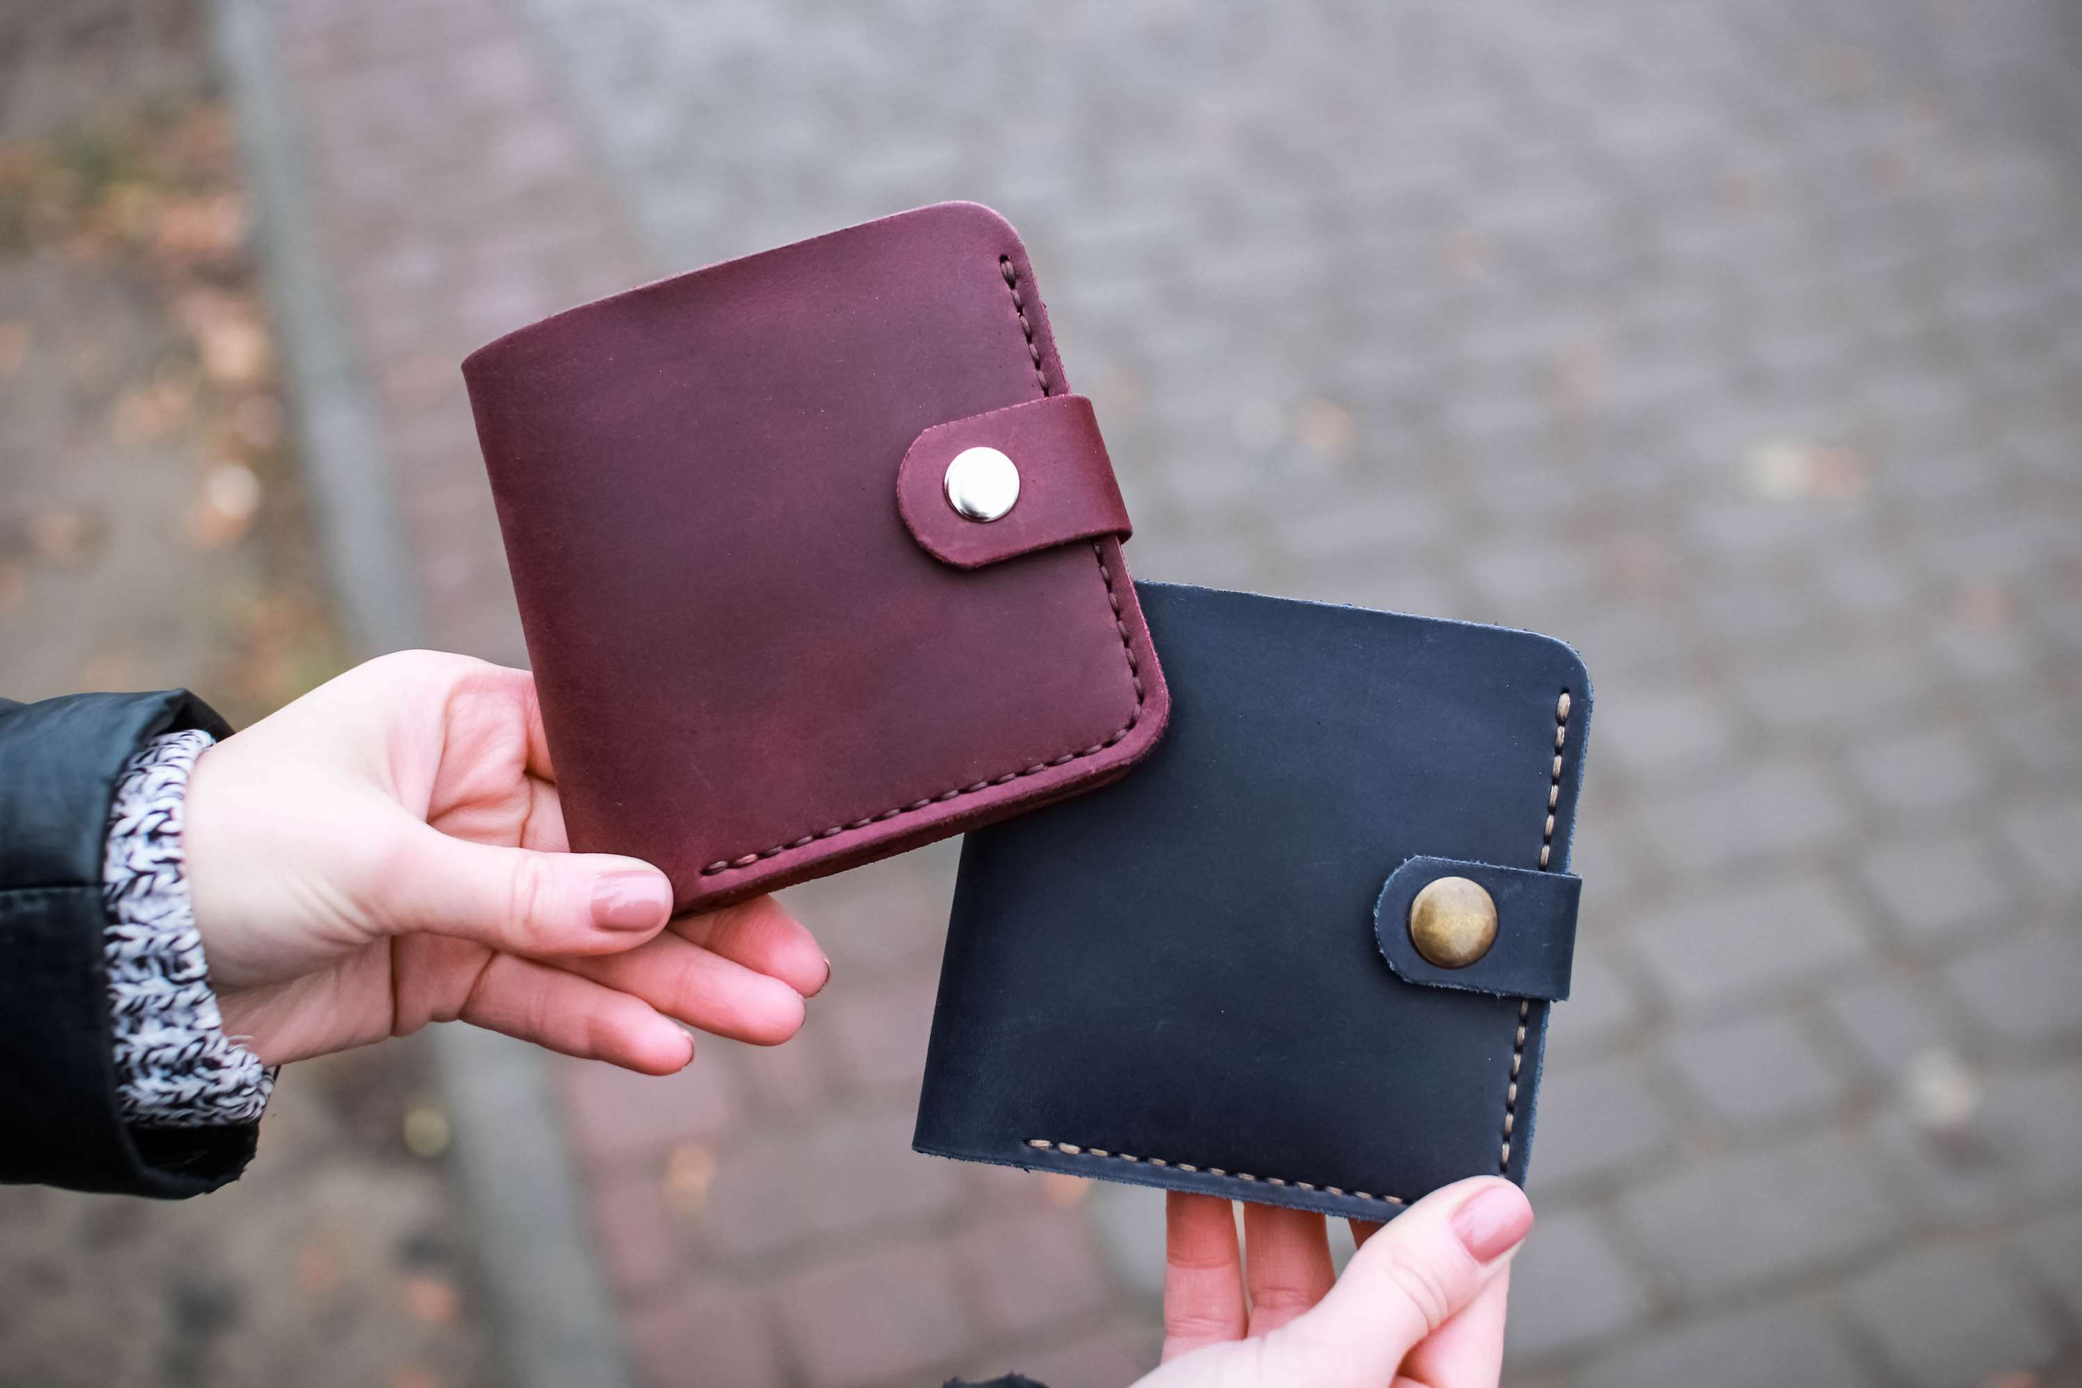
REVENUE MARKET SHARE BY SEGMENTS 2022
  Bifold Wallets
  Trifold Wallets
Type Segment
  Slim Wallets
  Billfolds
  Clutch Wallets
  Long Wallets
  Coin Wallets
Product Type Segment
  Men
  Women
Application Segment

Slide 5

Global Leather Wallet Market Revenue share for 2024
North America

Slide 6
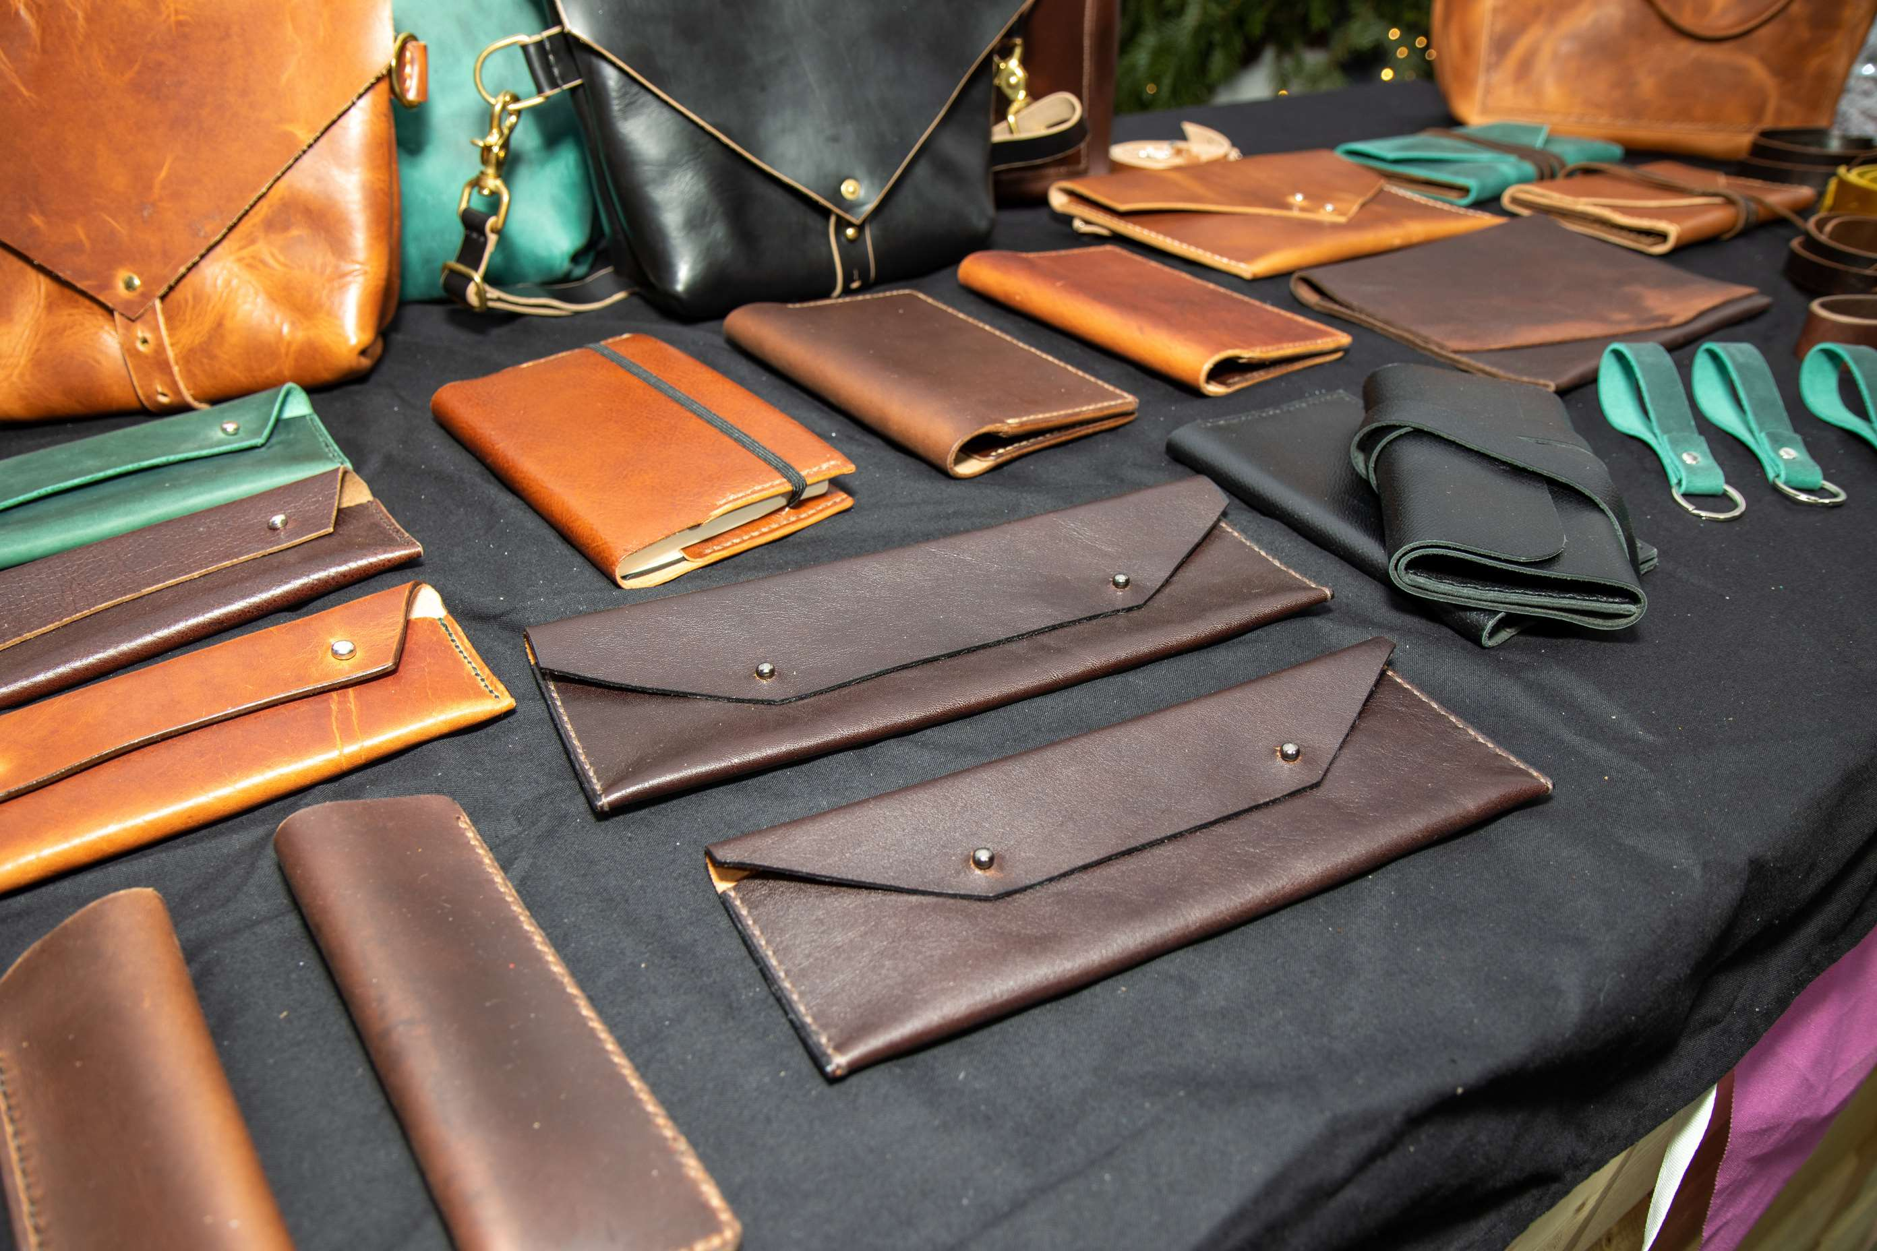
Rising Urbanization and the Minimalism Trend are Main Factors Driving Growth
Drivers
Rising Competition Between Key Players Could Restrain Market Growth
Restraints

Slide 7
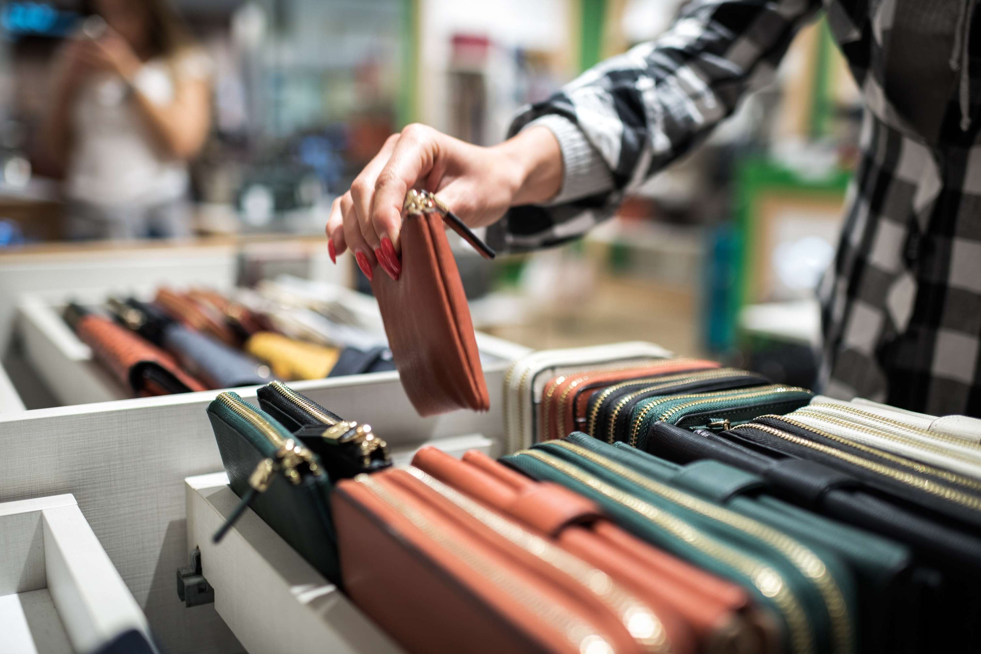
AUTHOR'S PERSPECTIVE
  The Global Leather Wallet Market is witnessing significant growth in the near future.
  A bill compartment, many card slots, and occasionally even additional pockets for money or other necessities can all be found in trifold wallets.
  The rising demand for leather wallets among working women professionals and the expanding appeal of these items among women, in general, are two important factors impacting the market's growth.
  Clutch wallets also sometimes feature extra pockets for things like ID cards, receipts, and a checkbook, as well as multiple card slots, a zippered change pocket, bill compartments, and bill compartments.
  Customers visiting these businesses have a wide range of brands to choose from before making a purchase.

Slide 8
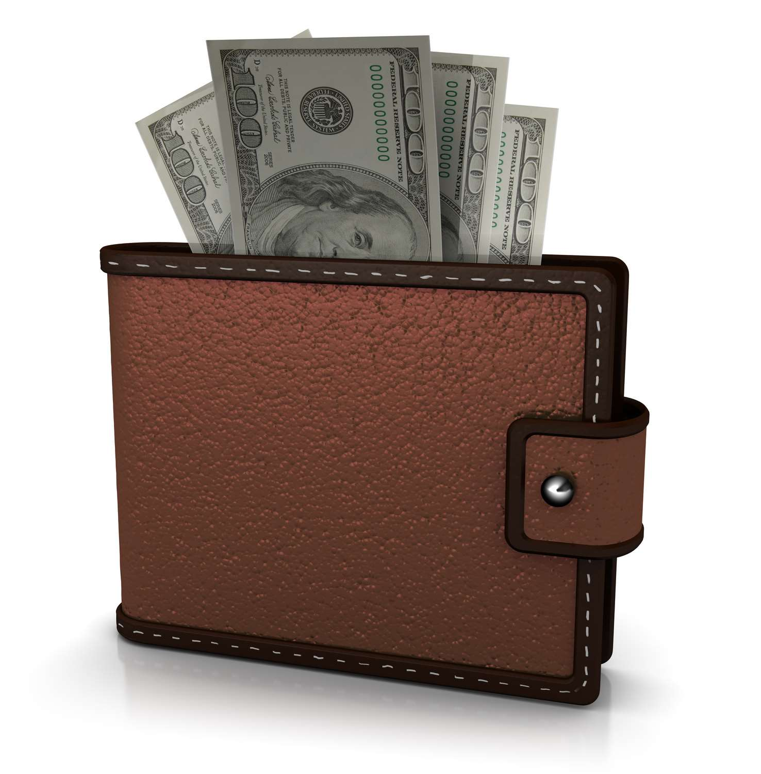









KEY PLAYERS

Slide 9


For Full Report
Contact us
COGNITIVE MARKET RESEARCH
Tel: +1 312-376-8303 | +44 020-8123-0732
India: (+91) 983-496-8611
sales@cognitivemarketresearch.com
Access the Full Report : https://tinyurl.com/4rr8544j
Please visit our website:
https://www.cognitivemarketresearch.com

