Slide 1

GLOBAL
LEGO CLASS BLOCKS
MARKET REPORT
2024
Global,Regional,CountryAnalysis

Slide 2

INTRODUCTION
Technology integration in education is a key driver for the lego class blocks market, as these blocks align seamlessly with STEM initiatives, providing a hands-on approach to learning technical concepts and enhancing educational value. The lego class blocks market is propelled by a rising awareness of early childhood development, as parents and educators acknowledge the crucial role of constructive play in fostering cognitive and motor skills. Lego class blocks, with their tactile nature and emphasis on creativity, play an instrumental role in this developmental process. As awareness grows regarding the long-term benefits of such play in early childhood, there is a corresponding increase in the demand for Lego Class Blocks as a favored educational toy contributing to the holistic development of young minds.

Slide 3


KEY INSIGHTS
CAGR
5.10%
2023- 2030

Slide 4

REVENUE MARKET SHARE BY SEGMENTS 2022
  Entertainment
  Education
  Children
  Adults
Type Segment
End User Segment
  Home
  Commercial
  Therapeutic
  Plastic
  Wood
  Metal
Application Segment
Material User Segment

Slide 5

Global LEGO Class Blocks Market Revenue share for 2024
North America

Slide 6

Pivotal Role of Lego Class Blocks in Nurturing Cognitive and Motor Skills in Young Learners to Drive Market Expansion
Drivers
Supply Chain Disruptions and Budget Constraints Impacting Markets
Restraints

Slide 7

AUTHOR'S PERSPECTIVE
  The Global LEGO Class Blocks Market is witnessing significant growth in the near future.
  The versatility of Lego Class Blocks in promoting creativity and cognitive abilities positions them as essential tools in educational settings, driving sustained demand within this category.
  The appeal of Lego Class Blocks for home use is driven by their versatility, fostering creativity and skill development in an informal learning environment.
  Lego sets featuring intricate designs contribute significantly to the expanding market, showcasing the enduring appeal of Lego Class Blocks across diverse age groups.
  Wood stands out as the fastest-growing category in the lego class blocks market, gaining traction for its eco-friendly and sustainable characteristics.

Slide 8

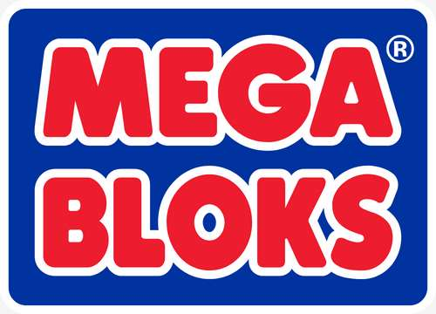


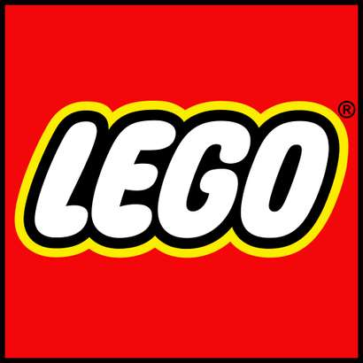
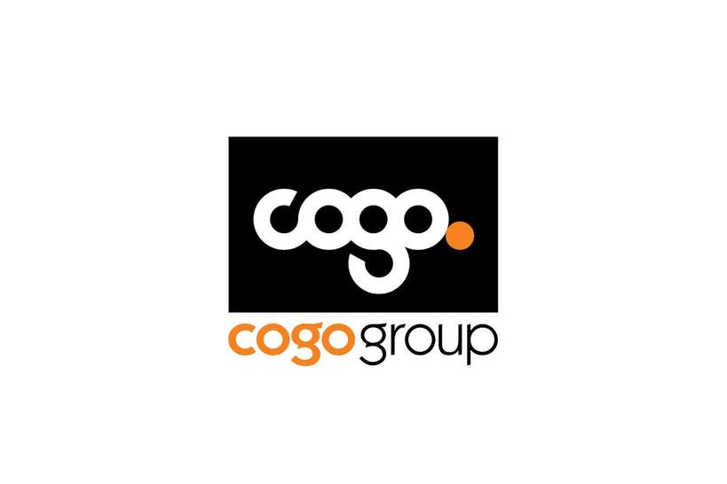

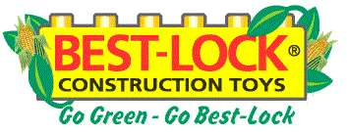
KEY PLAYERS

Slide 9


For Full Report
Contact us
COGNITIVE MARKET RESEARCH
Tel: +1 312-376-8303 | +44 020-8123-0732
India: (+91) 983-496-8611
sales@cognitivemarketresearch.com
Access the Full Report : https://tinyurl.com/442c2znt
Please visit our website:
https://www.cognitivemarketresearch.com

