Slide 1

GLOBAL
LED SURGICAL HEADLIGHTS
MARKET REPORT 2024
Global,Regional,CountryAnalysis

Slide 2

INTRODUCTION
Surgical headlights, also known as portable headlamps, are a form of equipment used by doctors and surgeons during surgical procedures. Some surgical headlights have a battery pack to power the light bulb, while others are powered by a fibre optic cable.

Slide 3


KEY INSIGHTS
FORECAST
$2,015.74 Million
2028
2023-
2030
CAGR
6.64%

Slide 4

REVENUE MARKET SHARE BY SEGMENTS 2022
Wireless LED Surgical Headlight
USD 1,334.73 Million
End-User Segment
Hospitals
USD 1,350.48 Million
Application analysis
Neurosurgery
USD 47.50 Million

Slide 5

GLOBAL LED SURGICAL HEADLIGHTS MARKET REVENUE SHARE FOR 2022
North America
USD 657.94 Million

Slide 6

Rise in number of surgical procedures coupled with increase in cancer cases across the globe
Drivers
High cost of LED surgical headlights
Restraints

Slide 7
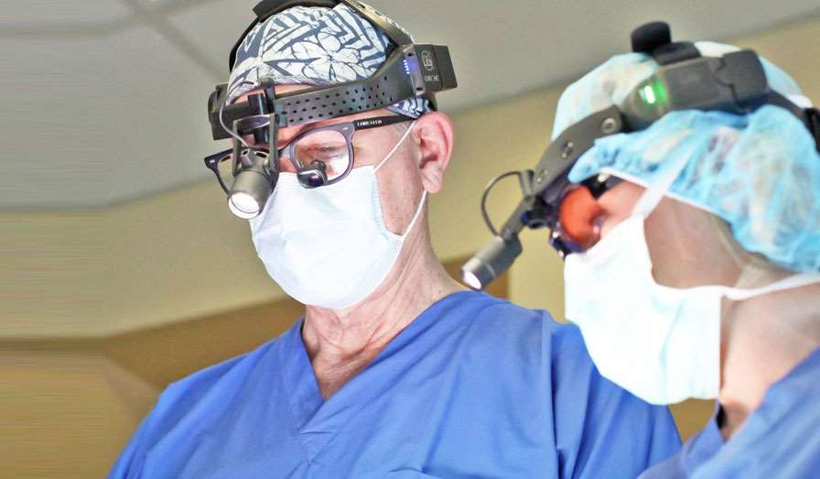
AUTHOR'S PERSPECTIVE
  The Global LED Surgical Headlights Market revenue in 2017: USD 1,014.37 Million
  Wireless LED Surgical Headlight held for largest share of total revenue generated in 2020
  Reconstructive Plastic Surgery held maximum share of LED Surgical Headlights market in 2020
  Hospitals held maximum share of LED Surgical Headlights market in 2020
  Rise in number of surgical procedures coupled with increase in cancer cases across the globe is driving the growth of market
  High cost of LED surgical headlights acts as a major restraint for the growth of the LED surgical headlights market
  Scope for technological advancements coupled with the rise in adoption of LED surgical headlights is expected to serve as a lucrative opportunity in the forecast period for the ley players operating in the market

Slide 8









KEY PLAYERS

Slide 9


For Full Report
Contact us
COGNITIVE MARKET RESEARCH
Tel: +1 312-376-8303 | +44 020-8123-0732
India: (+91) 983-496-8611
sales@cognitivemarketresearch.com
Access the Full Report : https://tinyurl.com/4tw8h9dr
Please visit our website:
https://www.cognitivemarketresearch.com

