Slide 1
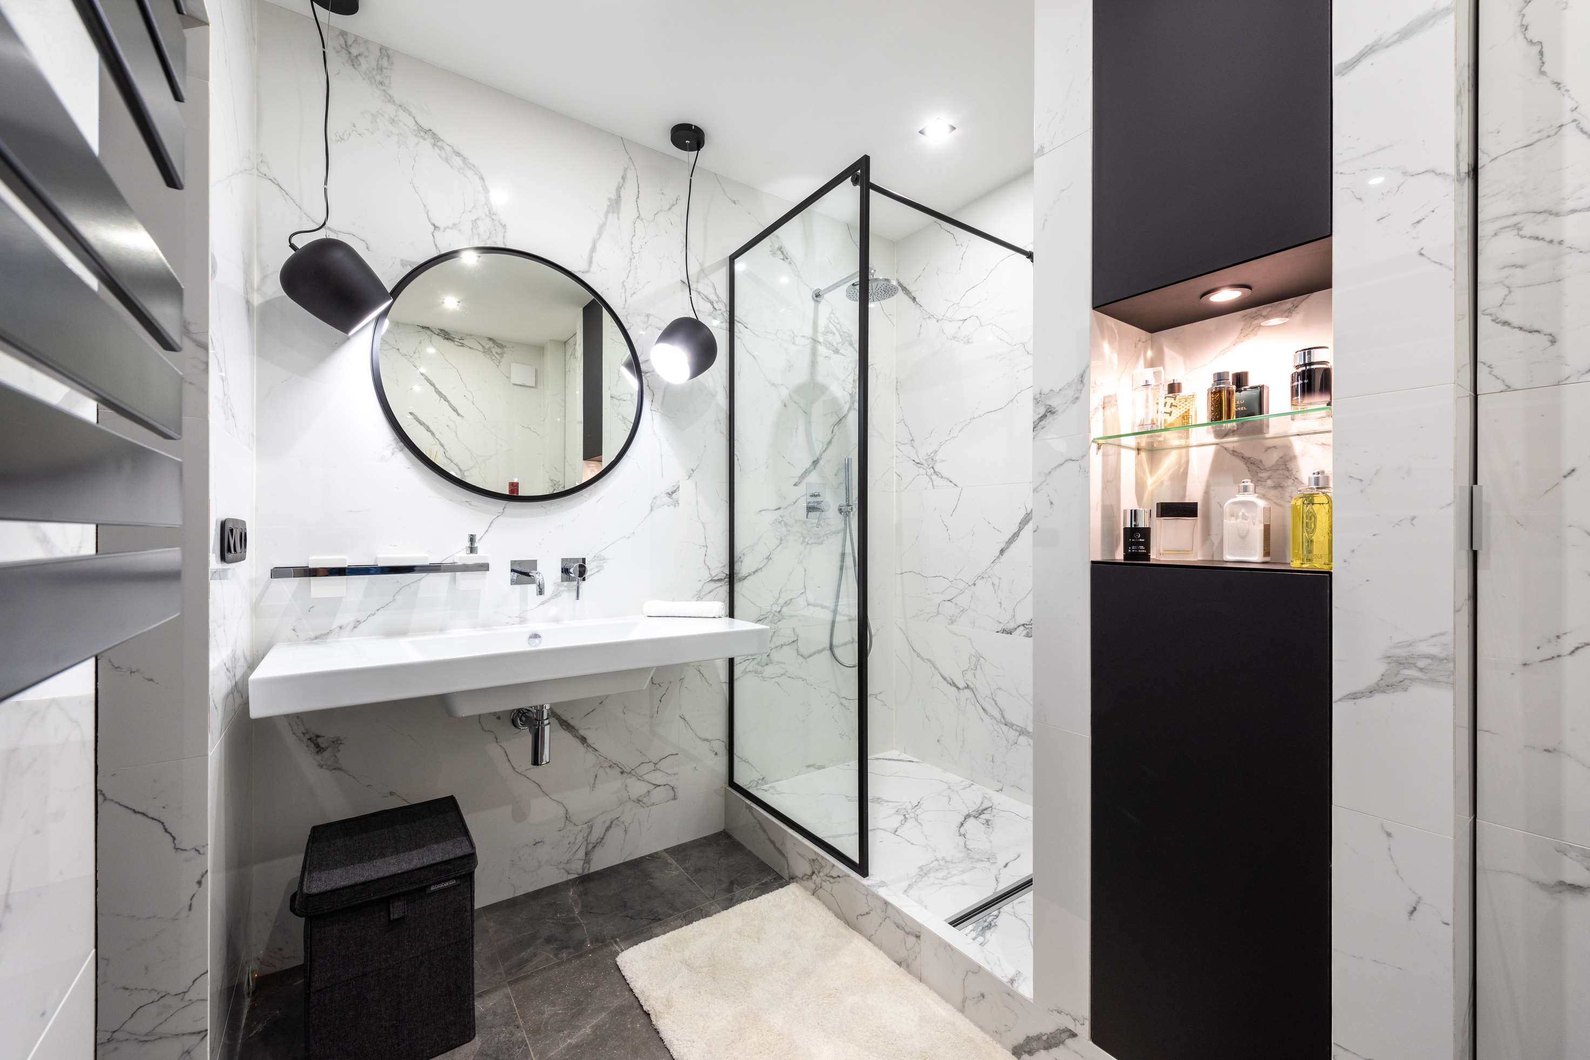
Global
LED Bathroom Mirrors
Market Report
2024
Global,Regional,CountryAnalysis

Slide 2
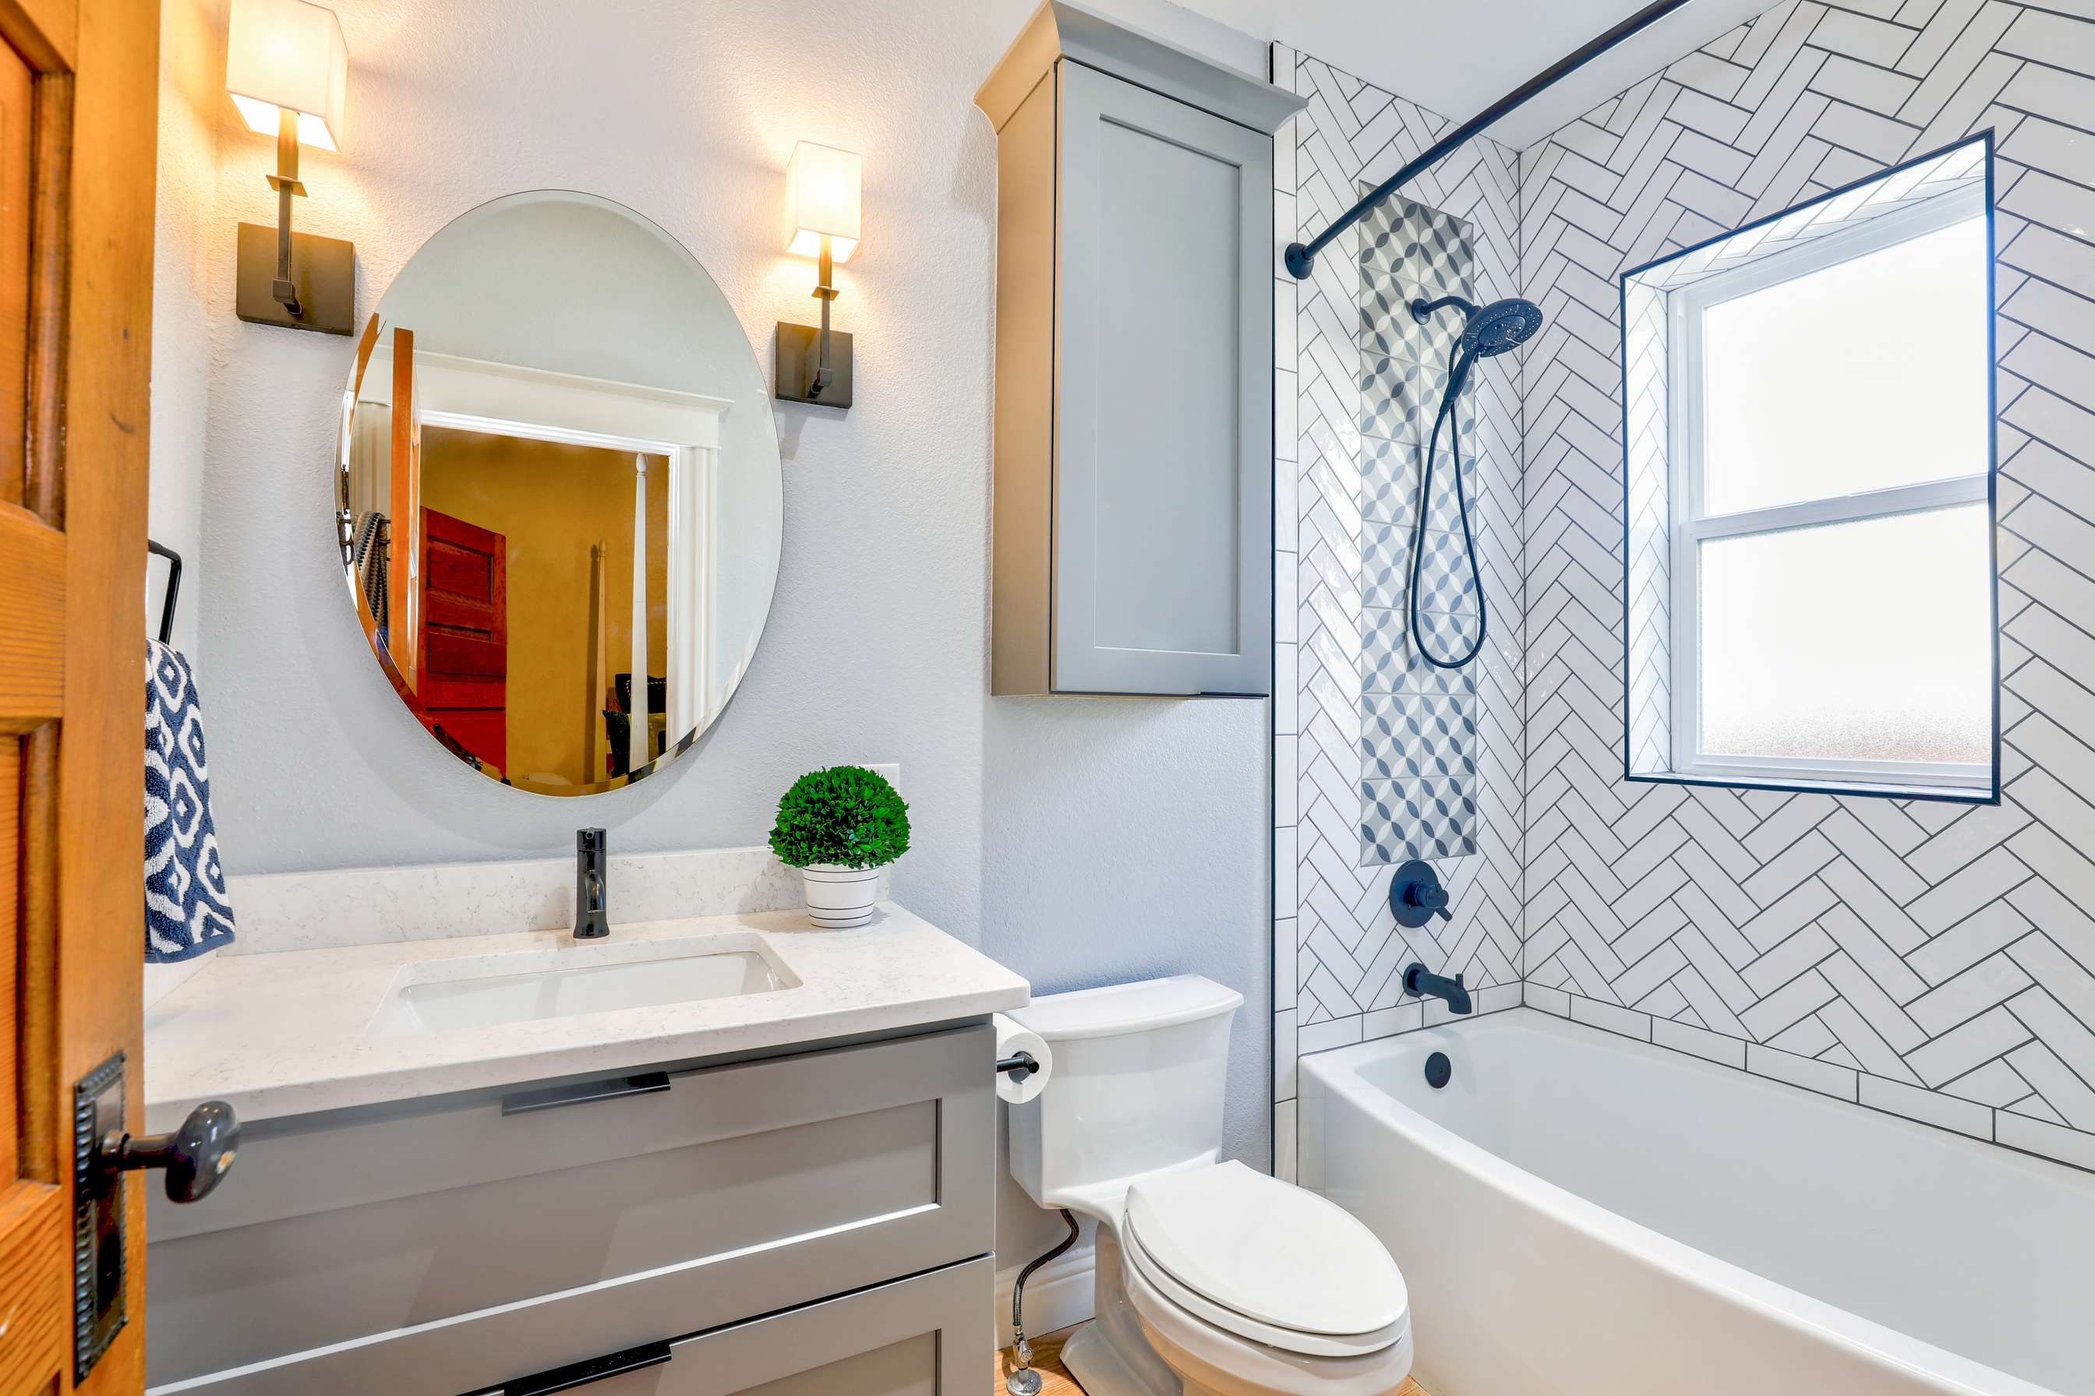
INTRODUCTION
An LED mirror is a mirror that has LED lights inside of it that illuminate its surface. There are several methods to add LED lighting to the mirror. There are versions with backlighting and those with only bulbs running down the edge of the mirror. As a result, it is also used in bathrooms.

Slide 3
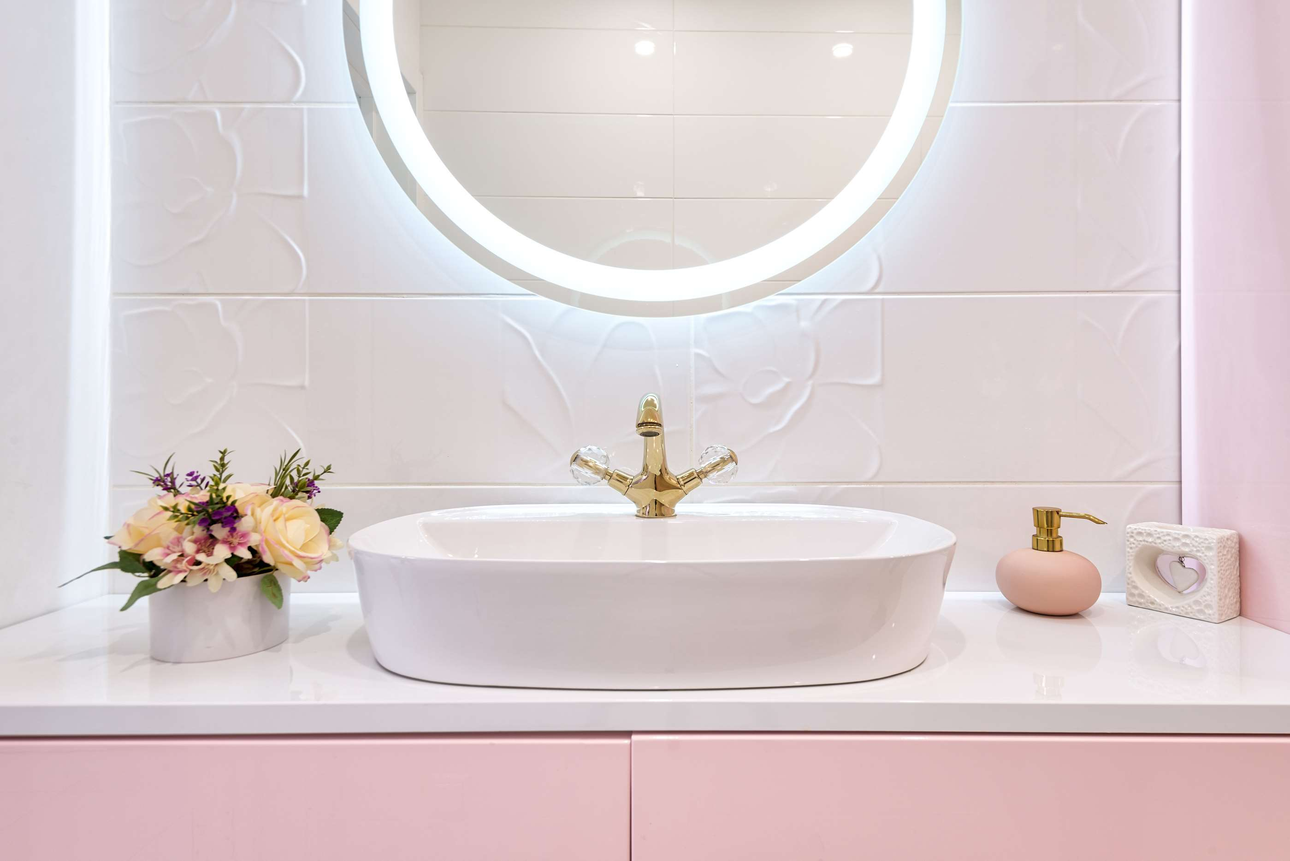

KEY INSIGHTS
MARKET SIZE
364.95 Million
2022
FORECAST
725.91 Million
2029
CAGR
10.32%
2023
-
2030

Slide 4
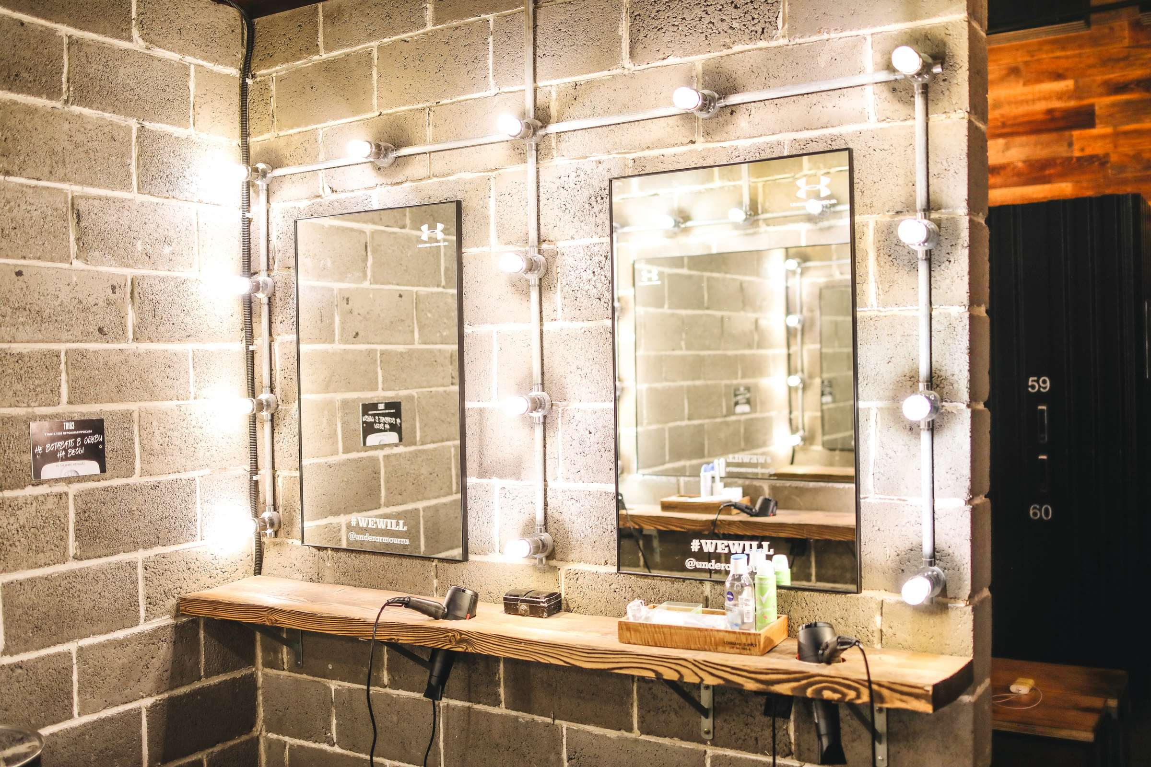
REVENUE MARKET SHARE BY SEGMENTS 2022
Floating
USD 471.14 Million
By Product
Households
USD 198.74 Million
Application

Slide 5

GLOBAL LED BATHROOM MIRRORS MARKET REVENUE SHARE FOR 2022
North America
USD 227.72 Million

Slide 6
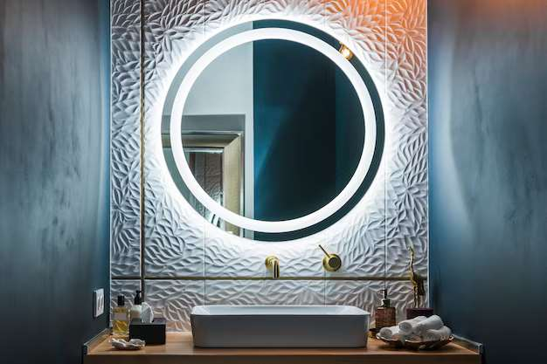
DRIVERS
Rising inclination towards high-end lifestyles
RESTRAINTS
High cost and flickering problem

Slide 7
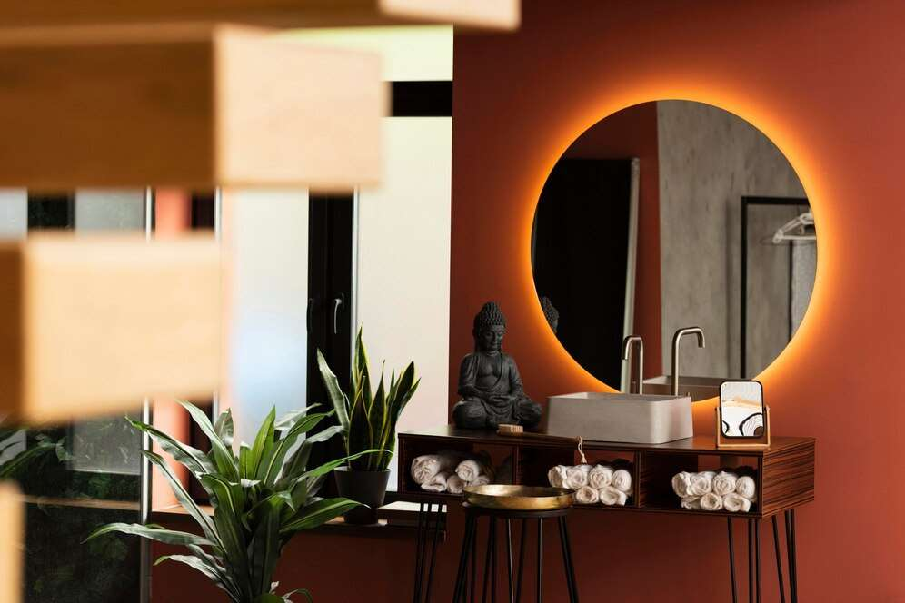
AUTHOR'S PERSPECTIVE
  The Global LED Bathroom Mirrors Market revenue in 2017: USD 330.69 Million
  Floating held for largest share of total revenue generated in 2020
  Restrooms held maximum share of LED Bathroom Mirrors market in 2020
  The rising inclination toward high-end lifestyles and growing adoption of LED light boosts the LED bathroom mirror market
  High costs and the flickering problem can hinder the growth of the LED bathroom mirror market
  Growing adoption of energy-efficient lighting technology is expected to provide enormous opportunities for the growth of the LED bathroom mirror market

Slide 8
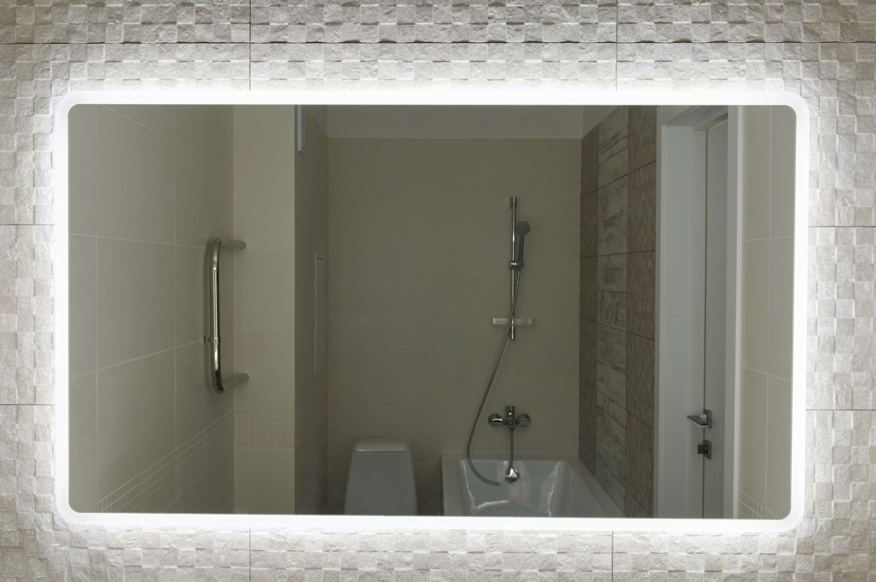






KEY PLAYERS

Slide 9


For Full Report
Contact us
COGNITIVE MARKET RESEARCH
Tel: +1 312-376-8303 | +44 020-8123-0732
India: (+91) 983-496-8611
sales@cognitivemarketresearch.com
Access the Full Report: https://tinyurl.com/ytazh8wp
Please visit our website:
https://www.cognitivemarketresearch.com

