Slide 1
GLOBAL
KITCHEN COOKWARE MARKET REPORT 2024
Global,Regional,CountryAnalysis

Slide 2
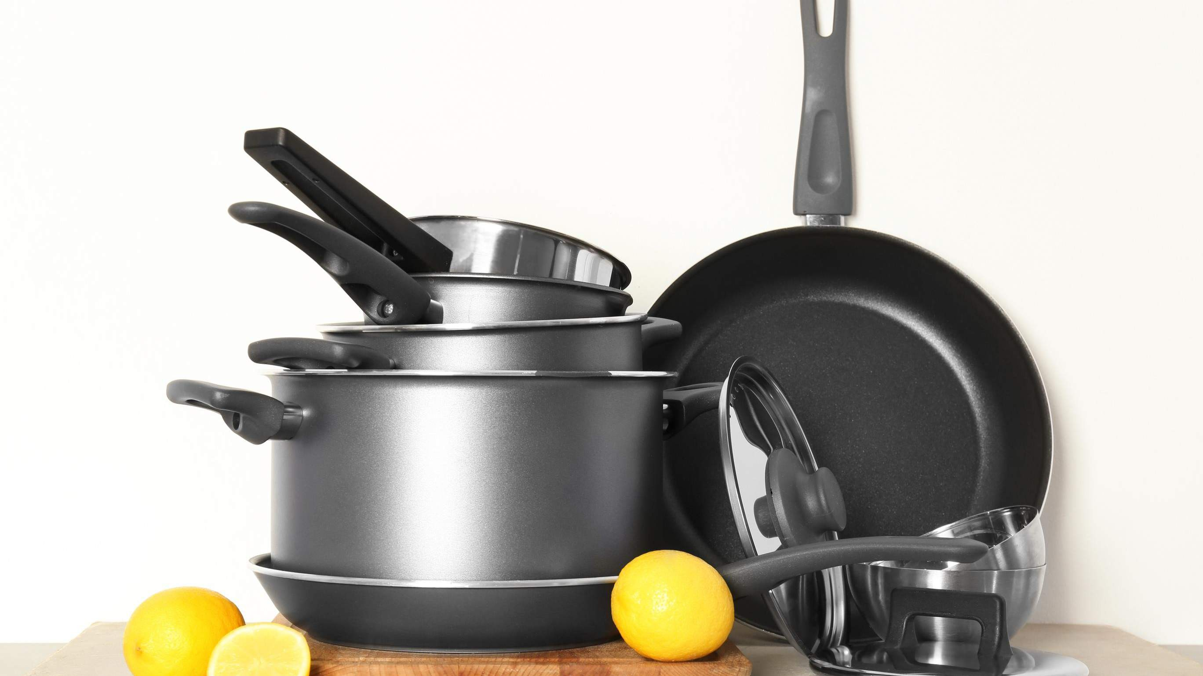
INTRODUCTION
The rising number of food-related television programs and blogs and the widespread availability of the internet all contribute to the boom in the kitchen cookware market. Because of this, more people are buying cookware for their own homes. Considerable expansion in the global kitchen cookware market can be attributed to these variables. Kitchen cookware is likely to continue growing in popularity as people become more health-conscious and want to prepare more of their meals at home, which is a growth for the kitchen cookware market over the forecast period.

Slide 3
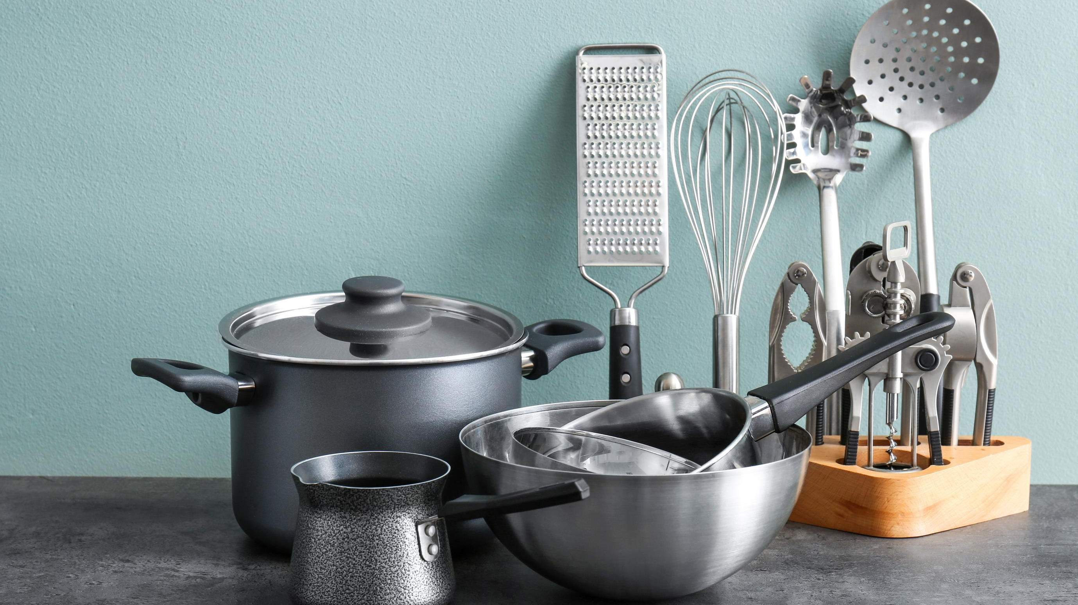

KEY INSIGHTS
CAGR 6.80%
2024
-
2031

Slide 4

REVENUE MARKET SHARE BY SEGMENTS 2022
Aluminum
Stainless Steel
Copper
Cast Iron
Porcelain Enamel
Pots & Pan
Cooking Racks
Cooking Tools
Microwave Cookware
Pressure Cookers
Product Segment
Type Segment
Hypermarkets and Supermarkets
Specialty Store
Online
Household
Restaurant
Others
Application Segment
Distribution Channel

Slide 5

Global Kitchen Cookware Market Revenue share for 2024
Asia Pacific

Slide 6



Creating New Designs and Technologies to Propel Market Growth
Changing Purchase Patterns to Restrict Market Growth

Slide 7
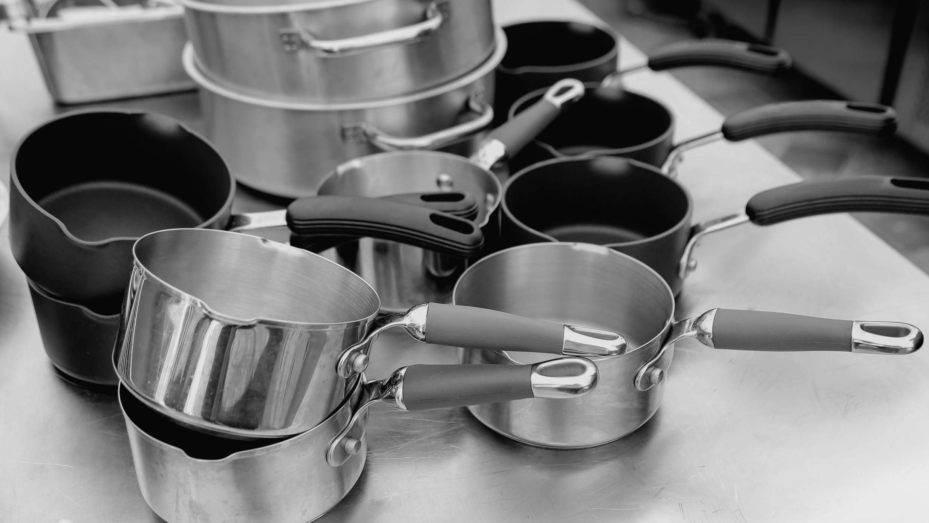
AUTHOR'S PERSPECTIVE
The Global Kitchen Cookware Market is witnessing significant growth in the near future.
Containers, frying pans, and baking parchment are just some of its many forms, but it is universal in its use in the kitchen.
Cookware sets also give households a practical way to equip their kitchens.
The cookware market offers various goods suited to different cooking techniques, making it convenient for eateries to access products
tailored to specific cooking methods, such as grilling, frying, baking, and simmering.

Slide 8
KEY PLAYERS

Slide 9


Contact us
For Full Report
COGNITIVE MARKET RESEARCH
Tel: + 1 312 - 376 - 8303 | + 44 020 - 8123 - 0732
India: ( + 91 ) 983 - 496 - 8611
sales@ cognitivemarketresearch. com
Access the Full Report : http://tinyurl.com/2ztec7bp
Please visit our website:
https://www.cognitivemarketresearch.com

