Slide 1
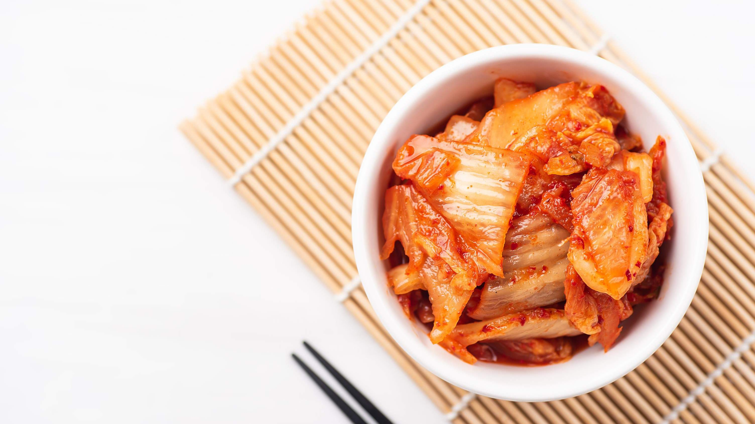
GLOBAL
Kimchi
MARKET REPORT 2024
Global,Regional,CountryAnalysis

Slide 2
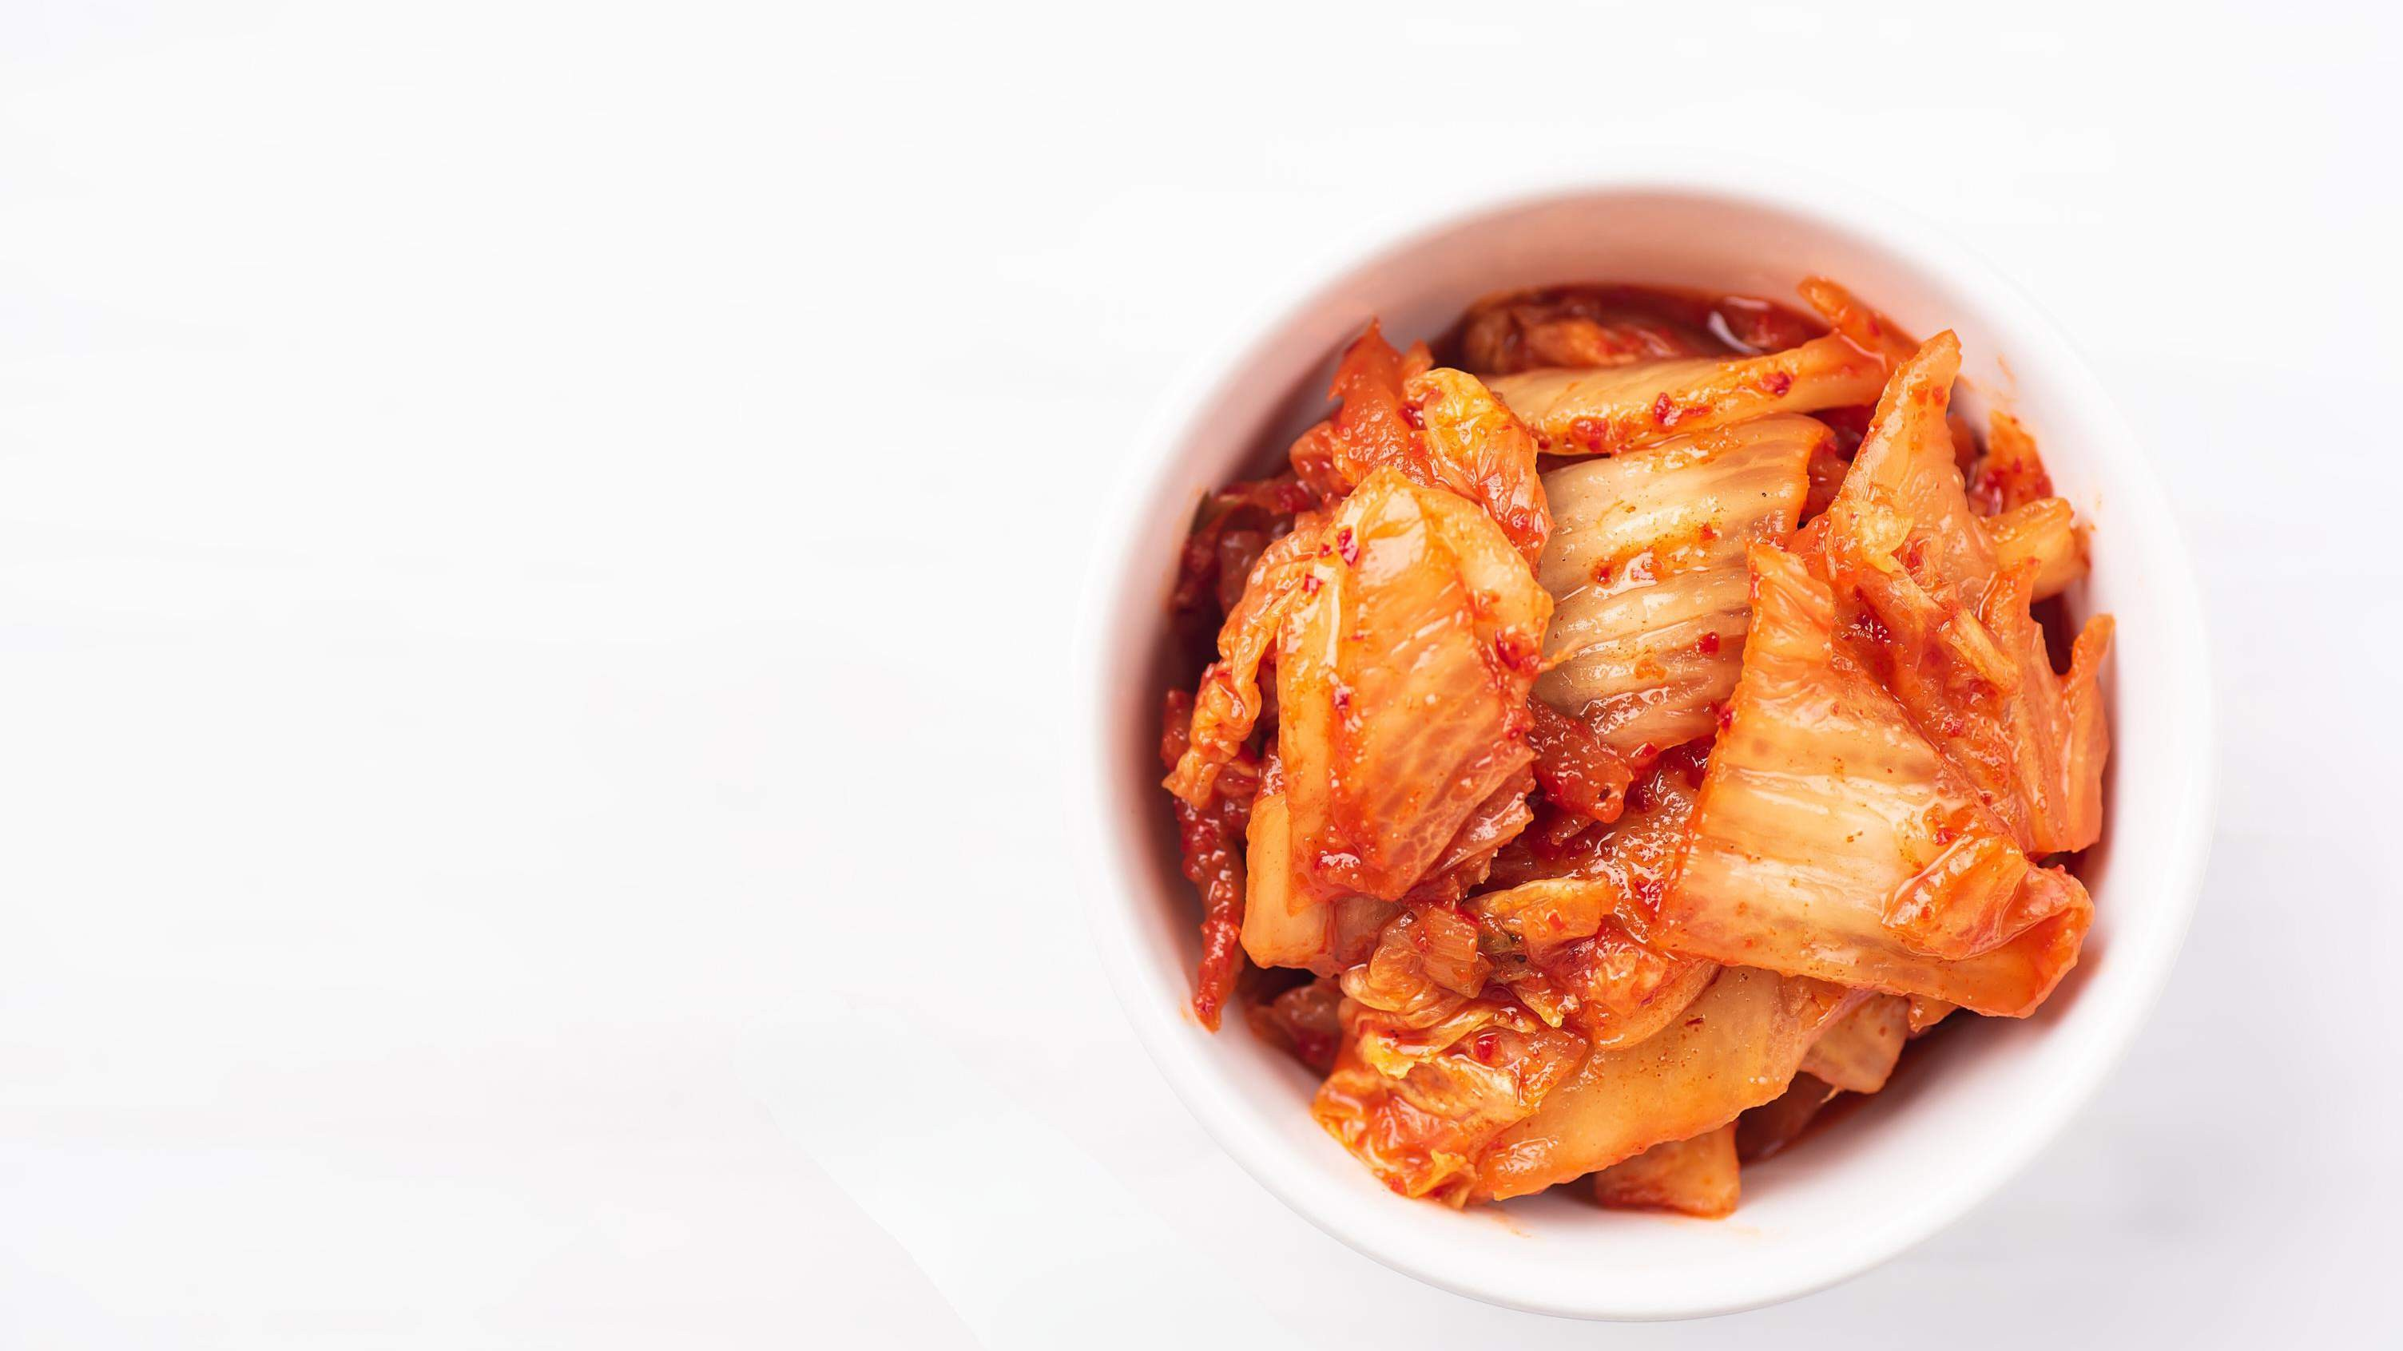
INTRODUCTION
The Growing popularity of Korean cuisine globally, increasing awareness of health- conscious consumers, rising influence of Korean culture, rise in ethnic food consumption, rise in availability Kimchi in mainstream supermarkets and online platforms, rising different tastes and preferences of consumers, rising popularity of fermented foods, increased globalization and cultural exchange, rising innovations in kimchi products and government initiatives and trade agreements are the major factors driving the growth of Kimchi market.

Slide 3
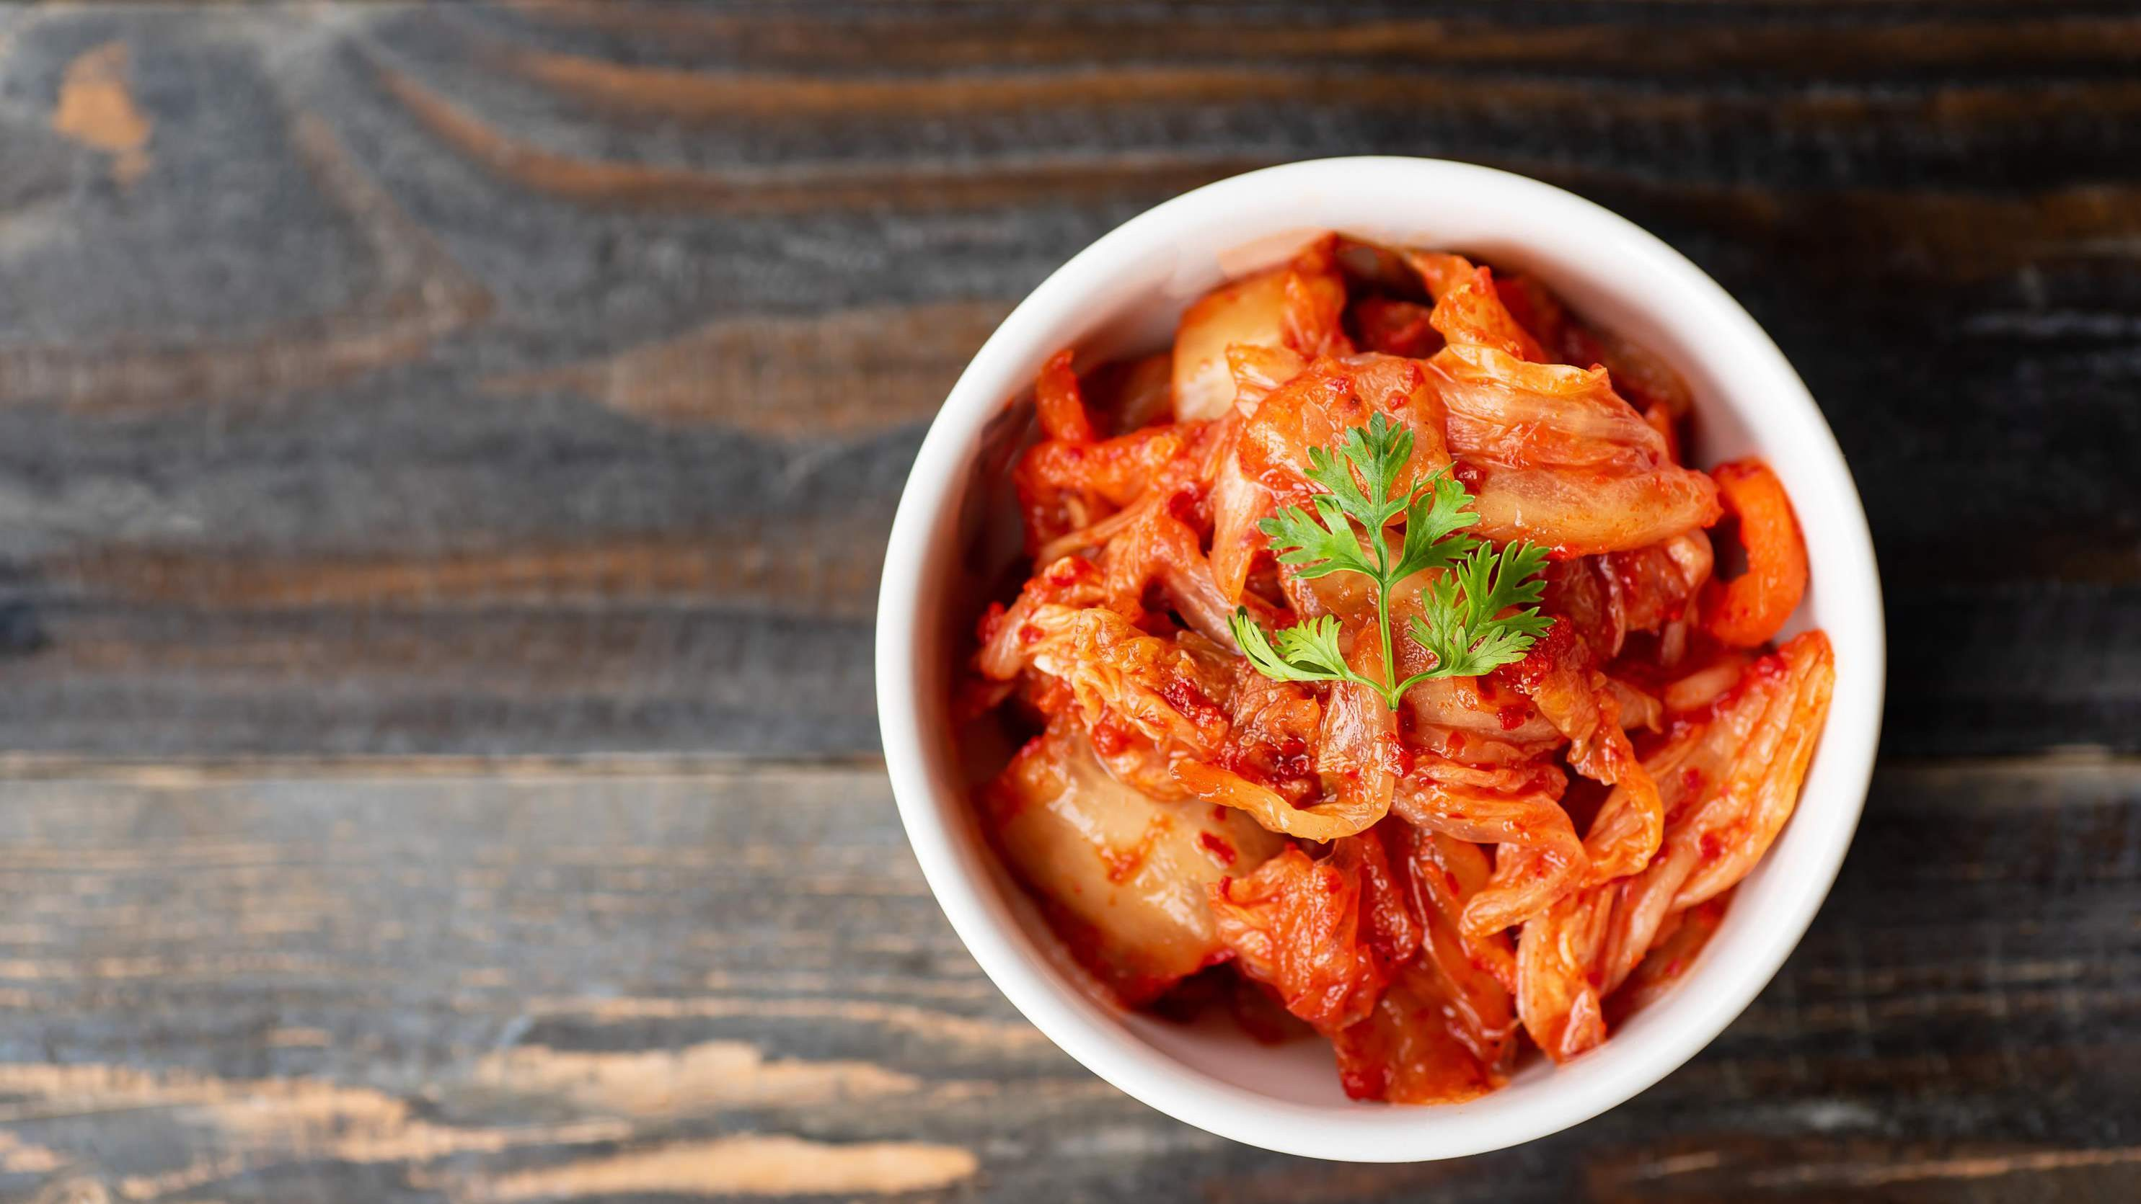

KEY INSIGHTS
MARKET SIZE
USD 758.9 billion
2023
20₋23
CAGR 6.5%
2030

Slide 4
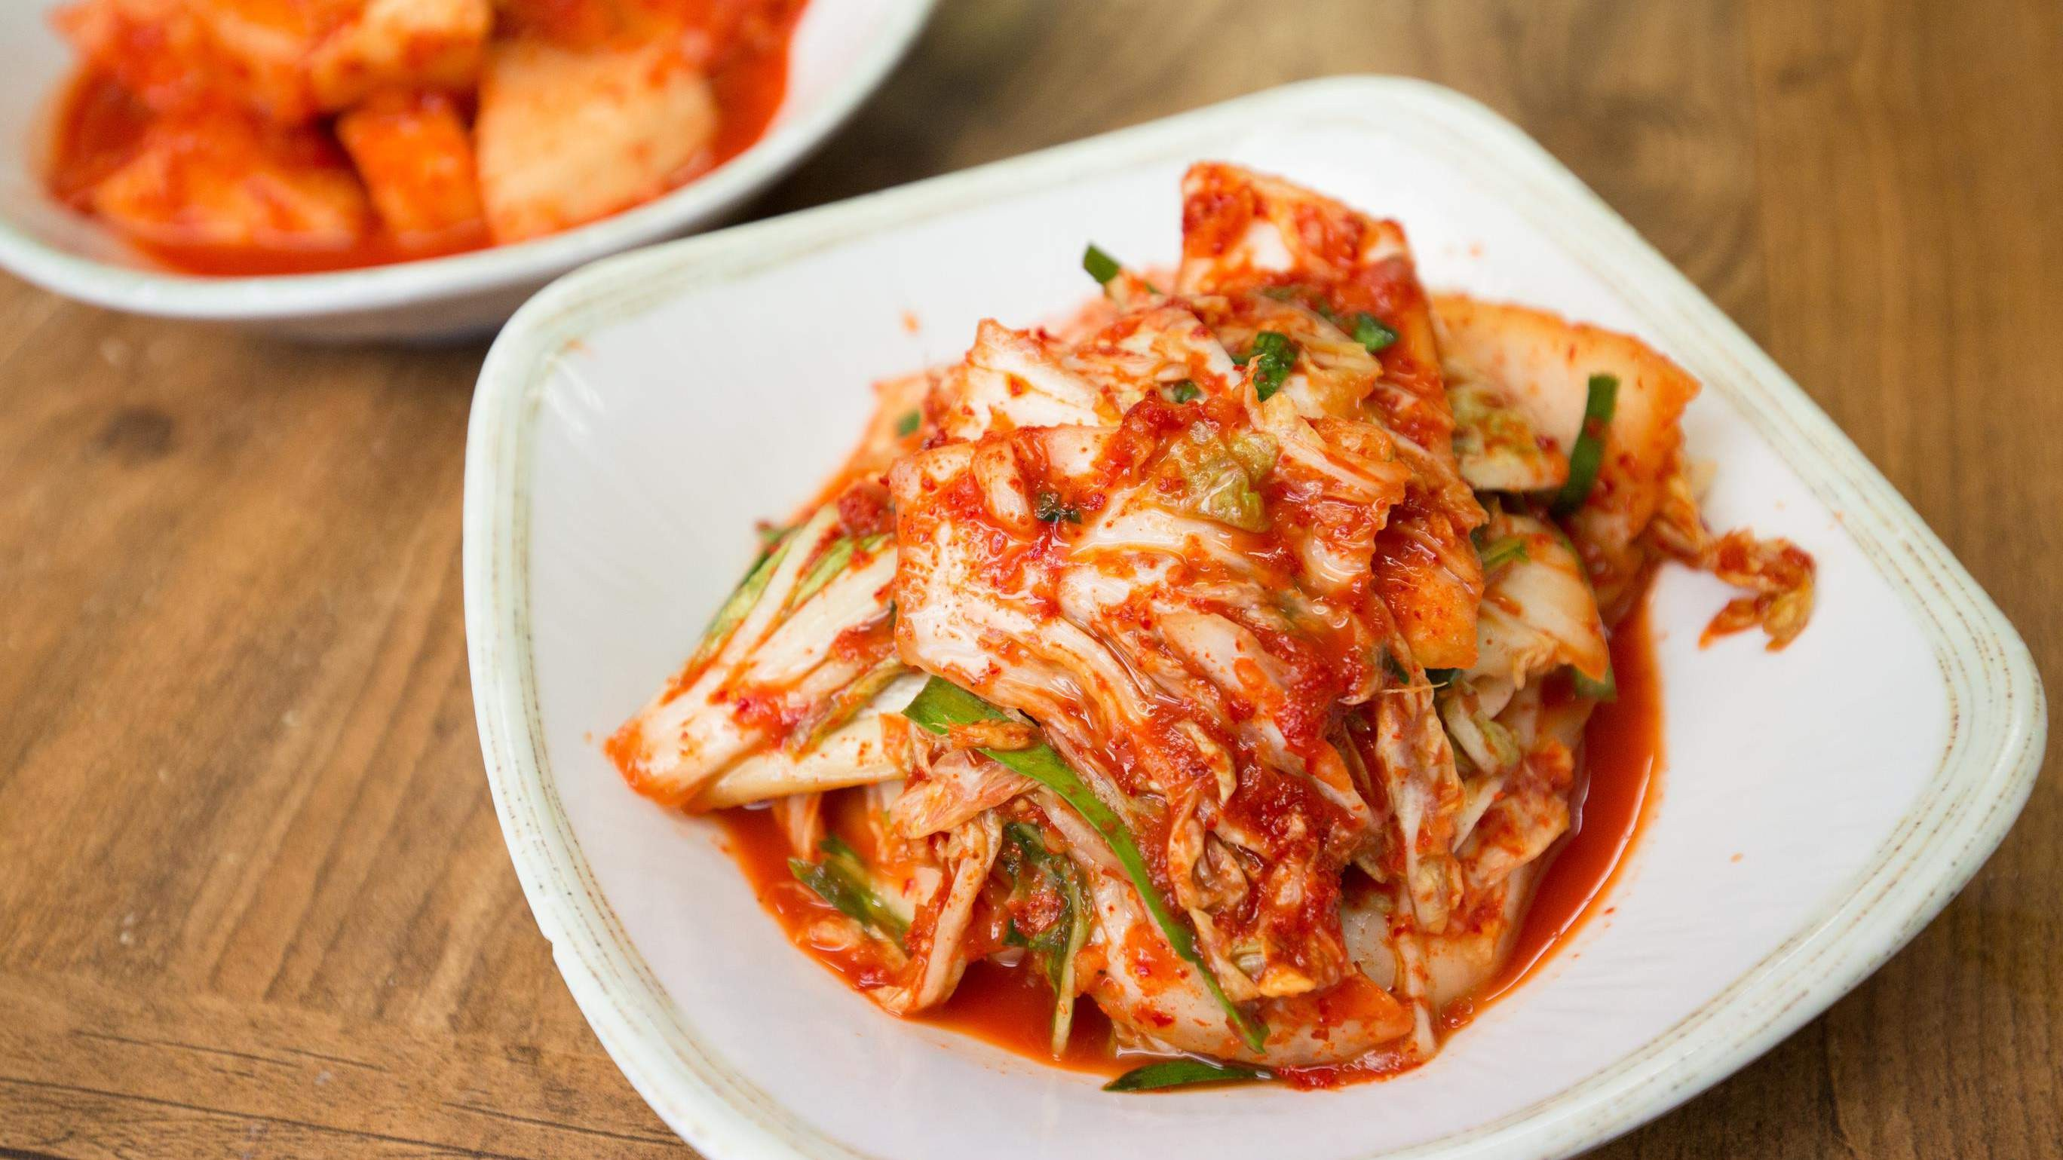
REVENUE MARKET SHARE BY SEGMENTS 2022
Kimchi Relish
Cabbage Kimchi
Cucumber Kimchi
Red Mustard Leaf Kimchi
Type Segment
Foodservice Industry
Retail/Household
Business to Business
Business to Consumer
Application Segment
Organic
Conventional
Nature Segment

Slide 5
Global Kimchi Market Revenue share for 2022
North America 38%

Slide 6
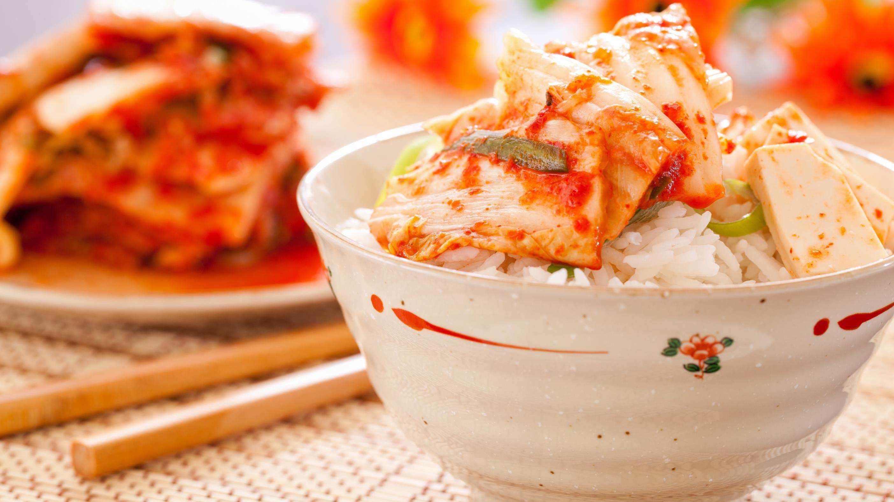



Slide 7
AUTHOR'S PERSPECTIVE
The Global Kimchi Market is witnessing significant growth in the near future.
It is a traditional and widely consumed form that involves fermented Napa
cabbage seasoned with ingredients like chilli pepper, garlic, ginger, and more.
The convenience of packaged kimchi products in retail outlets further facilitates its integration into home- cooked meals, contributing to the
expanding global appeal of this traditional Korean dish.

Slide 8
KEY PLAYERS

Slide 9


Contact us
For Full Report
COGNITIVE MARKET RESEARCH
Tel: + 1 312 - 376 - 8303 | + 44 020 - 8123 - 0732
India: ( + 91 ) 983 - 496 - 8611
sales@ cognitivemarketresearch. com
Access the Full Report : http://tinyurl.com/4wbw862f
Please visit our website:
https://www.cognitivemarketresearch.com

