Slide 1
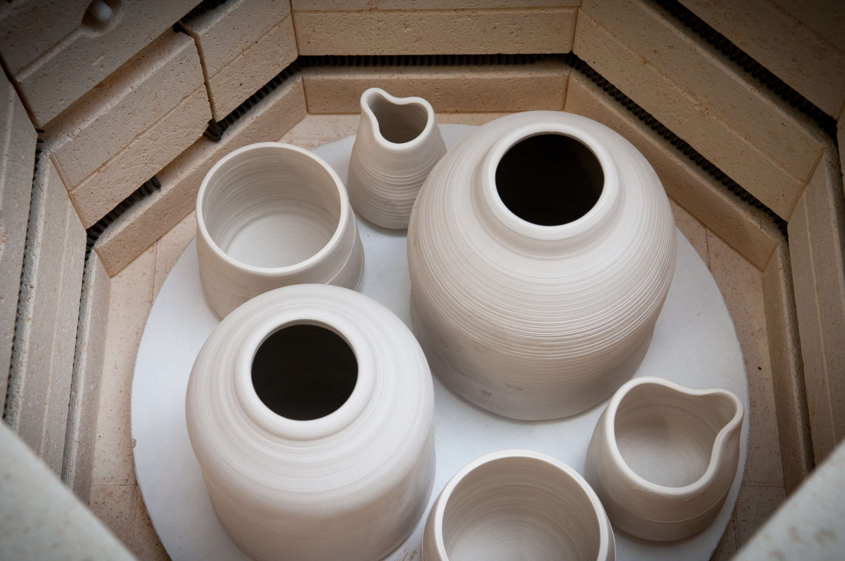
GLOBAL KILN FURNITURE
MARKET REPORT 2024
Global,Regional,CountryAnalysis

Slide 2
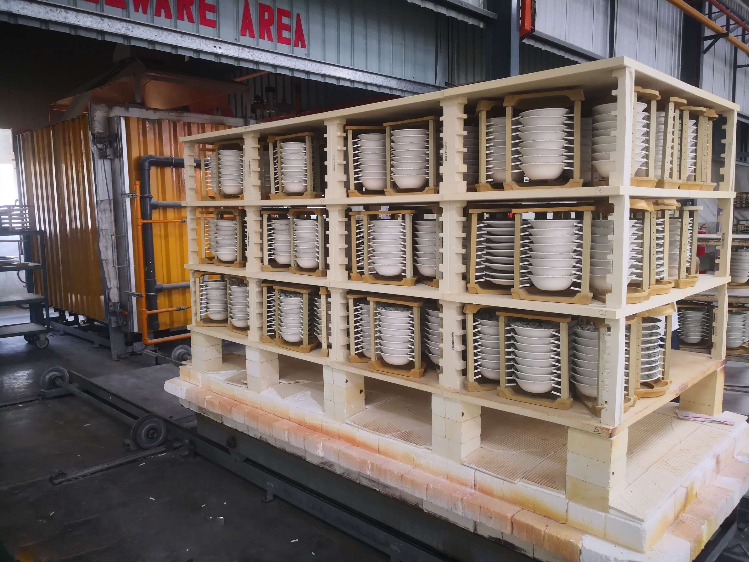
INTRODUCTION
Kiln furniture is the equipment used to support ceramics within the furnace and to provide extra room for firing. Kiln furniture is used for the manufacturing of specific parts, such as ceramic or metal components, for heating operations. Furniture in the kiln is sturdy, thermally resistant, lightweight, and capable of withstanding not just intense operational temperatures, but also the stress of frequent heating and cooling.

Slide 3


KEY INSIGHTS
FORECAST
$270.96 Million
2028
2023-
2030
CAGR
11.06%

Slide 4
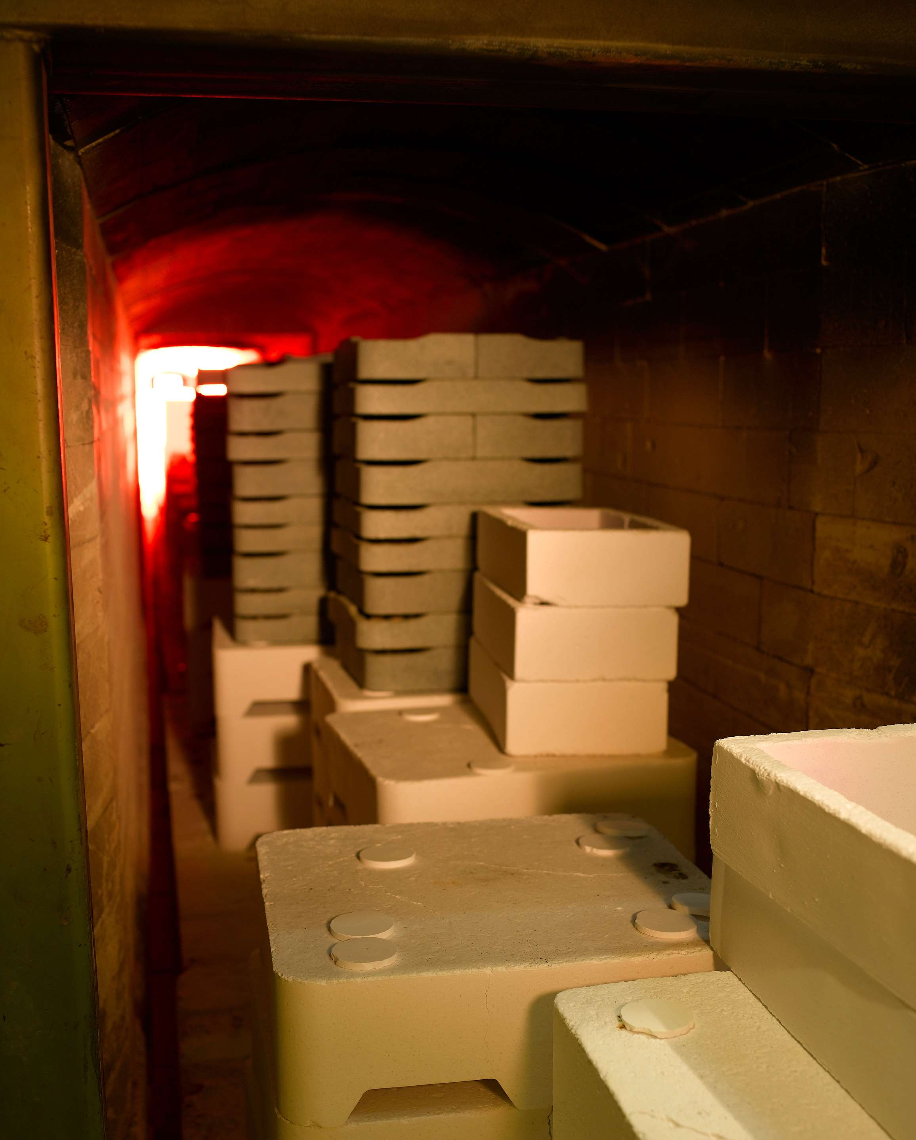
REVENUE MARKET SHARE BY SEGMENTS 2022
Type analysis
Silicon Carbide
USD 79.86 Million
Sales Channel
Online
USD 64.65 Million
by Application
Ceramic
USD 92.55 Million

Slide 5

Global Kiln Furniture Market Revenue share for 2022
North America
USD 69.77 Million

Slide 6
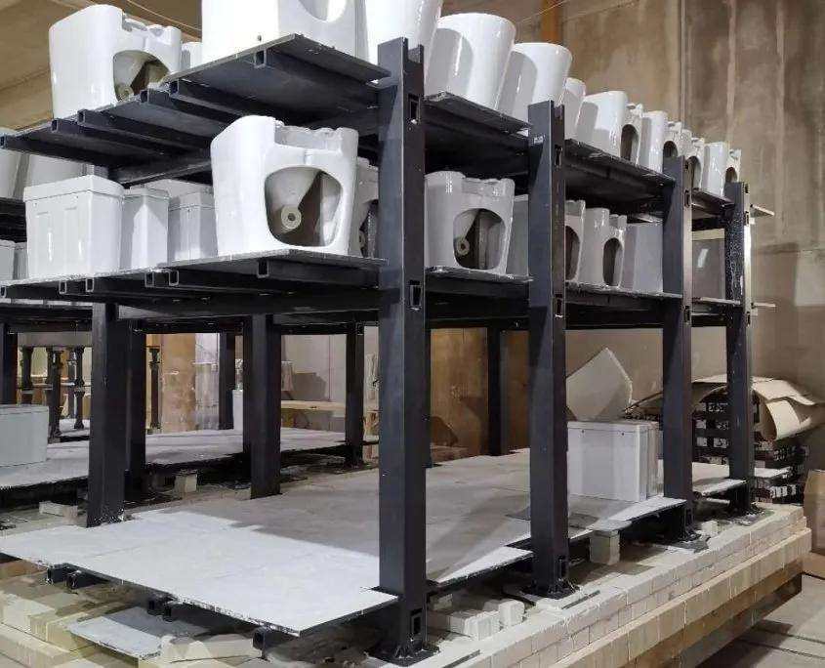
Rising demand for residential construction industry due to urbanization
Drivers
High replacement rate results in increase in the operational cost
Restraints

Slide 7
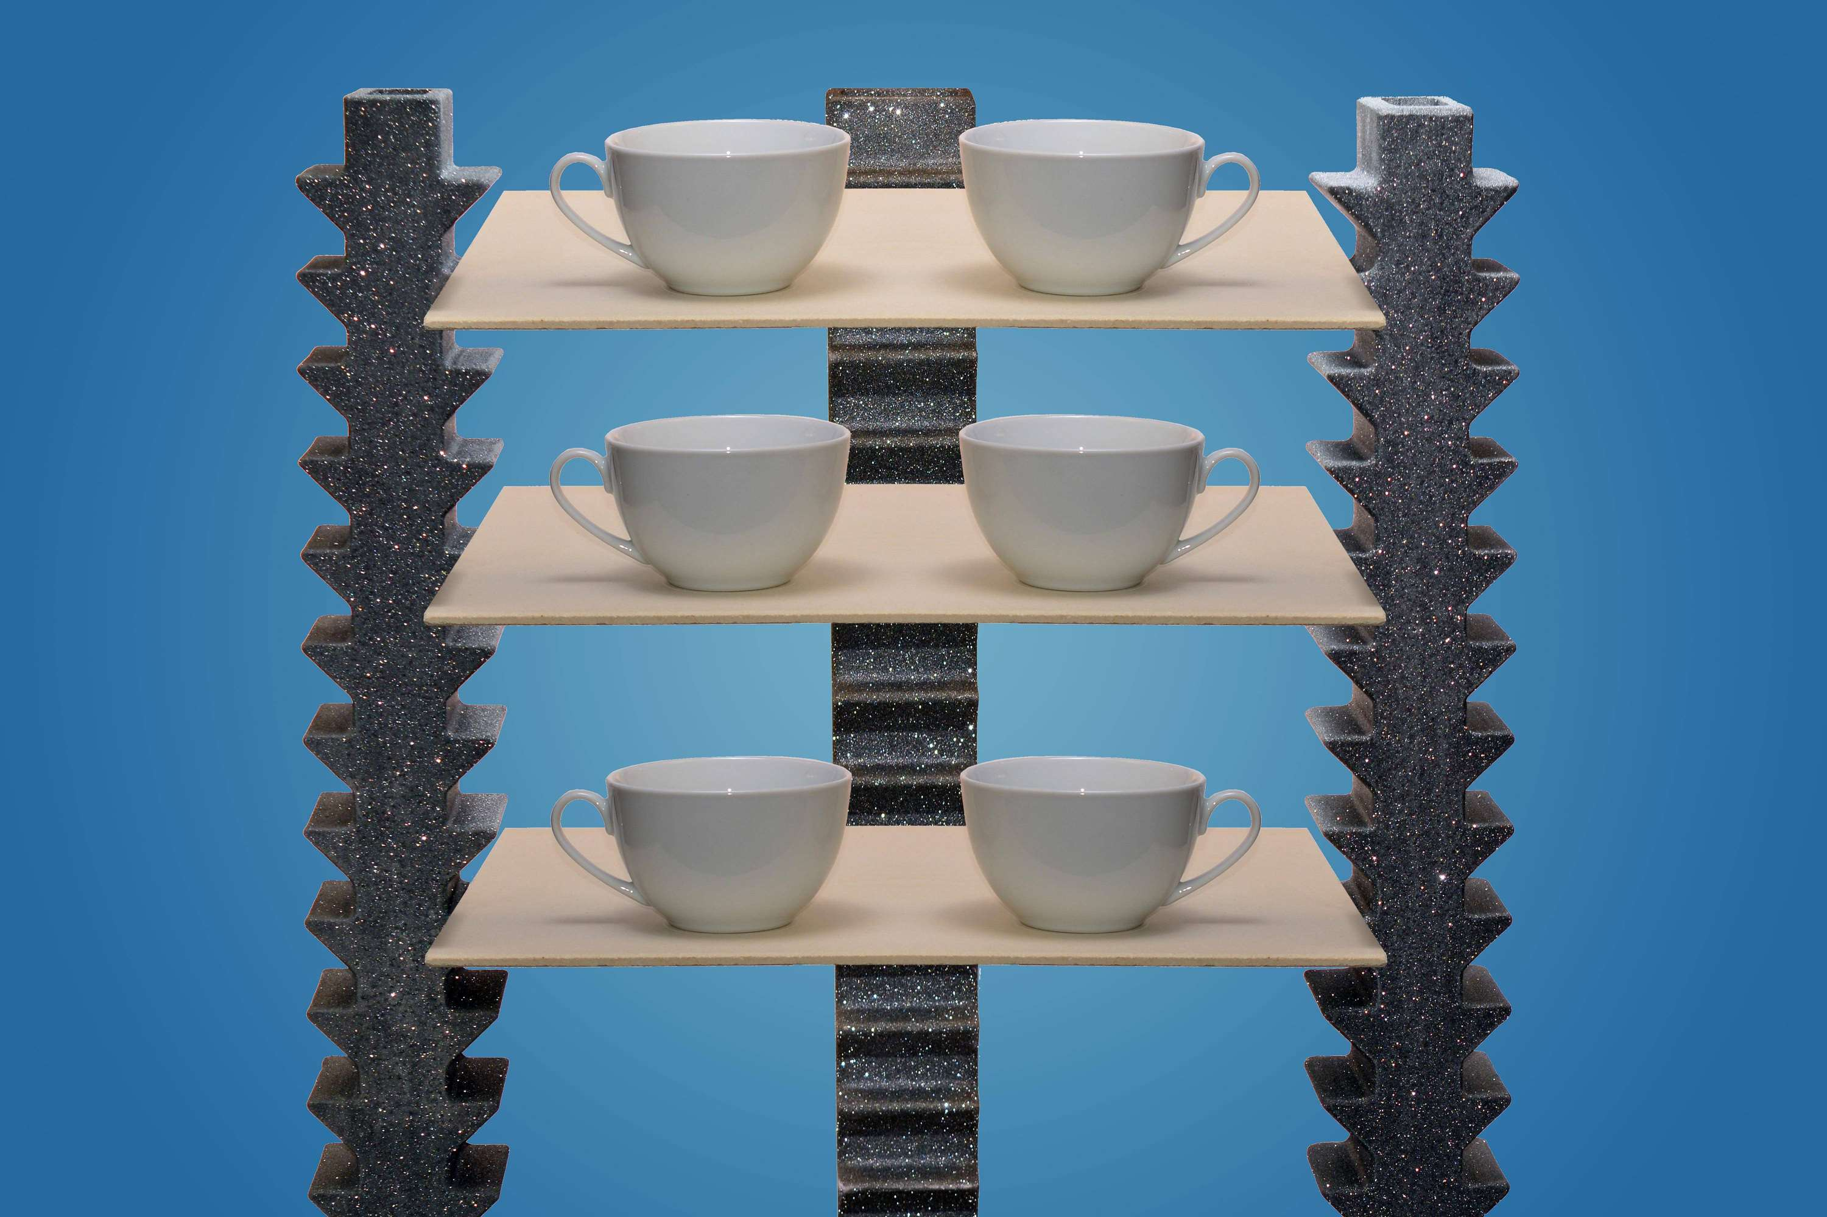
AUTHOR'S PERSPECTIVE
  The Global Kiln Furniture Market revenue in 2016: USD 116.33 Million
  Silicon carbide has been chosen as the basic material for the fabrication to have top-quality kiln furniture with maximum heat conductivity and resistance, high refractoriness under load, and strong mechanical strength.
  Pure alumina, alumina-mullite, and electro-fused zirconia kiln furniture are commonly used in electronic component heat treatment.
  Kiln furniture is used in the manufacture of components of the iron & steel industry, mining industry as well as for the mineral processing unit, coal, smelting, machinery, port and other industries, coal transportation, material delivery systems, pulverizing systems, ash discharge, dust removal systems, and other wearable mechanical equipment.

Slide 8







KEY PLAYERS

Slide 9


For Full Report
Contact us
COGNITIVE MARKET RESEARCH
Tel: +1 312-376-8303 | +44 020-8123-0732
India: (+91) 983-496-8611
sales@cognitivemarketresearch.com
Access the Full Report : https://tinyurl.com/4yjzkba5
Please visit our website:
https://www.cognitivemarketresearch.com

