Slide 1

GLOBAL
KIDS TOYS
MARKET REPORT
2024
Global,Regional,CountryAnalysis

Slide 2

INTRODUCTION
The production, marketing, and distribution of goods intended for children's amusement and growth are all included in the kids' toys market. Traditional toys like dolls and action figures are among them, as are cutting-edge technological and instructional toys. The dynamic and diverse market is driven by factors such as changing consumer preferences, parental emphasis on child development, and rising disposable budgets. It offers various alternatives to engage and stimulate youngsters, catering to different age groups and interests. To satisfy the needs of picky parents, manufacturers frequently incorporate technology, instructional elements, and safety regulations. Innovation, safety concerns, and a constant adjustment to cultural trends impacting children's play choices characterize the global kids' toys business.

Slide 3


KEY INSIGHTS
MARKET SIZE
USD 60251.2 million
2024
CAGR
3.50%
2024- 2031

Slide 4
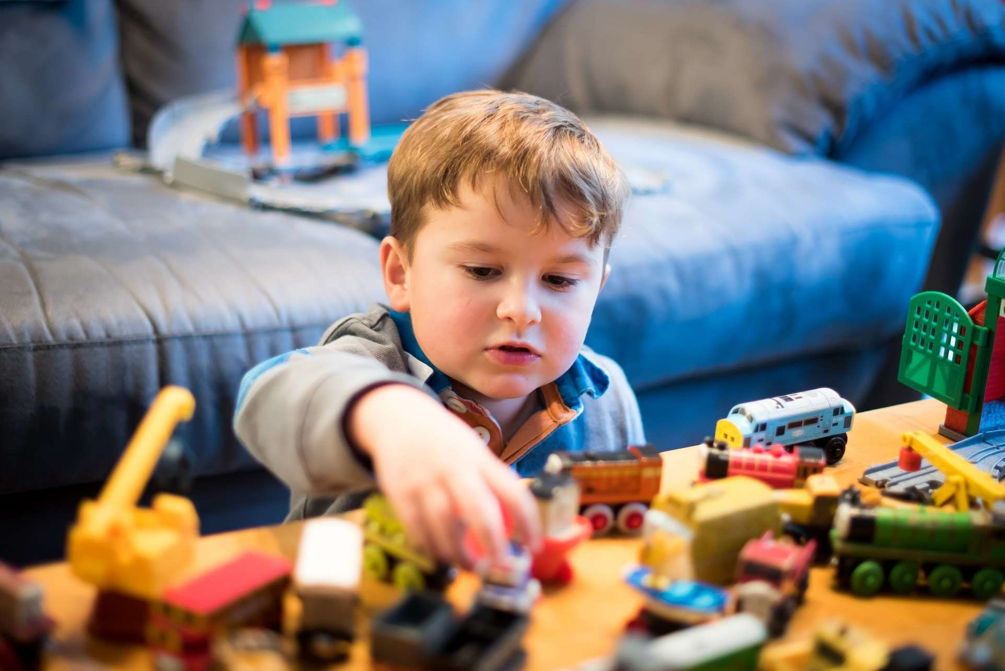
REVENUE MARKET SHARE BY SEGMENTS 2022
  Hypermarket/Supermarket
  Specialty Stores
  Departmental Stores
  Online Channels
Distribution Channel

Slide 5

Global Kids Toys Market Revenue share for 2024
North America
40%

Slide 6
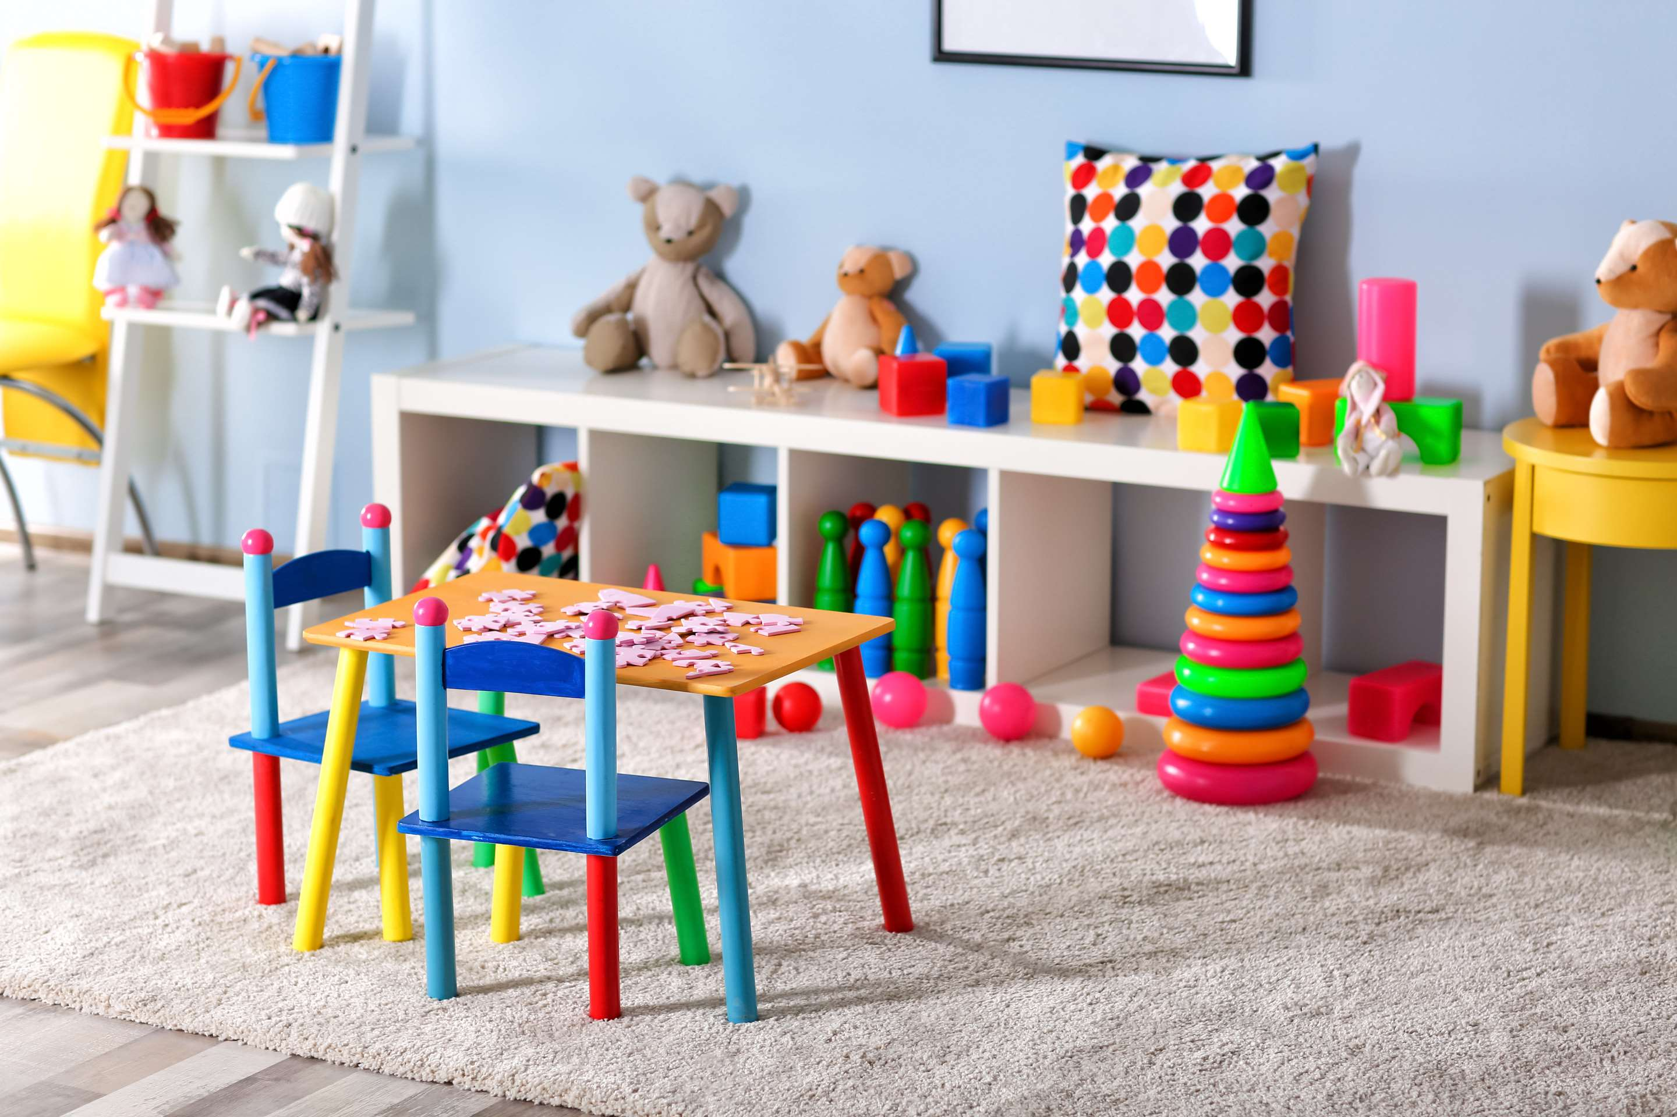
Increased Focus on Child Development to Propel Market Growth
Drivers
Safety Concerns to Limit the Sales
Restraints

Slide 7

AUTHOR'S PERSPECTIVE
  The global Kids Toys market will expand significantly by 3.50% CAGR between 2024 to 2031.
  Customers are selecting toys with components obtained ethically and sustainably as they become more aware about the effects of toys on the environment.
  Online retailers are becoming a more popular option for parents looking to buy toys because of their convenience and increased selection, which is broadening the market and increasing accessibility.
  The plush held the highest Kids Toys market revenue share in 2024.

Slide 8




KEY PLAYERS

Slide 9


For Full Report
Contact us
COGNITIVE MARKET RESEARCH
Tel: +1 312-376-8303 | +44 020-8123-0732
India: (+91) 983-496-8611
sales@cognitivemarketresearch.com
Access the Full Report : https://tinyurl.com/3hy9jxe9
Please visit our website:
https://www.cognitivemarketresearch.com

