Slide 1

GLOBAL
KIDS SNACKS
MARKET REPORT
2024
Global,Regional,CountryAnalysis

Slide 2
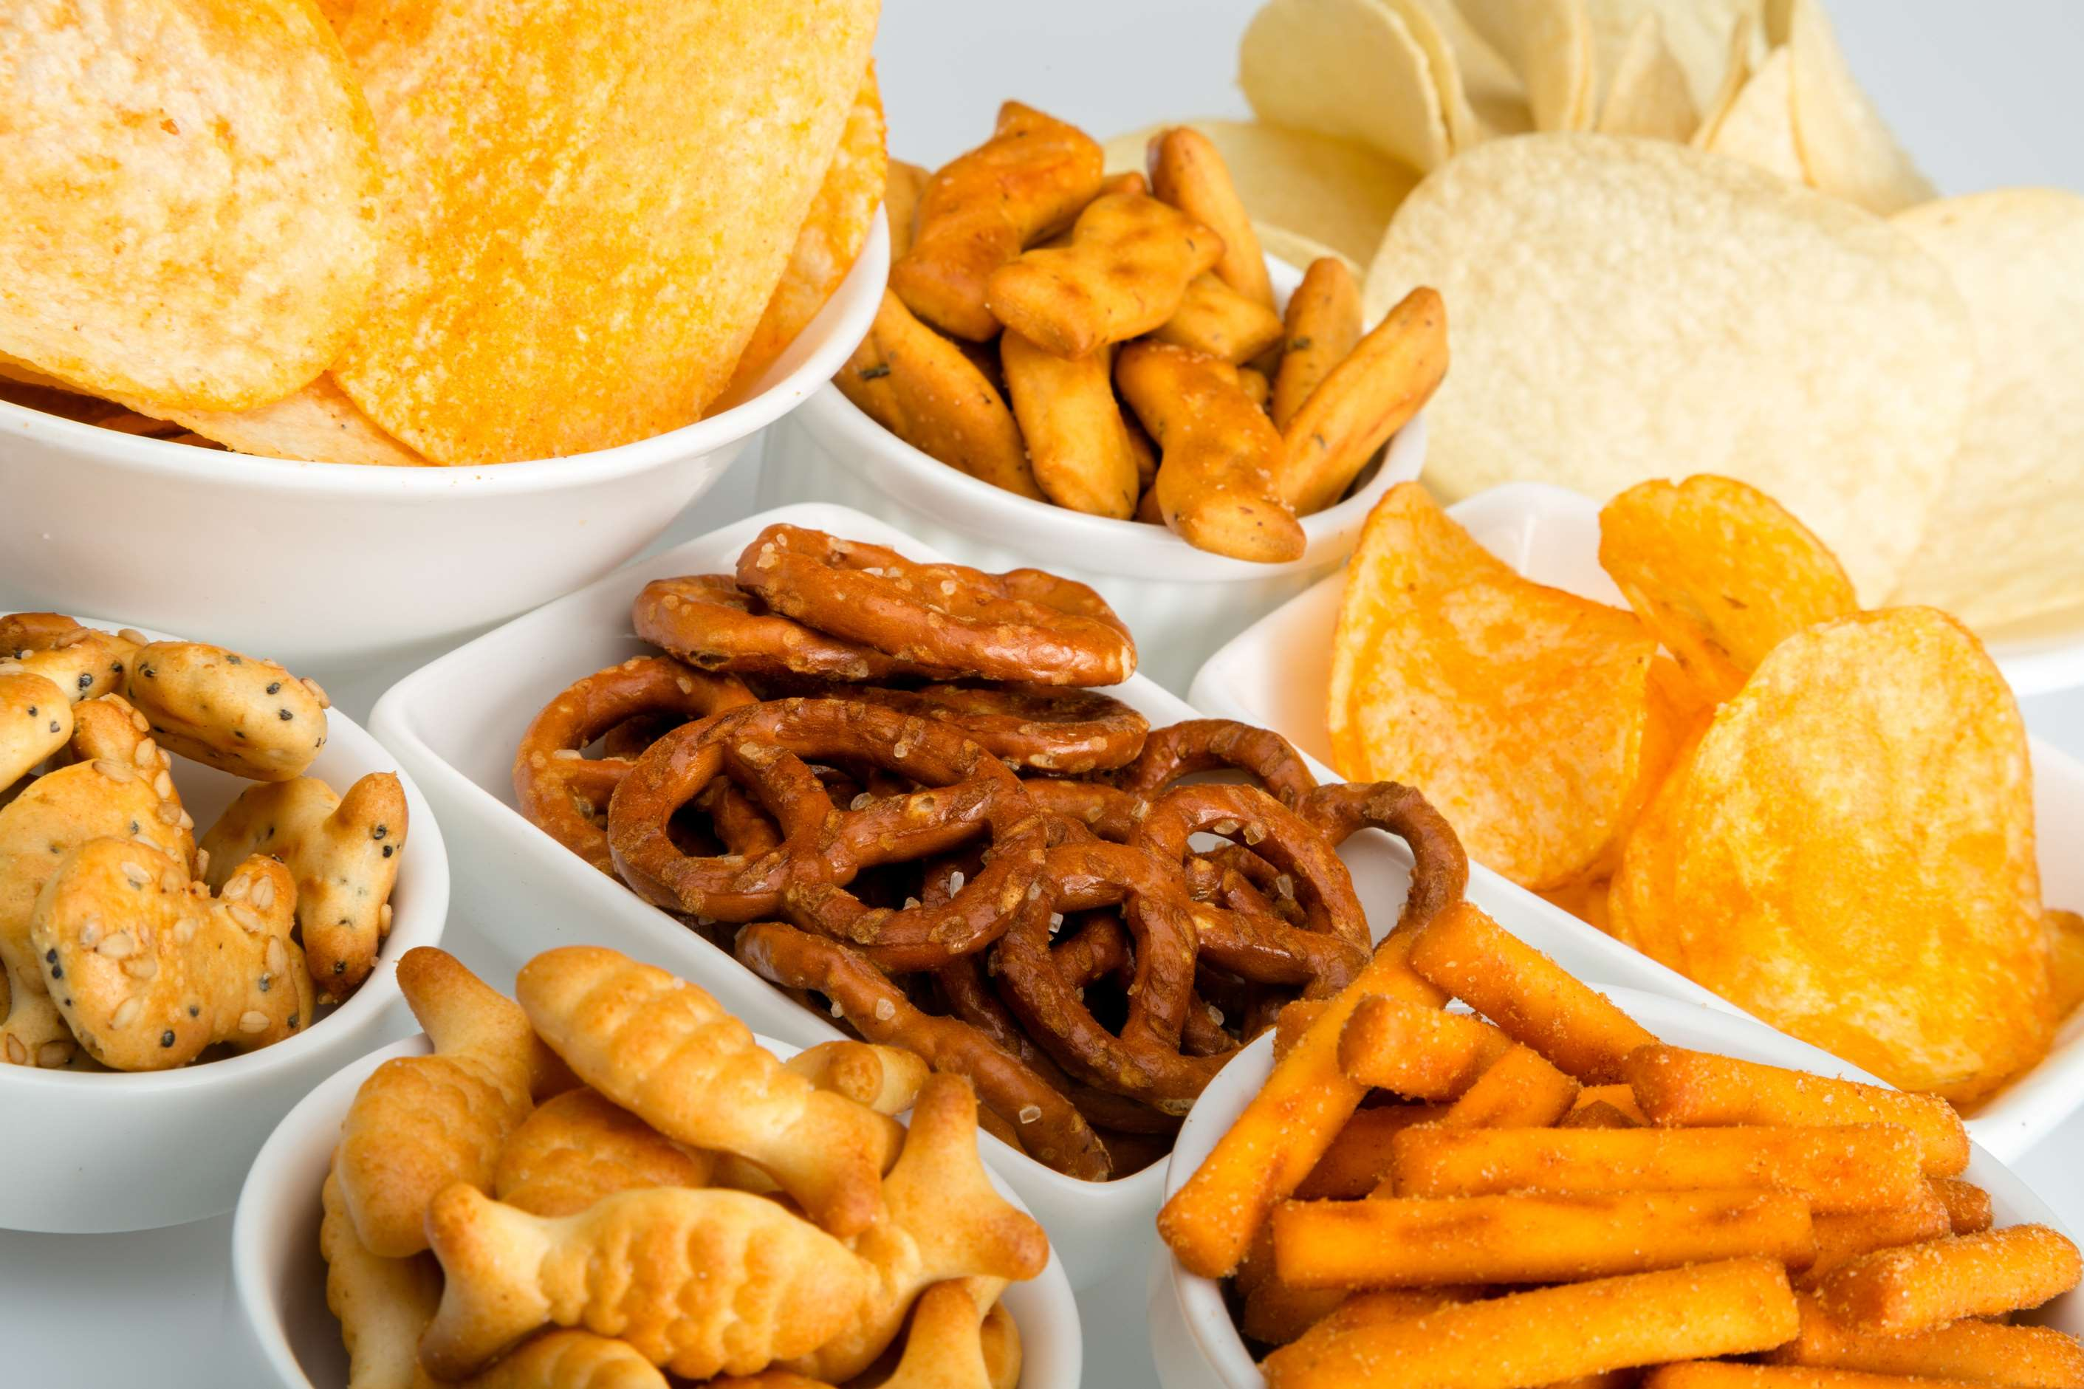
INTRODUCTION
The increasing awareness of healthy eating leads to a rise in busy lifestyles. The need for convenient, portable snacks, the rise in demand for organic and natural snacks, and the rise in food allergies and dietary restrictions have led to the development of allergen-free and gluten-free snacks, innovative flavors and shapes, creative and attractive packaging and marketing campaigns, expansion of online retail channels and e-commerce platforms, rising parental concerns about nutrition, inclusion of snacks in school lunches, cultures blend and international cuisines become more accessible, influence of peer and social media and growing awareness about the environmental impact of packaging and food production are the major factors driving the growth of the Kids Snacks market.

Slide 3


KEY INSIGHTS
MARKET SIZE
USD 61.5 billion
2023
CAGR
8.00%
2023- 2030

Slide 4

REVENUE MARKET SHARE BY SEGMENTS 2022
  Confectionary
  Bakery
  Frozen
Type Segment
  Hypermarket/ Supermarket
  Convenience Stores
  Specialty Stores
  Online Sales Channel
Application Segment

Slide 5

Global Kids Snacks Market Revenue share for 2024
Asia-Pacific
38%

Slide 6

Rising Demand for Innovative Snacks to Propel Market Growth
Drivers
Poor Nutritional Content to Hinder Market Growth
Restraints

Slide 7

AUTHOR'S PERSPECTIVE
  The Global Kids Snacks Market is witnessing significant growth in the near future.
  Confectionary snacks are popular among kids due to their appealing flavors and bright packaging, making them a favorite choice for indulgence and occasional treats.
  Convenience stores are often strategically located in residential areas and near schools, enhancing their appeal for parents and children seeking convenient snack options.

Slide 8










KEY PLAYERS

Slide 9


For Full Report
Contact us
COGNITIVE MARKET RESEARCH
Tel: +1 312-376-8303 | +44 020-8123-0732
India: (+91) 983-496-8611
sales@cognitivemarketresearch.com
Access the Full Report : http://tinyurl.com/msvpjpvw
Please visit our website:
https://www.cognitivemarketresearch.com

