Slide 1

GLOBAL
KIDS SCOOTER
MARKET REPORT
2024
Global,Regional,CountryAnalysis

Slide 2

INTRODUCTION
The kid's scooter market is growing due to several factors. First, there is a rising emphasis on outdoor activities and physical fitness for children, encouraging parents to invest in scooters as a fun and active mode of transportation. Additionally, the eco-friendly and cost-effective nature of scooters appeals to environmentally conscious parents. The availability of innovative designs and safety features further boosts their popularity, making kids' scooters a preferred choice for both recreation and short-distance commuting.

Slide 3
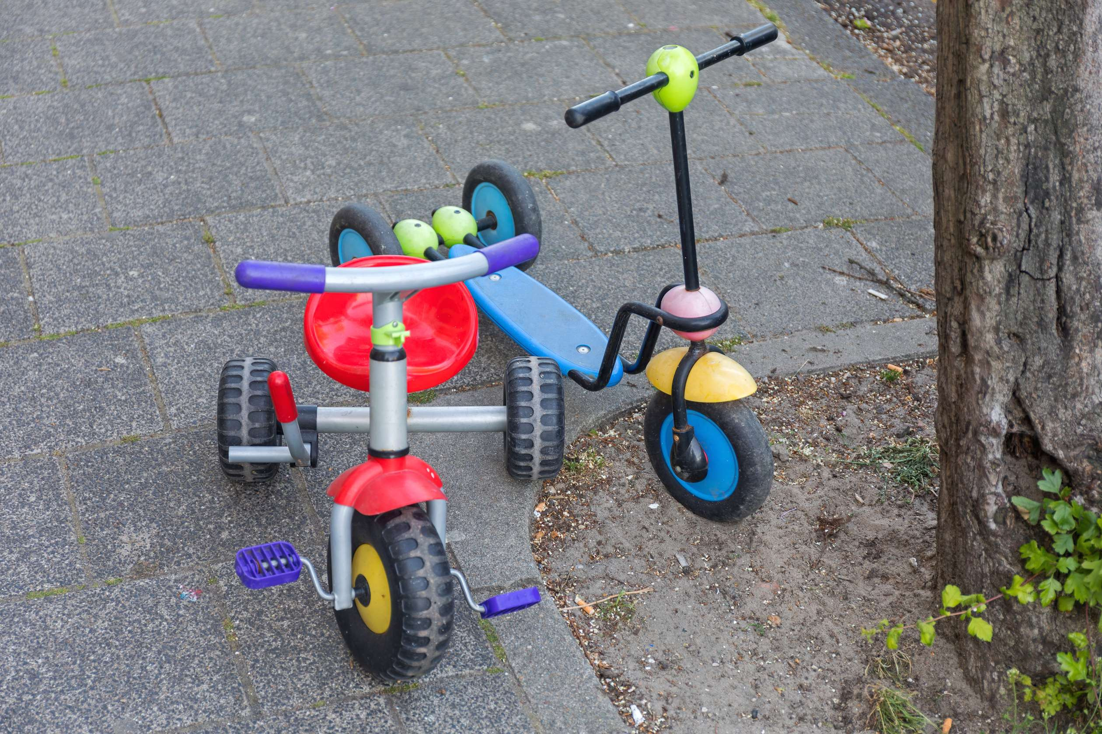

KEY INSIGHTS
MARKET SIZE
USD 0.02 billion
2023
CAGR
3.0%
2023- 2030

Slide 4

REVENUE MARKET SHARE BY SEGMENTS 2022
  2 Wheelers
  3 Wheelers
Type Segment
  Male
  Female
End-User Segment
  Retail Stores
  E-commerce Stores
Sales Channel Segment

Slide 5

Global Kids Scooter Market Revenue share for 2024
North America

Slide 6
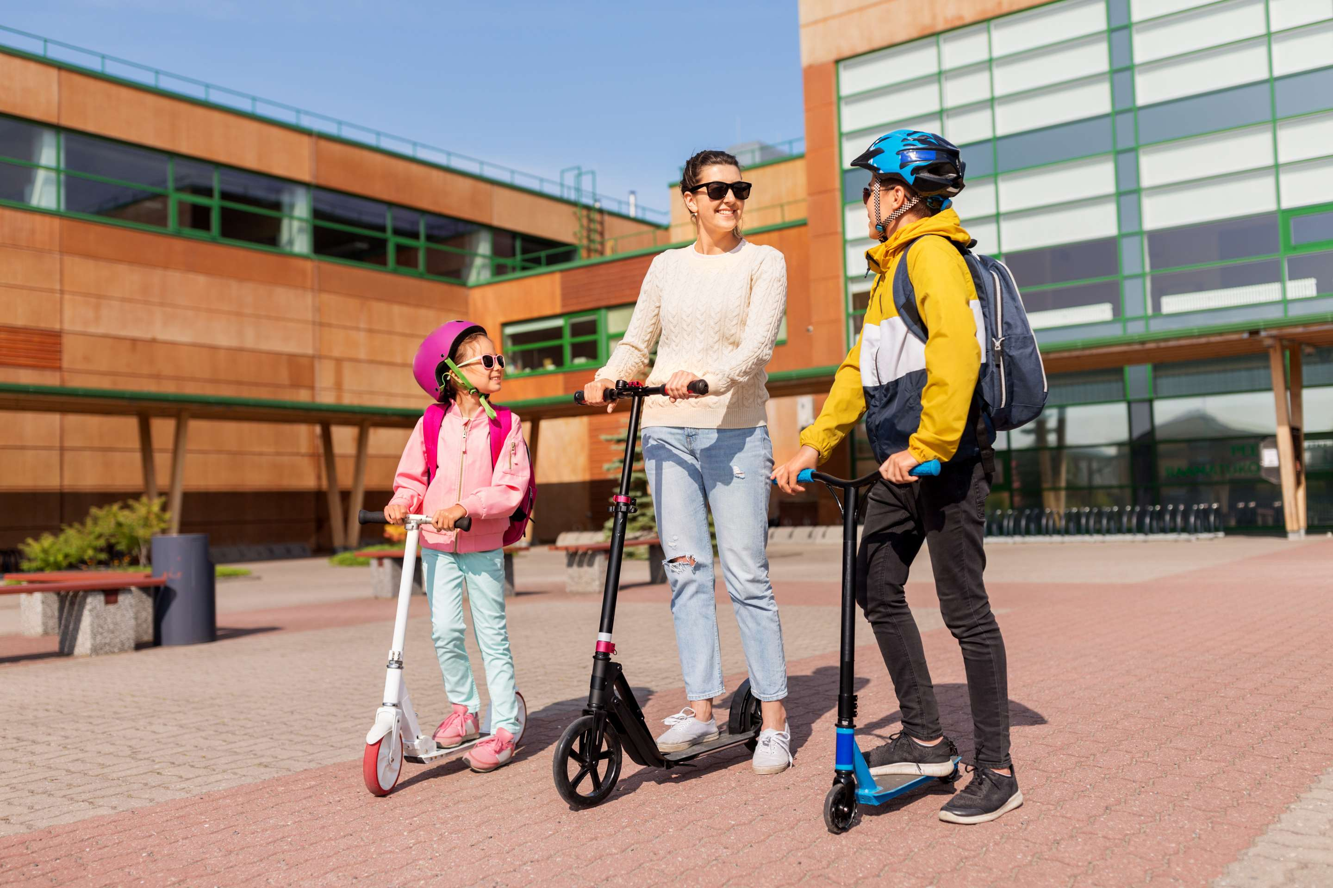
Changing Commuting Patterns to Propel Market Growth
Drivers
Safety Concerns Hinder Market Growth
Restraints

Slide 7

AUTHOR'S PERSPECTIVE
  The Global Kids Scooter Market is witnessing significant growth in the near future.
  Manufacturers are increasingly designing scooters with gender-neutral and appealing features, making them more attractive to girls.
  Parents and society are also encouraging girls to engage in active outdoor play, which includes scooter riding.
  Families often prefer to visit retail stores where they can see and touch the scooters, ensuring they meet safety and quality standards.

Slide 8











KEY PLAYERS

Slide 9


For Full Report
Contact us
COGNITIVE MARKET RESEARCH
Tel: +1 312-376-8303 | +44 020-8123-0732
India: (+91) 983-496-8611
sales@cognitivemarketresearch.com
Access the Full Report : https://tinyurl.com/4zeb9xzv
Please visit our website:
https://www.cognitivemarketresearch.com

