Slide 1
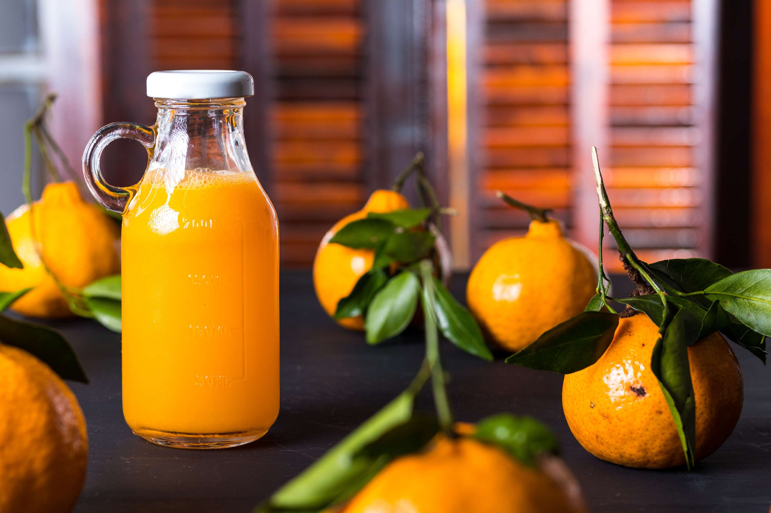
GLOBAL
JUICE CONCENTRATE
MARKET REPORT
2024
Global,Regional,CountryAnalysis

Slide 2
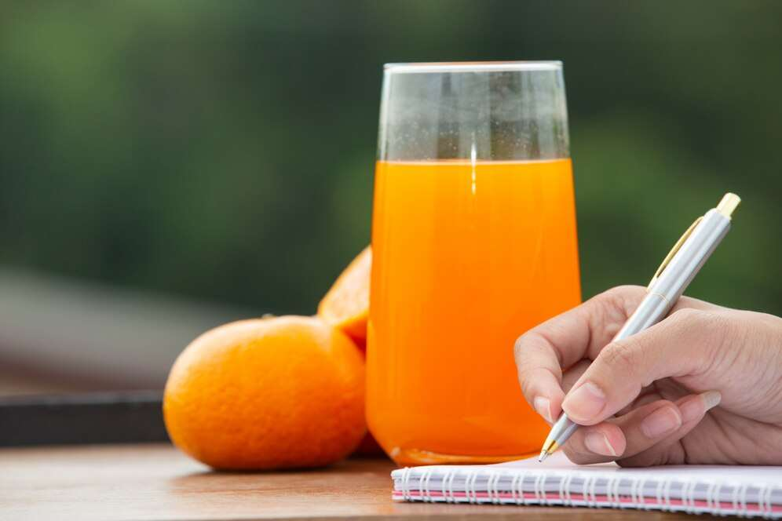
INTRODUCTION
A juice concentrate is a diluted form of the original juice. This is done to make it easier to store and transport and increase its shelf life. Juice concentrates are low-water fruit and vegetable juices that may also contain beneficial nutrients, including vitamins and minerals. The worldwide juice concentrate market is driven primarily by the rising need for quick and easy meals is propelling the worldwide juice concentrate industry. They can substitute fresh drinks in many situations and are convenient and inexpensive. The global demand for fruit concentrates is rising, driven by increasing levels of disposable income, shifting lifestyles, and urbanization. Additionally, the expansion of the juice concentrates market is consumers' growing need for handy food and drink items. Juice concentrates are anticipated to maintain their rapid rise in the next years due to their widespread use as a component in beverages, jams, jellies, infant meals, and other food and drink products, which is expected to drive juice concentrate market expansion during the forecast period.

Slide 3
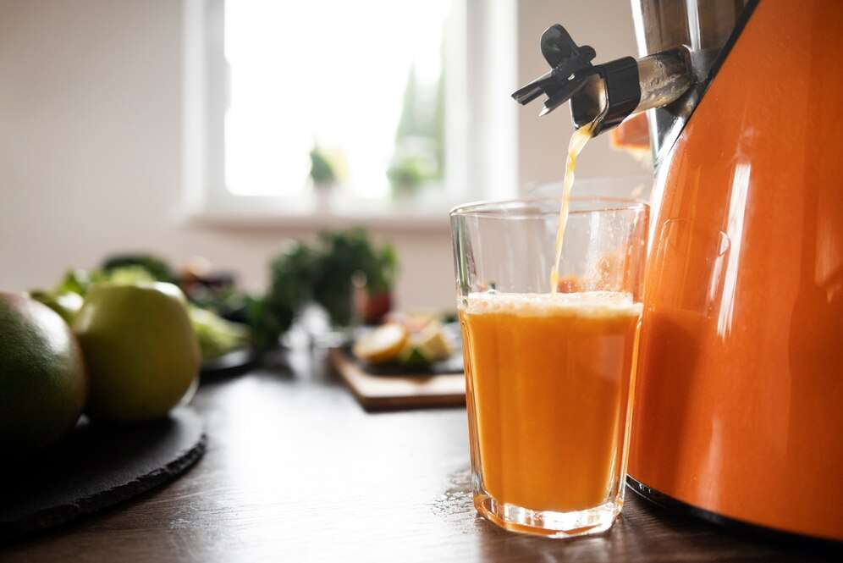

KEY INSIGHTS
MARKET SIZE
USD 73.8 billion
2023
CAGR
5.20%
2023- 2030

Slide 4
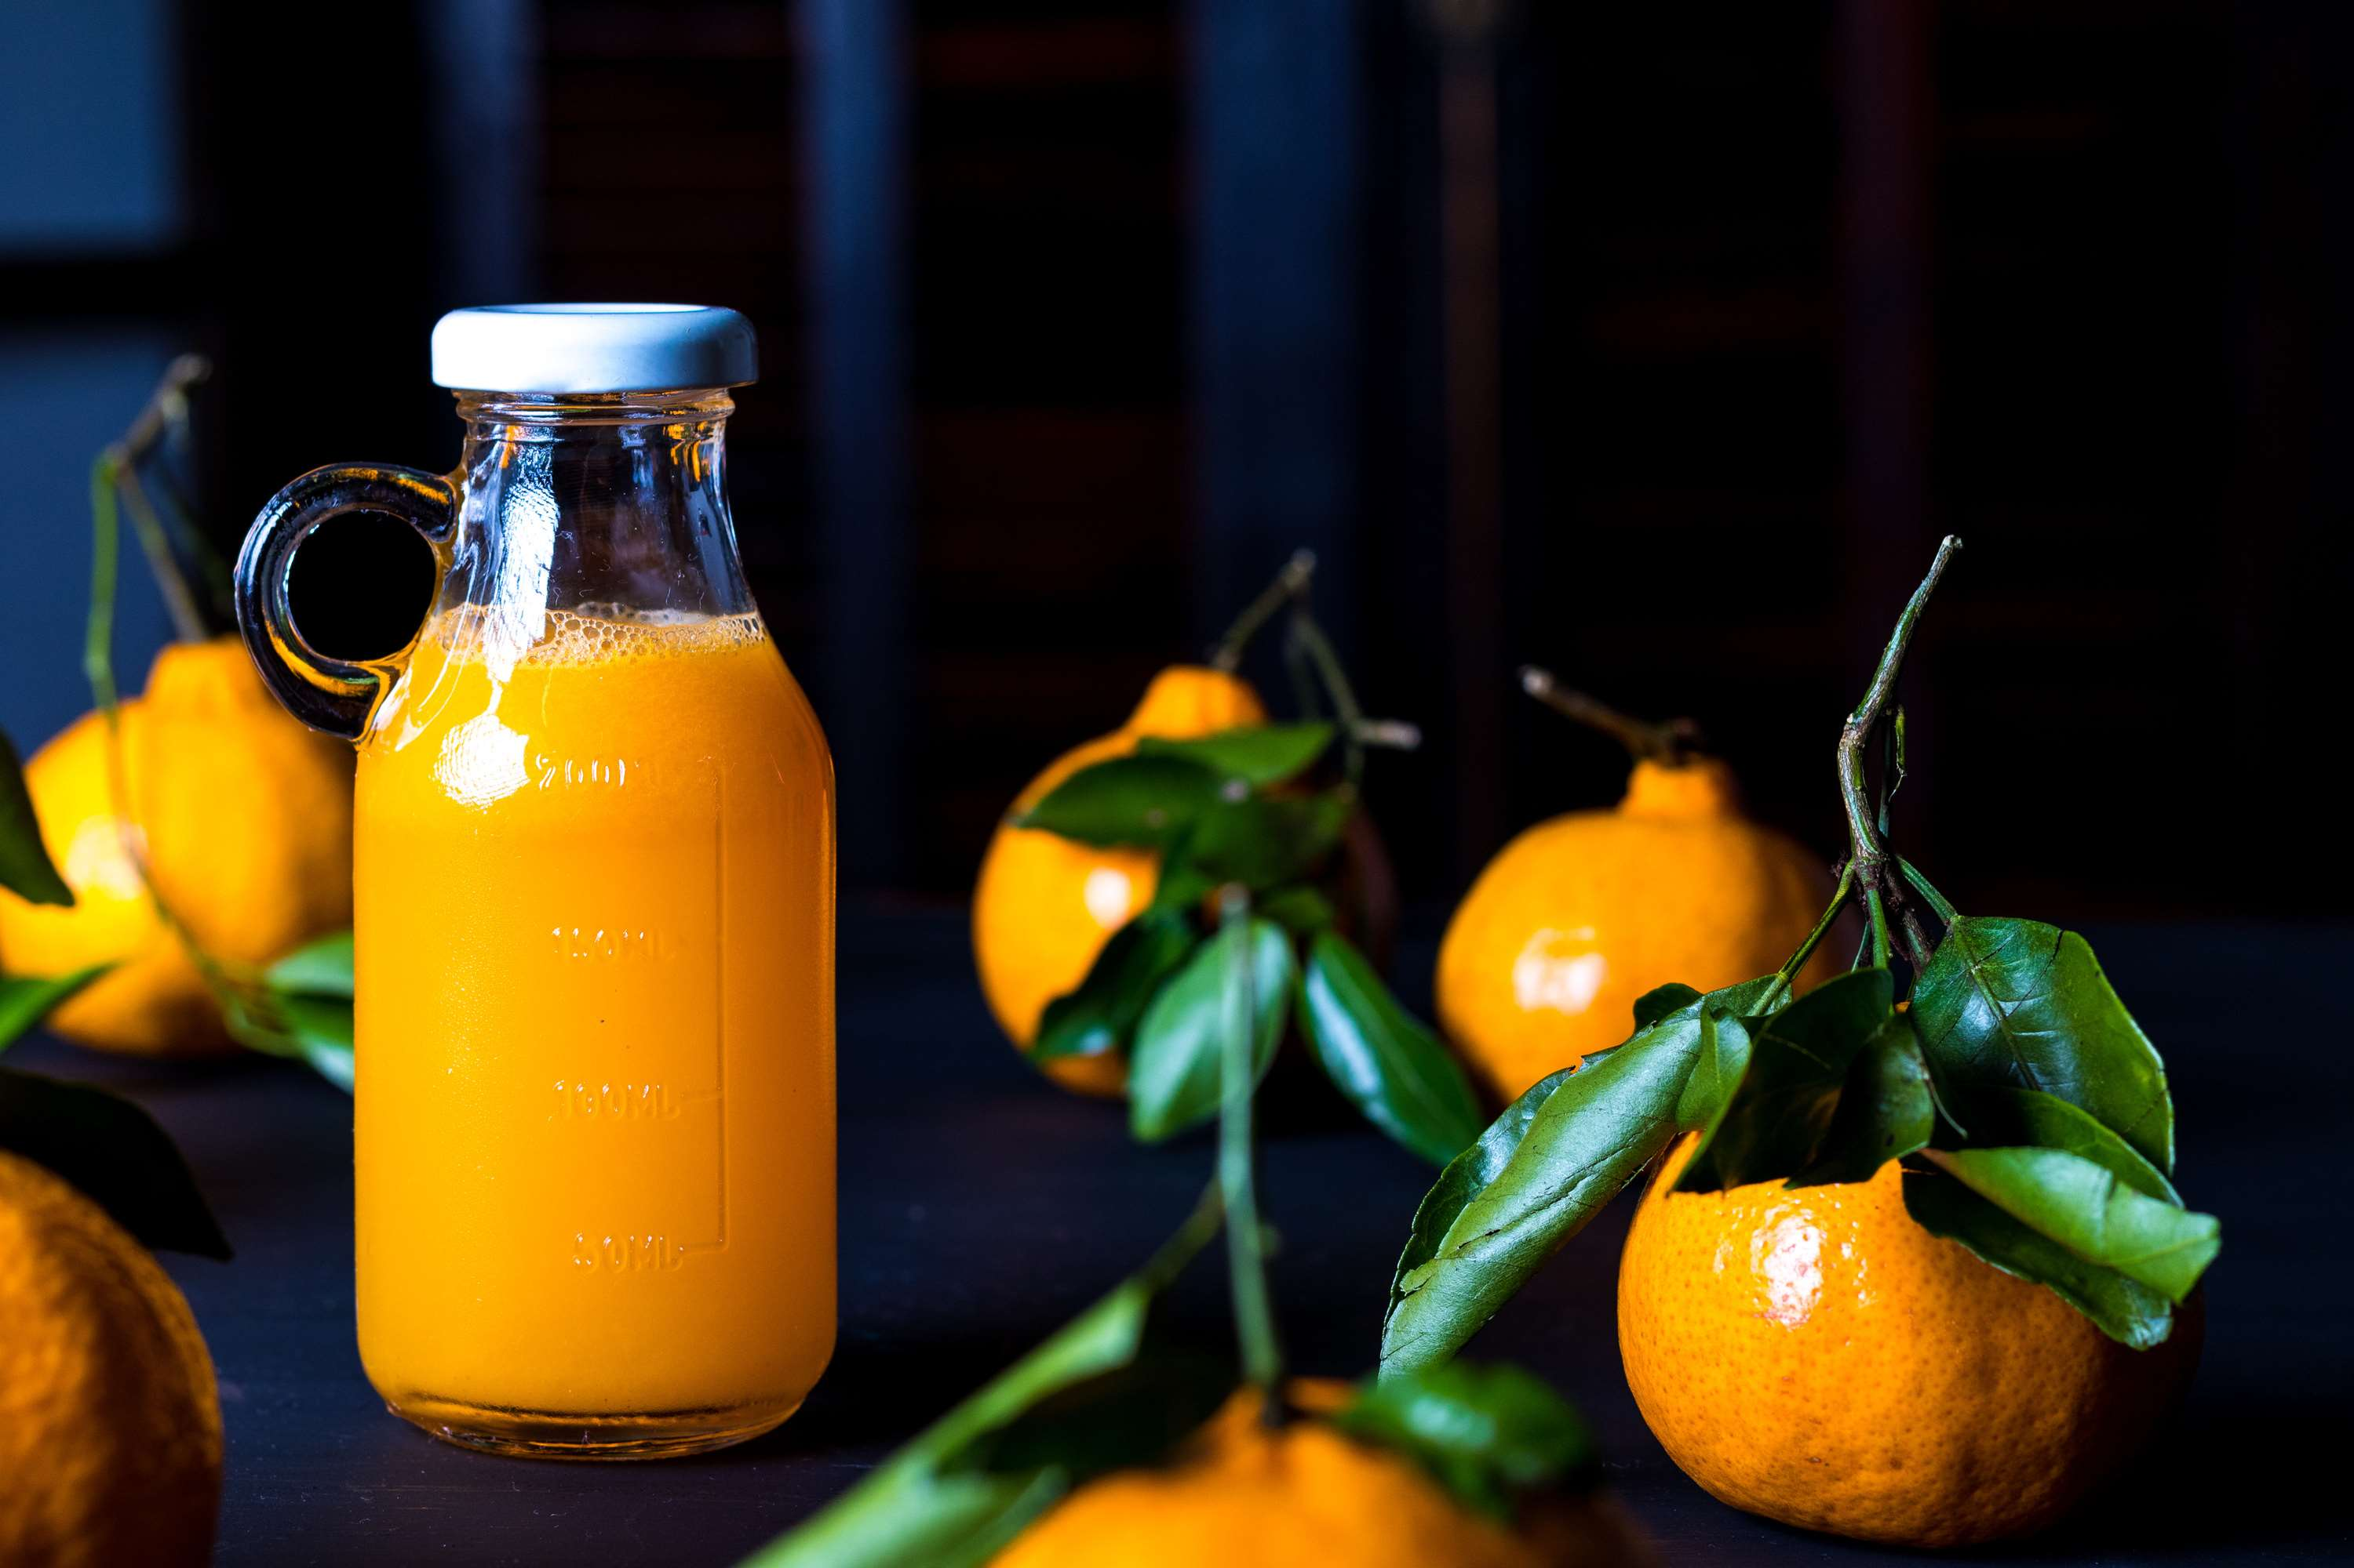
REVENUE MARKET SHARE BY SEGMENTS 2022
  Fruit
  Vegetables
Type Segment
  Clear Concentrate
  Powdered Concentrate
  Frozen Concentrate
Form Segment
  Beverages
  Soups & Sauces
  Dairy
  Bakery & Confectionery
  Other Application
Application Segment
  Food Industry
  Beverage Industry
  Foodservice
  Retailer Household
End User Segment
  Organic Juice Concentrate
  Conventional Juice Concentrate
Nature Segment

Slide 5

Global Juice Concentrate Market Revenue share for 2024
Asia Pacific
23%

Slide 6
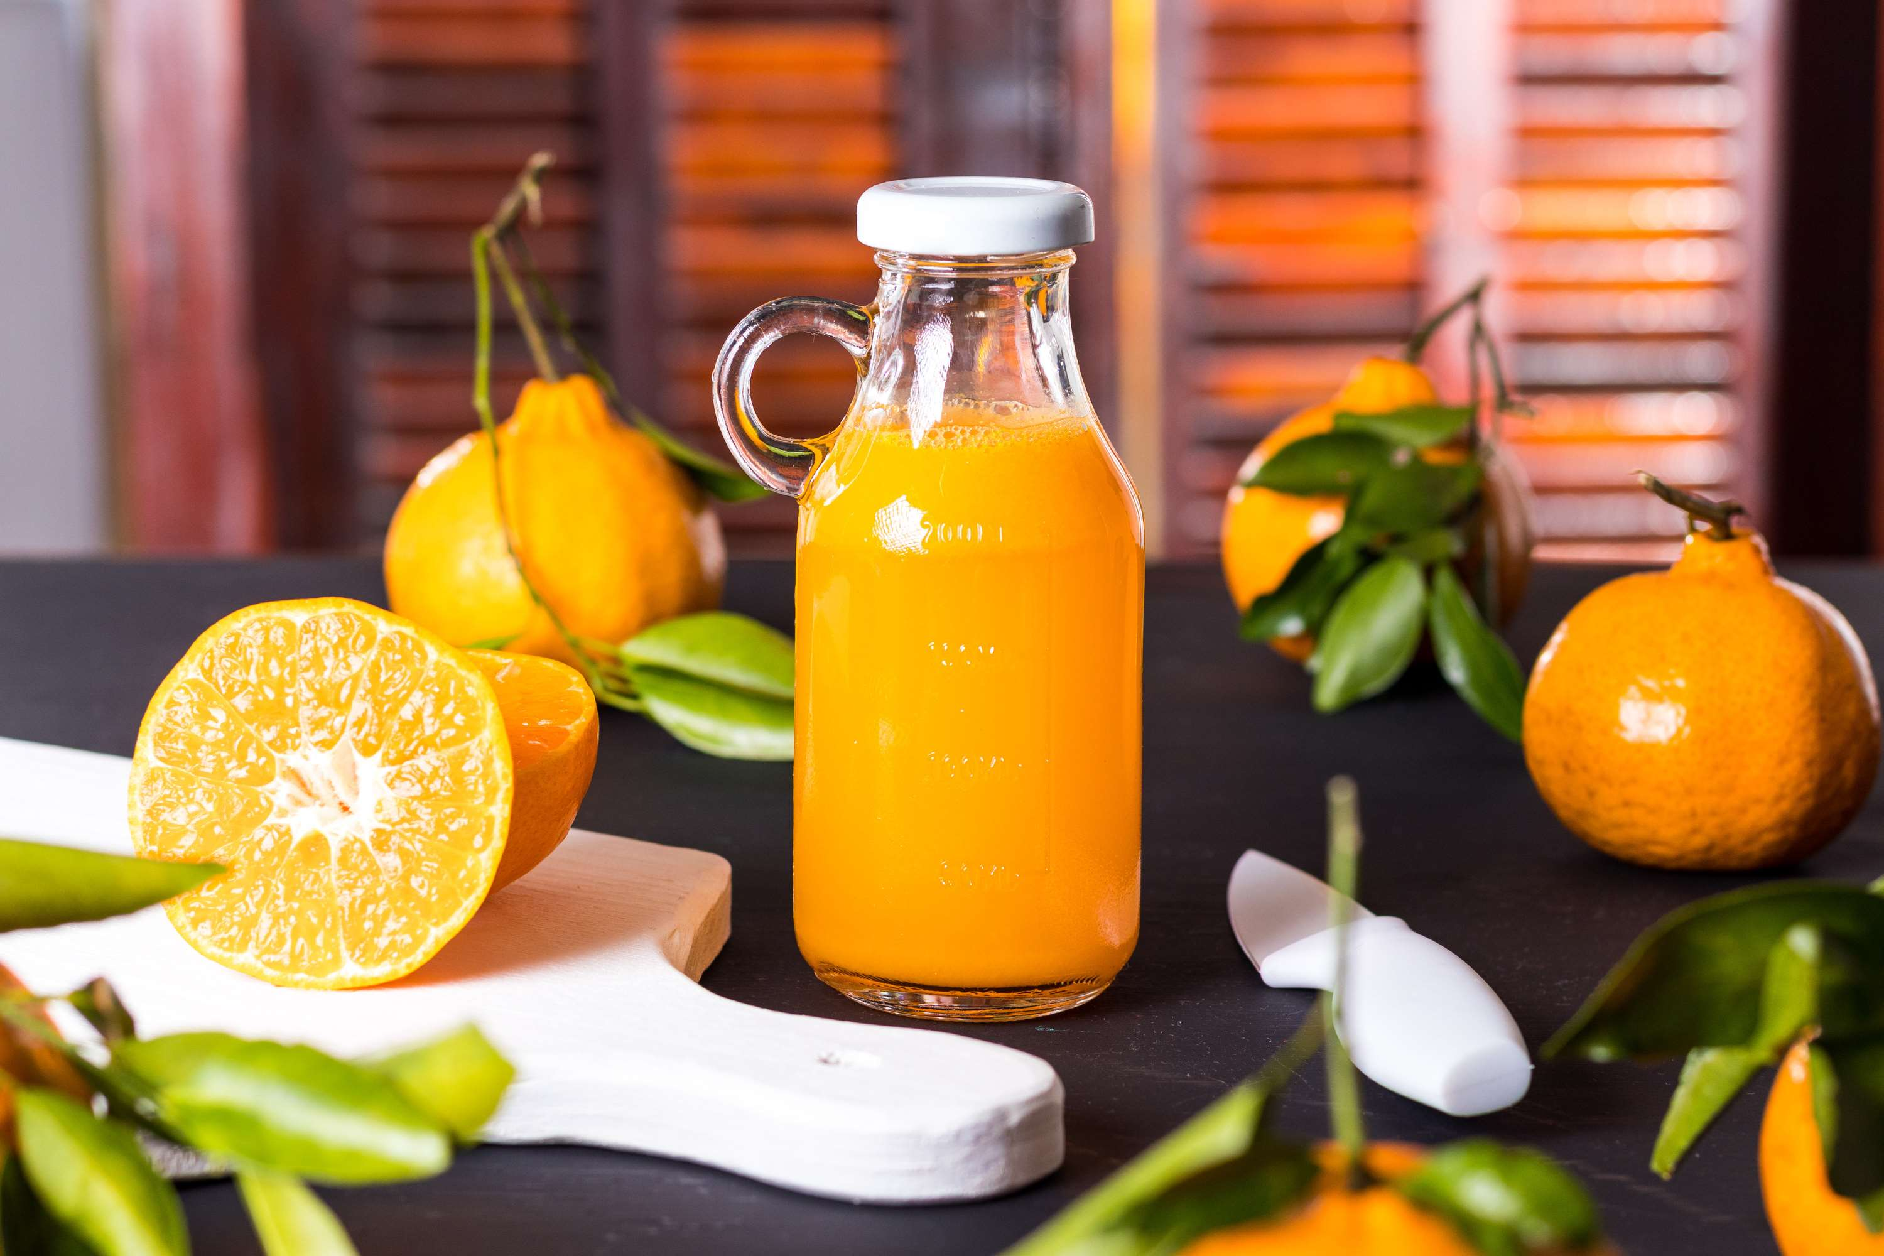
Advancements in Processing Technologies to Propel Market Growth
Drivers
Rising interest for Not from Concentrates and Other Fresh Foods is Restrict Market Growth
Restraints

Slide 7
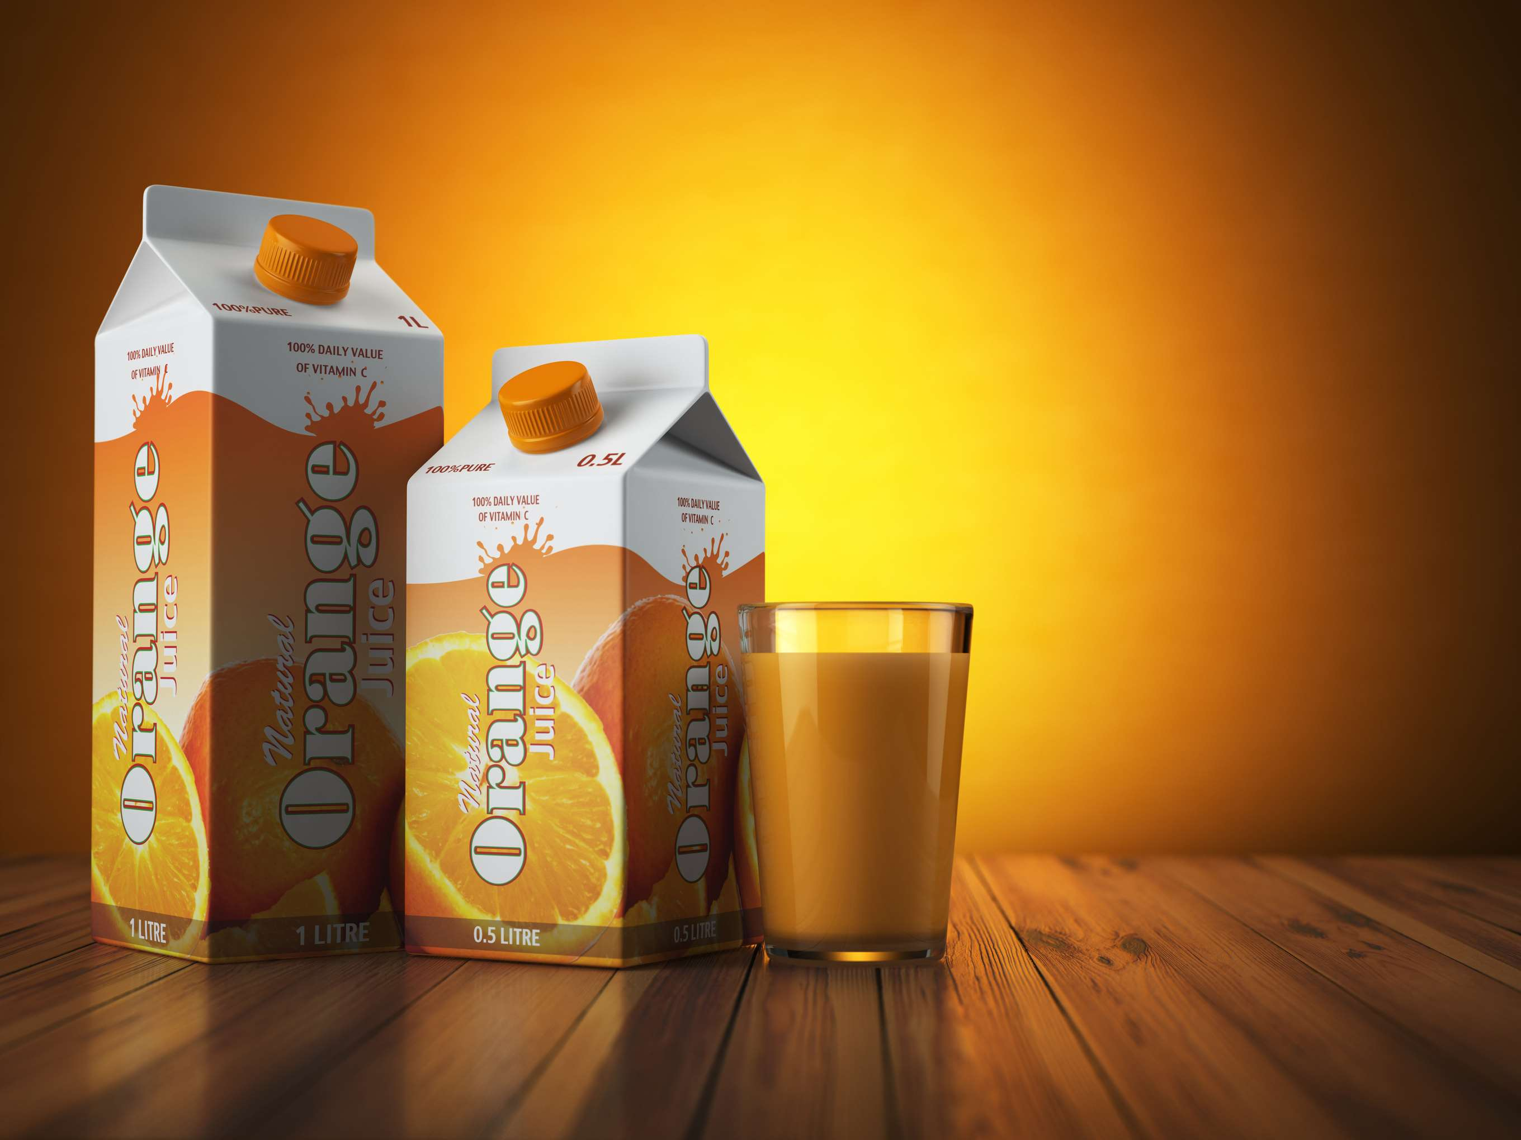
AUTHOR'S PERSPECTIVE
  The Global Juice Concentrate Market is witnessing significant growth in the near future.
  Citrus fruits, apples, and pineapples are in high demand because of their positive impact on health to fuel the market growth.
  Vegetables are the fastest-growing category over the forecast period because vegetable juice concentrates are a convenient substitute for consuming whole veggies, allowing those who have problems eating enough fruits and vegetables to acquire the necessary nutrients.
  Bakery and confectionery products can benefit from using juice concentrates as a natural sweetener instead of refined sugars.
  Conventional juice concentrate is the fastest-growing category over the forecast period; due to processing techniques like pasteurization, conventional juice concentrates might keep for longer than fresh fruit.

Slide 8
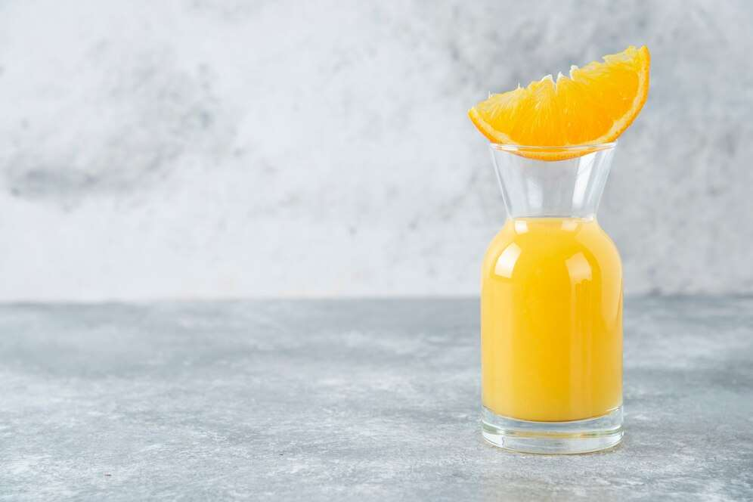




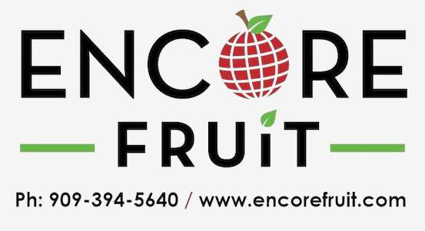
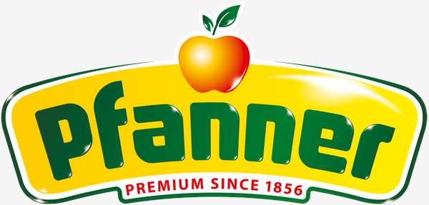
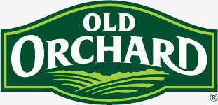
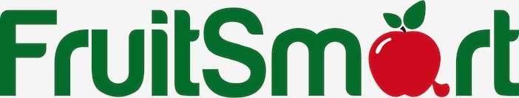
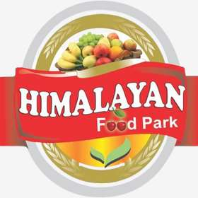


KEY PLAYERS

Slide 9


For Full Report
Contact us
COGNITIVE MARKET RESEARCH
Tel: +1 312-376-8303 | +44 020-8123-0732
India: (+91) 983-496-8611
sales@cognitivemarketresearch.com
Access the Full Report : http://tinyurl.com/25vvft93
Please visit our website:
https://www.cognitivemarketresearch.com

