Slide 1



JIGSAW PUZZLE
MARKET REPORT
2024
Qualitative Analysis + Quantitative Analysis

Slide 2

INTRODUCTION
The manufacture, marketing, and consumption of puzzles made up of pieces that fit together to produce an image when assembled are all included in the jigsaw puzzle market. These puzzles appeal to a wide range of consumers, including adults and kids looking for leisure, mental stimulation, and amusement. The market offers everything from easy-to-understand designs for novices to challenging puzzles with lots of pieces for puzzle experts. Classic jigsaw puzzles have developed to include themed versions with famous artwork, animals, and landscapes. The market has grown steadily over the years due to a number of causes, including rising disposable income, technology improvements, and a rise in interest in recreational activities that encourage offline interaction and mindfulness. The jigsaw puzzle industry is dynamic, offering a timeless activity in a constantly changing environment, thanks to its innovative use of digital technology combined with conventional manufacturing techniques.

Slide 3


KEY INSIGHTS
MARKET SIZE
USD 9915.2 million
2024
CAGR
12.40%
2024- 2031

Slide 4
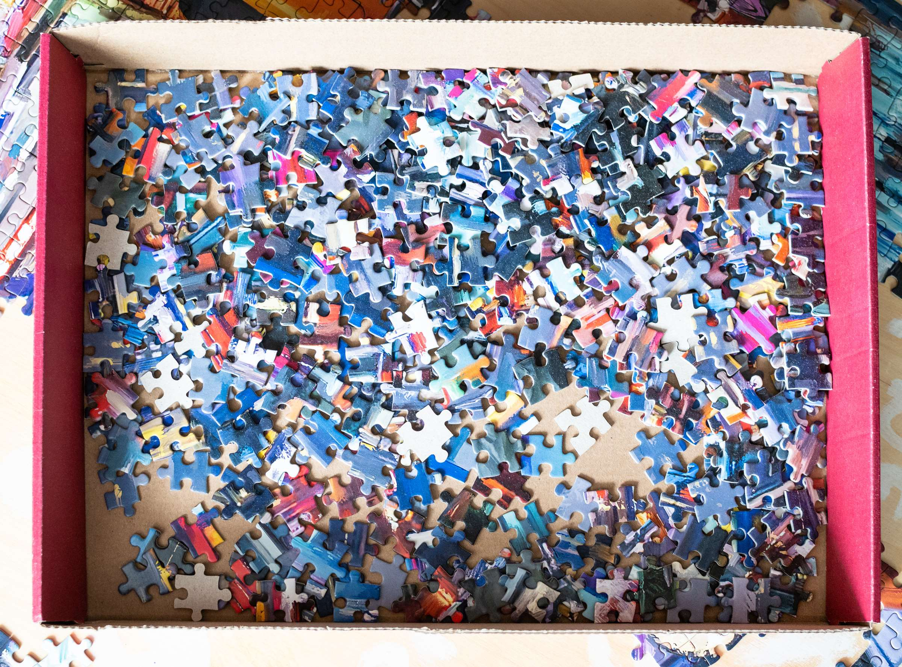
REVENUE MARKET SHARE BY SEGMENTS 2024
  Wood Materials
  Plastic Materials
  Paper Materials
  Metal Materials
  Magnetic Materials
  Easy
  Moderate
  Challenging
  Expert
Difficulty Level Segment
Type Segment
  Nature
  Art
  History
  Pop Culture
  Sports
  Custom
  Children
  Adults
  Elderly
  Educational Institutions
Application Segment
Theme Outlook Segment

Slide 5

North America
40%
North America Jigsaw Puzzle Market Revenue share for 2024 is 40%

Slide 6

  Growing Demand for Screen-Free Activities to Increase the Demand Globally
  Stress Relief and Cognitive Benefits to Propel Market Growth
Drivers
Restraints
Storage Requirements to Limit the Sales

Slide 7

AUTHOR'S PERSPECTIVE
  The global Jigsaw Puzzle market will expand significantly by 12.40% CAGR between 2024 to 2031.
  Jigsaw puzzles can be useful teaching tools for kids in addition to being entertaining.
  Children's fine motor skills, problem-solving techniques, hand-eye coordination, and shape recognition all improve when they finish puzzles. Furthermore, learning in a variety of areas can be reinforced by puzzles with educational elements.
  Traditional still lifes and landscapes are no longer the only designs available for jigsaw puzzles. Puzzle designers are always coming up with new themes, designs, degrees of difficulty, and shapes. This appeals to a wide range of interests and keeps puzzlers of all ages engaged and intrigued.

Slide 8












KEY PLAYERS

Slide 9


For Full Report
Contact us
COGNITIVE MARKET RESEARCH
Tel: +1 312-376-8303 | +44 020-8123-0732
India: (+91) 983-496-8611
sales@cognitivemarketresearch.com
Access the Full Report : https://tinyurl.com/55r5c2cs
Please visit our website:
https://www.cognitivemarketresearch.com

