Slide 1


INTEGRATED CIRCUITS MARKET REPORT

Slide 2

INTRODUCTION
Integrated circuits are small semiconductor chips made of silicon. It denotes an electronic component assembly consisting of fabricated miniature active and passive devices. It was developed to create circuits on microcomputers with multiple components and the interconnection ICs between them.

Slide 3

KEY INSIGHTS
MARKET SIZE
614.3 BILLION
2022
FORECAST
1,248.6 BILLION
2030
2023-
2030
CADR
9.2%

Slide 4
REVENUE MARKET SHARE BY SEGMENTS 2022
TYPE
1
PRODUCT TYPE
2
APPLICATION
3
APPLICATION- SPECIFIC IC: 65.7%
UNDERGROUND LHD LOADERS: 41.2%
ANALOG IC: 48.4%
END-USER
4
CONSUMER ELECTRONICS: 38.4%

Slide 5

GLOBAL INTEGRATED CIRCUITS MARKET REVENUE SHARE FOR 2022
NORTH AMERICA: 32.1%
The North America integrated circuit market dominates the industry owing to the presence of advanced electronics and telecommunications industries in the region and the trend of adopting the latest advanced technologies.

Slide 6
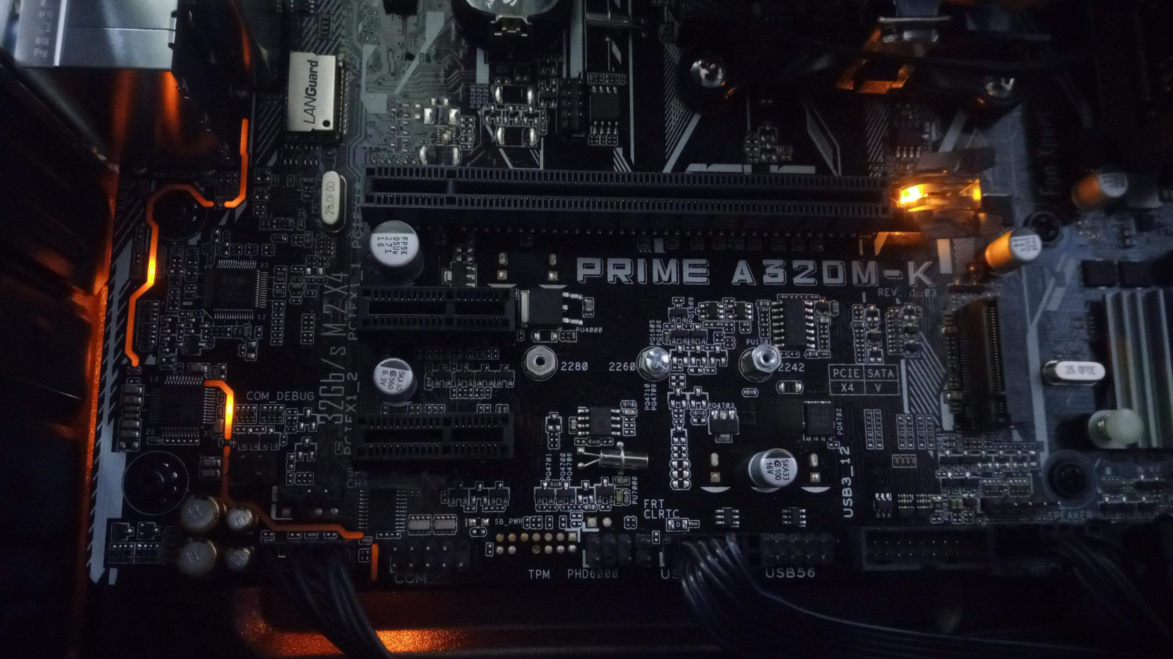


DRIVERS
Increasing demand for high- speed and efficient data transmission in data centers increasing use of integrated circuits in consumer electronic
RESTRAINTS
Low Chances of Repair or Re-fabrication

Slide 7

AUTHOR'S PERSPECTIVE
The application specific IC segment held the largest share in the global integrated circuit market in 2021 and is expected to remain dominant during the forecast period.
The consumer electronics segment is expected to dominate the global market. With the increasing usage of ICs in mobile phones, tablets, and laptops globally, the consumer electronics vertical is expected to offer significant growth opportunities to all players involved in the value chain.

Slide 8
KEY PLAYERS

Slide 9
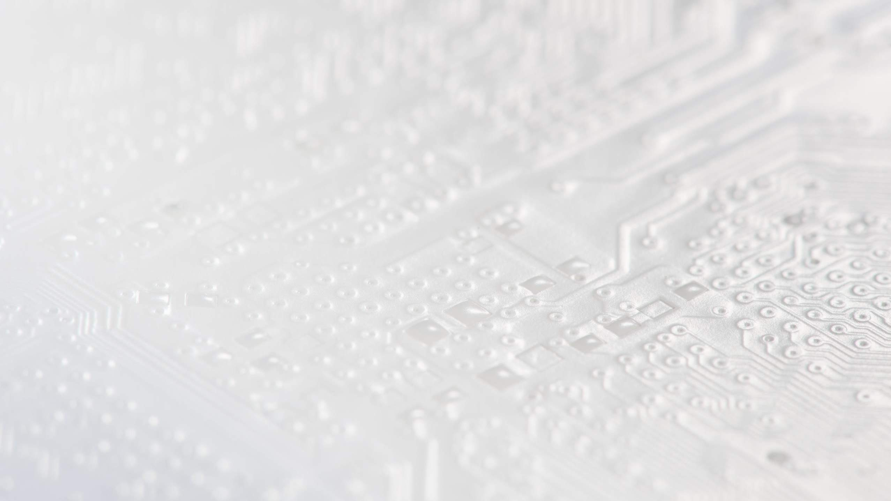

Contact us
For Full Report
COGNITIVE MARKET RESEARCH
Tel: + 1 312 - 376 - 8303 | + 44 020 - 8123 - 0732
India: ( + 91 ) 983 - 496 - 8611
sales@ cognitivemarketresearch. com
Access the Full Report : http://tinyurl.com/meherdye
Please visit our website:
https://www.cognitivemarketresearch.com

