Slide 1
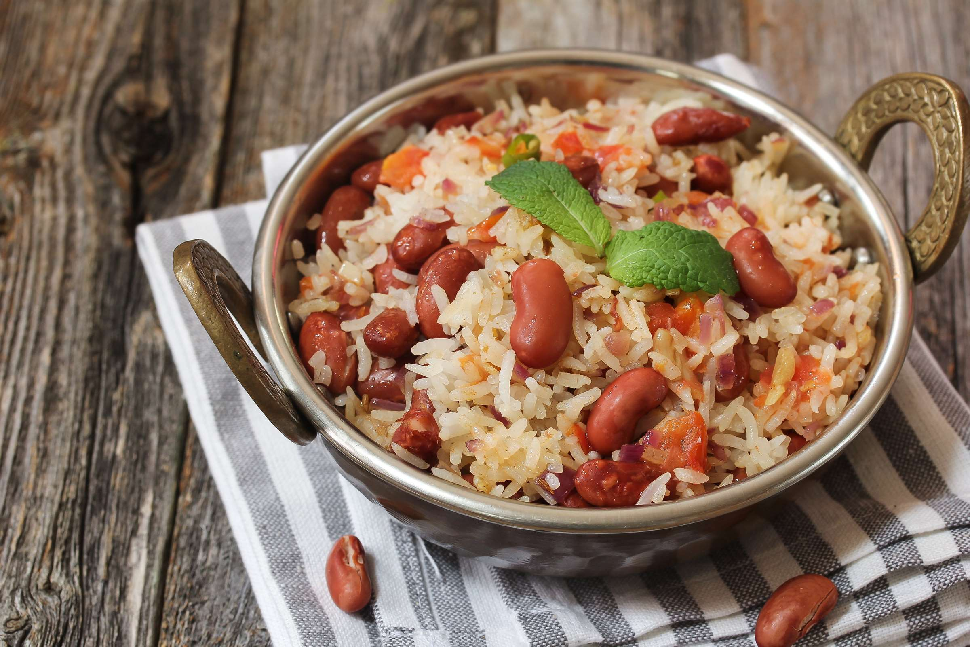
GLOBAL
INSTANT RICE
MARKET REPORT
2024
Global,Regional,CountryAnalysis

Slide 2

INTRODUCTION
The manufacture, distribution, and consumption of rice that has been processed to speed up cooking are all included in the instant rice market. Unlike conventional rice varieties, instant rice can be prepared more quickly since it goes through partial heating, dehydration, and occasionally fortification before packaging. Customers looking for quick meal options without sacrificing flavor or nutrition are catered to in this sector. Products made using instant rice come in various varieties, including flavored, brown, white, and organic, to accommodate various dietary requirements and tastes. Distributors, retailers, and makers of food are important market participants. The market is expanding due to growing urbanization, shifting consumer lifestyles, and increased demand for convenient food items. However, market dynamics can be impacted by pricing, competition from traditional rice, and supply chain problems.

Slide 3


KEY INSIGHTS
MARKET SIZE
USD 21512.2 million
2024
CAGR
6.20%
2024- 2031

Slide 4

REVENUE MARKET SHARE BY SEGMENTS 2022
  Sales
  Household
  HoReCa
  White Rice
  Brown Rice
Type Segment
End-Use Segment
  Hypermarket/Supermarket
  Grocery Store
  Online
  Specialty Stores
  Pouches
  Boxes
  Bags
  Cans
Sales Segment
Packaging Segment

Slide 5

Global Instant Rice Market Revenue share for 2024
North America
40%

Slide 6

  Rising disposable incomes to Increase the Demand Globally
  Growing Awareness of Health to Propel Market Growth
Drivers
Restraints
High Price to Limit the Sales

Slide 7

AUTHOR'S PERSPECTIVE
  The global instant rice market will expand significantly by 6.20% CAGR between 2024 to 2031.
  There is a growing demand for healthier instant rice options as people become more conscious of the value of eating a balanced diet. In response to this demand, producers are introducing new goods that contain whole grains, brown rice, and other healthful components.
  People may now purchase instant rice online more easily because to the growth of e-commerce. This increases the product's accessibility for a larger group of customers and contributes to an increase in sales.

Slide 8


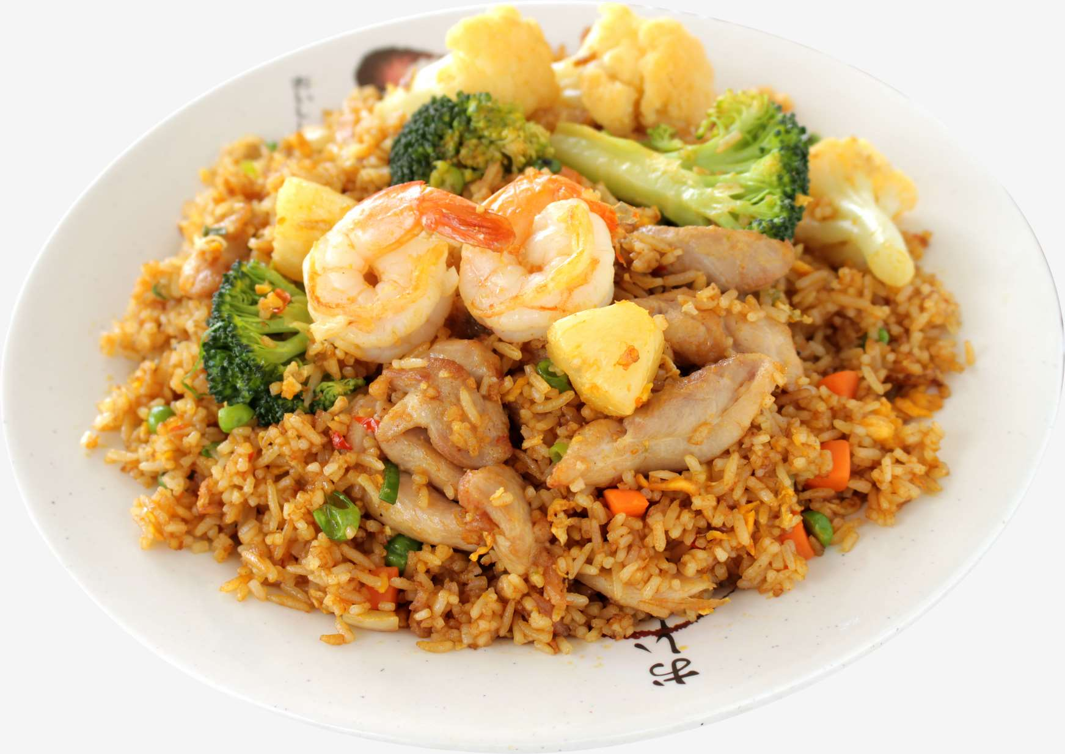






KEY PLAYERS

Slide 9


For Full Report
Contact us
COGNITIVE MARKET RESEARCH
Tel: +1 312-376-8303 | +44 020-8123-0732
India: (+91) 983-496-8611
sales@cognitivemarketresearch.com
Access the Full Report : https://tinyurl.com/2czxnu3n
Please visit our website:
https://www.cognitivemarketresearch.com

