Slide 1
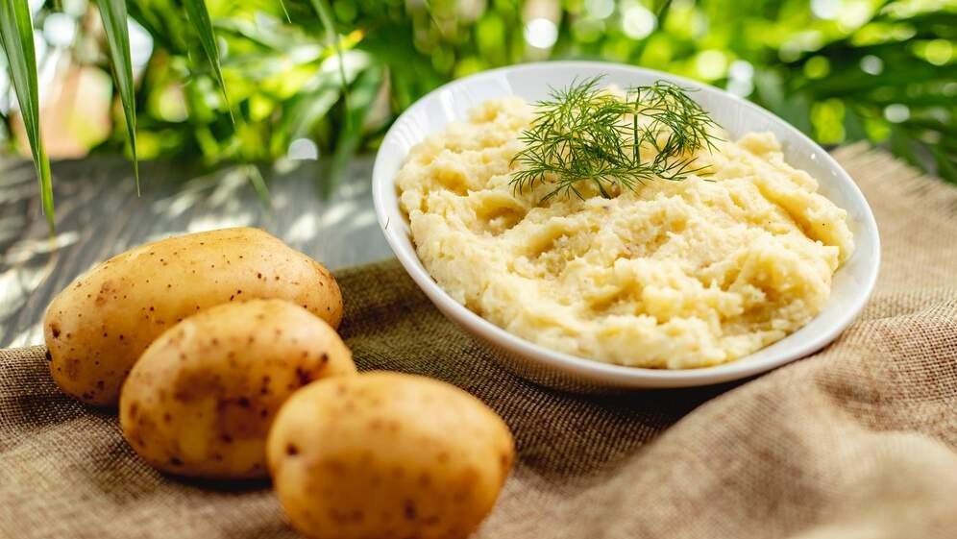
GLOBAL
INSTANT MASHED POTATOES
MARKET REPORT 2024
Global,Regional,CountryAnalysis

Slide 2
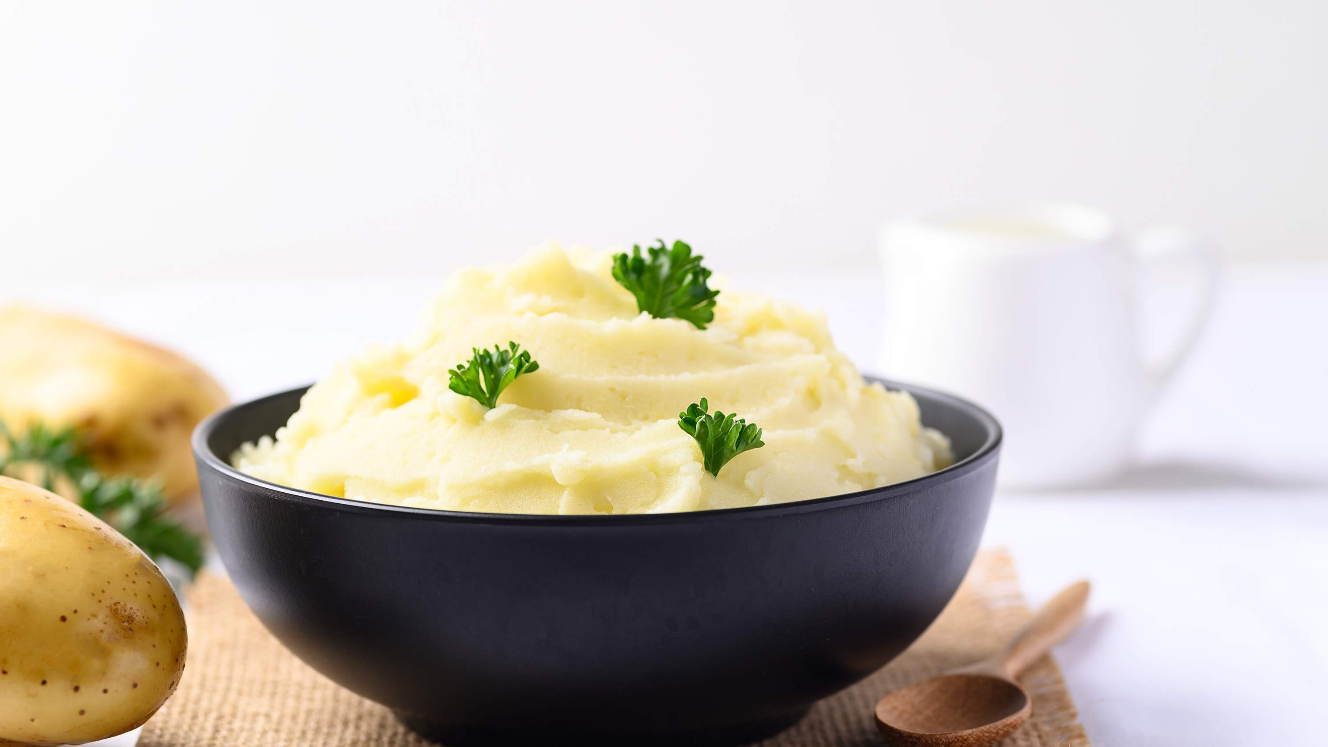
INTRODUCTION
Instant mashed potatoes are derived from potatoes that have been peeled and boiled before being mashed using a potato masher, fork, or electric mixer. To enhance the taste, butter, milk, salt, and pepper are frequently incorporated into the potatoes. Additional ingredients such as shredded cheese, green onions, or various herbs can also be added. The increasing demand for convenient food and beverages, particularly among consumers with busy lifestyles, as well as the rising number of working women and the health advantages associated with these products, are driving the growth of this market.

Slide 3
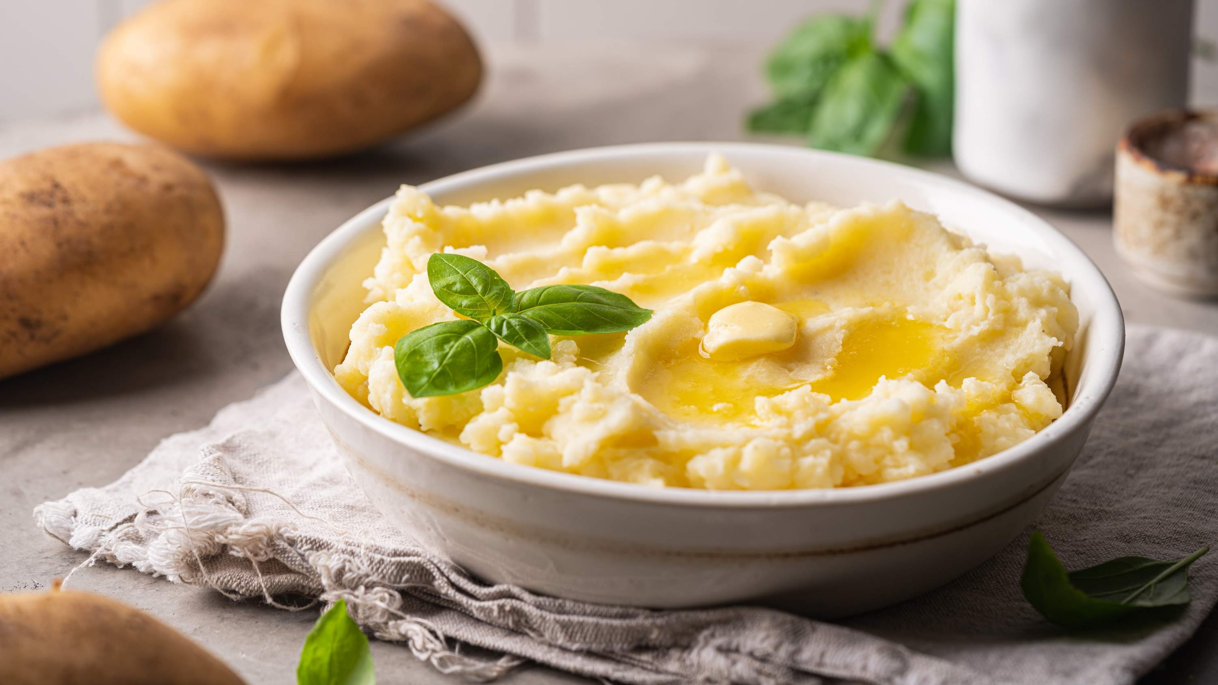

KEY INSIGHTS
20₋23
CAGR 6.30%
2030

Slide 4
REVENUE MARKET SHARE BY SEGMENTS 2022
Original Mashed Potatoes
Milk Flavored Mashed Potatoes
Type Segment
Online Sale Offline Sale
Application Segment

Slide 5
Global Instant Mashed Potatoes Market Revenue share for 2022
Asia Pacific

Slide 6

Rising Consumer Demand for Convenience Foods to Provide Viable Market Output Innovation and Product Diversification to Propel Market Growth
Drivers
Supply Chain Disruptions and Raw Material Shortages to Hinder Market Growth
Restraints

Slide 7
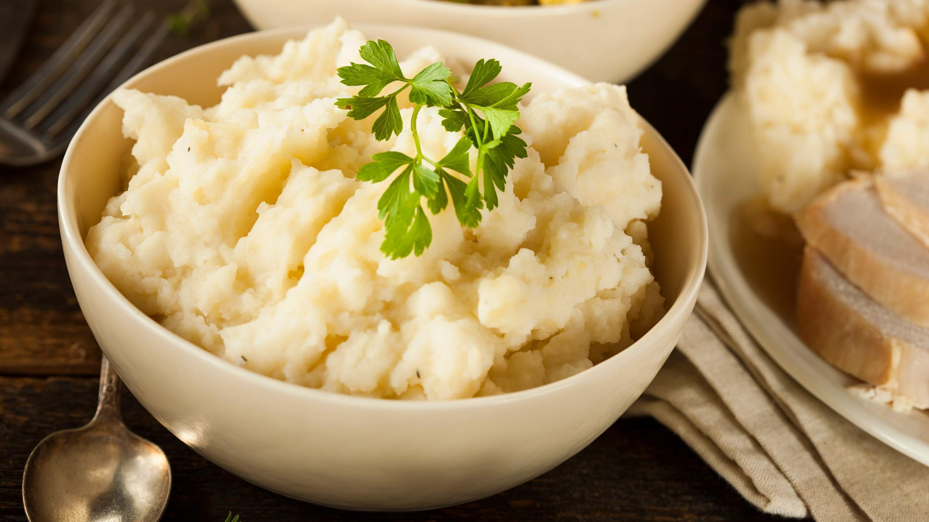
AUTHOR'S PERSPECTIVE
The Global Instant Mashed Potatoes Market is witnessing significant growth in the near future.
Original mashed potatoes serve as a blank canvas for various culinary innovations, allowing consumers to customize their meals according to individual preferences.
The milk-flavored mashed potatoes segment has witnessed rapid growth with the rising demand for premium and innovative food products, especially among millennials and urban consumers.
Traditional brick-and-mortar stores, including supermarkets, hypermarkets, and convenience stores, continue to be the primary source for consumers purchasing instant mashed potatoes.

Slide 8
KEY PLAYERS

Slide 9


Contact us
For Full Report
COGNITIVE MARKET RESEARCH
Tel: + 1 312 - 376 - 8303 | + 44 020 - 8123 - 0732
India: ( + 91 ) 983 - 496 - 8611
sales@ cognitivemarketresearch. com
Access the Full Report : http://tinyurl.com/375nd6vu
Please visit our website:
https://www.cognitivemarketresearch.com

