Slide 1

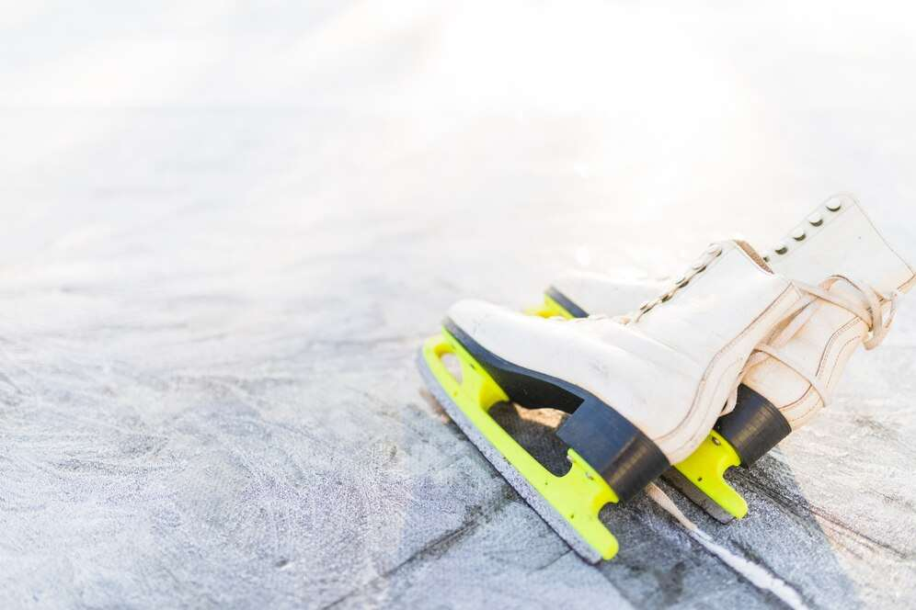
ICE HOCKEY SKATES
MARKET REPORT
2024
Qualitative Analysis + Quantitative Analysis

Slide 2
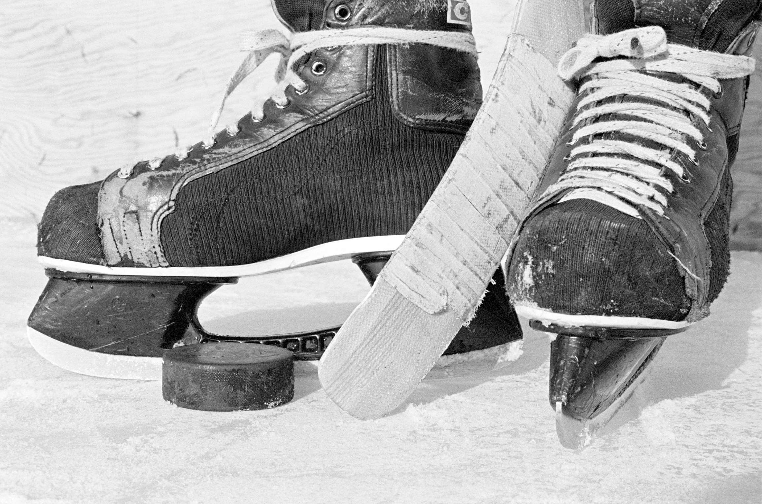
INTRODUCTION
The ice hockey skates market is a dynamic sector within the broader sports equipment industry, catering primarily to ice hockey enthusiasts ranging from amateur players to professionals. Characterized by constant innovation and technological advancements, this market offers a diverse range of products tailored to meet the demands of players seeking performance, comfort, and durability. Key factors driving the growth of the ice hockey skates market include increasing participation rates in ice hockey globally, rising disposable incomes, and a growing emphasis on fitness and recreational activities.

Slide 3
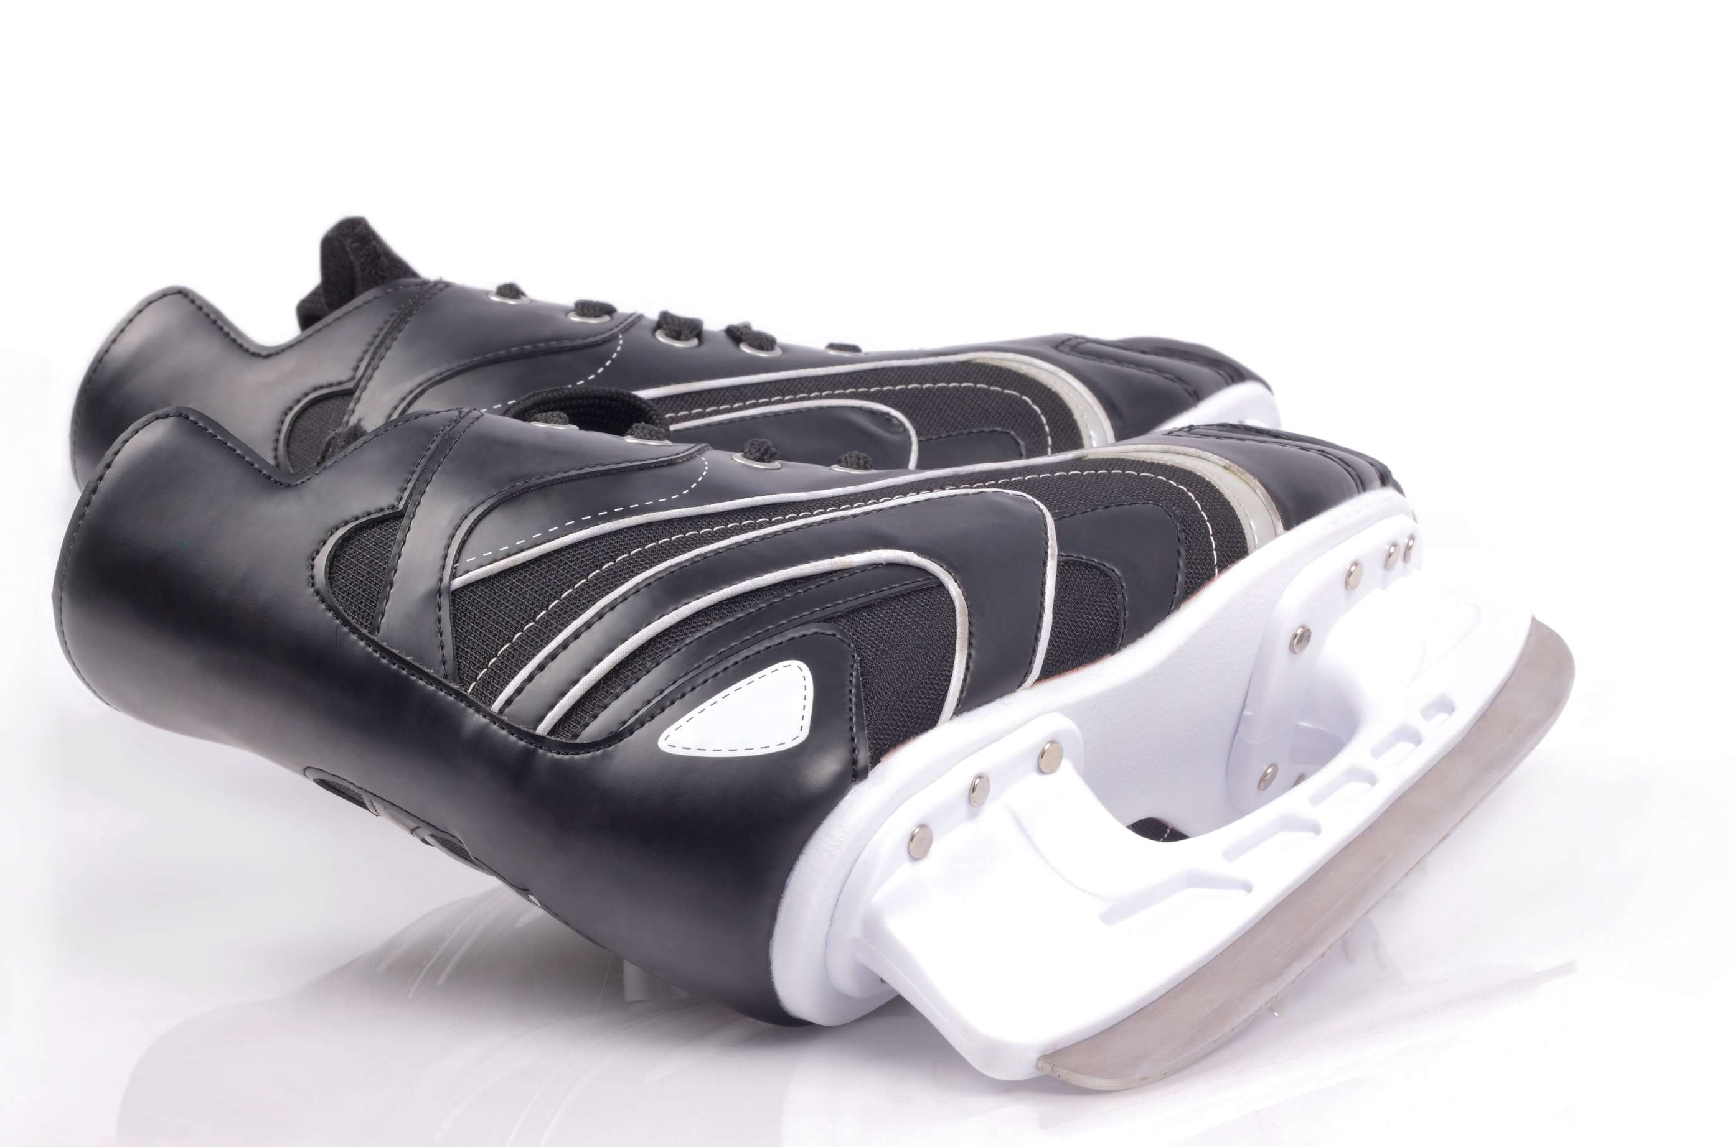

KEY INSIGHTS
CAGR
4.00%
2024- 2031

Slide 4
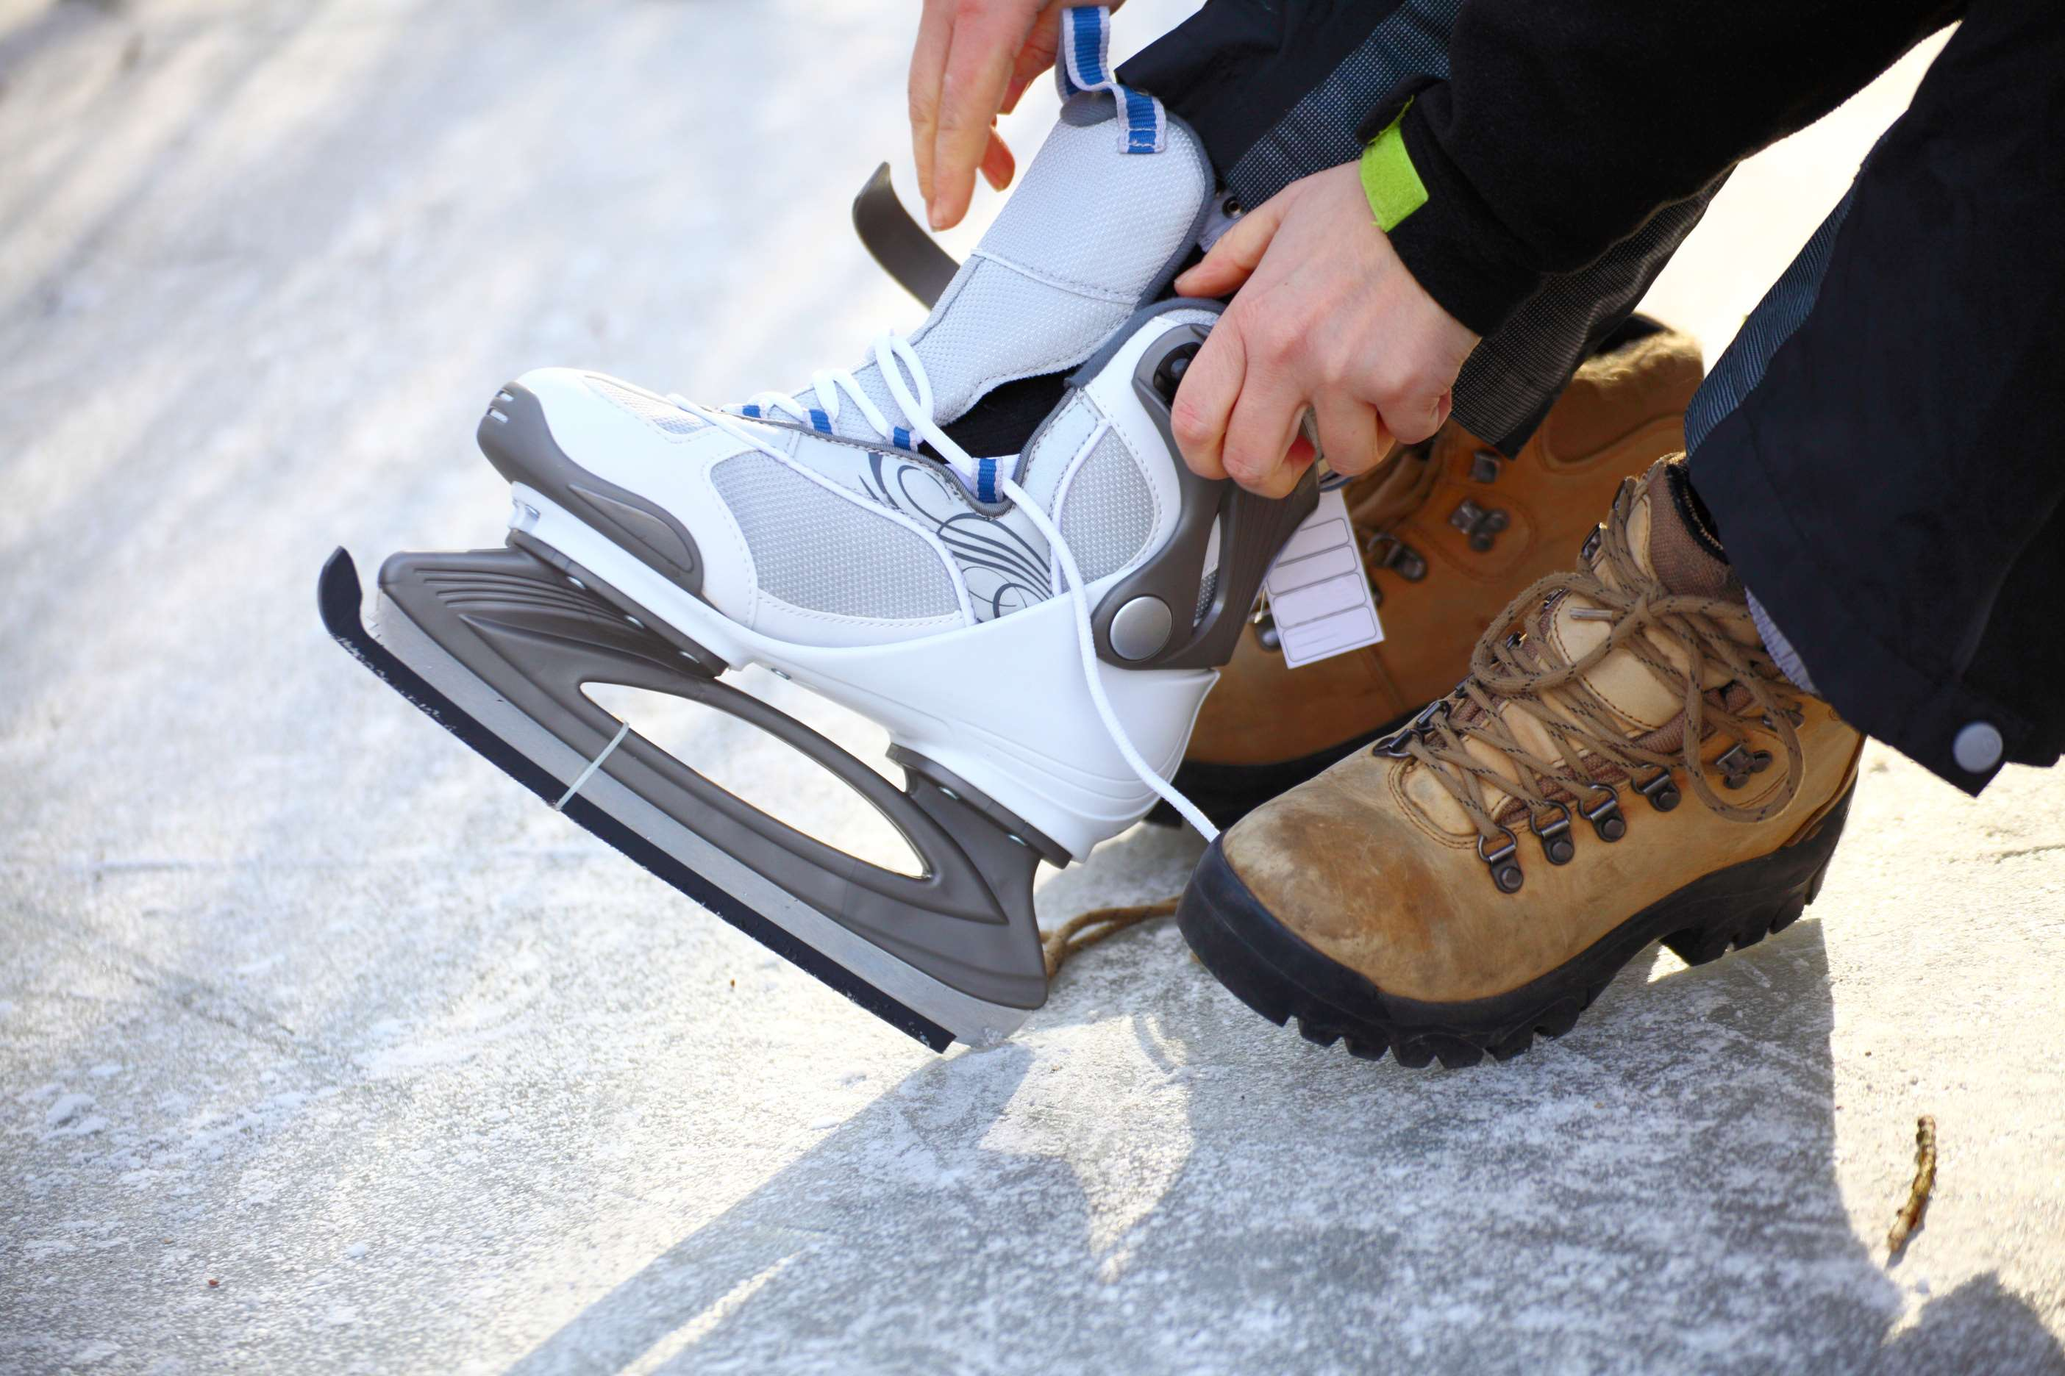
REVENUE MARKET SHARE BY SEGMENTS 2024
  D Width
  R Width
  E Width
  Below 500
  500 to 3000
  Above 3000
Type Segment
Lumen Segment
  Professional Athletes
  Amateurs
  Adjustable
  Fixed
Distribution Channel
Blade Type Segment

Slide 5

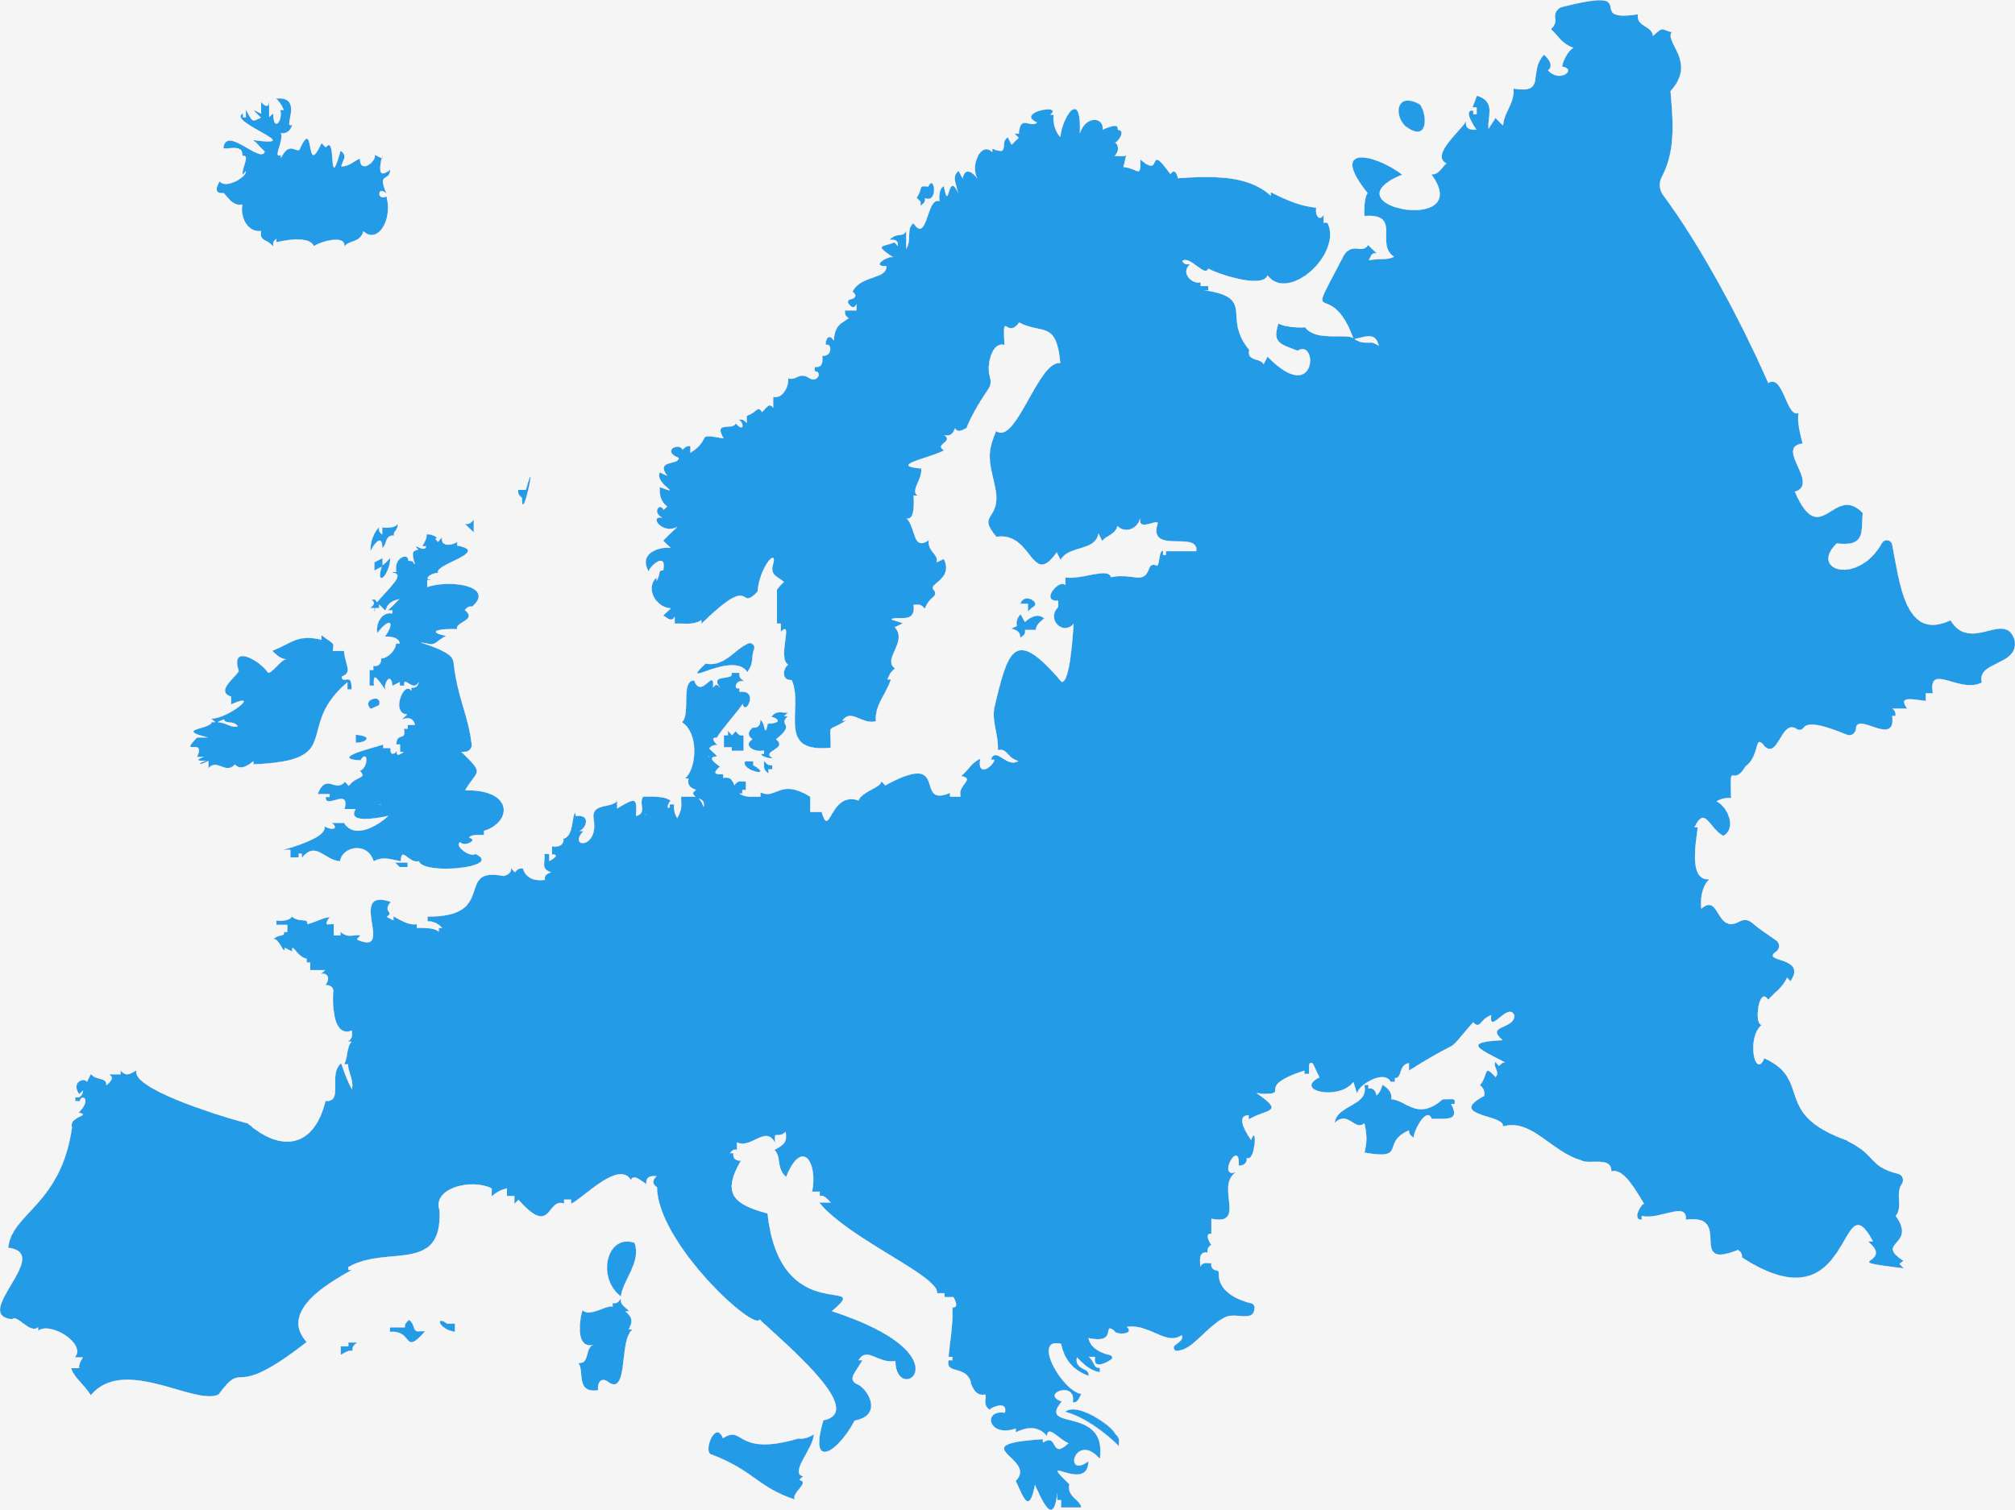
Europe Ice Hockey Skates Market Revenue share for 2024 is 30%
Europe
30%

Slide 6
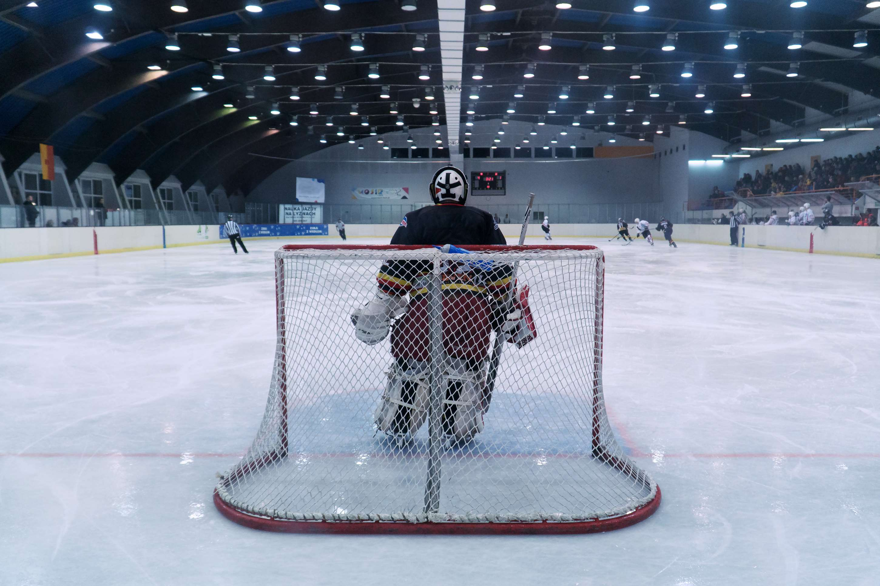
  Popularity and Growth of Ice Hockey to Increase the Demand Globally
  Growing Participation of Women in Ice Hockey to Propel Market Growth
Drivers
Costs and Pricing to Impede the Market Growth
Restraints

Slide 7

AUTHOR'S PERSPECTIVE
  The global Ice Hockey Skates market will expand significantly by 4.00%CAGR between 2024 and 2031.
  Amateur application stands out as the dominating category. Amateurs constitute a significant segment of the market, ranging from casual recreational players to serious enthusiasts participating in amateur leagues and competitions.
  Online distribution channels have experienced significant growth, driven by the convenience of e-commerce platforms and the widespread availability of a diverse range of products.

Slide 8

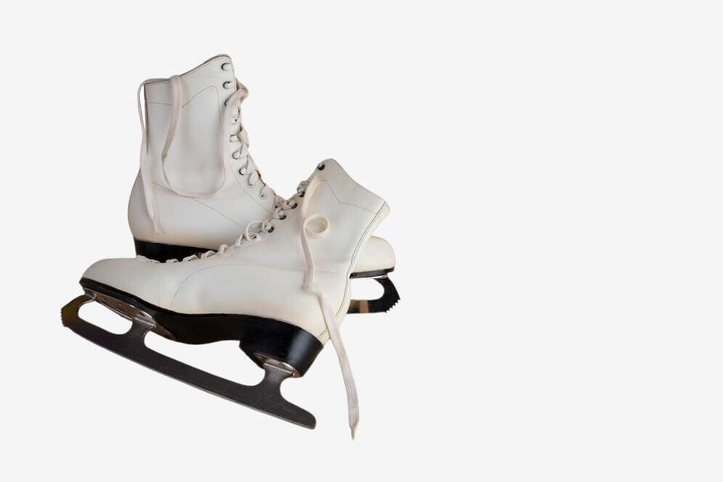










KEY PLAYERS

Slide 9


For Full Report
Contact us
COGNITIVE MARKET RESEARCH
Tel: +1 312-376-8303 | +44 020-8123-0732
India: (+91) 983-496-8611
sales@cognitivemarketresearch.com
Access the Full Report : https://tinyurl.com/2p9z8cyk
Please visit our website:
https://www.cognitivemarketresearch.com

