Slide 1
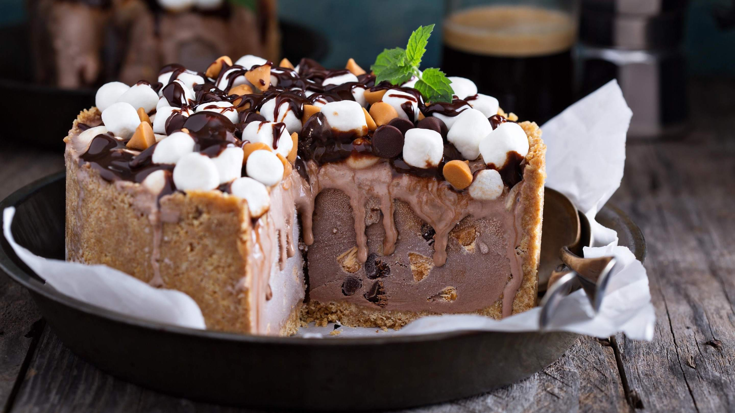
GLOBAL
Ice Cream Cake
MARKET REPORT 2024
Global,Regional,CountryAnalysis

Slide 2

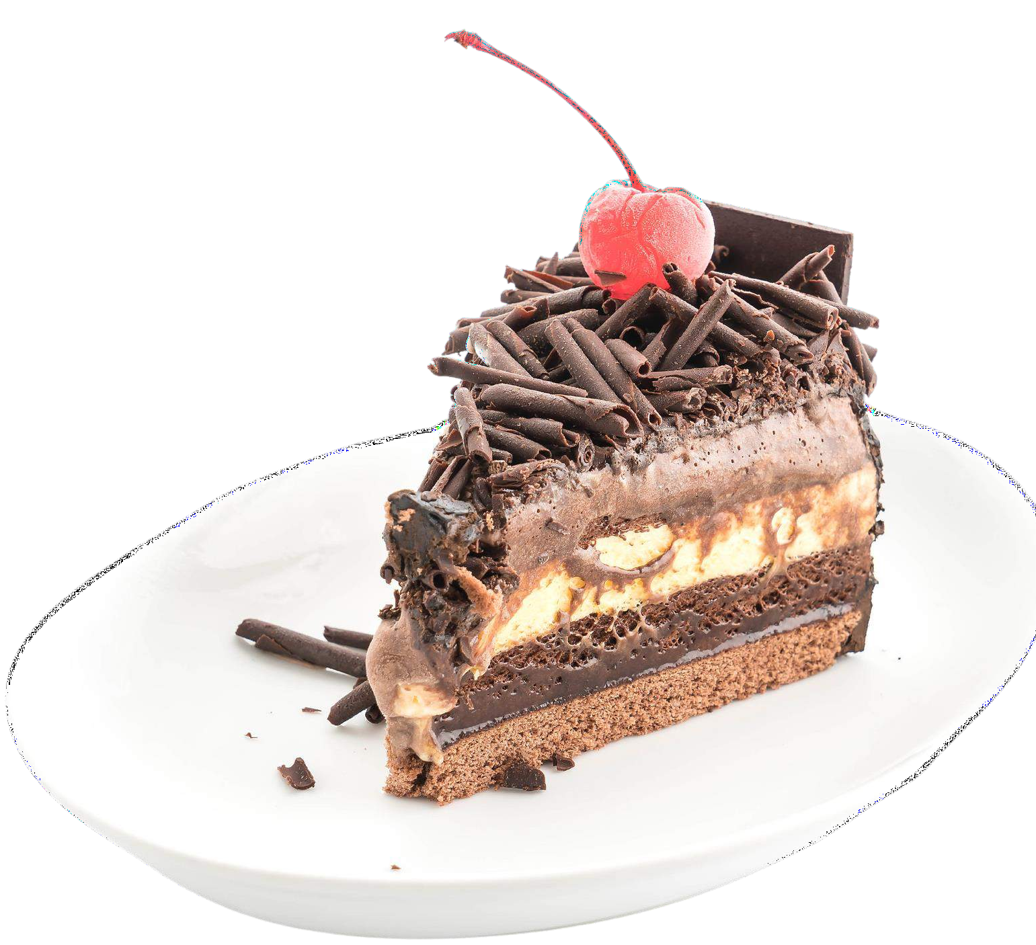
INTRODUCTION
Seasonal demand fluctuations in the Ice Cream Cake market lead to heightened consumer interest during warmer months. Manufacturers and retailers respond by increasing production and marketing efforts, primarily in the summer, ensuring both customer satisfaction and optimized inventory turnover. This strategy effectively aligns production and supply chains with shifting consumer preferences throughout the year. Ice cream cakes are closely tied to celebrations like birthdays and holidays, driving increased demand during these periods. This creates a distinct seasonal demand pattern in the market. To meet these celebratory needs, the industry introduces occasion-specific designs and flavors, boosting sales as consumers are drawn to a variety of choices tailored for special occasions, reinforcing the link between ice cream cakes and memorable celebrations.

Slide 3


KEY INSIGHTS
MARKET SIZE
USD 0.146 billion
2023
20₋23
CAGR 4.2%
2030

Slide 4
REVENUE MARKET SHARE BY SEGMENTS 2022
Chocolate Flavor
Vanilla Flavor
Fruit Flavor
Type Segment
Cake Occasion Segment
Birthdays
Weddings
Corporate events
Supermarkets/Hypermarkets
Convenience Stores
Specialty Stores
Online Retail
Distribution Channel
Regular Cake
Gluten-free Cake
Dairy-free Cake
Sugar-free Cake
Cake Type Segment
Low
Medium
High
Price Range Segment

Slide 5
Global Ice Cream Cake Market Revenue share for 2022
North America

Slide 6
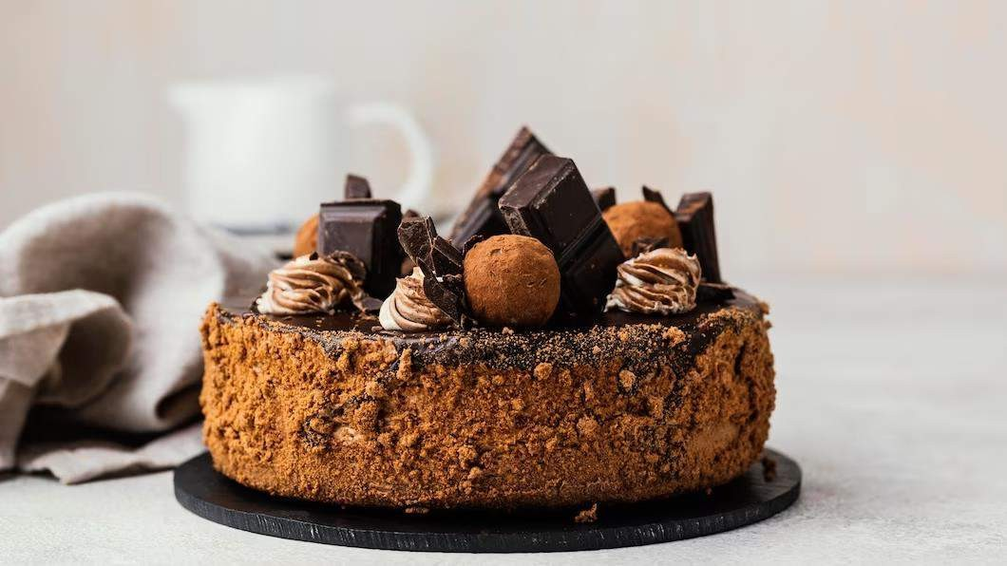





Slide 7

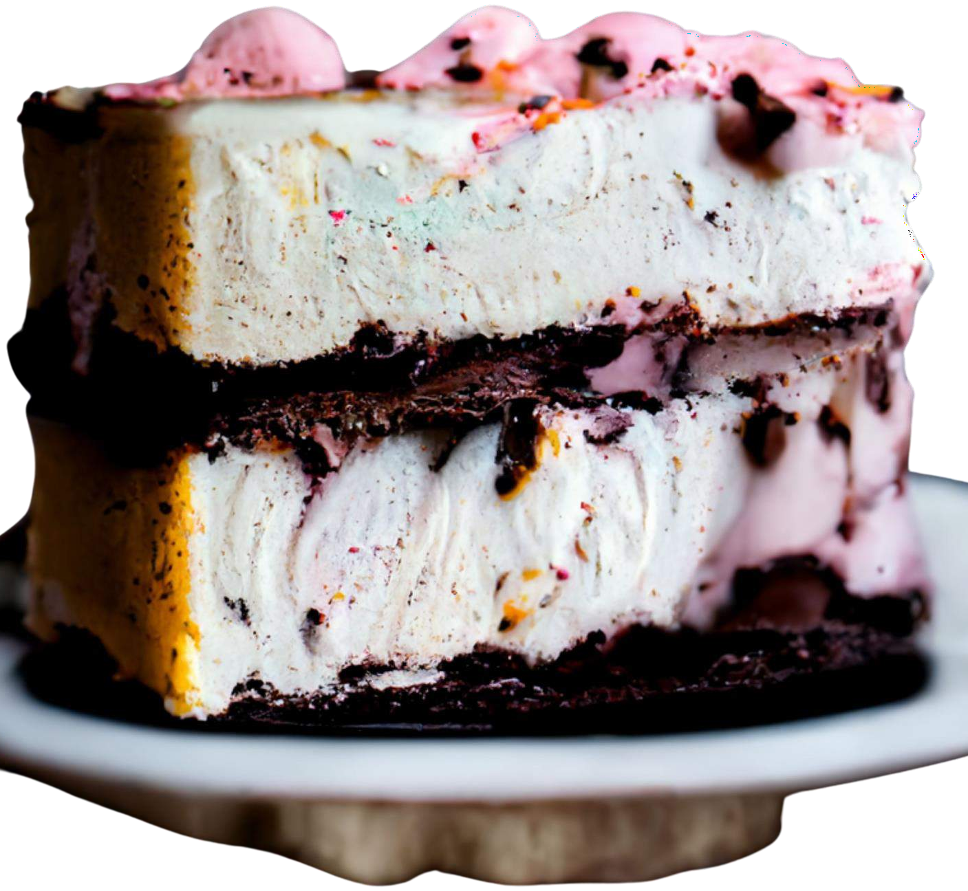
AUTHOR'S PERSPECTIVE
The Global Ice Cream Cake Market is witnessing significant growth in the near future.
The fusion of fruit flavors with the creaminess of ice cream has captured the interest of consumers, making it the fastest-growing segment as people seek a balance between indulgence and healthier options.
Consumers are increasingly willing to splurge on high-quality, artisanal, and customized ice cream cakes for special occasions, driving the growth of the high-priced segment.
The versatility and novelty of ice cream cakes are being recognized as a unique treat for professional occasions, making it a rapidly expanding segment of the market.

Slide 8
KEY PLAYERS

Slide 9


Contact us
For Full Report
COGNITIVE MARKET RESEARCH
Tel: + 1 312 - 376 - 8303 | + 44 020 - 8123 - 0732
India: ( + 91 ) 983 - 496 - 8611
sales@ cognitivemarketresearch. com
Access the Full Report : http://tinyurl.com/kwt99mpb
Please visit our website:
https://www.cognitivemarketresearch.com

