Slide 1

GLOBAL
IT SERVICES
MARKET REPORT
2024
Global,Regional,CountryAnalysis

Slide 2

INTRODUCTION
The IT services market refers to the industry that delivers a wide range of information technology-related services. It covers a wide variety of services, including software development, system integration, IT consulting, cybersecurity, cloud computing, and others. IT service providers provide businesses and organizations with expertise and solutions to help them effectively manage and utilize technology to achieve their goals and objectives. The growing reliance on technology in many industries, as well as the requirement for organizations to efficiently manage and utilize IT resources, are driving the market.

Slide 3


KEY INSIGHTS
MARKET SIZE
USD 984.8 billion
2022
CAGR
8.70%
2023- 2030

Slide 4

REVENUE MARKET SHARE BY SEGMENTS 2022
  Professional (System Integration and Consulting)
  Managed
By Service Type
  Small and Medium Enterprises
  Large Enterprises
IT Services Size
  BFSI
  Telecom munication
  Healthcare
  Retail
  Manufacturing
  Government
By End User

Slide 5

Global IT Services Market Revenue share for 2024
North America
35%

Slide 6

Increasing Number Of Smart Cities Supports Industry Growth
Drivers
Skills Shortages Are Limiting Market Growth
Restraints

Slide 7

AUTHOR'S PERSPECTIVE
  The Global IT Services Market is witnessing significant growth in the near future.
  A study by IDG for NTT Ltd. found that roughly 55% of companies are seeking for managed service providers to reduce security risks and deliver value-added services.
  Software development, data analytics, cloud computing, cybersecurity, and digital transformation solutions suited to the individual demands of each industry are examples of IT services in this segment.

Slide 8







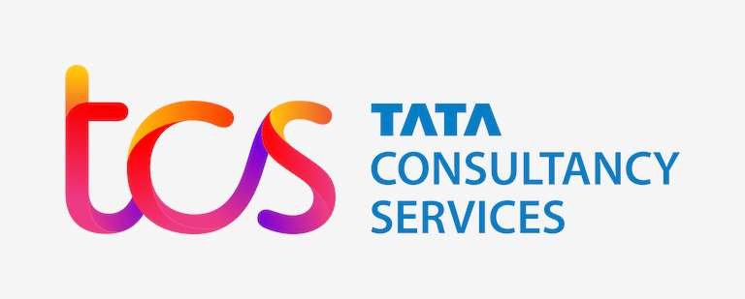

KEY PLAYERS

Slide 9


For Full Report
Contact us
COGNITIVE MARKET RESEARCH
Tel: +1 312-376-8303 | +44 020-8123-0732
India: (+91) 983-496-8611
sales@cognitivemarketresearch.com
Access the Full Report : https://tinyurl.com/3a9w3kvr
Please visit our website:
https://www.cognitivemarketresearch.com

