Slide 1
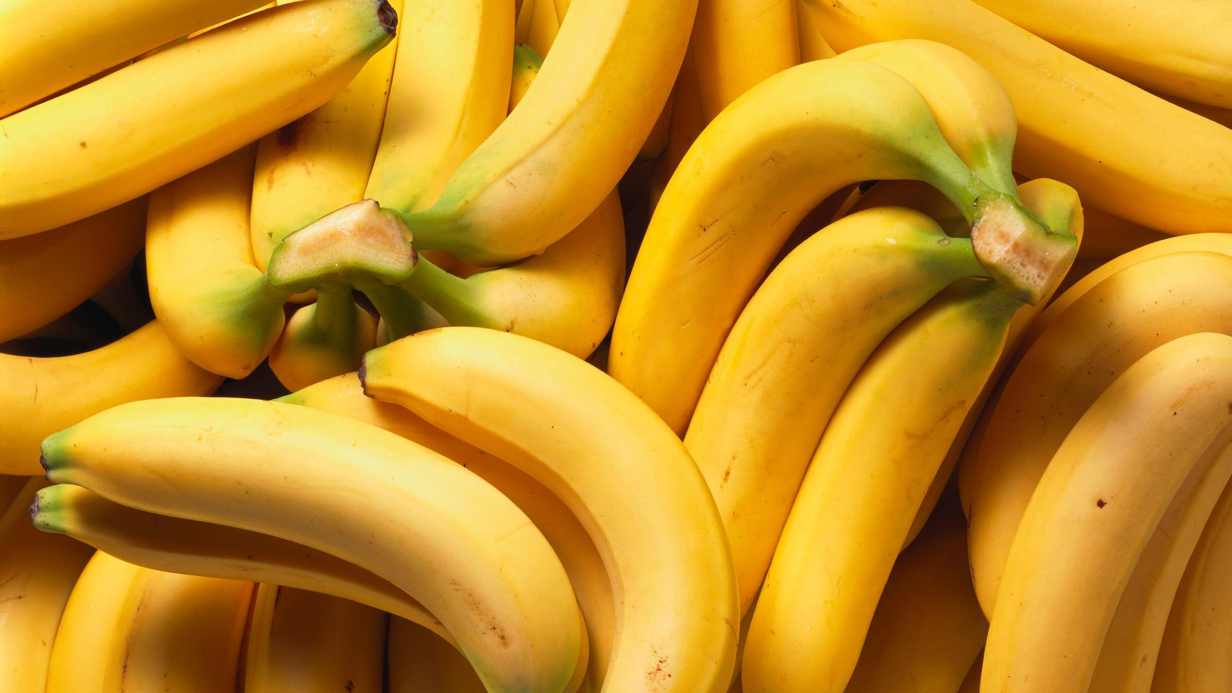
GLOBAL
IFQ BANANA
MARKET REPORT 2024
Global,Regional,CountryAnalysis

Slide 2
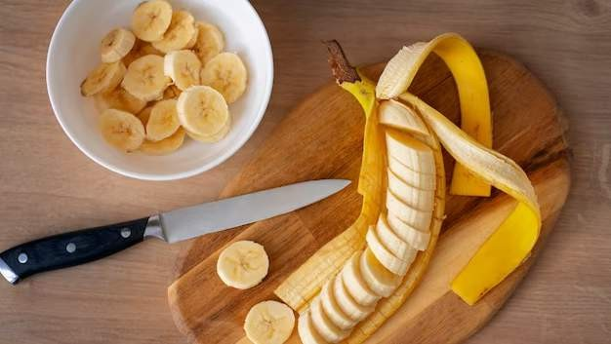
INTRODUCTION
The market is expected to witness substantial growth, driven by highly influenced by consumer preferences and trends. As people look for more convenient and healthier options, frozen fruits like IQF bananas are gaining popularity due to their year-round availability, long shelf life, and preserved nutrients. The availability of raw materials (bananas) has a significant impact on the IQF Banana market. Large banana-producing countries such as India, China, the Philippines, and Ecuador can influence market trends through export volumes, weather-affecting harvests, and production fluctuations.

Slide 3
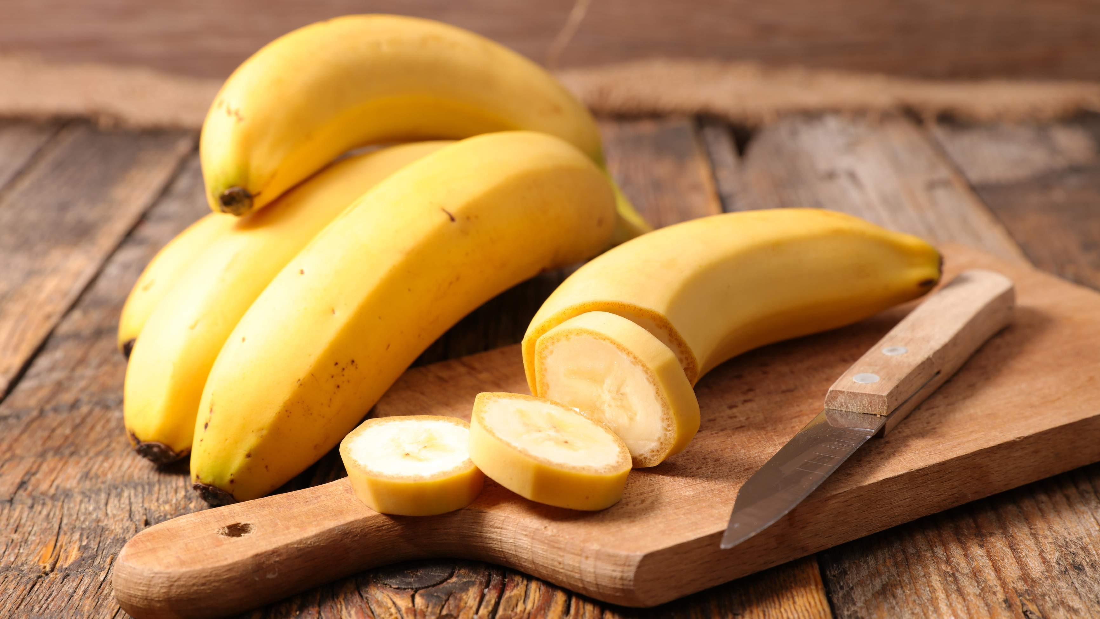

KEY INSIGHTS
20₋23
CAGR 7.30%
2030

Slide 4
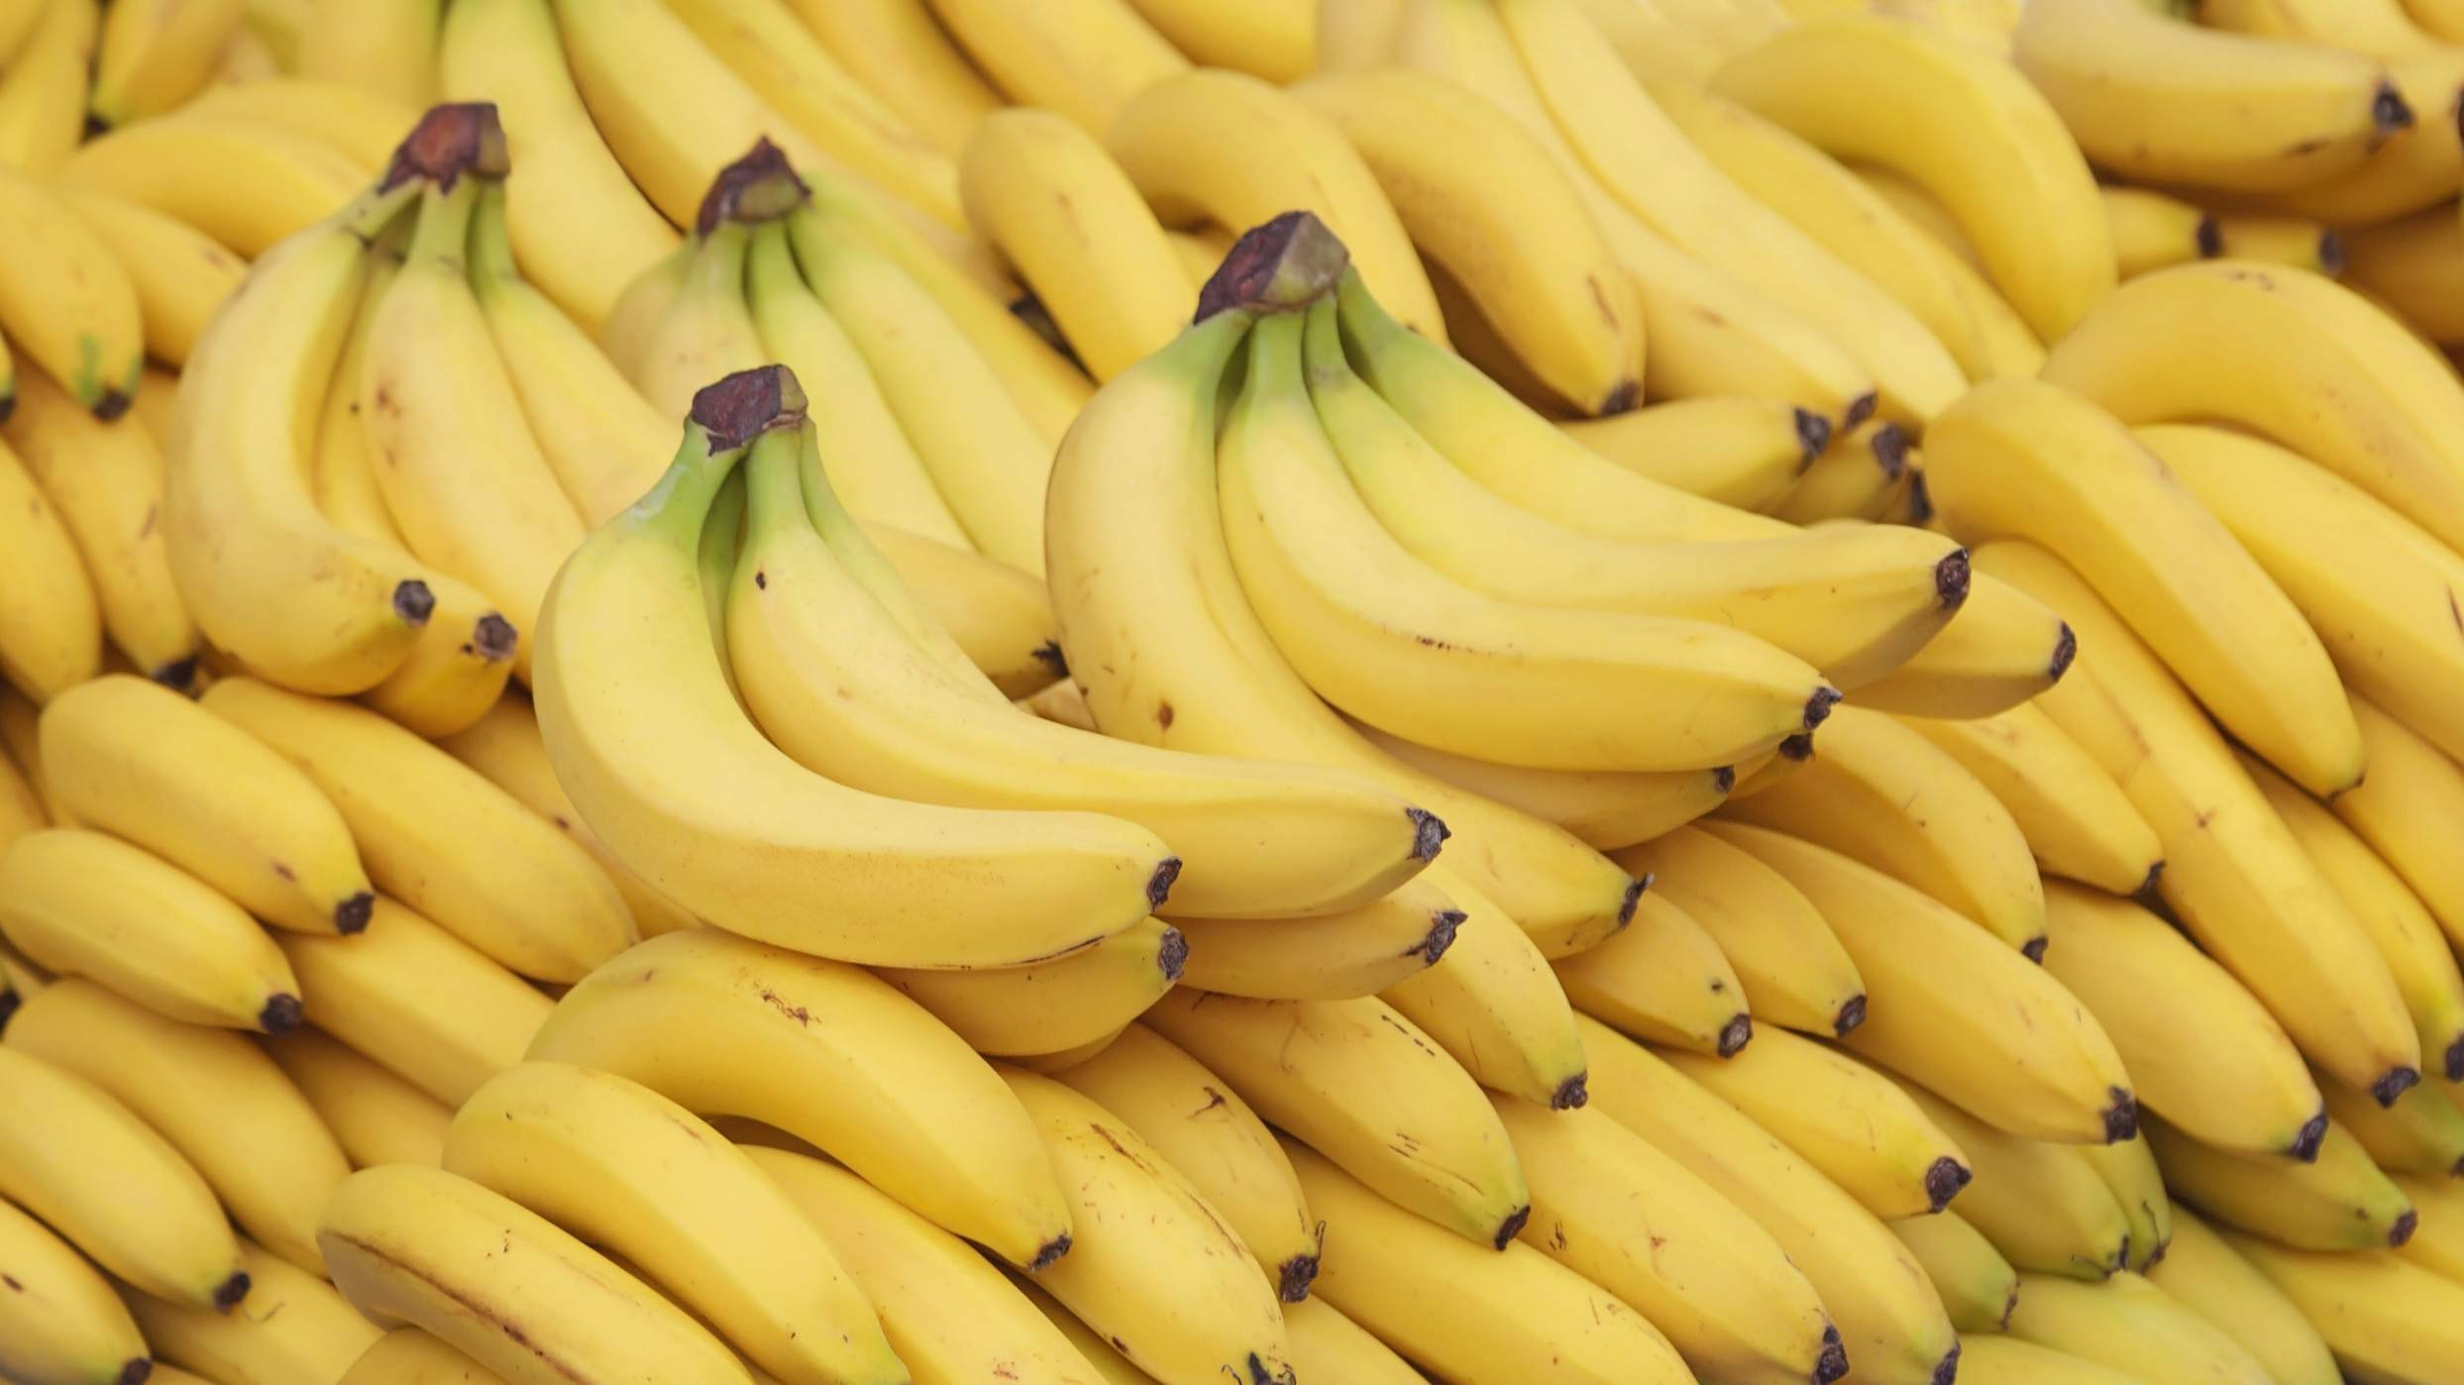
REVENUE MARKET SHARE BY SEGMENTS 2022
Sliced Bananas Diced Bananas Aseptic Banana Puree
Type Segment
Retail Outlets Online Stores Hypermarket/Super market
Application Segment
Commercial Residential
End User Segment

Slide 5
Global IFQ Banana Market Revenue share for 2022
North America 33%

Slide 6
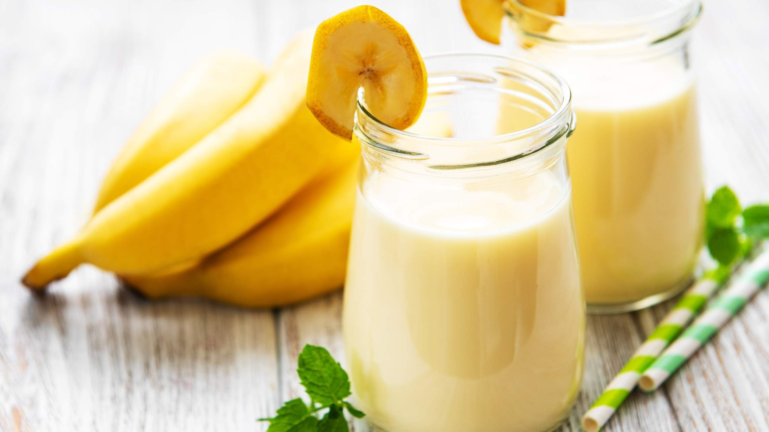
Health and Wellness Trends to Propel Market Growth
Drivers
Seasonal Volatility and Crop Dependency to Restrict Market Growth
Restraints

Slide 7
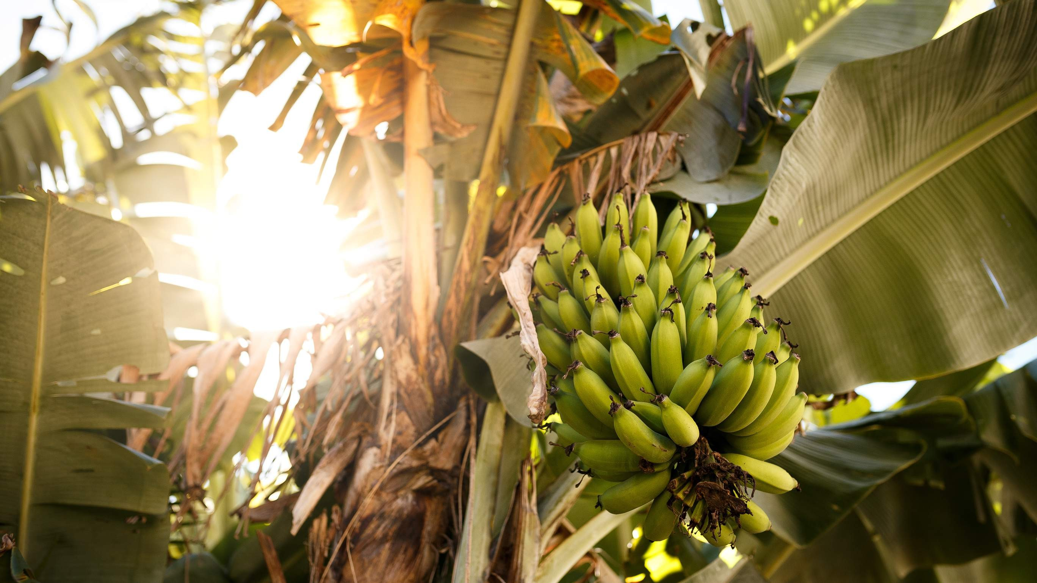
AUTHOR'S PERSPECTIVE
The Global IFQ Banana Market is witnessing significant growth in the near future. Sliced bananas are versatile and can be used in a variety of baking and cooking applications.
It's a popular addition to breakfast foods like cereal, yogurt, and pancakes, as well as desserts, salads, smoothies, and baked goods.
Freezing sliced bananas allows consumers to save overripe bananas, reducing food waste.
Supermarkets usually offer a wide range of frozen fruit, allowing customers to choose from a variety of brands, pack sizes, and types of IQF bananas to suit different preferences.

Slide 8
KEY PLAYERS

Slide 9


Contact us
For Full Report
COGNITIVE MARKET RESEARCH
Tel: + 1 312 - 376 - 8303 | + 44 020 - 8123 - 0732
India: ( + 91 ) 983 - 496 - 8611
sales@ cognitivemarketresearch. com
Access the Full Report : http://tinyurl.com/y2cjy5vm
Please visit our website:
https://www.cognitivemarketresearch.com

