Slide 1
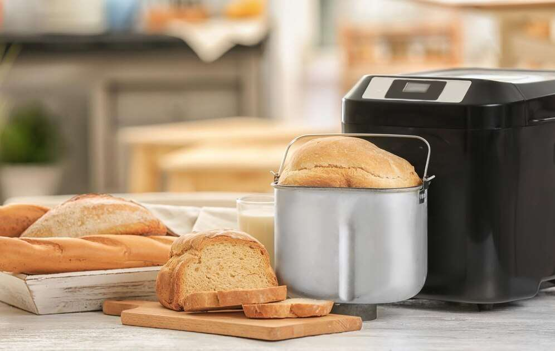
GLOBAL
HOUSEHOLD BREAD MACHINE
MARKET REPORT
2024
Global,Regional,CountryAnalysis

Slide 2
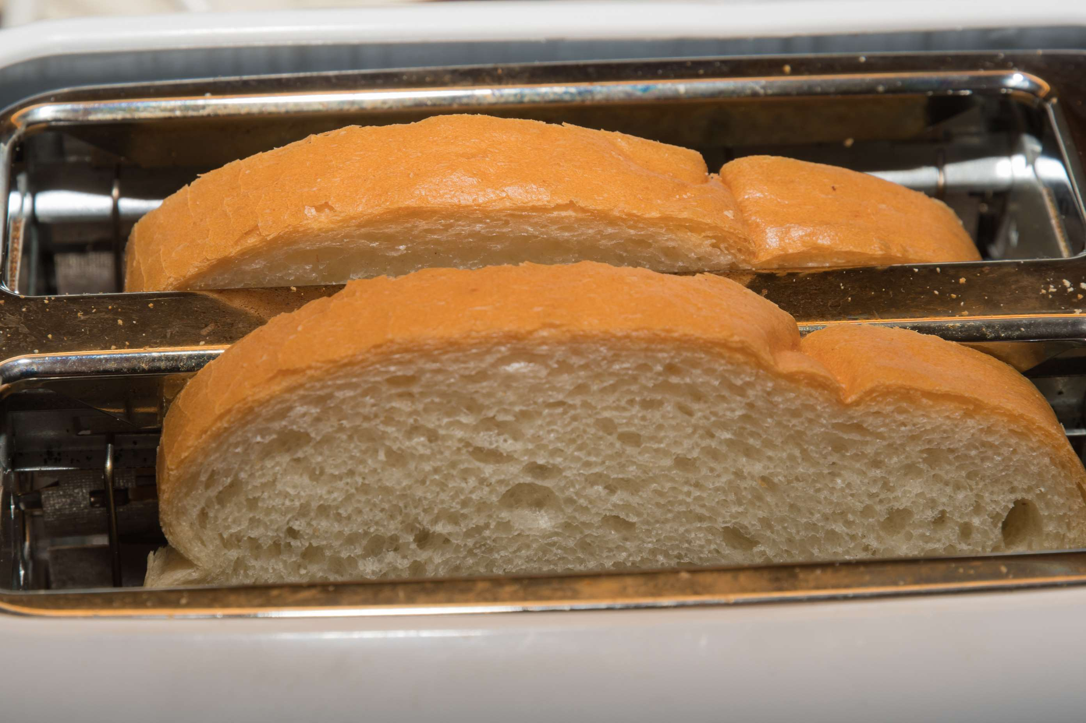
INTRODUCTION
The demand for bread makers is primarily being driven by rising disposable income in both developed and emerging nations, as well as increasing knowledge of the usage of basic technological appliances at home. A significant portion of the market's growth rate is being driven by the increasing number of working women throughout the world and convenient meal preparation at home. There are more dual-working families in both developed and emerging nations, which is increasing market demand. The bread maker industry is expected to grow as a result of people using fully automated equipment more frequently to produce fresh bread. A few other elements balancing the market's growth pace include the employment of cutting-edge technologies and the introduction of a variety of user-friendly features in bread makers.

Slide 3
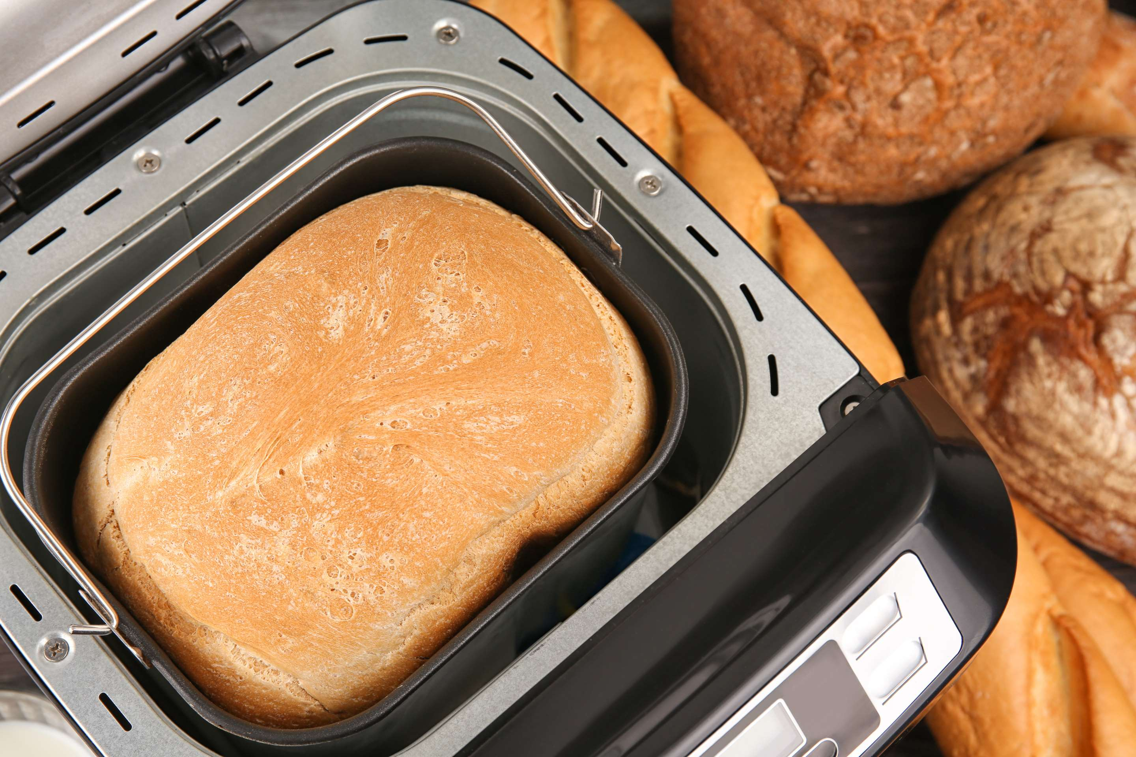

KEY INSIGHTS
CAGR
7.90%
2023- 2030

Slide 4
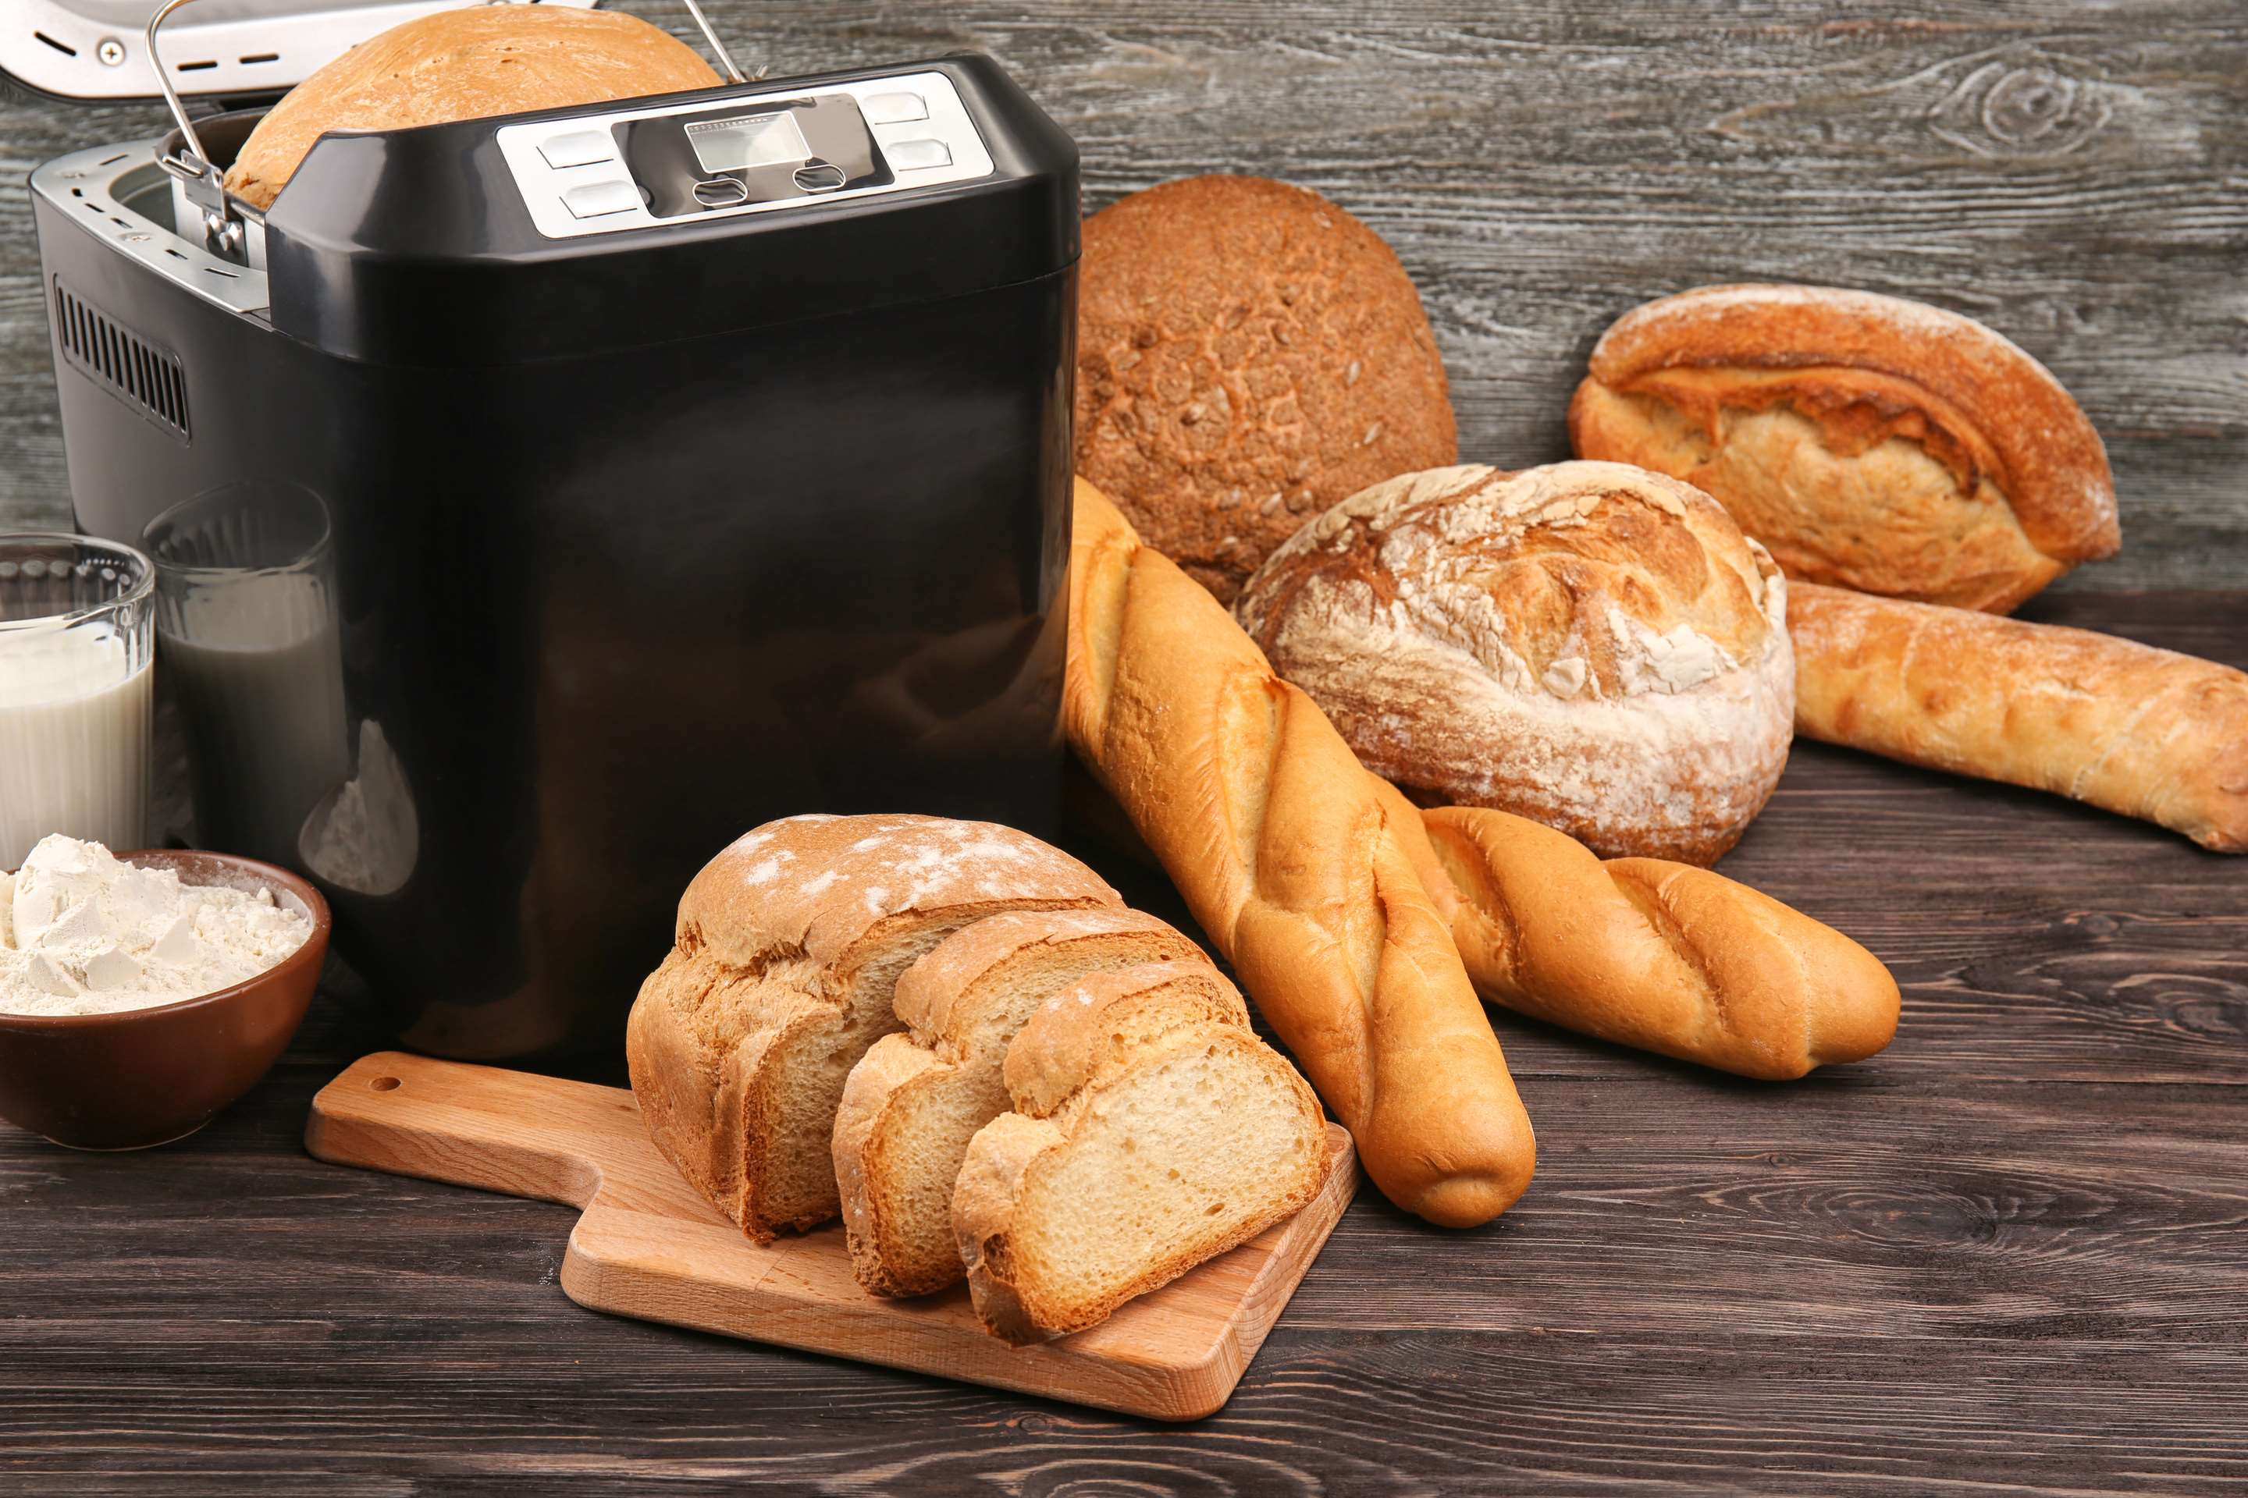
REVENUE MARKET SHARE BY SEGMENTS 2022
  Plastic Bread Machine
  Stainless Steel Bread Machine
  Cold Plate Bread Machine
Type Segment
Distribution Channel
  Online
  Offline
  Less Than 500g
  500-750g
  750-1000g
  More Than 1000g
Capacity Segment

Slide 5

Global Household Bread Machine Market Revenue share for 2024
North America
35%

Slide 6

Increasing Efforts by Market Participants in the Sector to Propel Market Growth
Drivers
Complexity and Difficulties with the Equipment Hinder Market Growth
Restraints

Slide 7
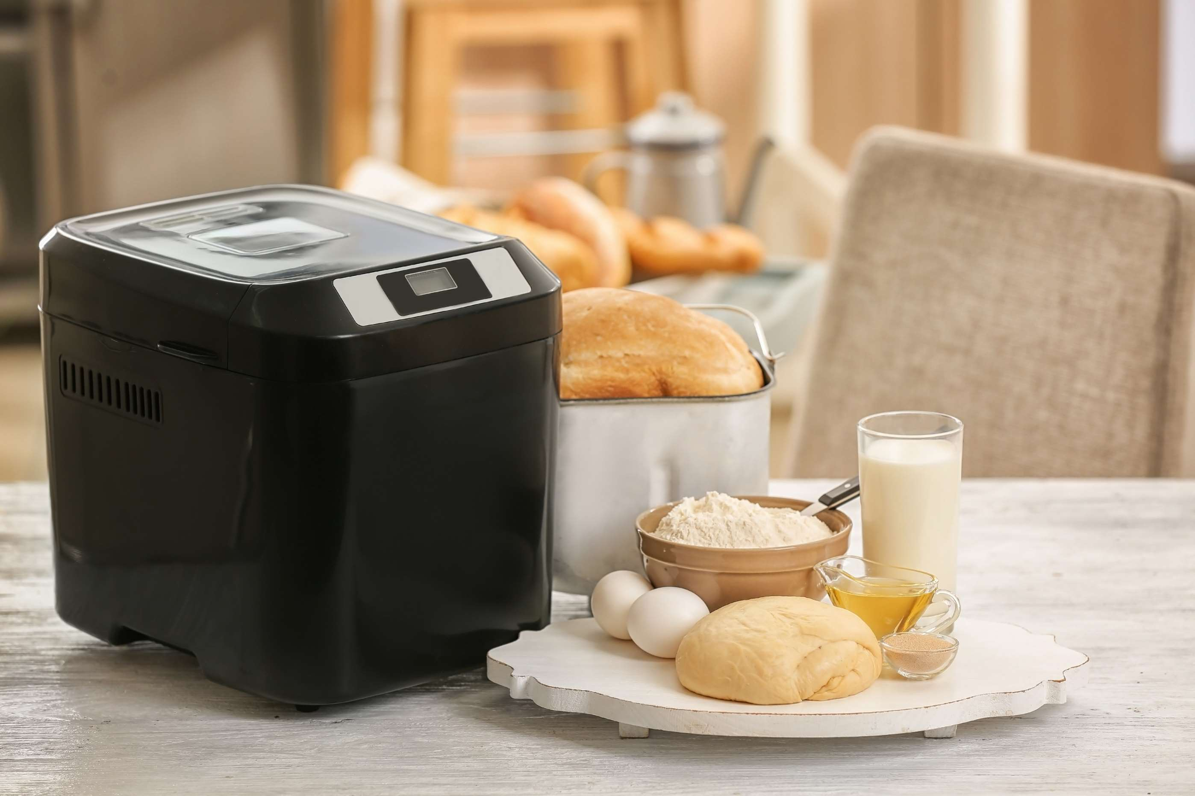
AUTHOR'S PERSPECTIVE
  The Global Household Bread Machine Market is witnessing significant growth in the near future.
  Consumers often prefer stainless steel appliances for their longevity and resistance to corrosion
  Stainless steel is a food-safe material that does not react with food or produce harmful chemicals.
  Consumers may be choosing these machines to have more control over the ingredients in their bread, including whole grains, seeds, and natural sweeteners.
  Cold plate bread machines are versatile and can be used to make a wide variety of bread types, including specialty and artisanal bread.

Slide 8










KEY PLAYERS

Slide 9


For Full Report
Contact us
COGNITIVE MARKET RESEARCH
Tel: +1 312-376-8303 | +44 020-8123-0732
India: (+91) 983-496-8611
sales@cognitivemarketresearch.com
Access the Full Report : https://tinyurl.com/986esp44
Please visit our website:
https://www.cognitivemarketresearch.com

