Slide 1


HOTEL CHAINS
MARKET REPORT
2024
Qualitative Analysis + Quantitative Analysis

Slide 2

INTRODUCTION
The resort chains marketplace contains a network of hospitality institutions operated beneath a common logo, offering standardized offerings and amenities across more than one place. These chains generally range from finances to luxurious segments and cater to various tourist desires, which include commercial enterprise journeys, amusement holidays, and occasions. Key players within the marketplace include globally diagnosed manufacturers such as Marriott International, Hilton Worldwide, and AccorHotels. Hotel chains leverage brand reputation, loyalty applications, and centralized reservation structures to attract clients and maximize occupancy quotes. They additionally benefit from economies of scale in procurement, advertising, and operations. However, they face demanding situations together with opposition from alternative lodging alternatives, fluctuations in travel demand, and regulatory compliance.

Slide 3


KEY INSIGHTS
MARKET SIZE
USD 152158.2 million
2024
CAGR
5.21%
2024- 2031

Slide 4
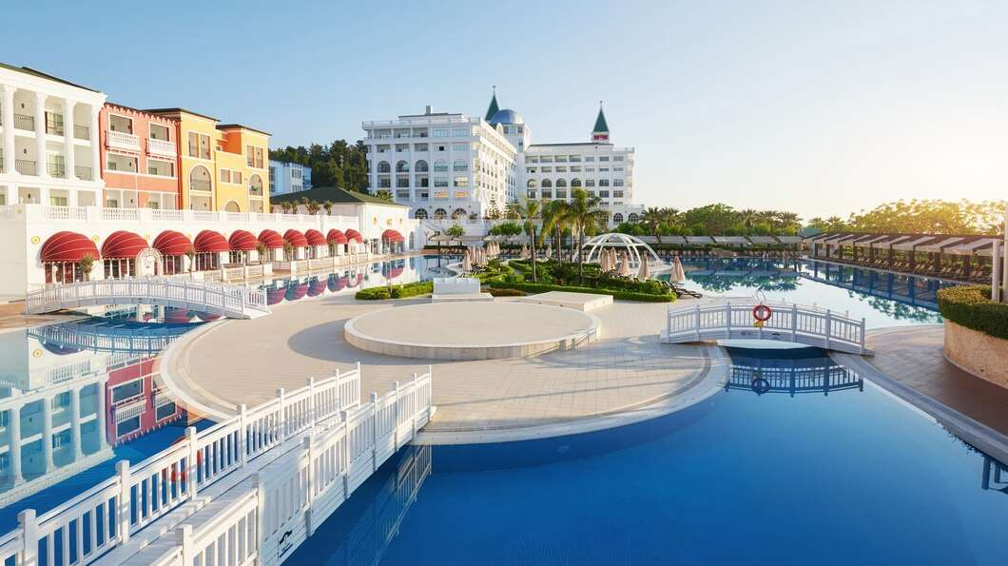
REVENUE MARKET SHARE BY SEGMENTS 2024
  Economy Rooms stands out as the dominating category.
  Mid-range Rooms emerges as the fastest-growing category in the Hotel Chains market.
Type Segment
  The dominating category is Online Booking
  The fastest-growing category in the Hotel Chains market is Offline Booking.
Application Segment

Slide 5

REGION ANALYSIS
NORTH AMERICA
Europe
Asia Pacific
Latin America
MIDDLE EAST AFRICA
40%
30%
23%
5%
2%
North America Hotel Chains Market Revenue share for 2024 is 40%

Slide 6

  Rise of Global Tourism to Increase the Demand Globally
  Growing Preference for Branded Accommodation to Propel Market Growth
Drivers
Restraints
Fluctuations in Travel Demand to Limit the Sales

Slide 7

AUTHOR'S PERSPECTIVE
  The global Hotel Chains market will expand significantly by 5.21% CAGR between 2024 to 2031.
  Economic growth in emerging countries leads to higher disposable income and travel spending.
  This establishes a new market sector in which hotel brands can increase their reach.
  Leading hotel chains are stressing the client experience by providing personalized services, innovative features (such as self-service kiosks and mobile check-in), and reward programs tailored to a wide range of consumer preferences.

Slide 8





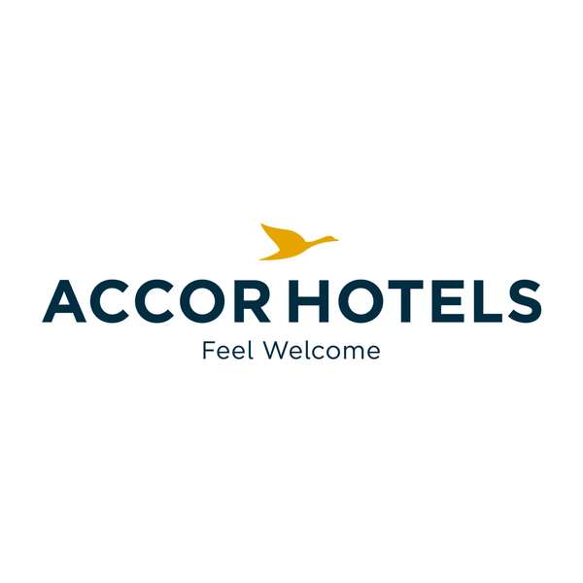








KEY PLAYERS

Slide 9


For Full Report
Contact us
COGNITIVE MARKET RESEARCH
Tel: +1 312-376-8303 | +44 020-8123-0732
India: (+91) 983-496-8611
sales@cognitivemarketresearch.com
Access the Full Report : https://tinyurl.com/y2tmn4yr
Please visit our website:
https://www.cognitivemarketresearch.com

