Slide 1
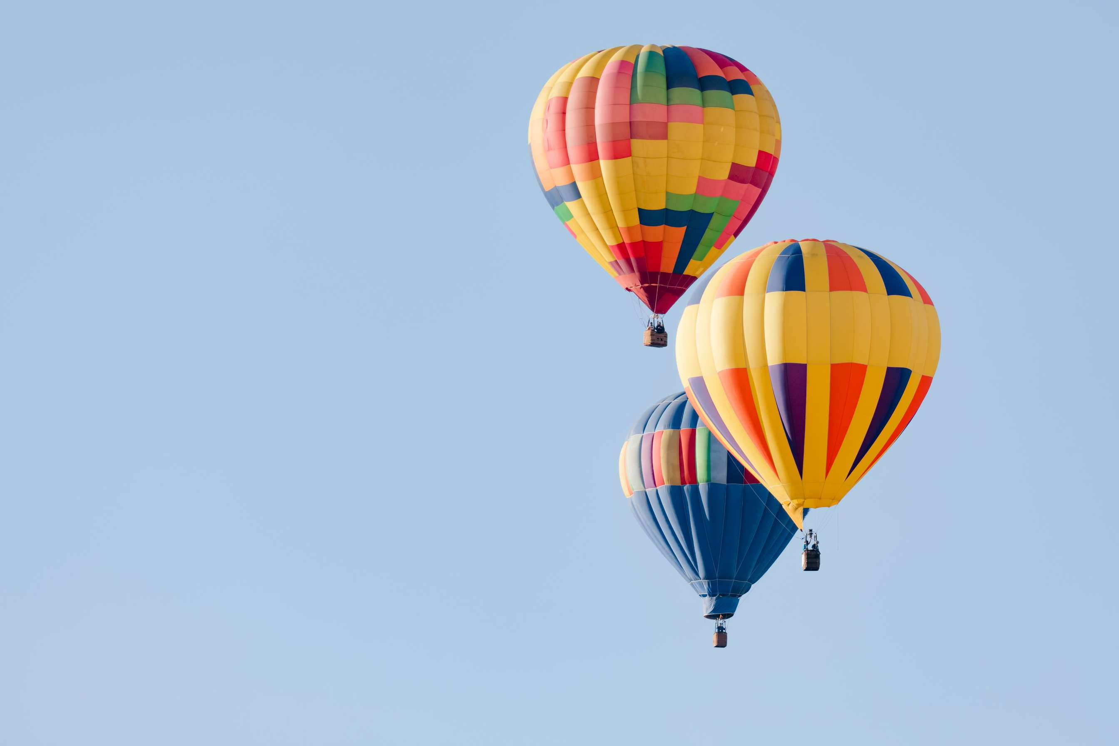
GLOBAL
HOT AIR BALLOON RIDE
MARKET REPORT
2024
Global,Regional,CountryAnalysis

Slide 2
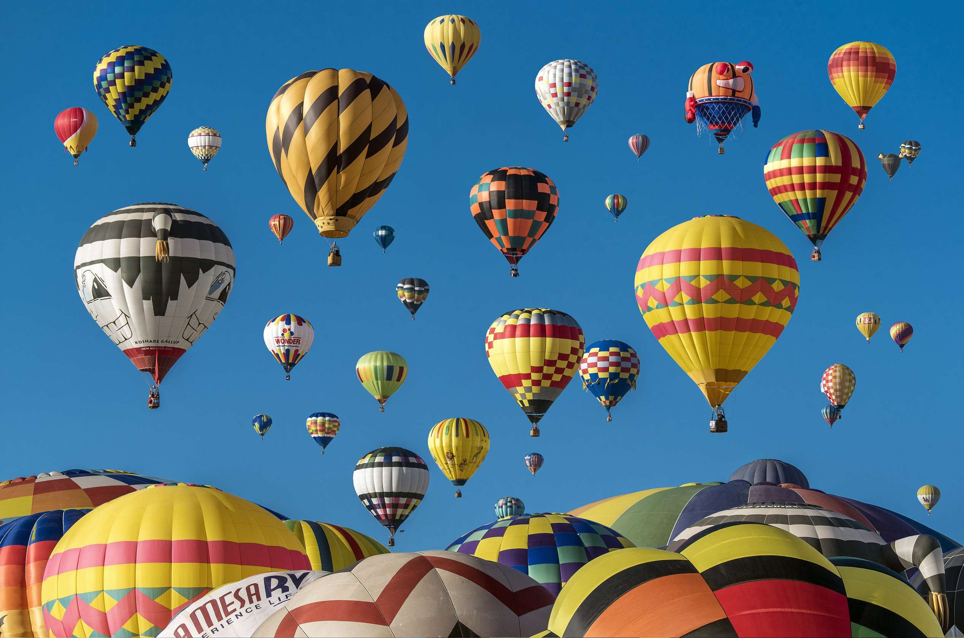
INTRODUCTION
Hot air balloon rides are growing in popularity for several reasons. They offer a unique and serene way to experience breathtaking landscapes, making them a sought-after leisure activity. Additionally, operators are enhancing safety measures, reassuring customers in the post-COVID-19 world. Social media and marketing efforts have also raised awareness and interest in balloon rides. Furthermore, the desire for outdoor and eco-friendly adventures aligns with the environmentally friendly nature of hot air ballooning, contributing to its growth in the leisure and tourism industry.

Slide 3
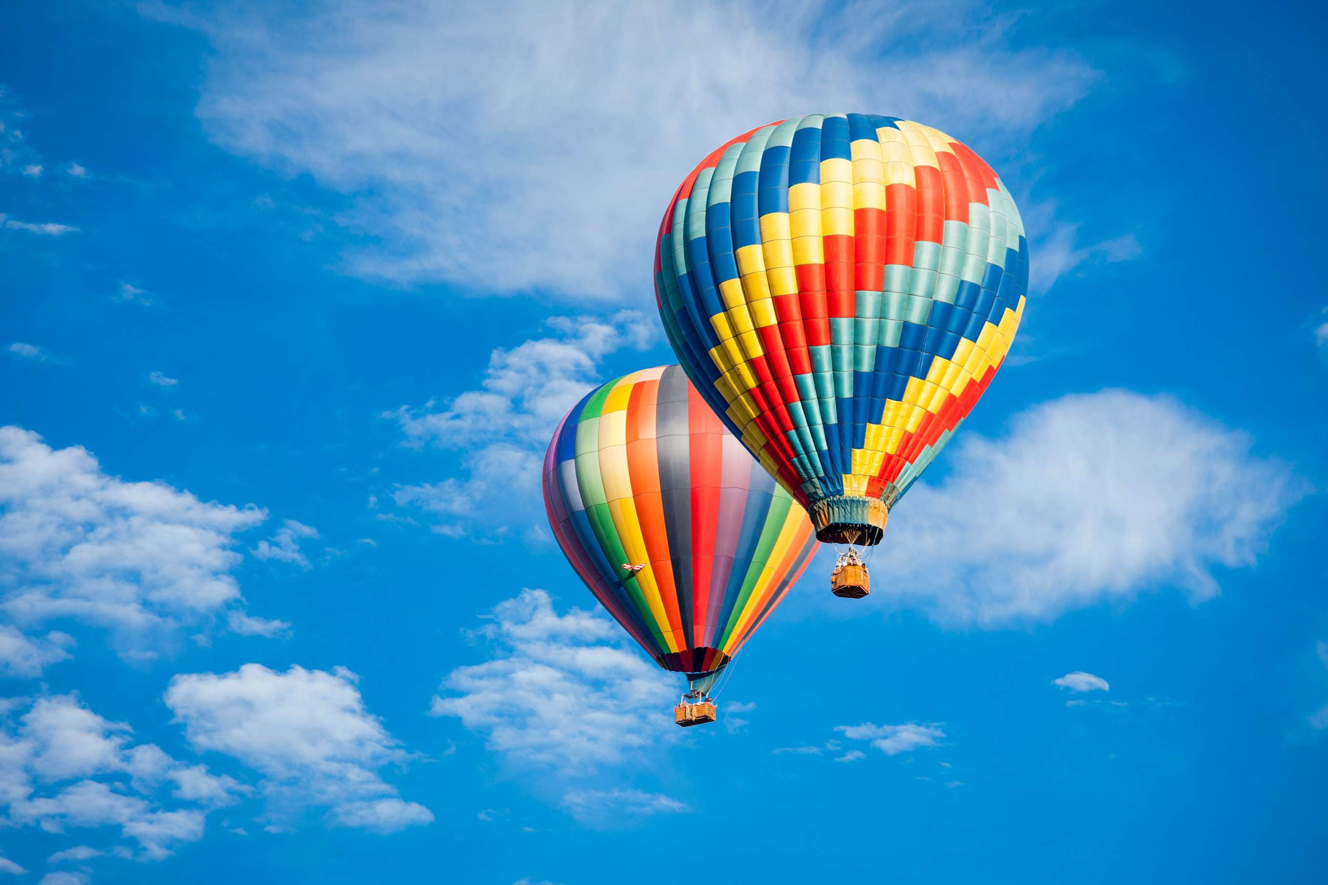

KEY INSIGHTS
MARKET SIZE
USD 0.48 billion
2023
CAGR
8.1%
2023- 2030

Slide 4
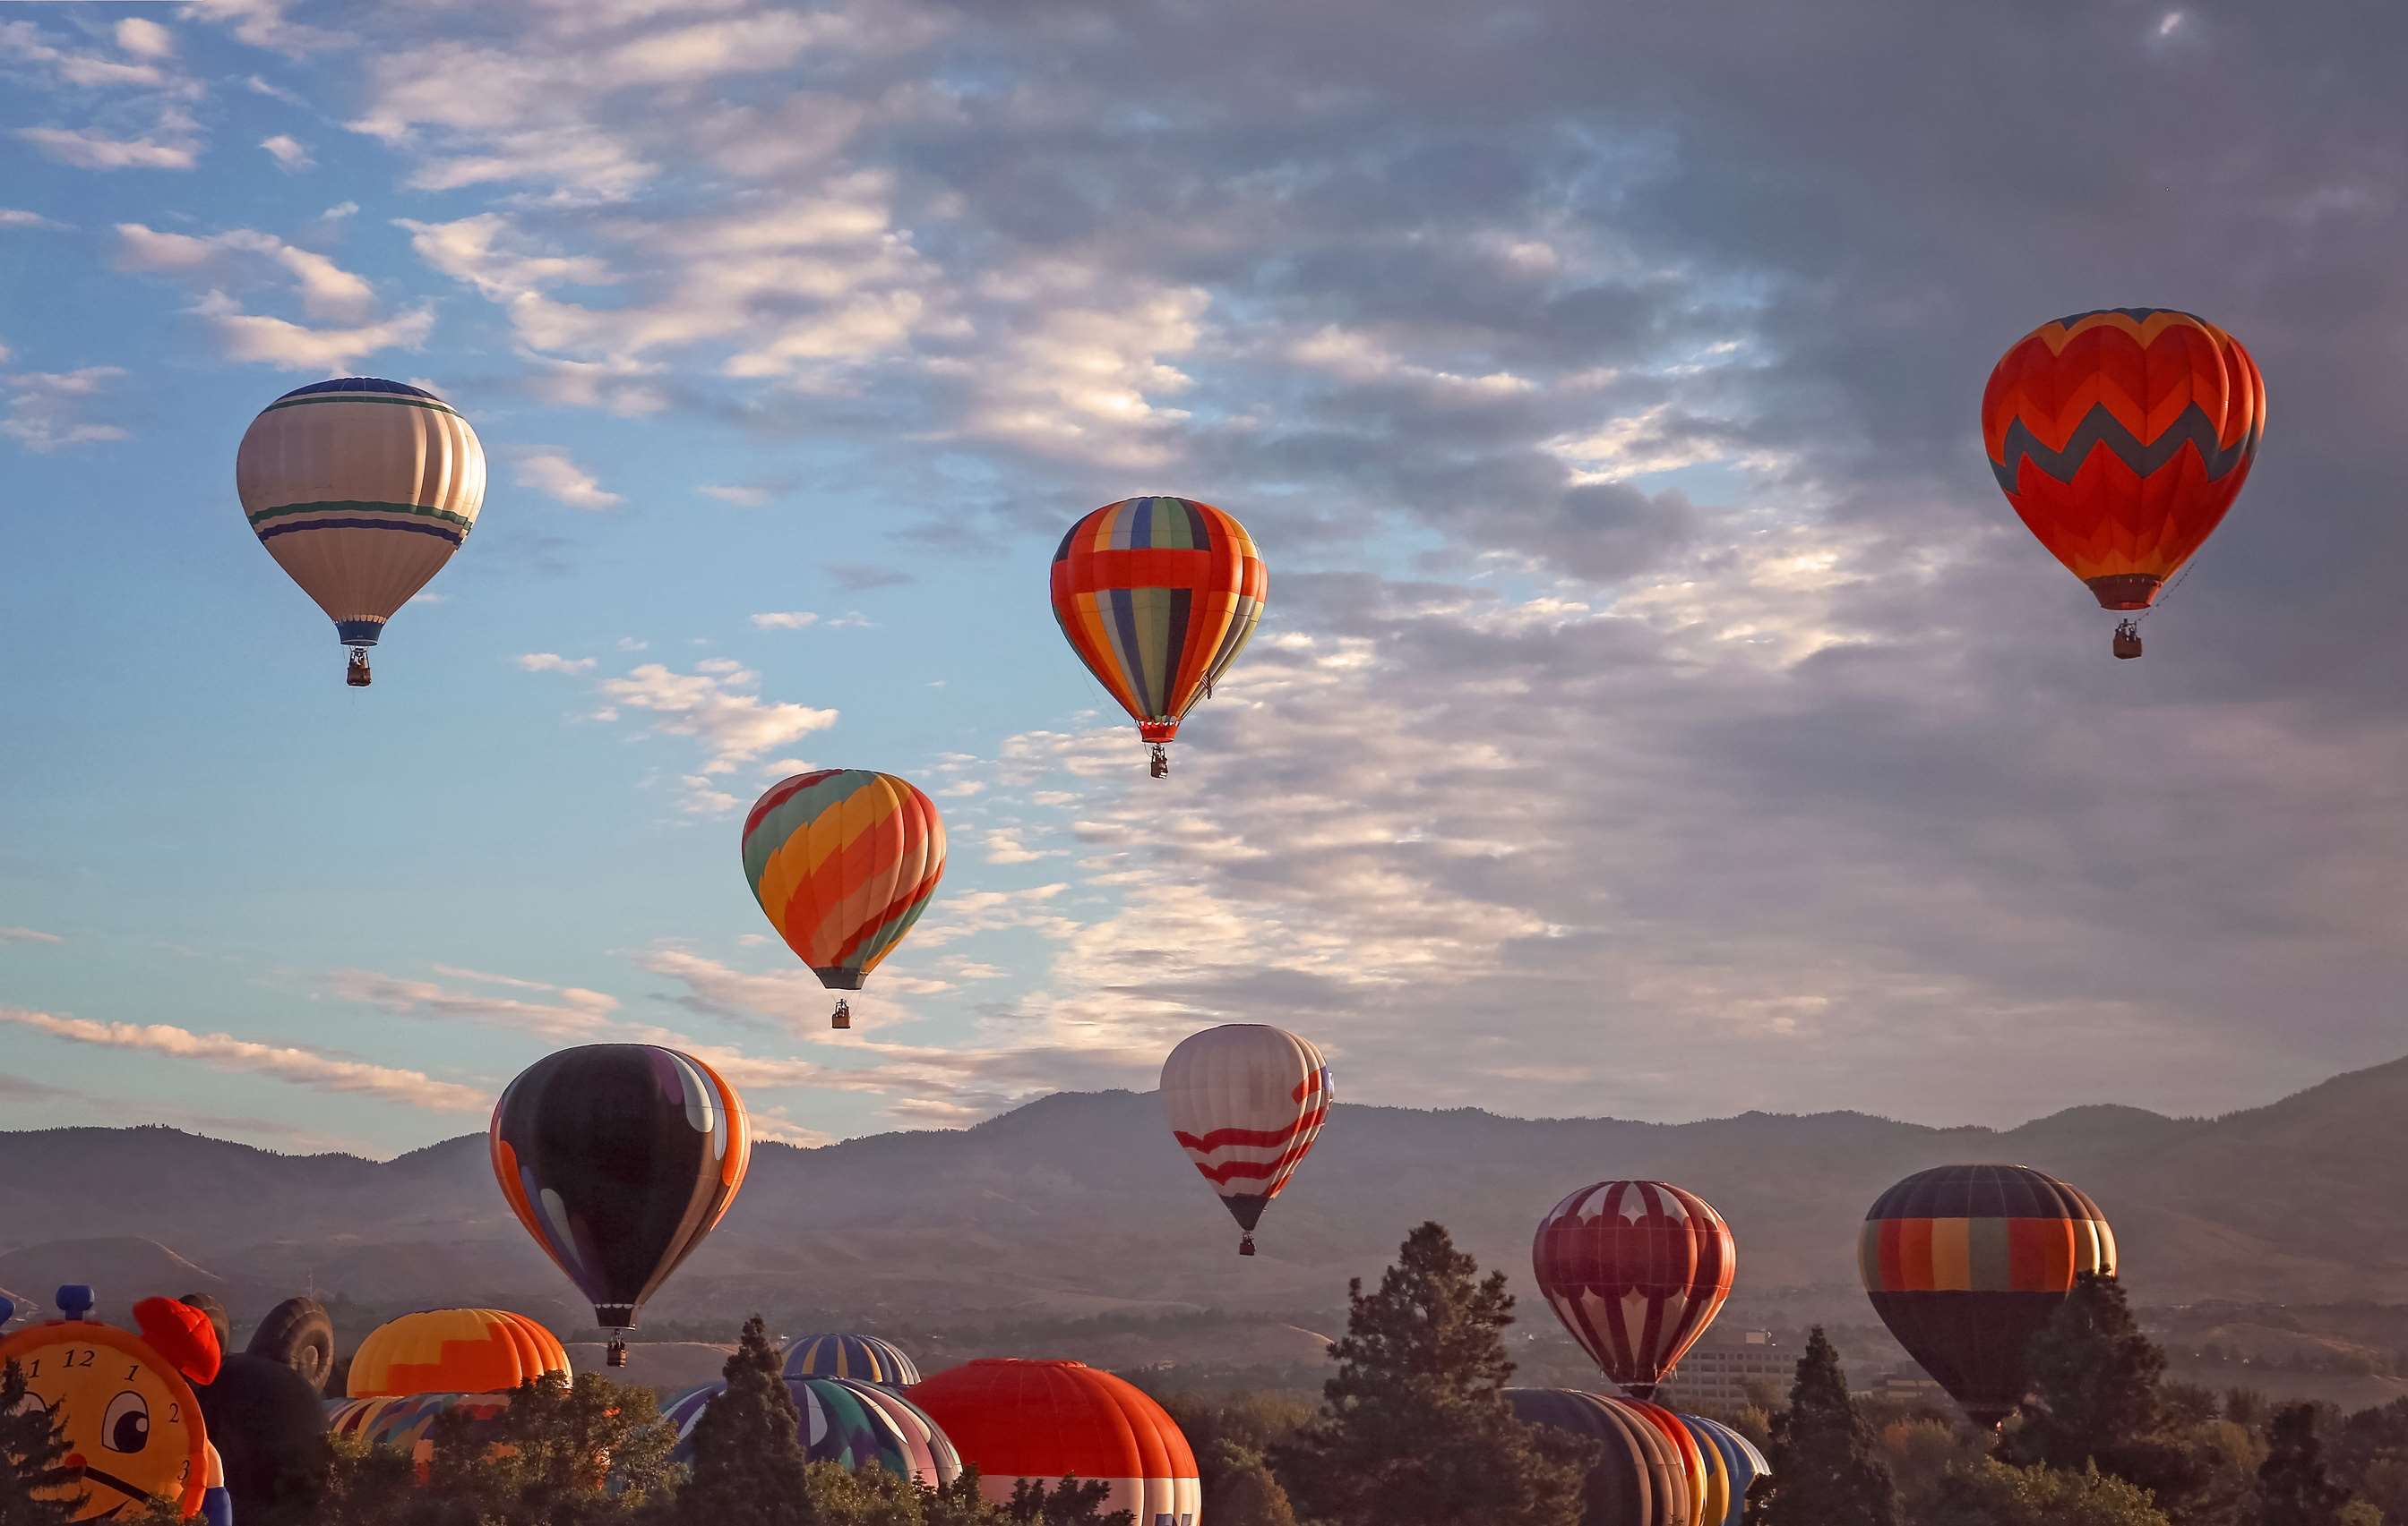
REVENUE MARKET SHARE BY SEGMENTS 2022
Tethered flights provide a taste of the hot air balloon experience without the logistical challenges of traditional free flights, expanding the market to include those seeking a shorter, more accessible adventure.
Type Segment
Tourism applications have captured the hot air balloon ride market due to their ability to offer breathtaking aerial perspectives of tourist destinations.
Application Segment

Slide 5

Global Hot Air Balloon Ride Market Revenue share for 2024
North America
35%

Slide 6
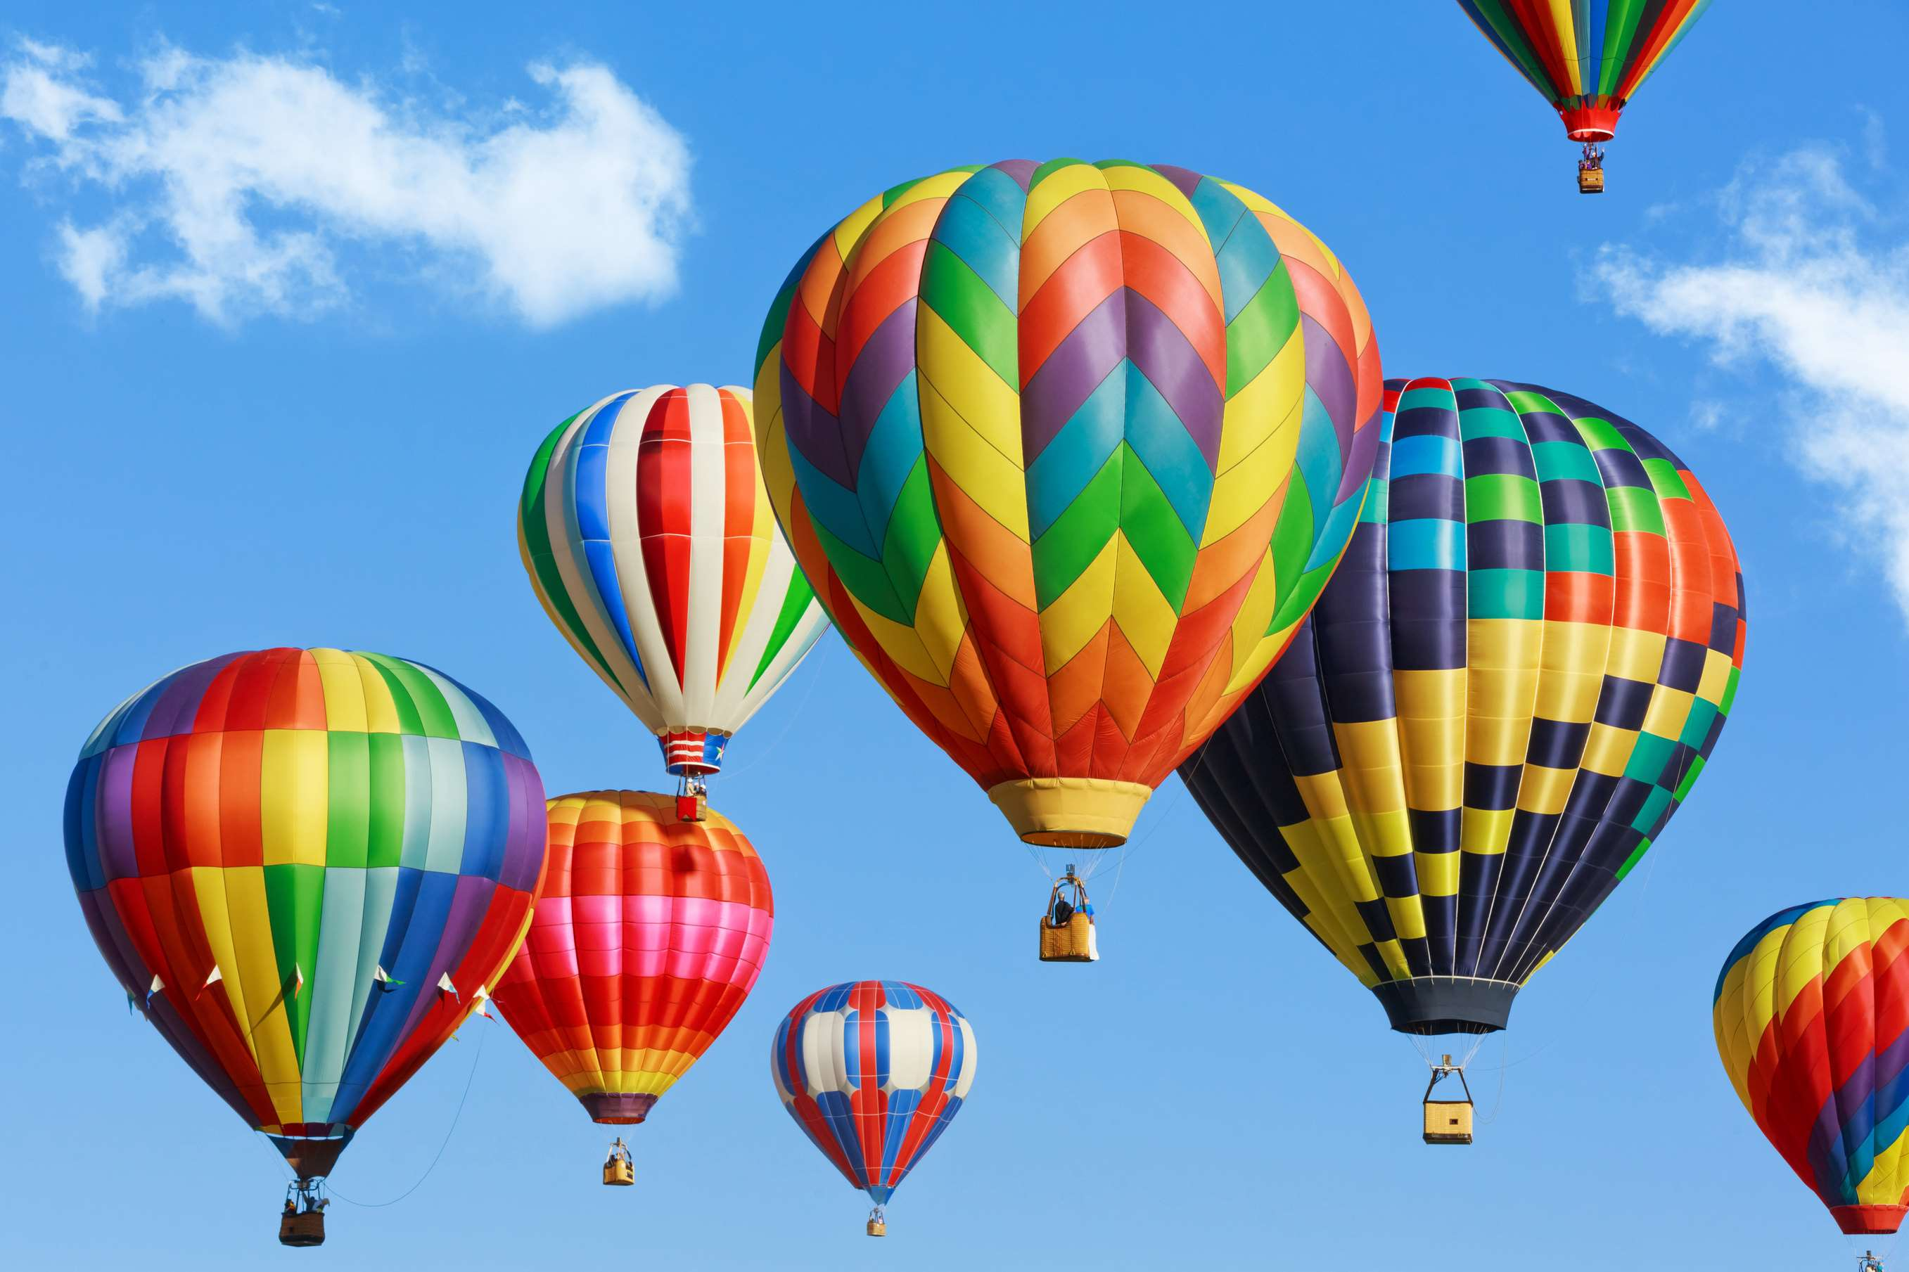
Technological Advancements to Propel Market Growth
Drivers
Weather Dependency and Safety Concerns to Hinder Market Growth
Restraints

Slide 7

AUTHOR'S PERSPECTIVE
  The Global Hot Air Balloon Ride Market is witnessing significant growth in the near future.
  Tethered flights provide a taste of the hot air balloon experience without the logistical challenges of traditional free flights, expanding the market to include those seeking a shorter, more accessible adventure.
  Passengers can enjoy unobstructed, serene views while drifting through the sky, creating a memorable experience.
  Tourism applications have captured the hot air balloon ride market due to their ability to offer breathtaking aerial perspectives of tourist destinations.
  Balloon rides provide a unique and memorable way to experience iconic landscapes, historical sites, and natural wonders.

Slide 8



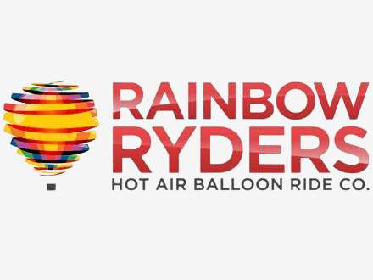



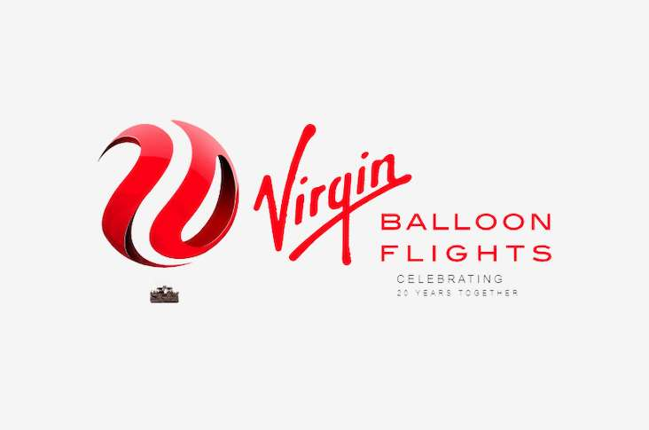
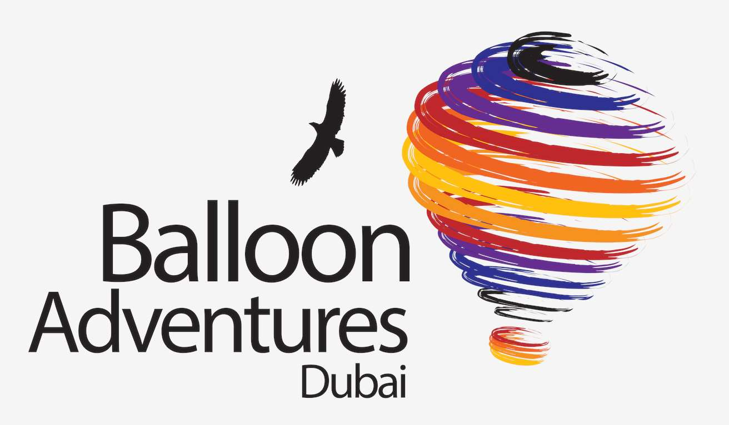


KEY PLAYERS

Slide 9


For Full Report
Contact us
COGNITIVE MARKET RESEARCH
Tel: +1 312-376-8303 | +44 020-8123-0732
India: (+91) 983-496-8611
sales@cognitivemarketresearch.com
Access the Full Report : https://tinyurl.com/2s4jcvcp
Please visit our website:
https://www.cognitivemarketresearch.com

