Slide 1

GLOBAL
HOME ESPRESSO MACHINES
MARKET REPORT
2024
Global,Regional,CountryAnalysis

Slide 2

INTRODUCTION
Growing espresso enthusiasts and those wishing to reduce their trips to coffee shops are driving growth in the market for home espresso machines worldwide. Worldwide, espresso is the favoured coffee. Customers want a quick substitute for high-end coffee shops. Home espresso makers can let you get your dose in the convenience of your kitchen. The worldwide market for home espresso machines is further driven by increasing disposable income, shifting beverage preferences, and growing penetration of portable smart kitchen products. Market participants are creating a compact, user-friendly, and quick-operating home espresso model.

Slide 3
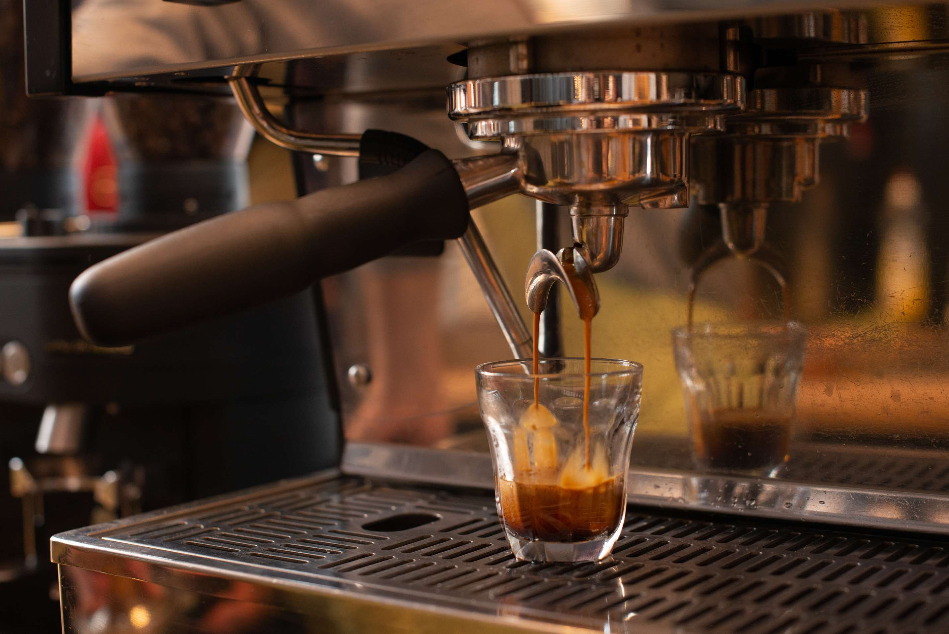

KEY INSIGHTS
CAGR
5.90%
2023- 2030

Slide 4

REVENUE MARKET SHARE BY SEGMENTS 2022
  Steam-Driven Machines
  Lever-Driven Machines
  Pump-Driven Machines
Type Segment
  Manual Machines
  Semi-Automatic Machines
  Automatic Machines
  Super-Automatic Machines
  Coffee Pod Machines
Operation Segment

Slide 5
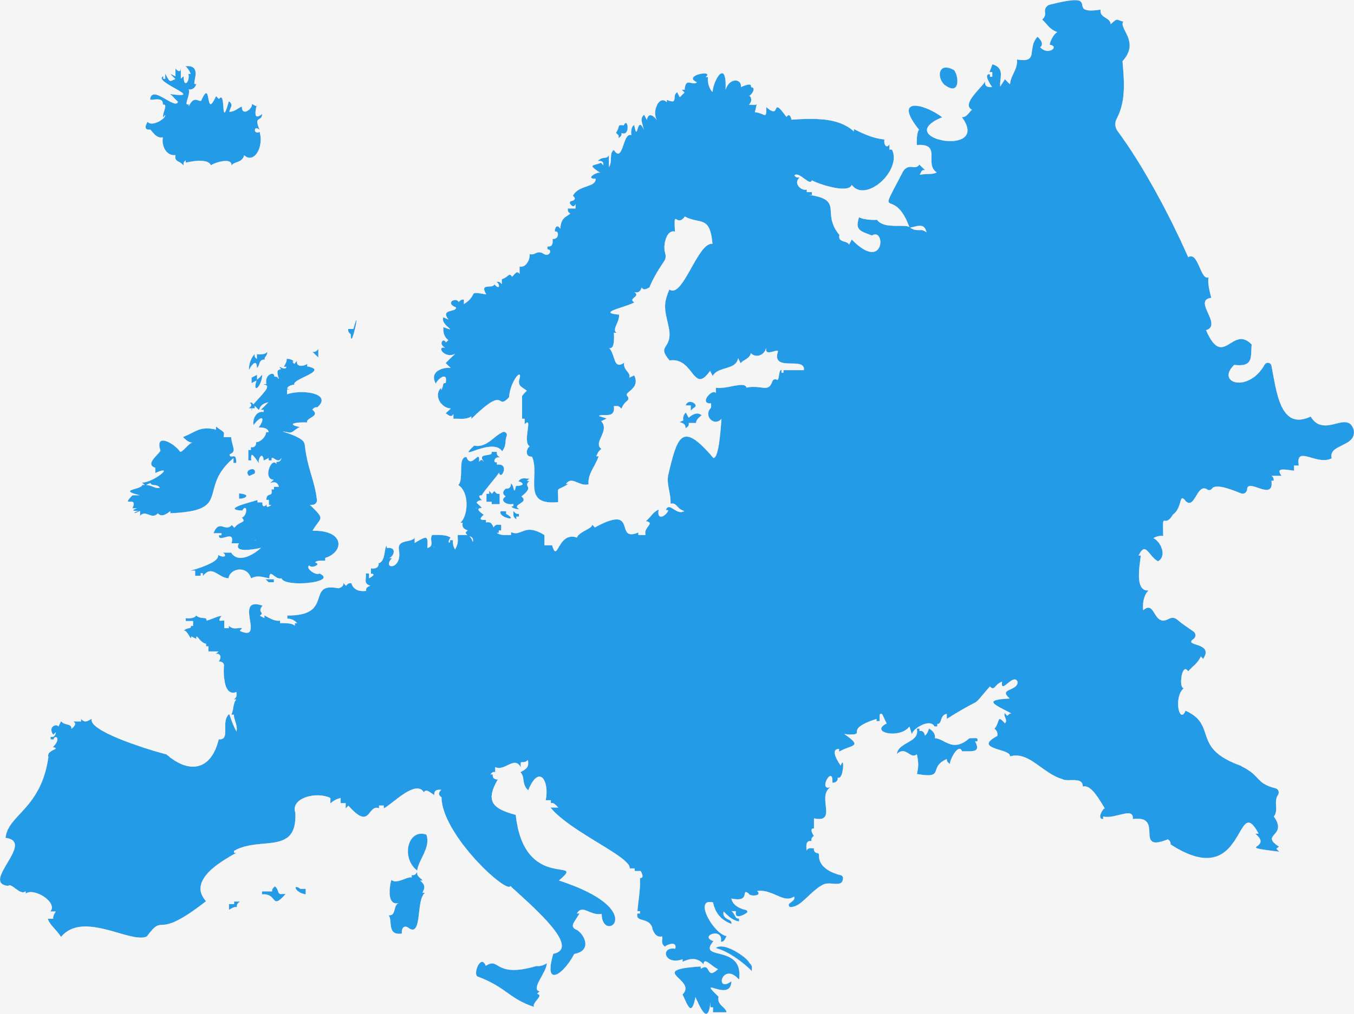
Global Home Espresso Machines Market Revenue share for 2024
Europe

Slide 6

Price Cut Surging the Sale of Espresso Maker Market
Drivers
High Maintenance and Repair Cost Hinder Market Growth
Restraints

Slide 7
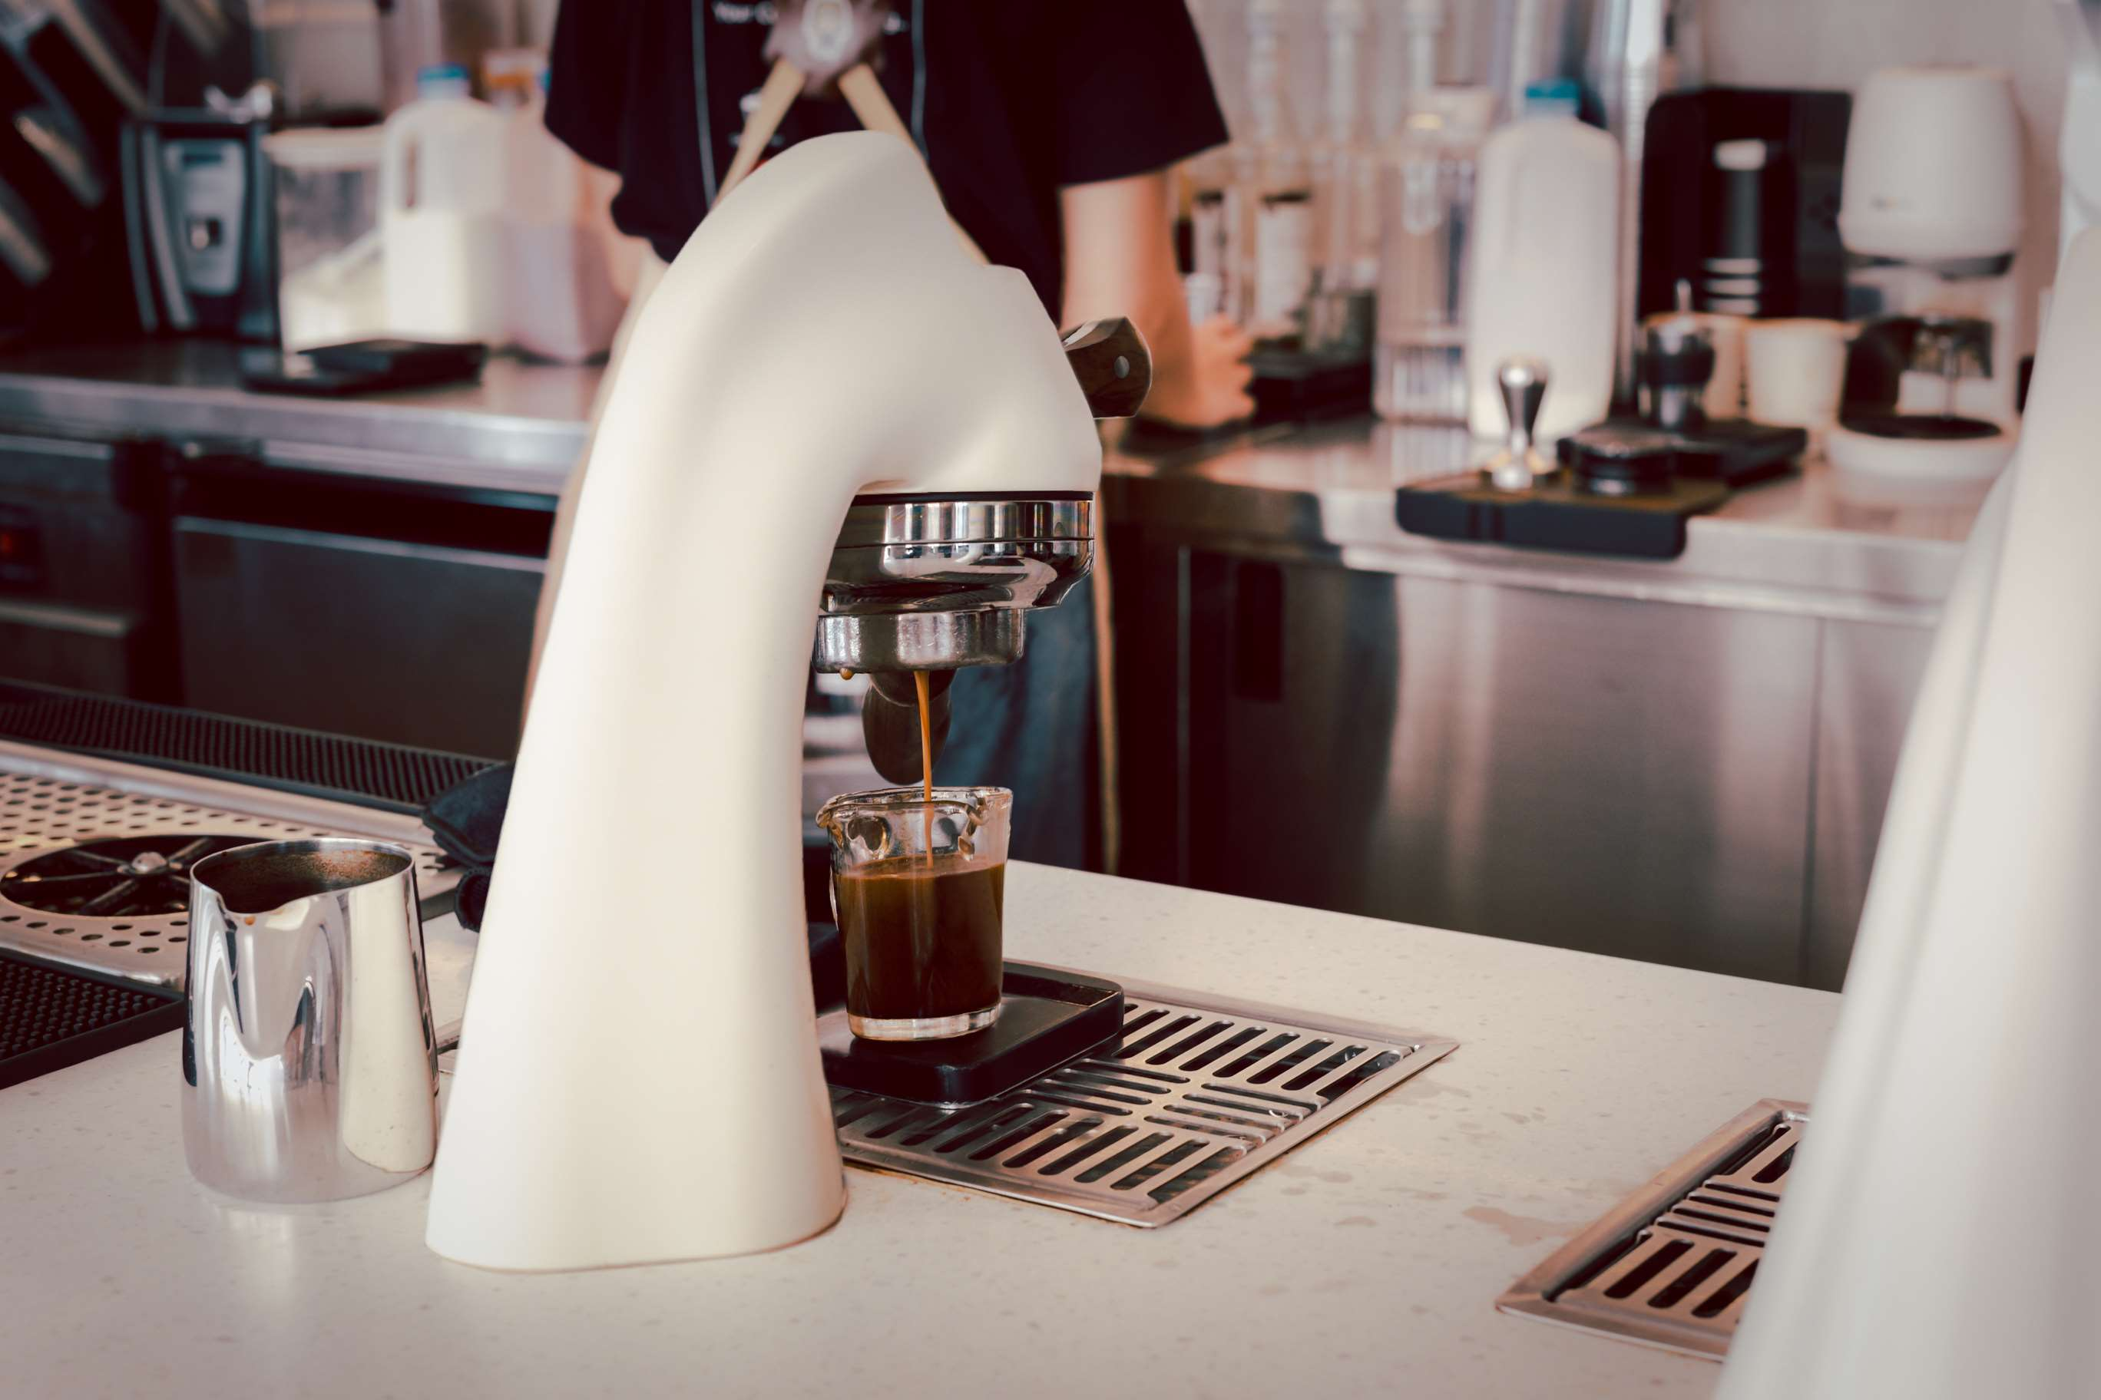
AUTHOR'S PERSPECTIVE
  The Global Home Espresso Machines Market is witnessing significant growth in the near future.
  Espresso requires a specific group of pressure (usually 9 bars), and pump-driven machines can consistently achieve and maintain this pressure, which is crucial for producing authentic espresso shots with crema.
  Physical retail stores provide this opportunity, allowing potential buyers to get a feel for the machine's build quality, size, and features
  Semi-automatic machines typically offer a range of customizable settings, including grind size, shot volume, and brew temperature..

Slide 8












KEY PLAYERS

Slide 9


For Full Report
Contact us
COGNITIVE MARKET RESEARCH
Tel: +1 312-376-8303 | +44 020-8123-0732
India: (+91) 983-496-8611
sales@cognitivemarketresearch.com
Access the Full Report : http://tinyurl.com/5n9ypmrp
Please visit our website:
https://www.cognitivemarketresearch.com

