Slide 1
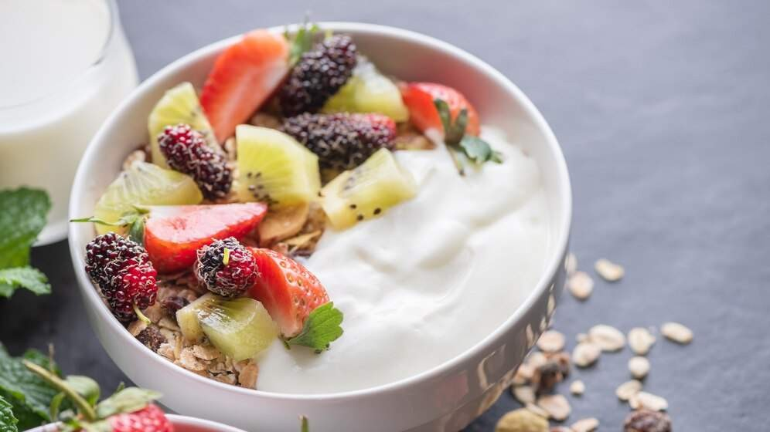
GLOBAL
HIGH PROTEIN YOGURT MARKET REPORT 2024
Global,Regional,CountryAnalysis

Slide 2

INTRODUCTION
Proteins are large molecules made up of numerous amino acid residues. Yogurt is a dairy product created through bacterial fermentation. High- protein yogurt contains a significant amount of protein compared to other molecules. It was designed to attract specific customers such as athletes, young people, and bodybuilders. The growing awareness of consumer dietary habits is boosting the high-protein yogurt market. The increasing demand for improved nutrition and convenience is also driving the growth of high- protein yogurt.

Slide 3
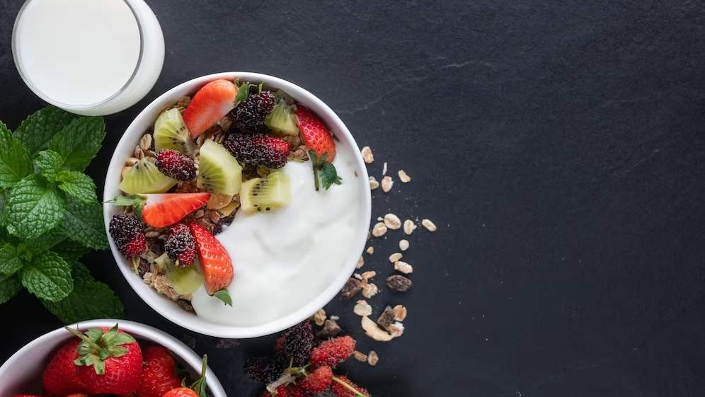

KEY INSIGHTS
MARKET SIZE
USD 36.5 billion
2022
2023
CAGR 7.50%
-
2030

Slide 4


REVENUE MARKET SHARE BY SEGMENTS 2022
Spoonful Drinkable
Product Type
Food Service (HoReCa) Store-Based Retailing
Hypermarkets or Supermarkets Food and Drink Specialty Stores Independent Small Grocery
Application segment

Slide 5

Global High Protein Yogurt Market Revenue share for 2022
North America

Slide 6

Innovation in Product Formulations to Propel Market Growth
Drivers
Fluctuating Raw Material Costs to Restrict Market Growth
Restraints

Slide 7

AUTHOR'S PERSPECTIVE
The Global High Protein Yogurt Market is
witnessing significant growth in the near future.
Spoonful products offer a classic and tangible
yogurt- eating experience, allowing consumers to enjoy high protein content in a recognizable
format.
The popularity of drinkable yogurt is further
fueled by its suitability for busy l ifestyles and the perception of it being a nutritious beverage.
Consumers increasingly turn to online platforms to explore and purchase various food products,
including high protein yogurt.
Consumers often prefer the convenience and accessibility of hypermarkets or supermarkets
when purchasing high- protein yogurt due to the diverse product offerings and the ability to
compare and select from various brands.

Slide 8

KEY PLAYERS

Slide 9


Contact us
For Full Report
COGNITIVE MARKET RESEARCH
Tel: + 1 312 - 376 - 8303 | + 44 020 - 8123 - 0732
India: ( + 91 ) 983 - 496 - 8611
sales@ cognitivemarketresearch. com
Access the Full Report : http://tinyurl.com/2r8mjbh3
Please visit our website:
https://www.cognitivemarketresearch.com

