Slide 1

HI TECH MEDICAL DEVICES MARKET REPORT

Slide 2

INTRODUCTIO N
Medical devices have quickly become an important aspect of the monitoring and treatment of a variety of illnesses.
Personal healthcare has risen dramatically, with many customers
seeking out and acquiring advanced high- tech medical gadgets in order to better understand and manage their health.

Slide 3



KEY INSIGHTS
MARKET SIZE
91.22 billion
2022
FORECAST
72.59 billion
2030
2023-
2030
CAGR 29.6%

Slide 4



REVENUE MARKET SHARE BY SEGMENTS 2022
By Product: Virtual Reality Sets, Smart Phones, Fitness Trackers, Tablets, Smart Watches, and Other Products
By Site: Clip, Shoe Sensors, Handheld, Bracelet, Headband, Strap, and Other Sites
By Application:Sports and Fitness, Remote Patient Monitoring, Home Healthcare

Slide 5
GLOBAL HI TECH MEDICAL DEVICES MARKET REVENUE SHARE FOR 2022
North America

Slide 6
Growing regulatory support from the government for Hi-tech medical devices
Increasing healthcare expenditure across the globe significantly drives the market growth
High Cost of Hi-tech Medical Devices

Slide 7

AUTHOR'S PERSPECTIVE
Hi-Tech Medical Devices Market is driven by growing regulatory support from the government for Hi-tech medical devices and Technological development in Hi-tech medical devices these factors are expected to boost the market growth.

Slide 8
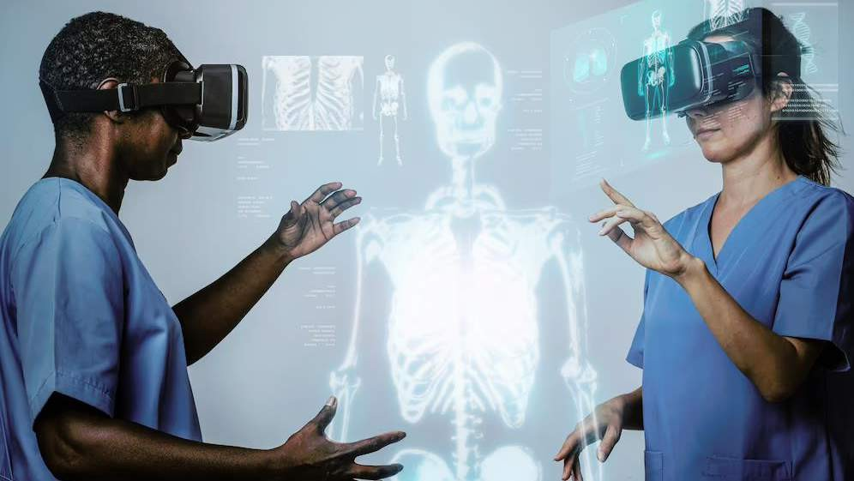






KEY PLAYERS

Slide 9


Contact us
For Full Report
COGNITIVE MARKET RESEARCH
Tel: + 1 312 - 376 - 8303 | + 44 020 - 8123 - 0732
India: ( + 91 ) 983 - 496 - 8611
sales@ cognitivemarketresearch. com
Access the Full Report : https://shorturl.at/lnvzN
Please visit our website:
https://www.cognitivemarketresearch.com

