Slide 1
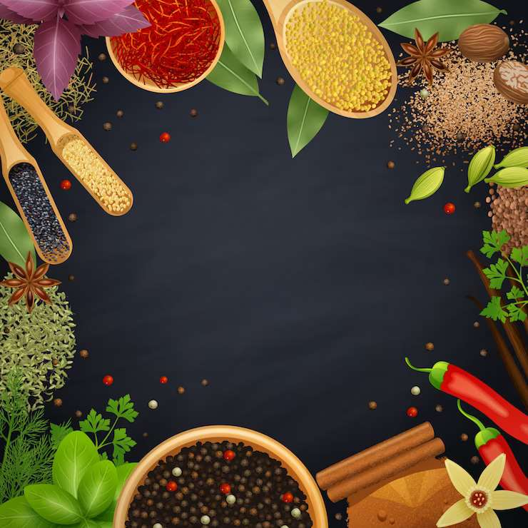
HERBS AND SPICES
MARKET REPORT

Slide 2
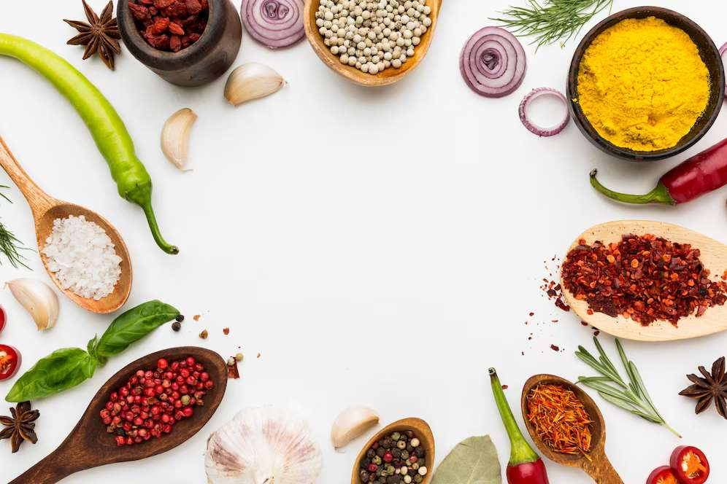
INTRODUCTION
Spices are natural plant products used to improve the flavour, aroma, taste and color of food products. They are also used in beverages, liquors, and pharmaceutical, cosmetic and perfumery products. Herbs are the group of plants consumed for macronutrients with savory and aromatic properties and are used for flavouring, garnishing of food and also for medicinal purpose. Thus, herbs and spices have been used for cooking and medicinal purpose.

Slide 3
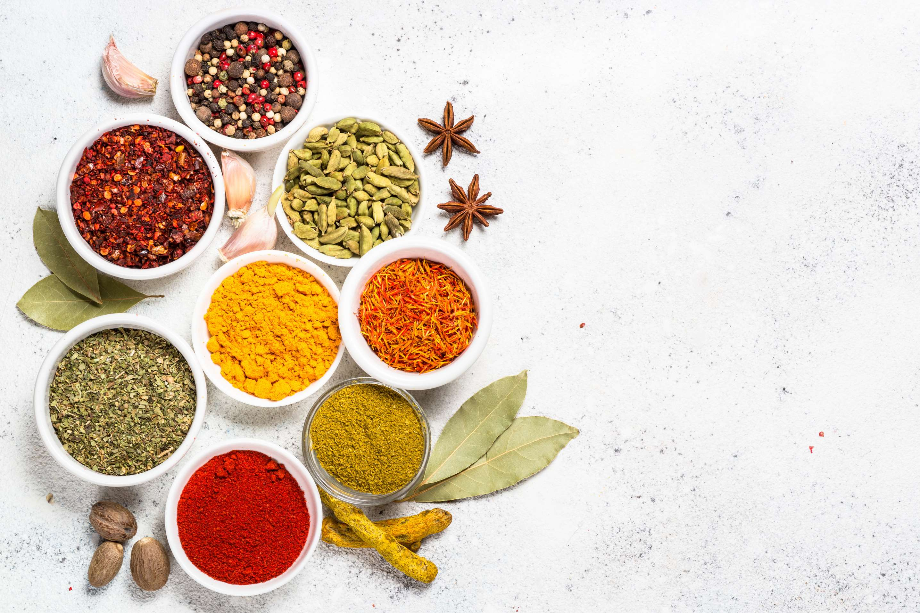

KEY INSIGHTS
MARKET SIZE
US$ 243 Billion
2022
FORECAST
$8,479.71 Million
2030
2023-
2030
CAGR
4.31%

Slide 4
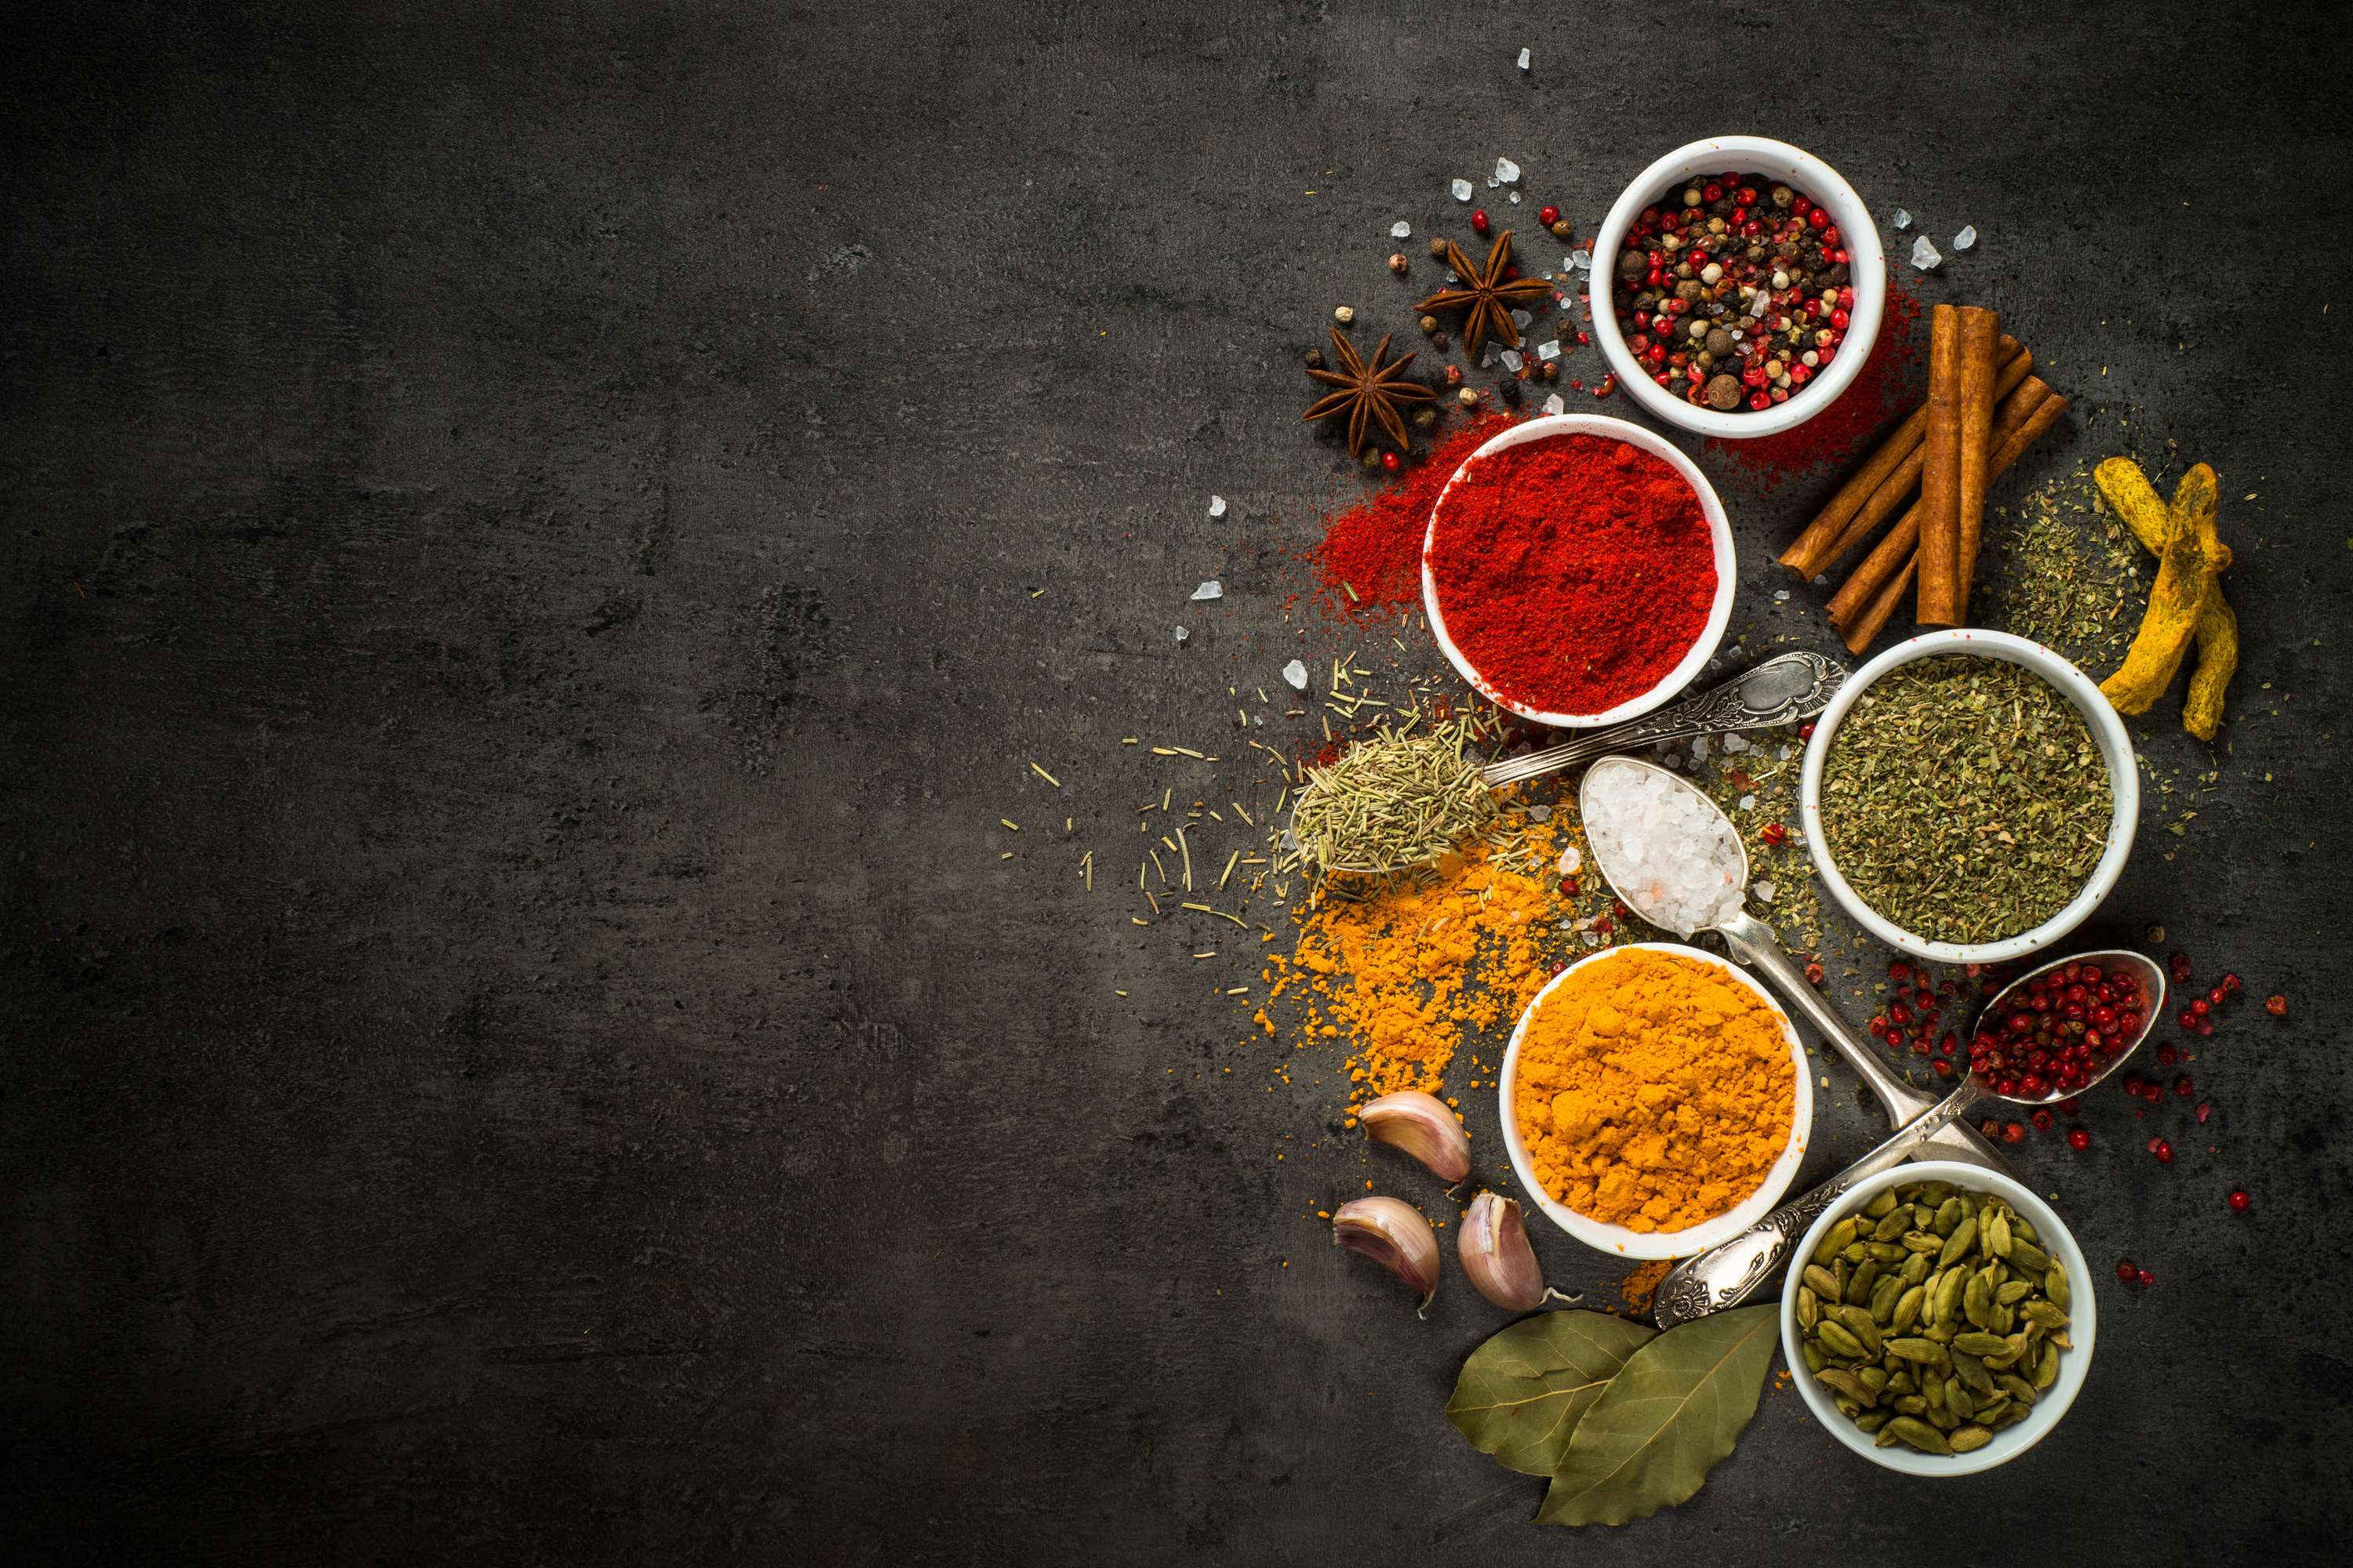
REVENUE MARKET SHARE BY SEGMENTS 2022
TYPE ANALYSIS
  Paprika
  Cumin
  Cinnamon
  Chili Powder
  Oregano
BY APPLICATION
  Food
  Beverage
  Food Service
  Retail

Slide 5
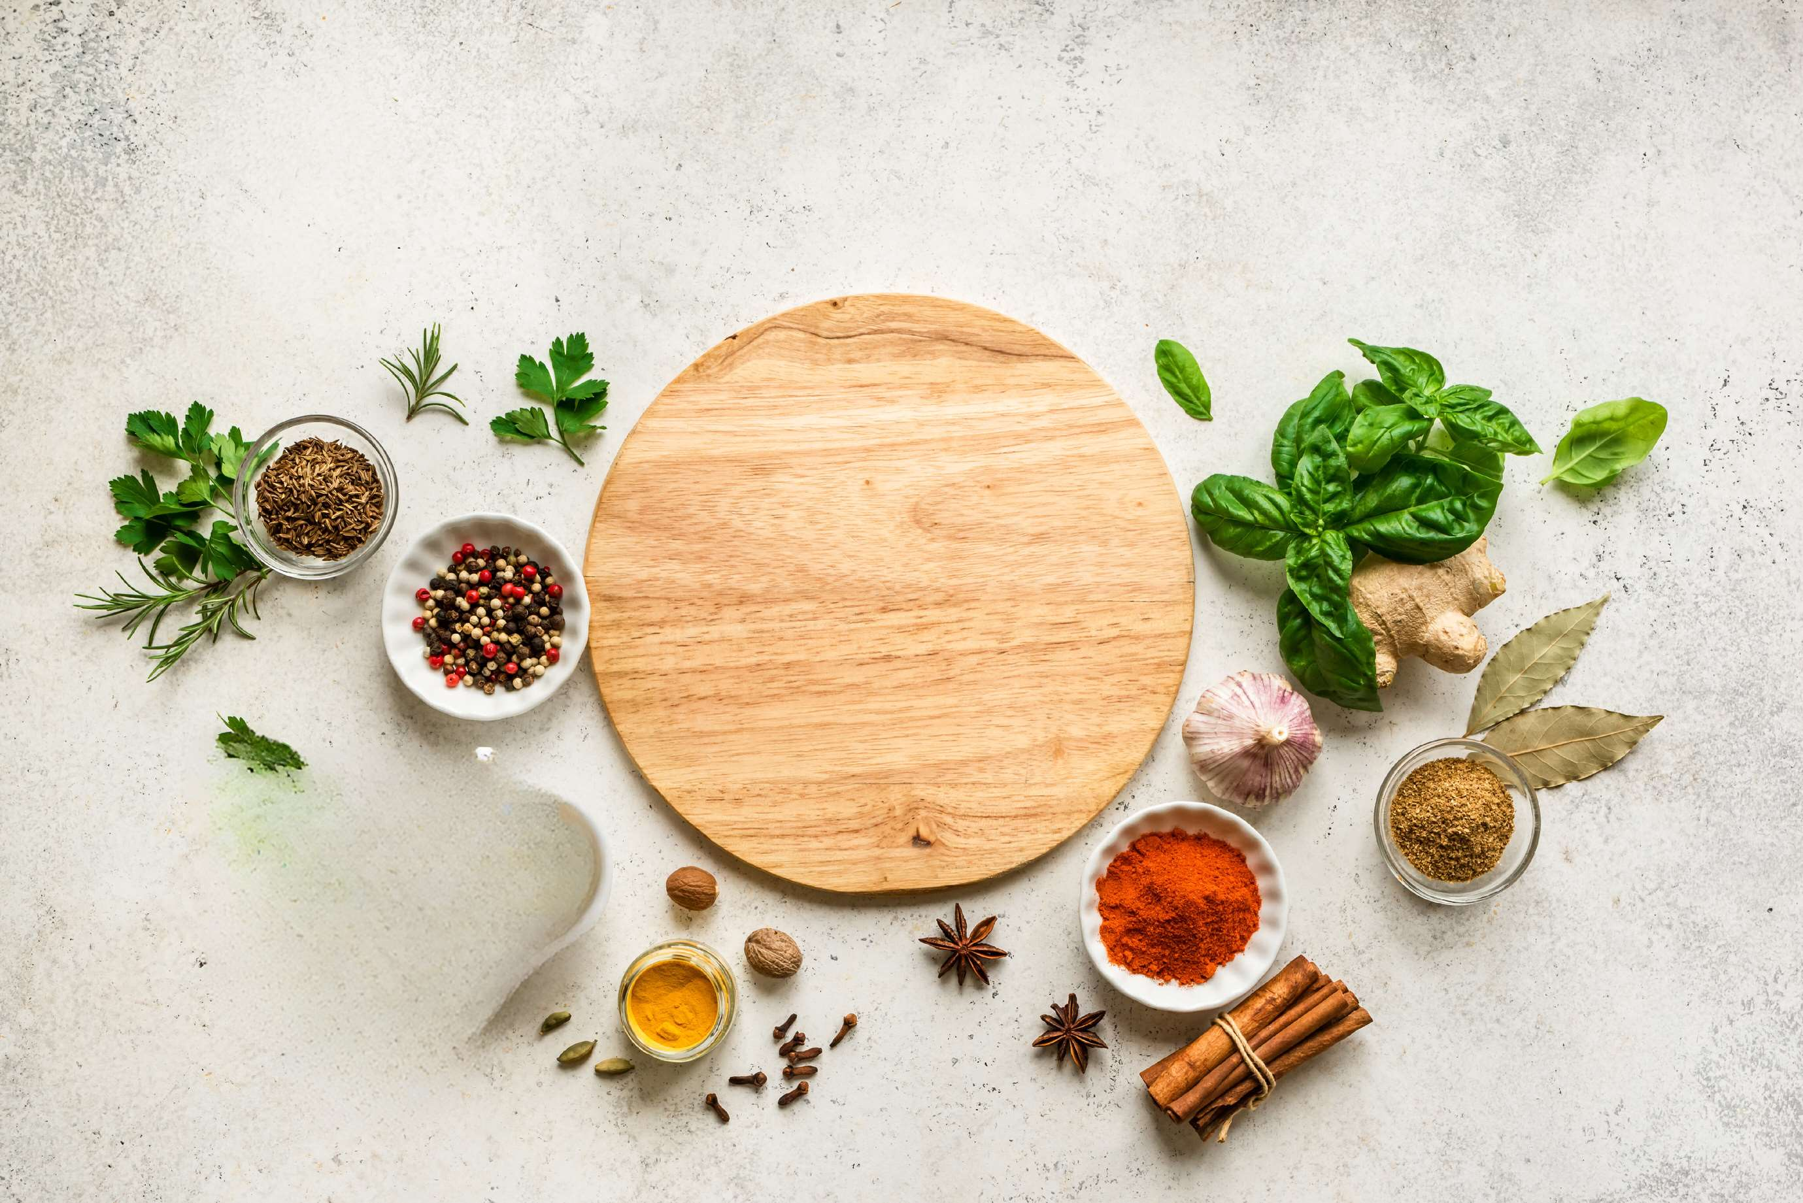

GLOBAL HERBS AND SPICES MARKET REVENUE SHARE FOR 2022
EUROPE
25.9 Billion

Slide 6
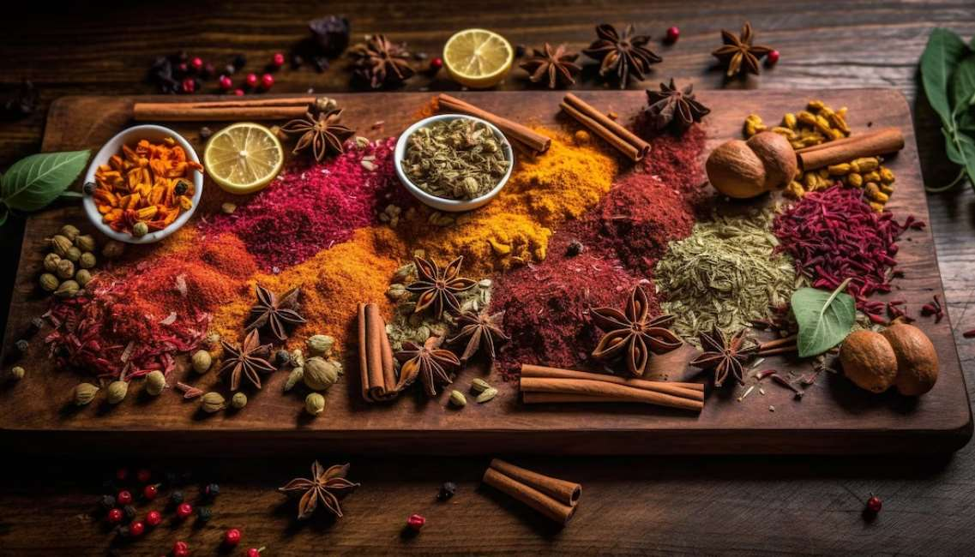
Rising demand for herbs and spices in Europe
Drivers
Lack of domestic production
Restraints

Slide 7

AUTHOR'S PERSPECTIVE
  The Global Herbs and Spices Market is witnessing significant growth in the near future.
  In 2023, the Paprika segment accounted for noticeable share of global Herbs and Spices Market and is projected to experience significant growth in the near future.
  The Food segment is expected to expand at the significant CAGR retaining position throughout the forecast period.
  Some of the key companies Givaudan S.A, Takasago International Corporation and others are focusing on its strategy building model to strengthen its product portfolio and expand its business in the global market.

Slide 8







KEY PLAYERS

Slide 9
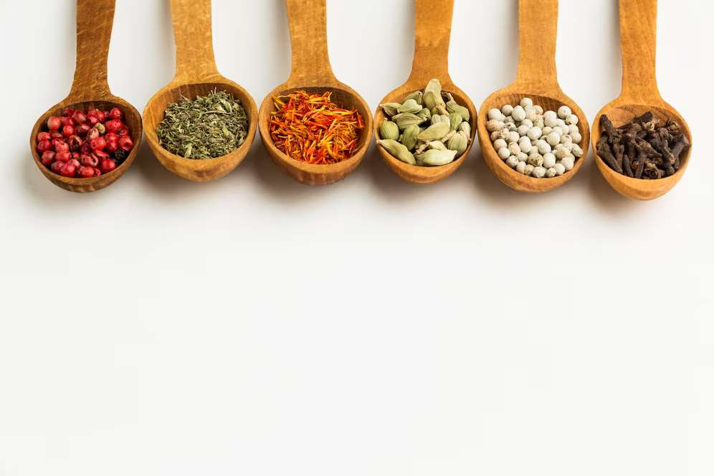

For Full Report
Contact us
COGNITIVE MARKET RESEARCH
Tel: +1 312-376-8303 | +44 020-8123-0732
India: (+91) 983-496-8611
sales@cognitivemarketresearch.com
Access the Full Report : https://shorturl.at/hoqu7
Please visit our website:
https://www.cognitivemarketresearch.com

