Slide 1


HERBAL TEA
MARKET REPORT
2024
Qualitative Analysis + Quantitative Analysis

Slide 2
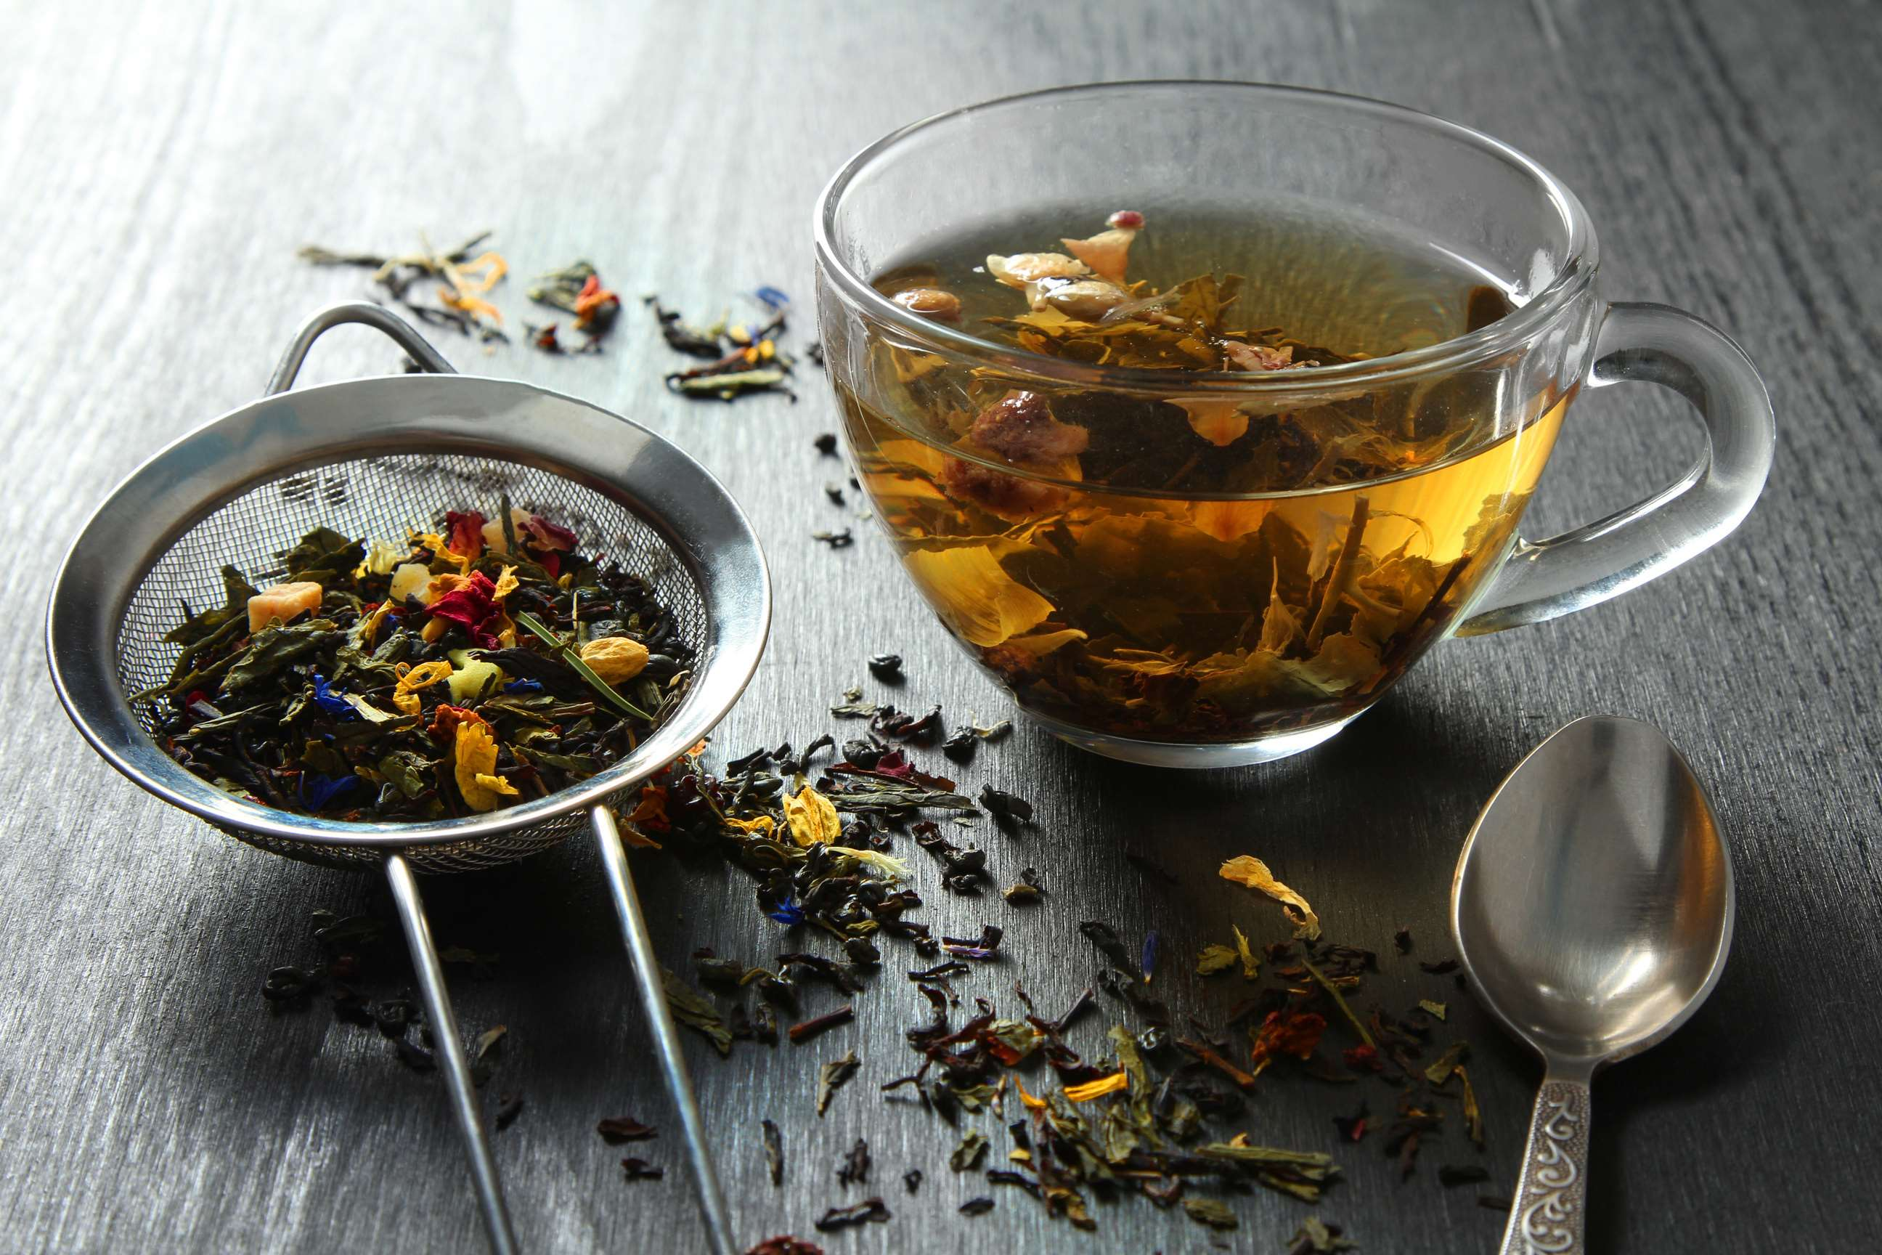
INTRODUCTION
Herbal tea, often referred to as tisane, encompasses a diverse array of beverages made from the infusion or decoction of herbs, spices, flowers, or other plant material in hot water. Unlike traditional tea, which is derived from the Camellia sinensis plant, herbal tea is caffeine-free, making it a popular choice for those seeking a soothing and naturally flavored alternative. Herbal teas are celebrated for their potential health benefits, ranging from aiding digestion to promoting relaxation and boosting immunity, depending on the herbs used. With a rich history spanning cultures worldwide, herbal teas continue to captivate consumers with their diverse flavors and wellness properties.

Slide 3


KEY INSIGHTS
MARKET SIZE
USD 3691.2 million
2024
CAGR
4.30%
2024- 2031

Slide 4
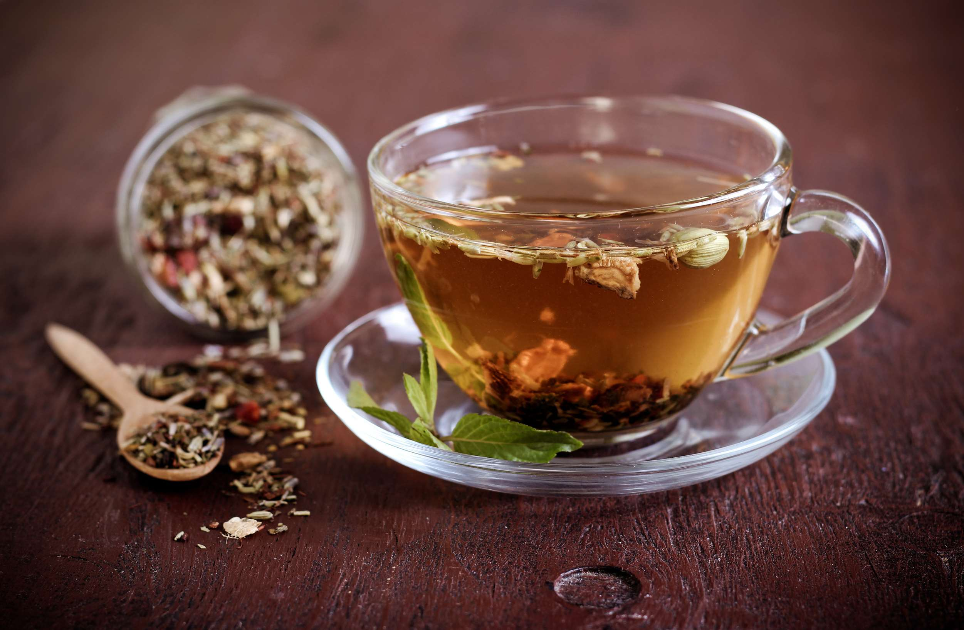
REVENUE MARKET SHARE BY SEGMENTS 2024
  Single blend stands out as the dominating category due to their simplicity and purity, appealing to consumers seeking specific flavors and health benefits.
  Mixed blend emerges as the fastest-growing category in the Herbal Tea market as they offer unique flavor combinations and enhanced health benefits.
Type Segment
  The dominating category is chamomile due to its well-known calming properties, attracting consumers seeking relaxation and stress relief.
  The fastest-growing category in the Herbal Tea market is turmeric driven by its acclaimed anti-inflammatory properties and vibrant flavor profile.
Flavour Type Segment

Slide 5
REVENUE MARKET SHARE BY SEGMENTS 2024
  Cognitive Health
  Gut and Digestive Health
  Multifunctional
  Others
Function Segment
  Tea Bags
  Loose Leaf
Form Segment
  Syrups
  Premixes
  Powdered Ready to Drink
  Liquid Ready to Drink
  Pouches
  Jars/Cans
  Tea Bag
Product Segment
Pack Type Segment

Slide 6

REGION ANALYSIS
NORTH AMERICA
Europe
Asia Pacific
Latin America
MIDDLE EAST AFRICA
USD 1476.48 million
USD 1107.36 million
USD 848.98 million
USD 184.56 million
USD 73.82 million
North America held the major market share for more than 40% of the global revenue with a market size of USD 1476.48 million in 2024 and will grow at a CAGR of 2.5% from 2024 to 2031.

Slide 7
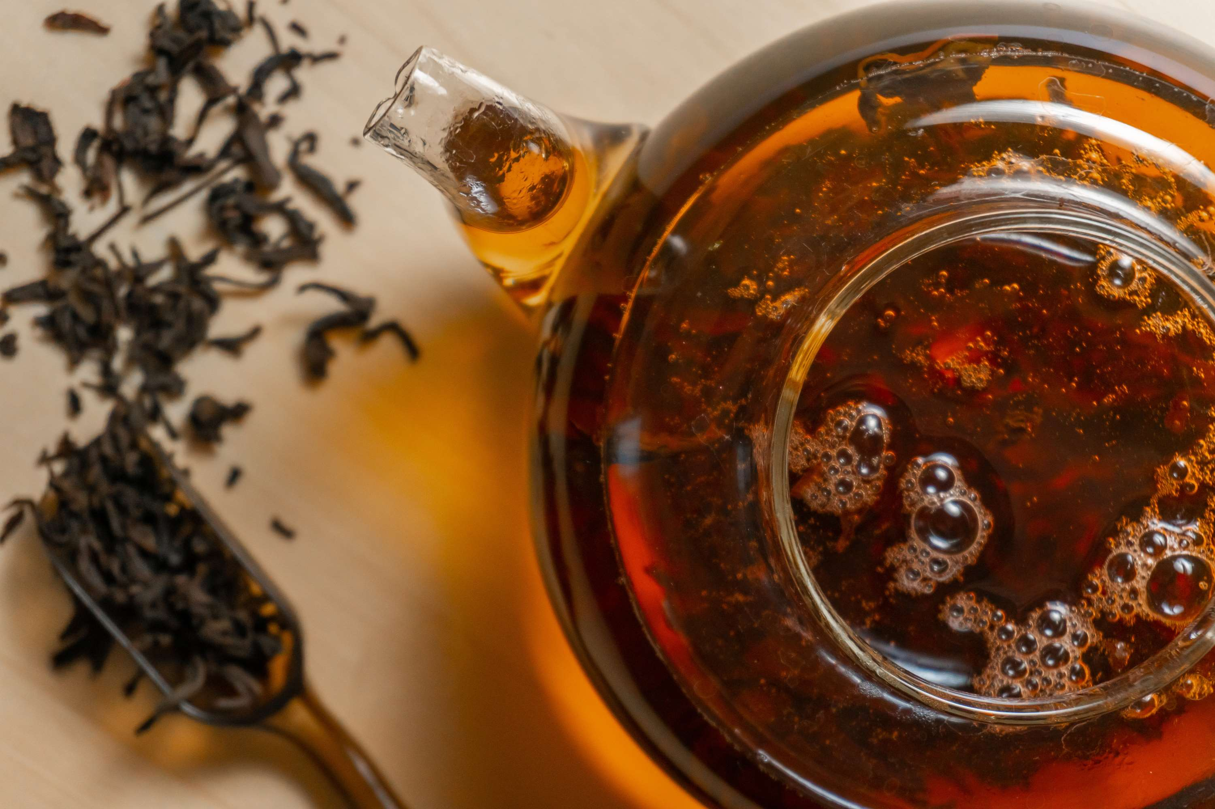
  Increasing Health Consciousness to Increase the Demand Globally
  Growing Preference for Natural Products to Propel Market Growth
Drivers
Restraints
Seasonal variability to Limit the Sales

Slide 8
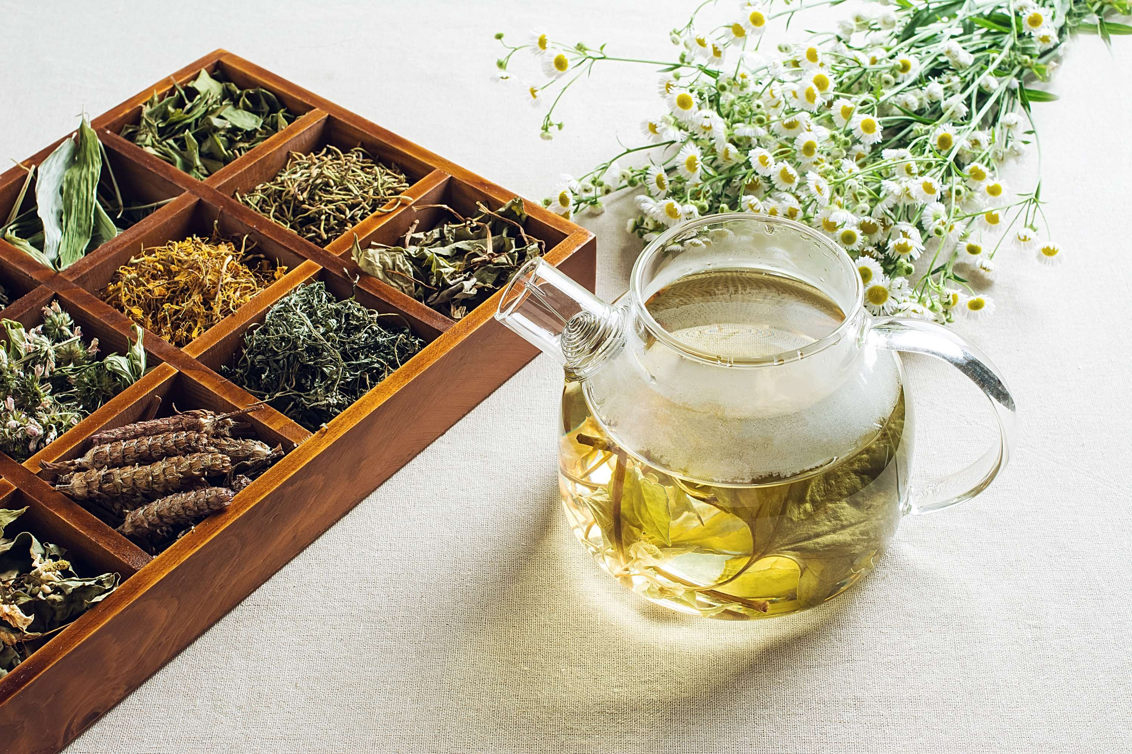
AUTHOR'S PERSPECTIVE
  The global Herbal Tea market will expand significantly by 4.30% CAGR between 2024 to 2031.
  Sales of Single Blend herbal teas are increasing due to their simplicity, purity, and transparency in ingredients, which resonate with health-conscious consumers seeking specific flavors and health benefits.
  Chamomile tea sales are increasing due to its renowned calming properties, mild flavor, and perceived health benefits, appealing to consumers seeking relaxation, stress relief, and improved sleep quality.

Slide 9














KEY PLAYERS

Slide 10


For Full Report
Contact us
COGNITIVE MARKET RESEARCH
Tel: +1 312-376-8303 | +44 020-8123-0732
India: (+91) 983-496-8611
sales@cognitivemarketresearch.com
Access the Full Report : https://tinyurl.com/yc6y9kua
Please visit our website:
https://www.cognitivemarketresearch.com

