Slide 1

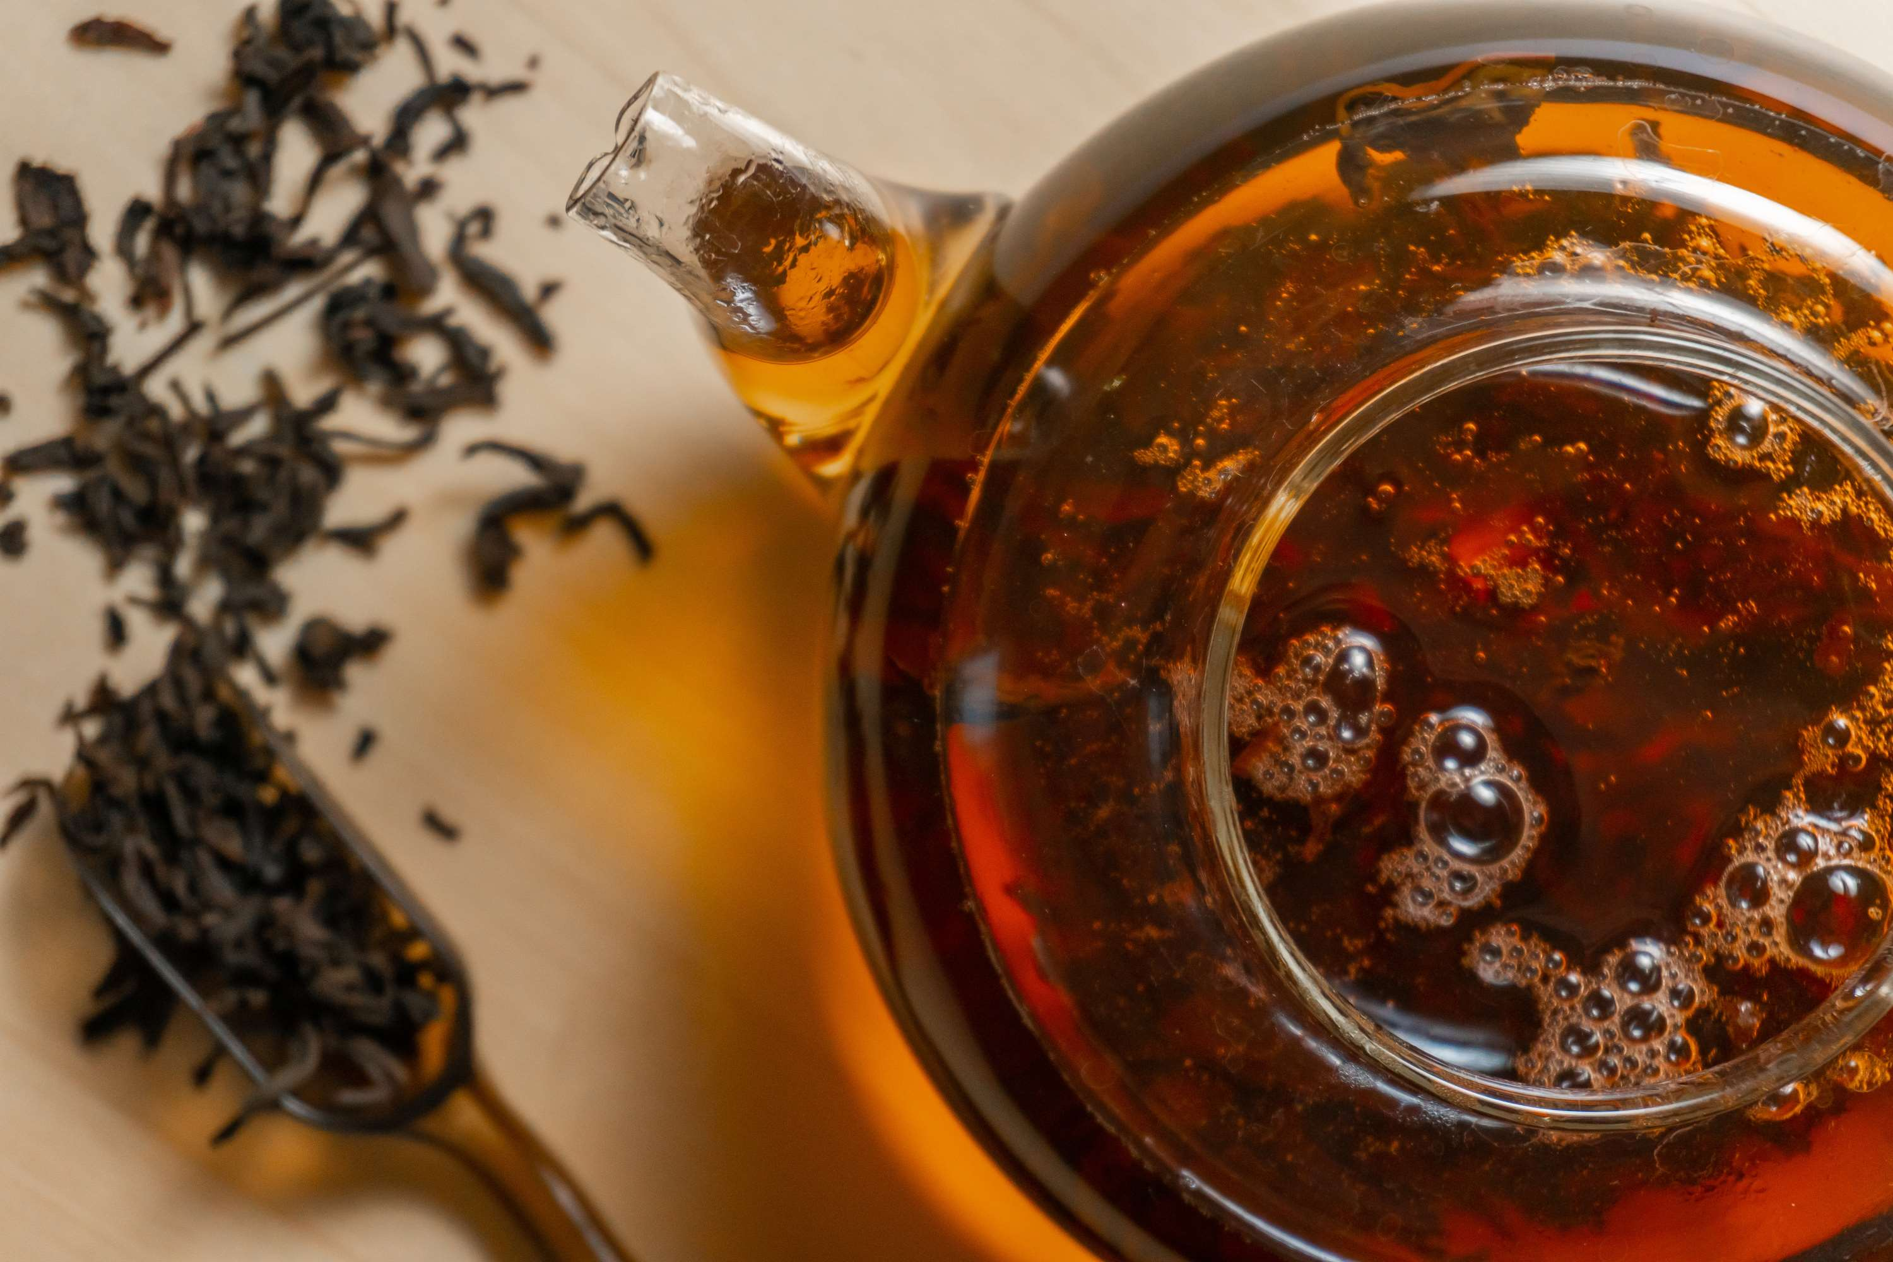

HERBAL BEVERAGE
MARKET REPORT
2024
Qualitative Analysis + Quantitative Analysis

Slide 2
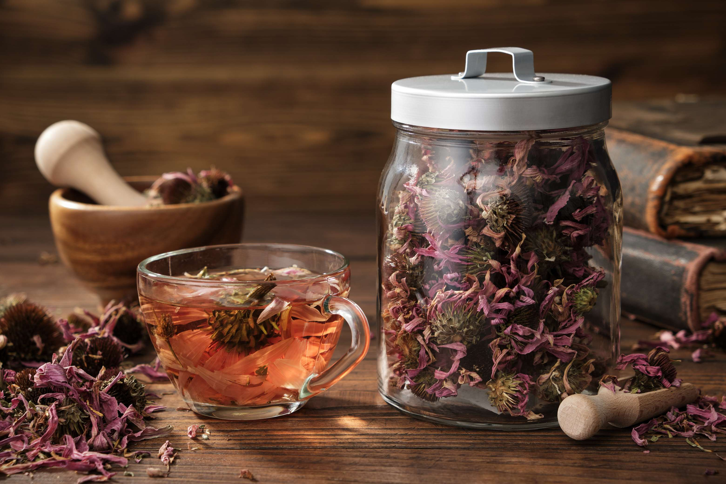
INTRODUCTION
A herbal beverage refers to a drink made from various plants or plant extracts, often infused in hot water. These beverages can include herbal teas, infusions, or decoctions, offering flavors, aromas, and potential health benefits derived from the natural properties of the herbs used. The rise in consumer awareness about health benefits associated with herbal ingredients, increasing preference for natural and organic products over synthetic ingredients, functional benefits of beverages, rising demand for non-alcoholic beverages by health-conscious consumers, continuous innovation in flavors, packaging, and product formulations by manufacturers, effective marketing strategies, increasing globalization & cultural influences, availability of herbal beverages, expansion of distribution channels and increased environmental concerns are the major factors influencing the growth of the Herbal Beverage Market.

Slide 3
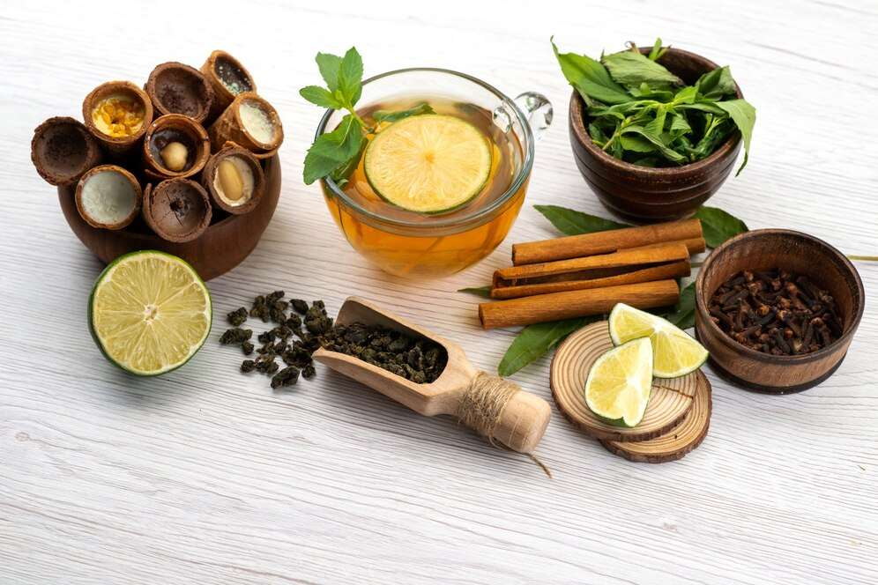

KEY INSIGHTS
MARKET SIZE
USD 1681.2 million
2024
CAGR
5.60%
2024- 2031

Slide 4
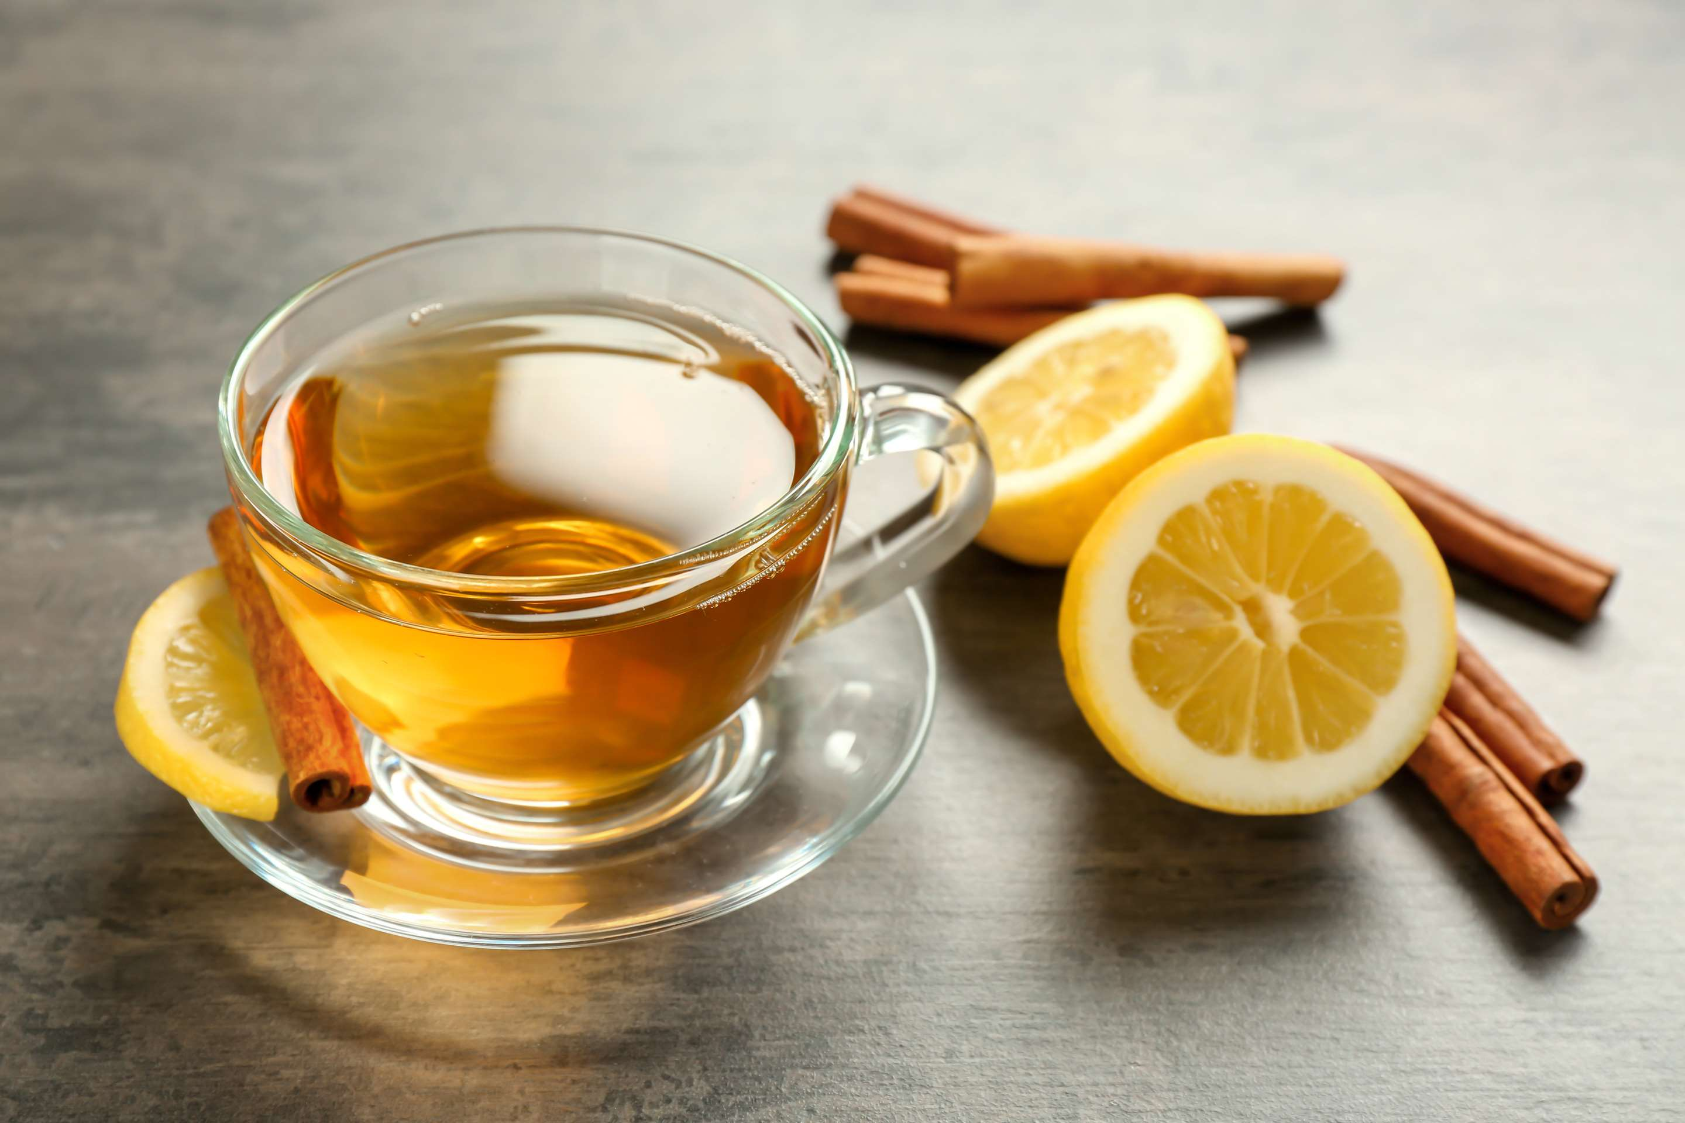
REVENUE MARKET SHARE BY SEGMENTS 2024
  Herbal Tea
  Healthcare Drink
  Sports Drink
Type Segment
  Online
  Offline
Distribution Channel
  Normal Drinking
  Functional Drinking
Application Segment

Slide 5
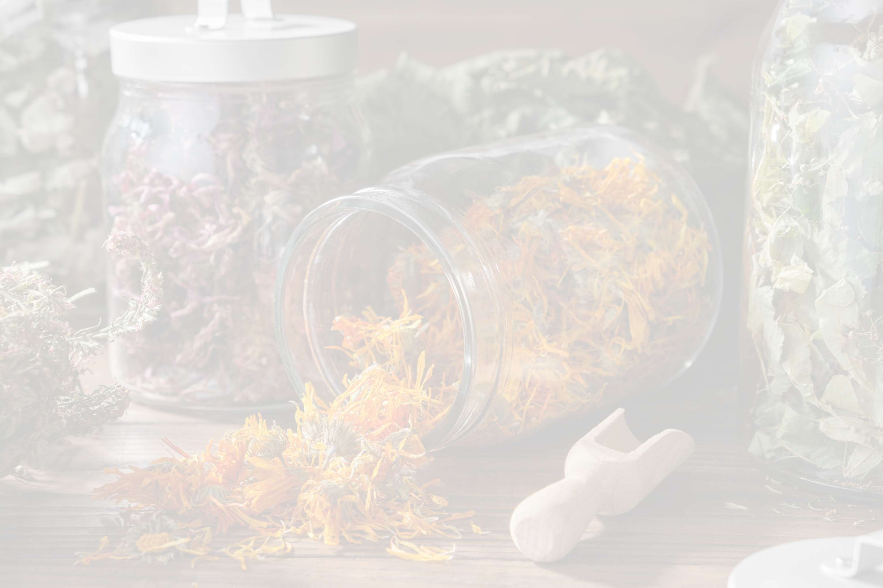

North America
40%
North America Herbal Beverage Market Revenue share for 2024 is 40%

Slide 6
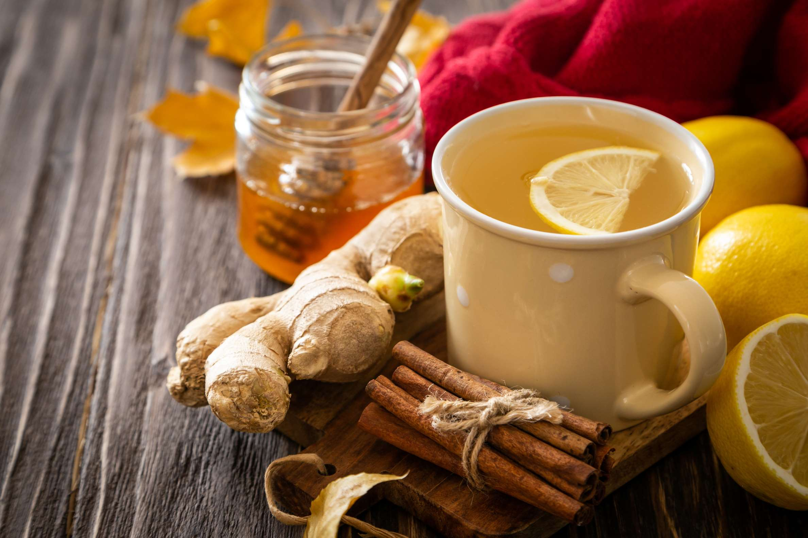
  Continuous innovation in flavors to Provide Viable Market Output
  Increasing preference for natural and organic products over synthetic ingredients propels Market Growth.
Drivers
Limited consumer awareness of benefits to Restrict Market Growth
Restraints

Slide 7
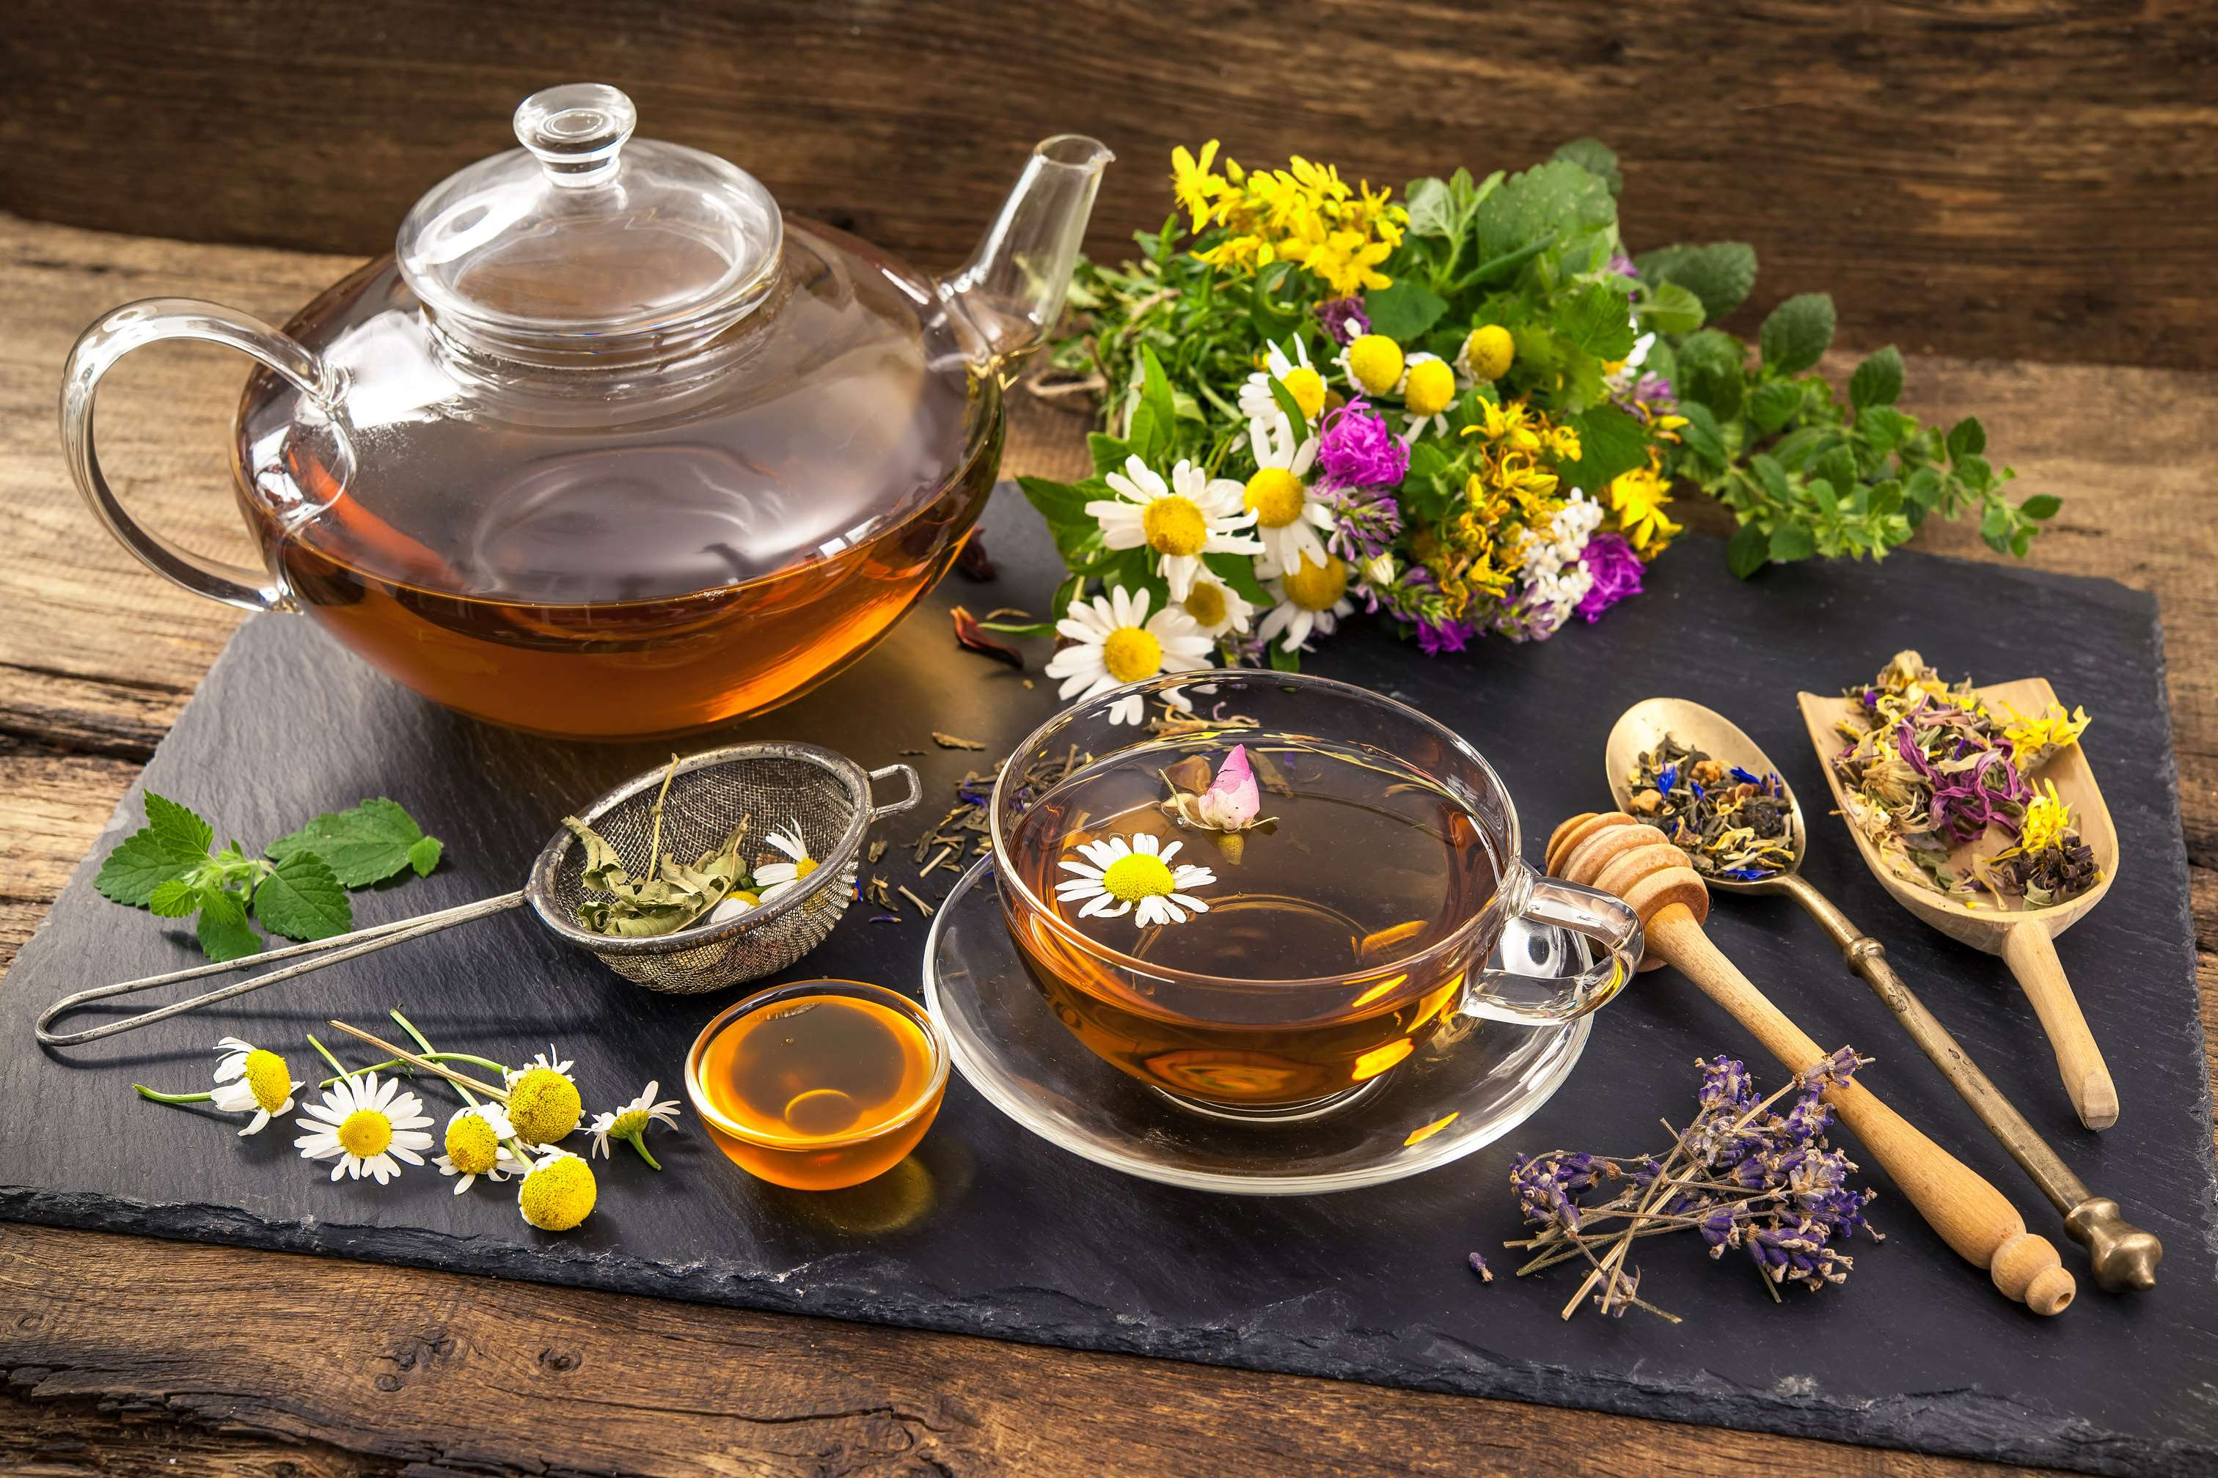
AUTHOR'S PERSPECTIVE
  The global Herbal Beverage market will expand significantly by 5.60% CAGR between 2024 and 2031.
  Sales of the herbal tea segment are set to rise.
  Herbal teas are renowned for their therapeutic properties and natural flavors. They cater to health-conscious consumers seeking relaxation, detoxification, or immune support.
  There is an increasing preference for natural and organic products over synthetic ingredients, functional benefits of beverages, and rising demand for non-alcoholic beverages.

Slide 8
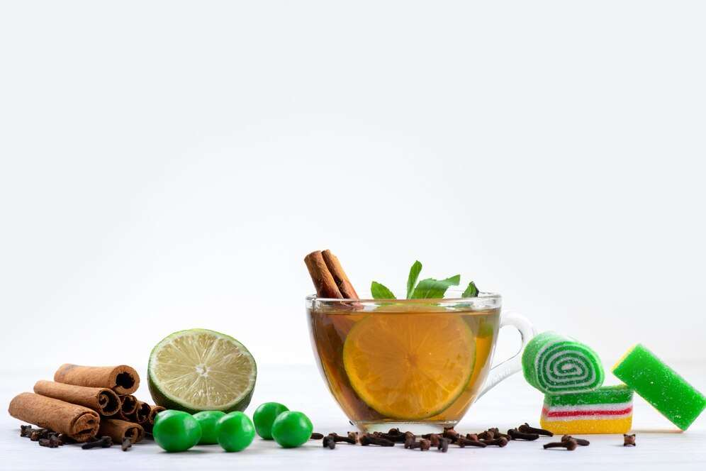
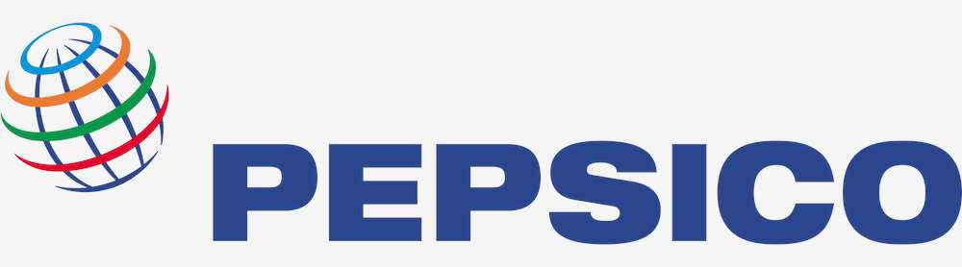
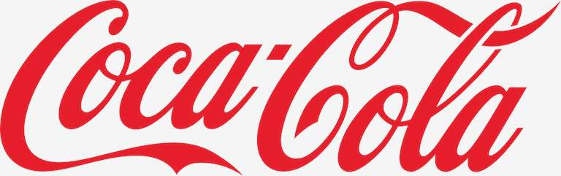

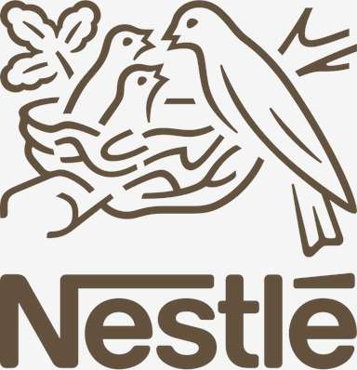
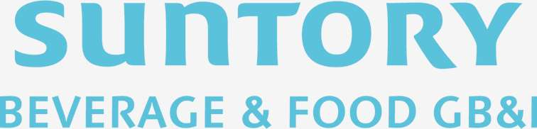
KEY PLAYERS

Slide 9


For Full Report
Contact us
COGNITIVE MARKET RESEARCH
Tel: +1 312-376-8303 | +44 020-8123-0732
India: (+91) 983-496-8611
sales@cognitivemarketresearch.com
Access the Full Report : https://tinyurl.com/5cfz4r6f
Please visit our website:
https://www.cognitivemarketresearch.com

