Slide 1





Global,Regional,CountryAnalysis

Slide 2





Slide 3



MARKET SIZE
$6.87 BILLOn
2022
MARKET SIZE
$19.37 bILLOn
2030
2023
CAGR 22.6%
-
2030

Slide 4
Seed 32.17%
By Type
Textile 28.14%
Application
Conventional 69.74%
Source Segment

Slide 5


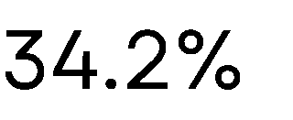

Slide 6




Slide 7









































































Slide 8












Slide 9


Contact us
For Full Report
COGNITIVE MARKET RESEARCH
Tel: + 1 312 - 376 - 8303 | + 44 020 - 8123 - 0732
India: ( + 91 ) 983 - 496 - 8611
sales@ cognitivemarketresearch. com
Access the Full Report : http://tinyurl.com/2edkt8ny
Please visit our website:
https://www.cognitivemarketresearch.com

