Slide 1
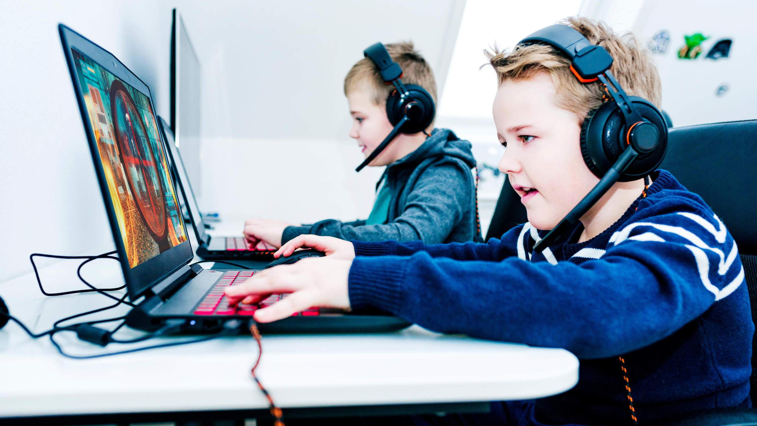


Slide 2

INTRODUCTION
Headphones are a pair of small loudspeaker drivers worn on or around the head over a user's ears. Kids headphones are the headphones specially design considering the size, length, and other features like noise reduction and volume limit etc. Kid’s headphones are usually preferring for education purpose or to keep the child busy and maintain the other work balance. Rapid adoption of smart devices coupled with growing online education system is the primary driving factor of the global headphones for kids’ market.

Slide 3


KEY INSIGHTS
MARKET SIZE
s12,614.55 Million
2028
2023-
2030
CAGR 18.27%

Slide 4
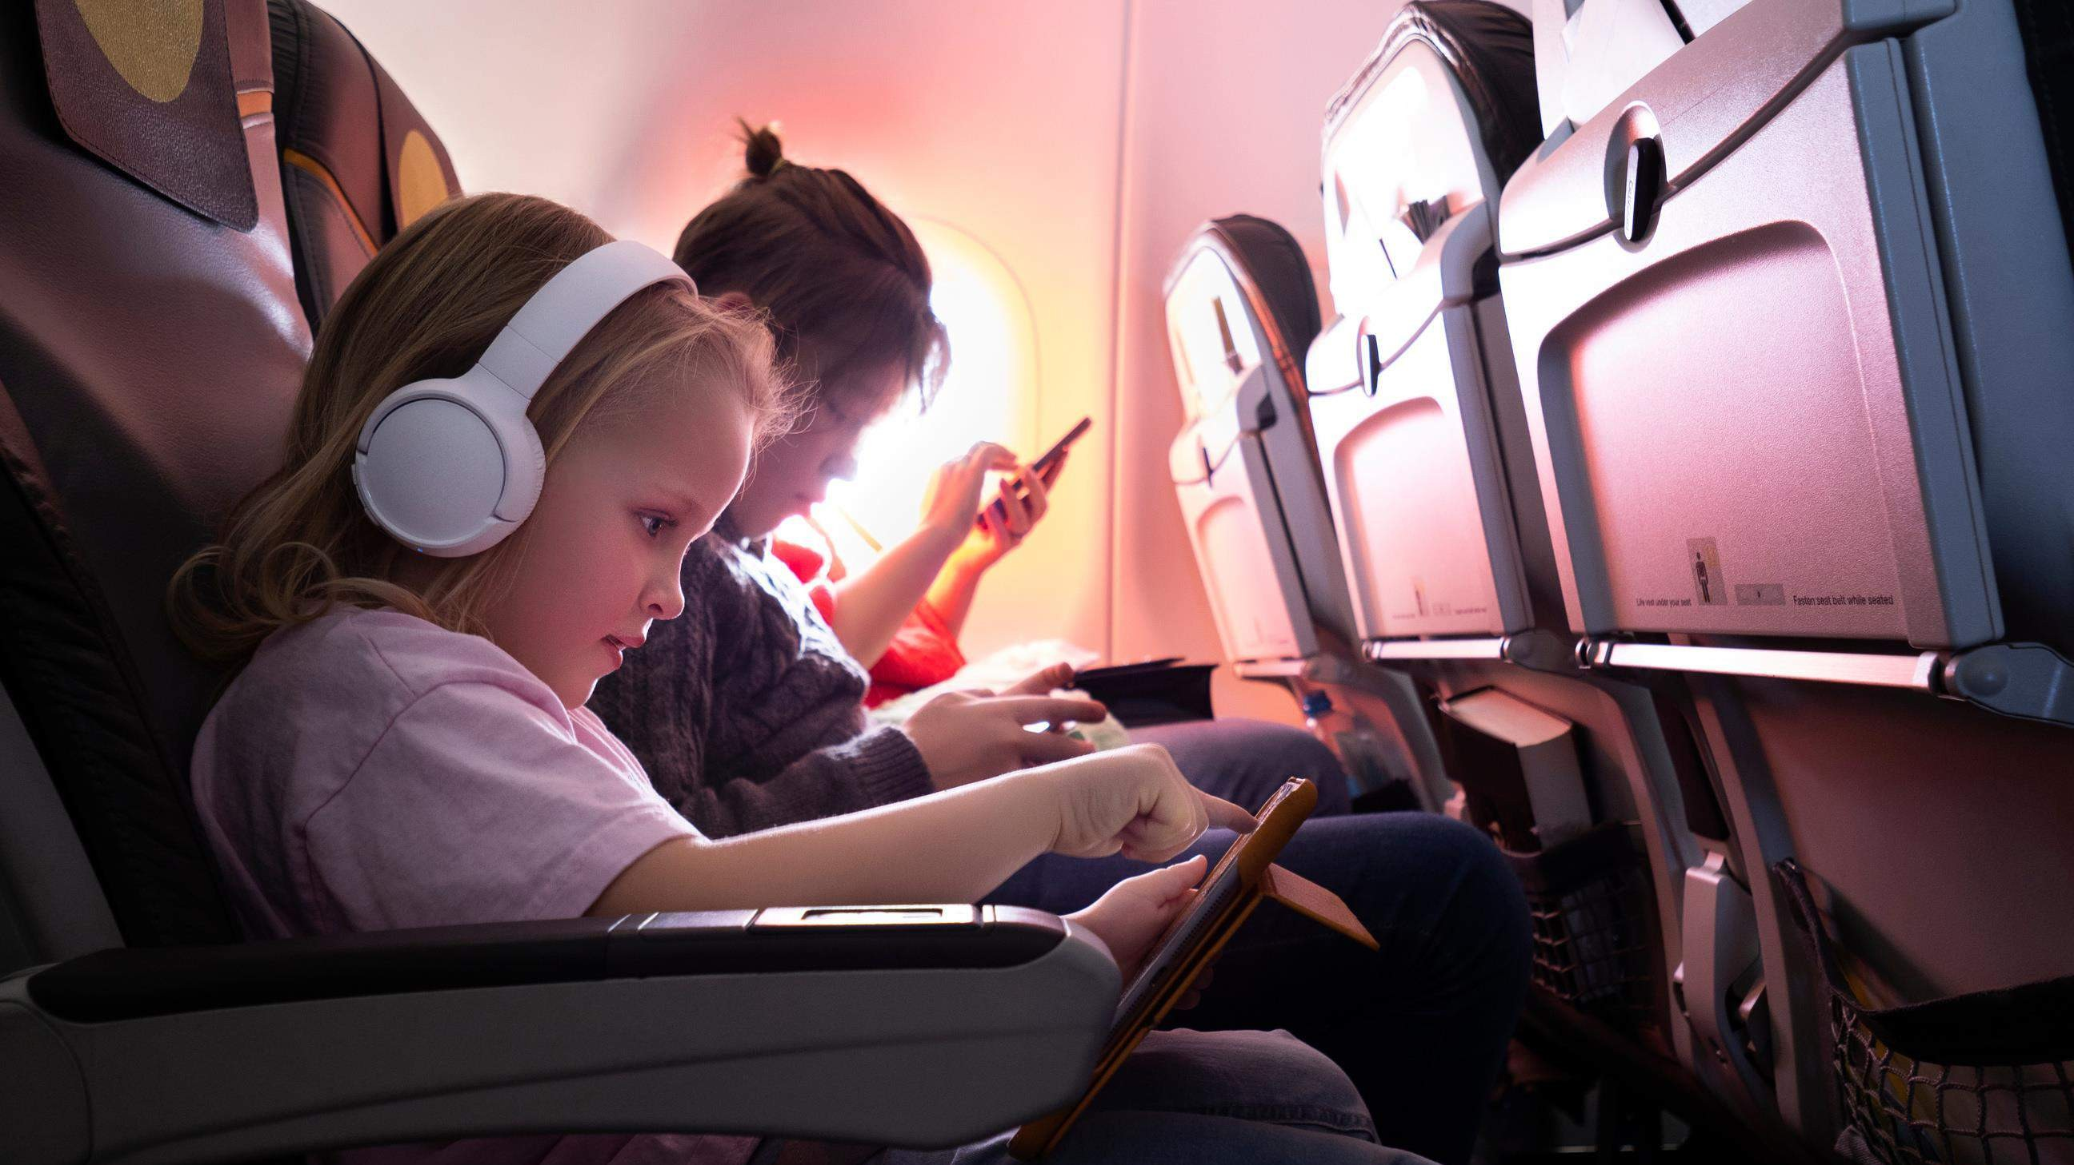
REVENUE MARKET SHARE BY SEGMENTS 2022
Application Segment
Cell Phone
Computer
Gaming
by type
Distribution channel
Direct
Indirect
Wired Headphones USD 7,598.15 Million

Slide 5

GLOBAL HEADPHONES FOR KIDS MARKET REVENUE SHARE FOR 2022
North America USD 3,843.65 Million

Slide 6



Rapidly increasing online education
Harmful Effects due to uncontrolled use of headphone.

Slide 7

AUTHOR'S PERSPECTIVE
The Global Headphones for Kids Market revenue in 2016: USD 3,533.46 Million
Total revenue expected in year 2028: USD 12,614.55 Million
CAGR from 2021-2028 is expected to be: 18.27%
Based on Type segment, the market is segmented into Wired Headphones and Wireless Headphones
Wired Headphones accounted for largest share of total revenue generated in 2019
Cell Phone held maximum share of Headphones for Kids market in 2019
Direct held highest share of Headphones for Kids market in 2019

Slide 8
KEY PLAYERS

Slide 9


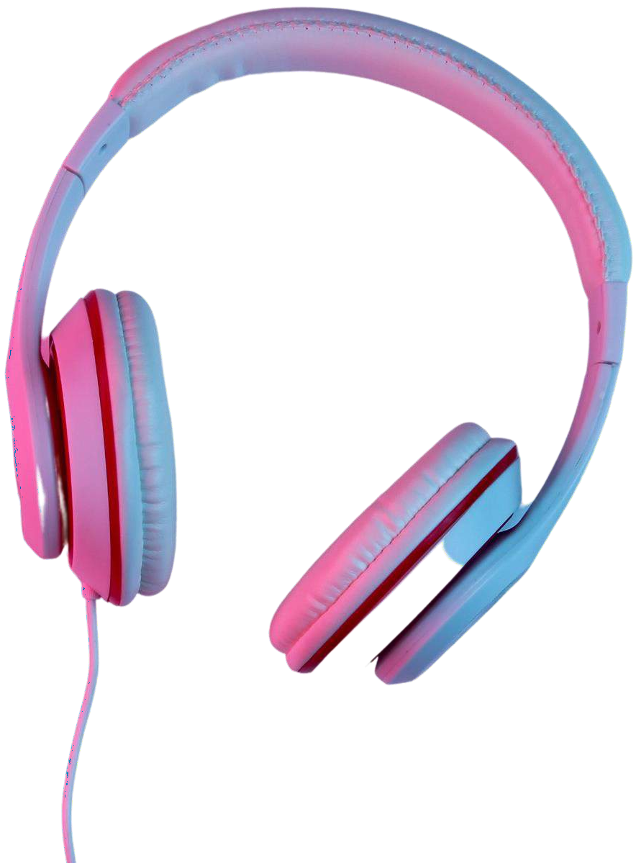
Contact us
For Full Report
COGNITIVE MARKET RESEARCH
Tel: + 1 312 - 376 - 8303 | + 44 020 - 8123 - 0732
India: ( + 91 ) 983 - 496 - 8611
sales@ cognitivemarketresearch. com
Access the Full Report : https://tinyurl.com/y6k6wk2b
Please visit our website:
https://www.cognitivemarketresearch.com

