Slide 1
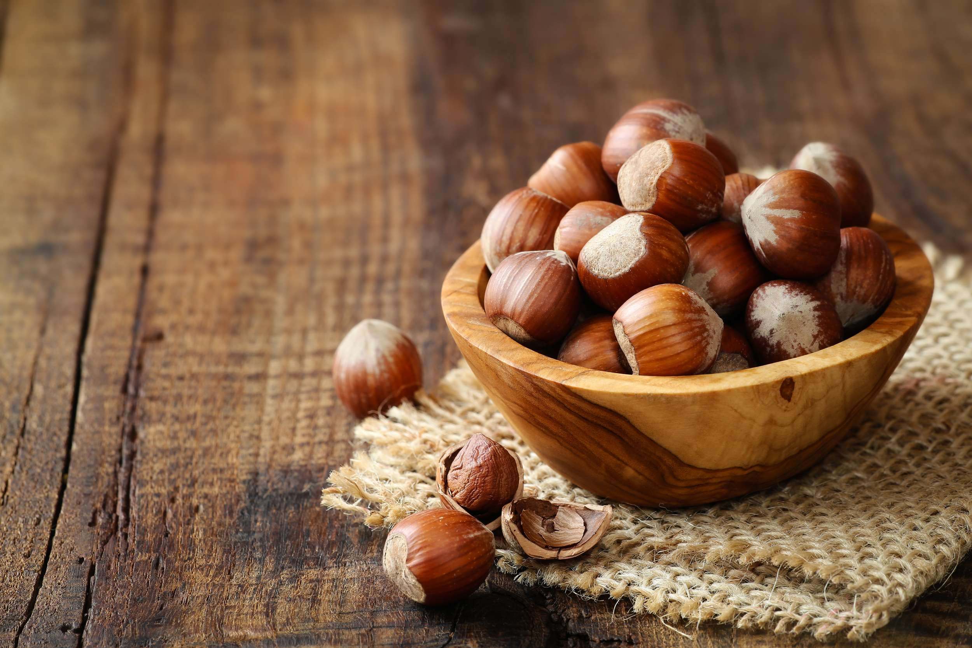
HAZELNUT
MARKET REPORT 2024
Global,Regional,CountryAnalysis

Slide 2

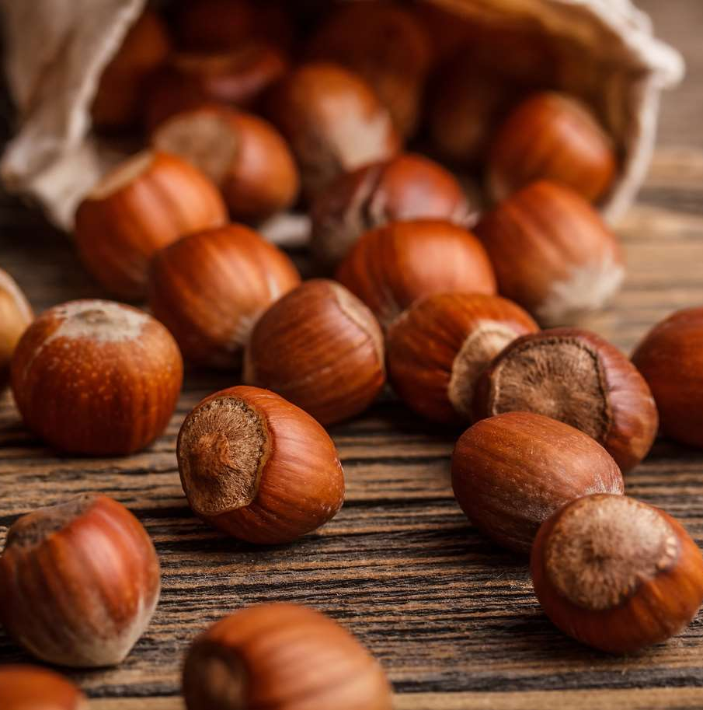
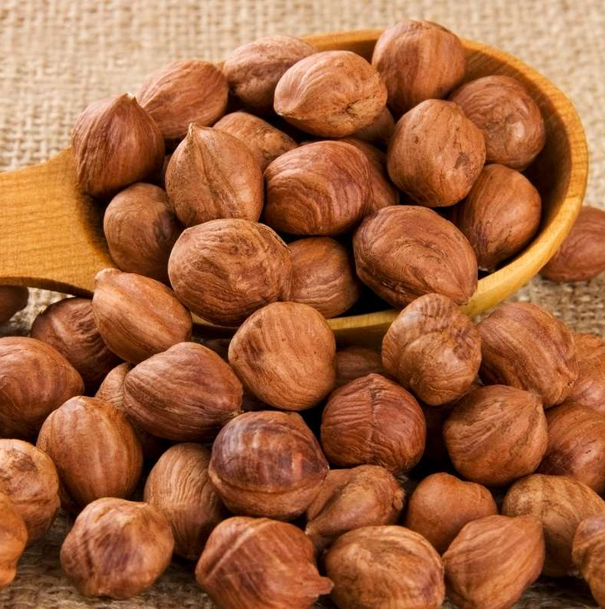
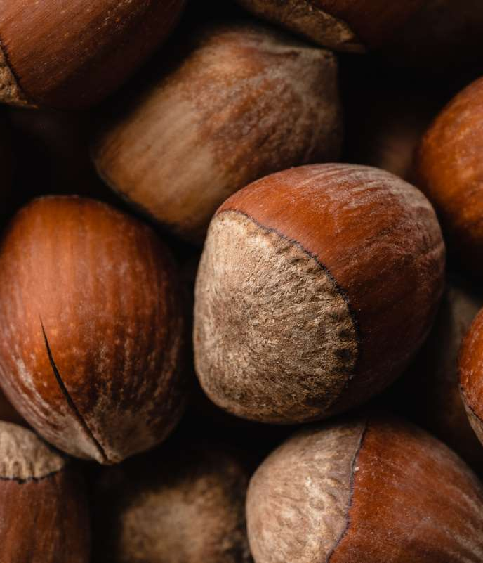


INTRODUCTION
The hazelnut is the fruit of the hazel tree and so encompasses all nuts derived from species of the genus Corylus, particularly those of Corylus avellana. Depending on the species, they are often called cobnuts or filberts.The hazelnuts themselves are tiny and spherical, roughly the size of a huge marble. Hazelnuts are crunchy while fresh, but can be processed into a creamy paste when ground. They have a rich flavor that stands out even when combined with other strong flavors, such as chocolate.

Slide 3
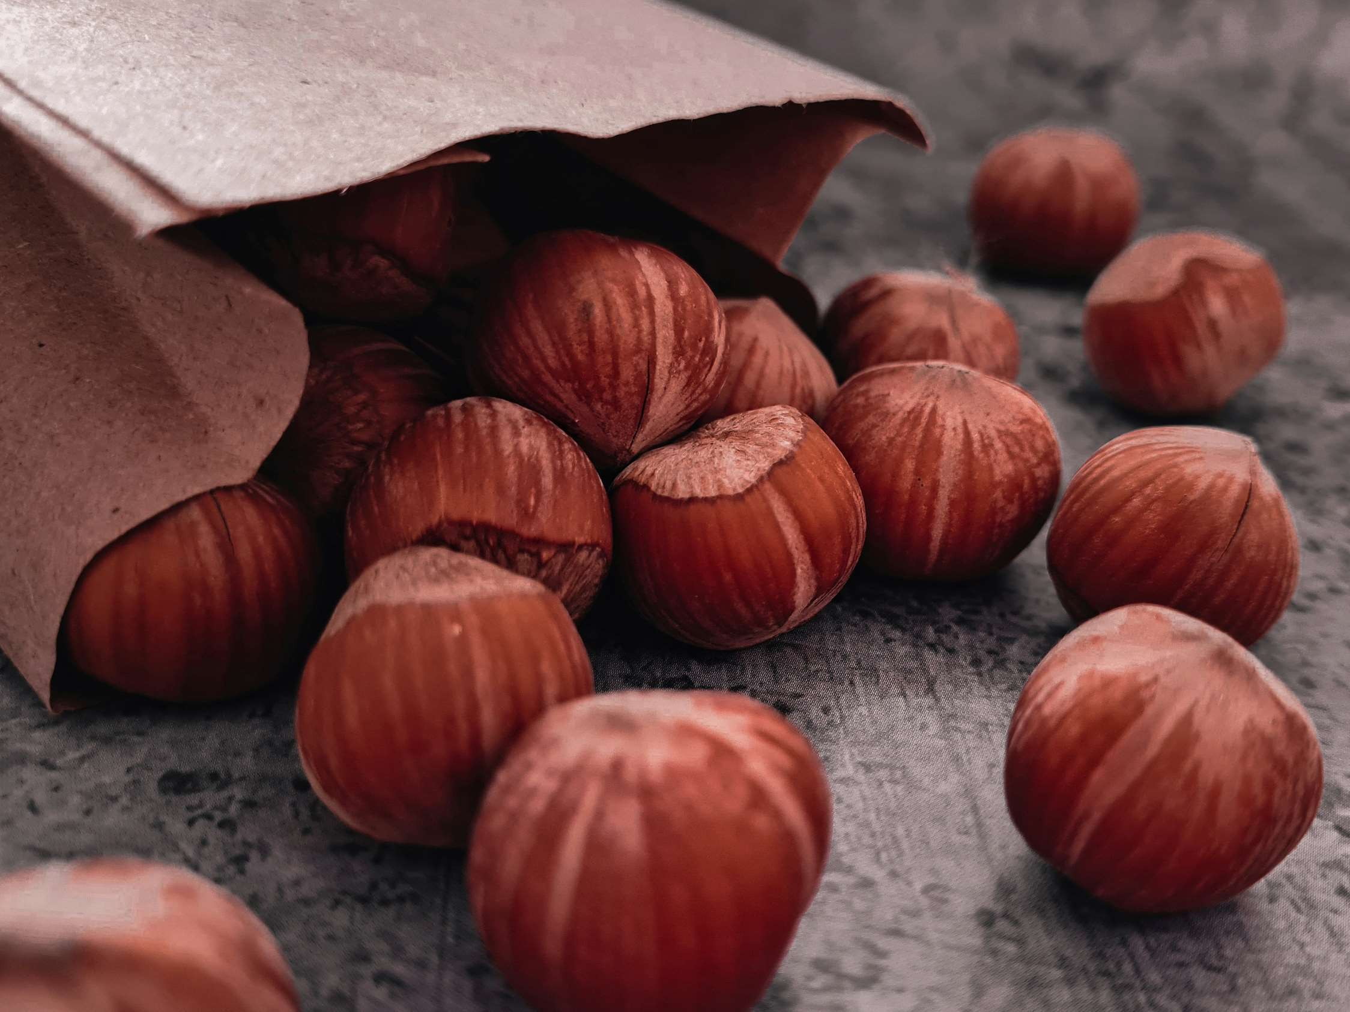


KEY INSIGHTS
MARKET SIZE
474.21 million
2022
FORECAST
$15,112.21 Million
2030
2023-
2030
CAGR
7.34%

Slide 4
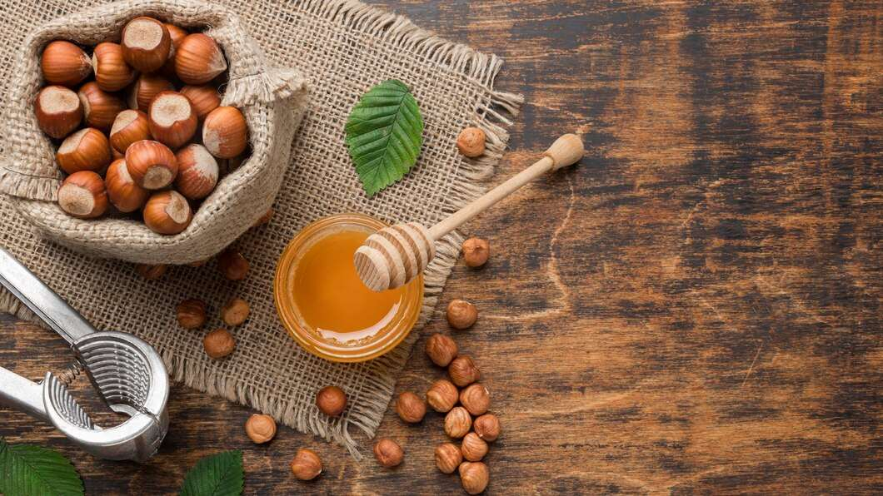
REVENUE MARKET SHARE BY SEGMENTS 2022
BY TYPE
WHOLE/IN-SHELL HAZELNUT :3,923.95 MILLION
BY APPLICATION
INDUSTRIAL : 8,769.42 MILLION
CATEGORY SEGMENT
CONVENTIONAL : 8,651.88 MILLION
SHAPE SEGMENT
ROUND KERNELS : 7,288.66 MILLION

Slide 5

GLOBAL HAZELNUT MARKET REVENUE SHARE FOR 2022
North America
4,915.70 Million

Slide 6
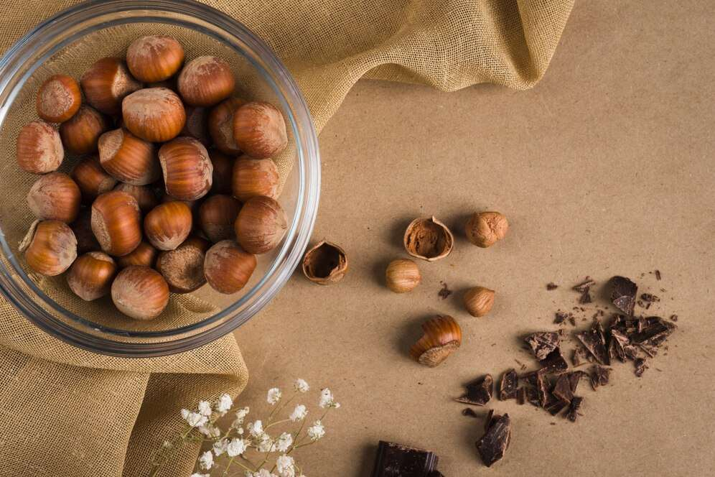
Increase in awareness about health and nutrition-based products
Drivers
Restraints
Price Volatility in Raw-materials

Slide 7
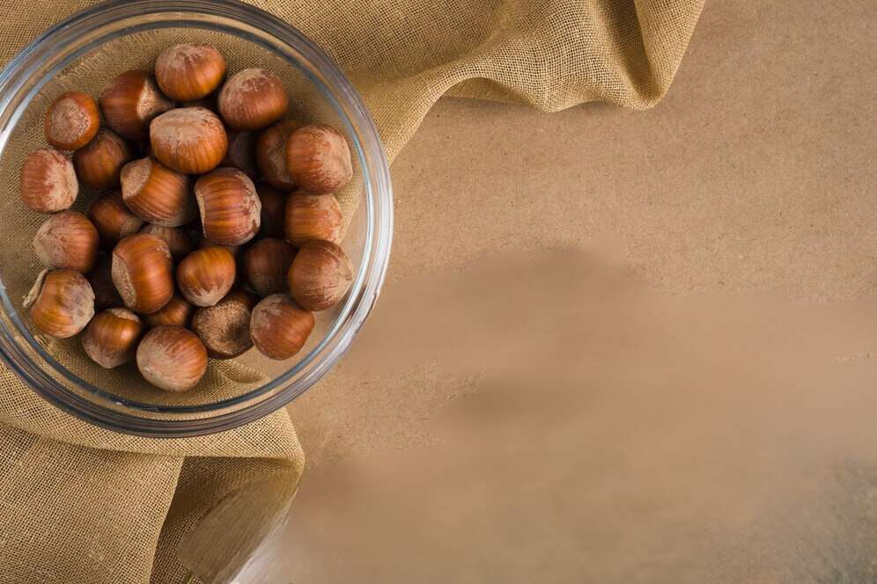
AUTHOR'S PERSPECTIVE
  The Global Hazelnut Market revenue in 2016: USD 11,342.60 Million
  Whole/In-shell Hazelnut held for largest share of total revenue generated in 2019
  Conventional held the maximum share of total revenue generated in 2019
  Round Kernels held the maximum share of total revenue generated in 2019
  Akcakoca held the maximum share of total revenue generated in 2019
  Plastic or Metal Drums held the maximum share of total revenue generated in 2019
  Industrial held the maximum share of total revenue generated in 2019.

Slide 8

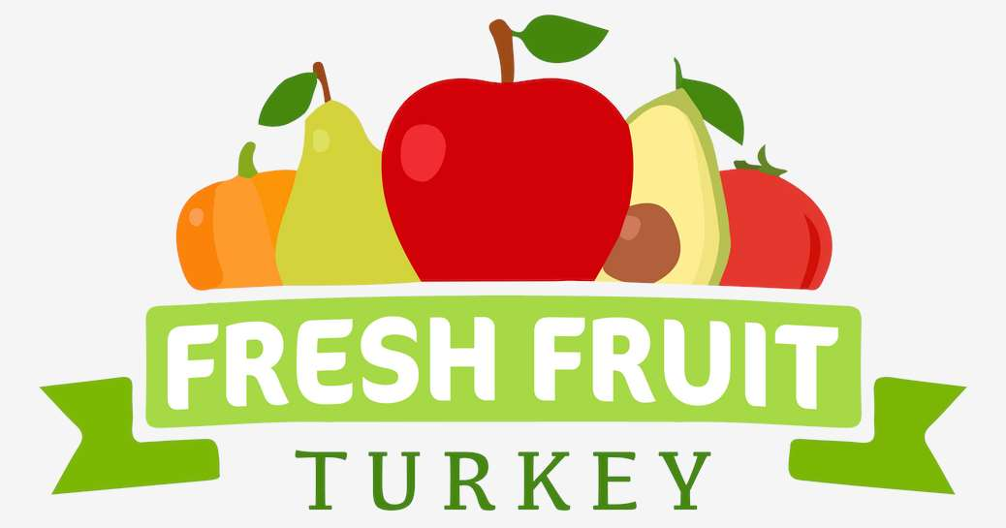





KEY PLAYERS

Slide 9


For Full Report
Contact us
COGNITIVE MARKET RESEARCH
Tel: +1 312-376-8303 | +44 020-8123-0732
India: (+91) 983-496-8611
sales@cognitivemarketresearch.com
Access the Full Report : https://shorturl.at/hoqu7
Please visit our website:
https://www.cognitivemarketresearch.com

