Slide 1

GLOBAL
HATS
MARKET REPORT
2024
Global,Regional,CountryAnalysis

Slide 2
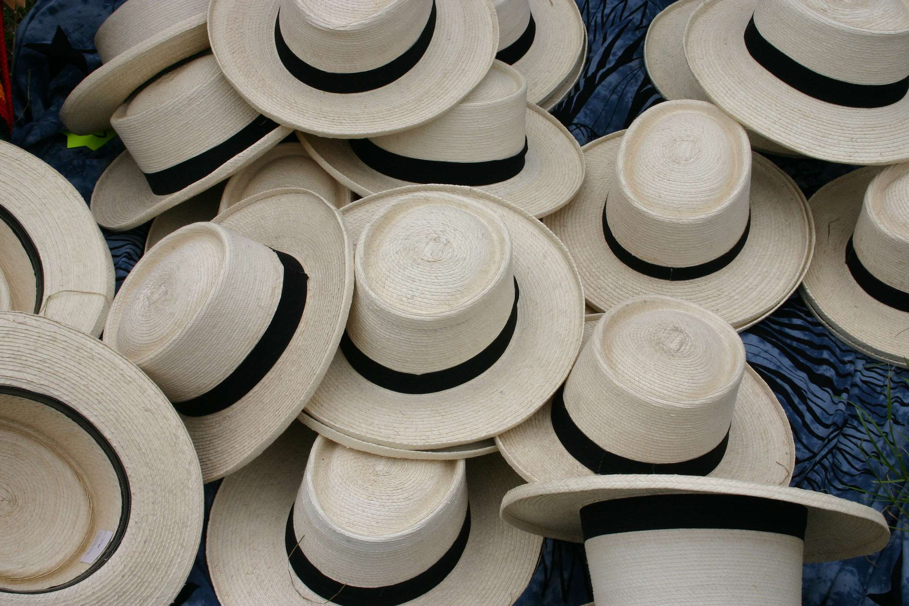
INTRODUCTION
Increasing numbers of people living in cities worldwide have raised the bar for style trends everywhere, helping fuel demand. An opportunity for market expansion is the growing popularity of smart headwear that tracks vital signs and energy use. Additionally, rising athlete demand is fueling the expansion of the global market for sports hats. Hats are in high demand because athletes in outdoor sports like baseball, cricket, and polo wear them frequently to block the sun and keep their eyes safe from the glare. This is expected to fuel the market growth over the next few years.

Slide 3


KEY INSIGHTS
MARKET SIZE
USD 8.8 billion
2023
CAGR
4.60%
2023- 2030

Slide 4

REVENUE MARKET SHARE BY SEGMENTS 2022
  Women’s Hats
  Men’s Hats
  Unisex Hats
Product Type Segment
  Online
  Offline
Distribution Channel
  Cotton
  Wool
  Synthetic
  Straw
  Felt
Application Segment

Slide 5
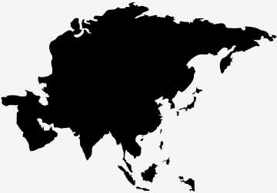
Global Hats Market Revenue share for 2024
Asia-Pacific

Slide 6

Rise of Online Shopping to Propel Market Growth
Drivers
Enhanced Competition to Restrict Market Growth
Restraints

Slide 7

AUTHOR'S PERSPECTIVE
  The Global Hats Market is witnessing significant growth in the near future.
  Women’s is the fastest-growing category over the forecast period because women's hats with tailored designs for sports or outdoor pursuits improve comfort and performance.
  Fashion is the fastest-growing category over the forecast period because it can be used in various settings and contexts.
  The wool is the fastest-growing category over the forecast period, as it helps control body temperature, making the head cool in warm weather and warm in frigid ones.
  E-commerce sales have increased due to the massive drive toward digitization during the coronavirus outbreak.

Slide 8
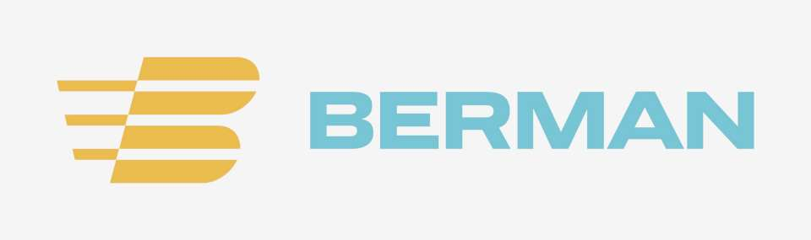
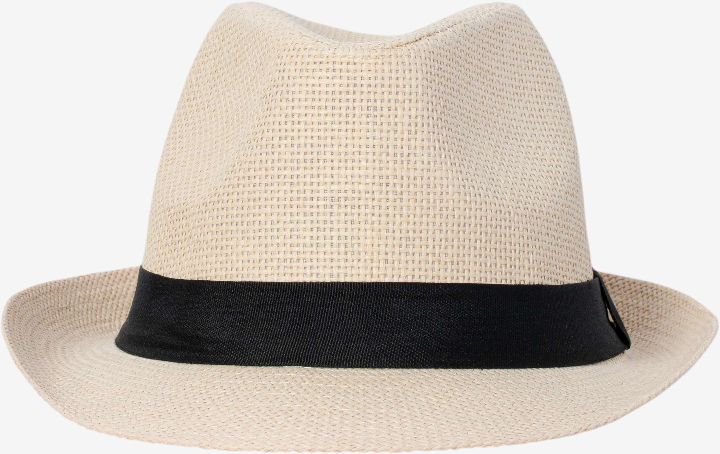


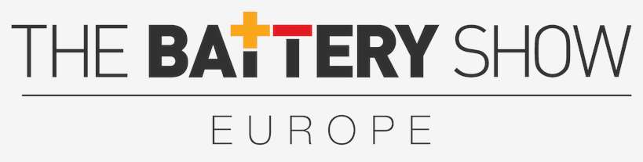
KEY PLAYERS

Slide 9


For Full Report
Contact us
COGNITIVE MARKET RESEARCH
Tel: +1 312-376-8303 | +44 020-8123-0732
India: (+91) 983-496-8611
sales@cognitivemarketresearch.com
Access the Full Report : https://tinyurl.com/mrxtcju4
Please visit our website:
https://www.cognitivemarketresearch.com

