Slide 1
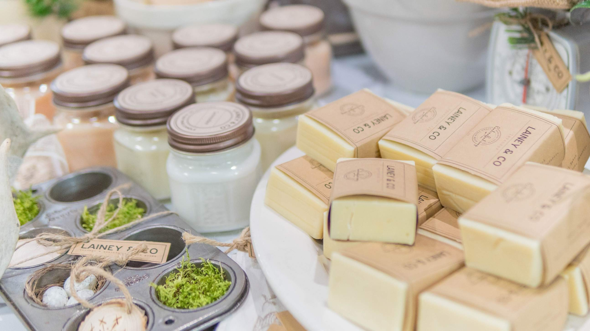
GLOBAL
HANDMADE SOAP
MARKET REPORT 2024
Global,Regional,CountryAnalysis

Slide 2
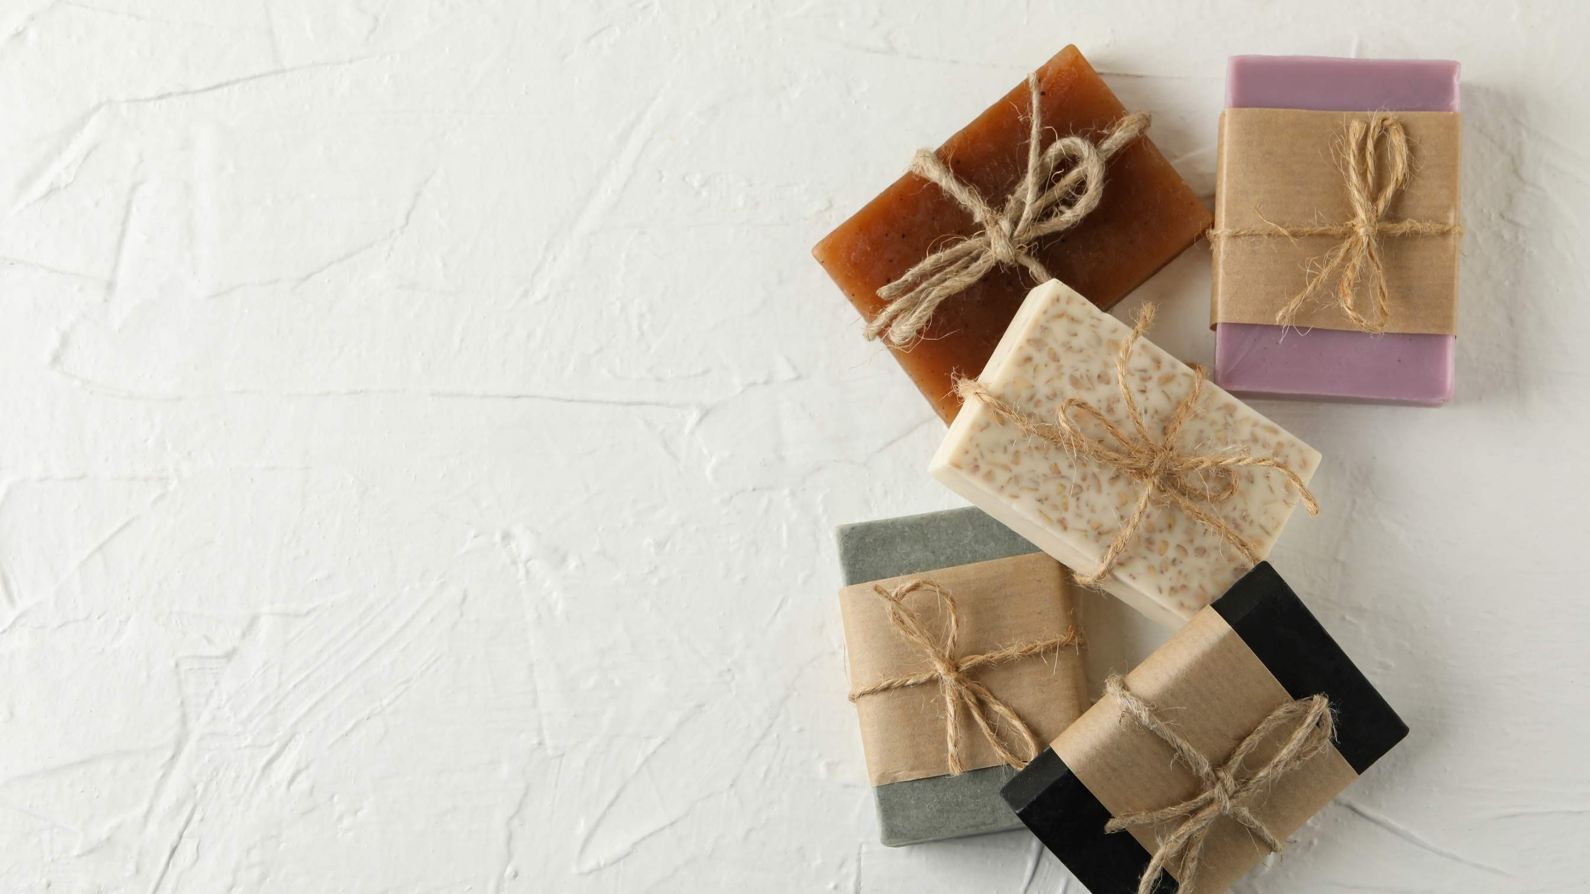
INTRODUCTION
Handmade soap is prepared by hand rather than in a factory. It is frequently thought to be more natural and/or better quality than factory-made soap.
Handmade soap is created by blending natural components including oils, herbs, flowers, and spices. These soaps are good for your skin because they include no harsh chemicals or artificial perfumes that can irritate it. Rising awareness of skin and beauty care, combined with a global demand for chemical- free skin and hair care products, is propelling market expansion. The shift in customer preference for natural and safe components is further propelling market expansion. Increasing demand for organic soaps from emerging markets is expected to drive market expansion over the forecast period. The time- consuming manufacturing process is likely to slow market expansion.

Slide 3
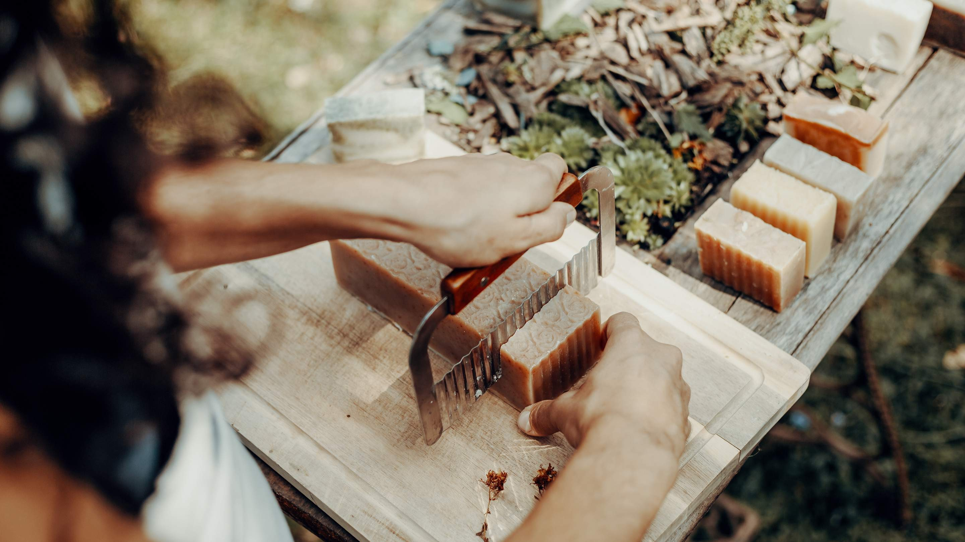

KEY INSIGHTS
MARKET SIZE
USD 7915.2 million
2023
20₋23
CAGR 5.20%
2030

Slide 4
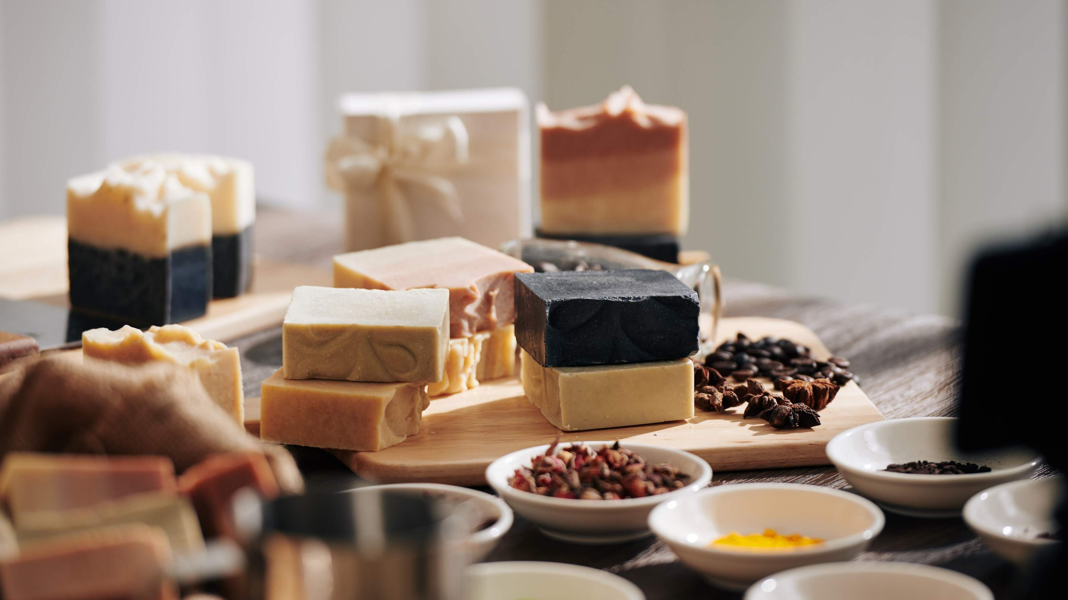
REVENUE MARKET SHARE BY SEGMENTS 2022
Online Retail
Specialty Stores
Distribution Channel
Residential Commercial Hotels
Spas
End-User Segment
Oils Lye
Additives Fragrance Colorants
Raw Material Segment

Slide 5
Global Handmade Soap Market Revenue share for 2022
North America 40%

Slide 6
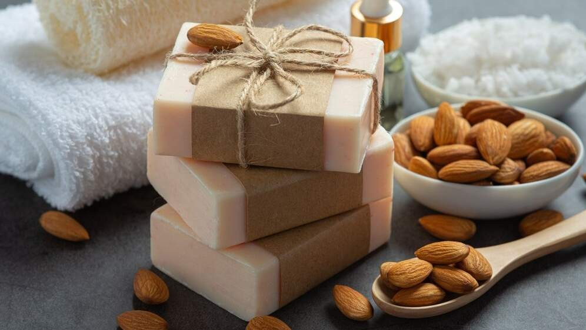
Key Market Players Introducing Unique Soaps is Fuelling the Market Growth
Drivers
Increasing the Availability of Alternative Products is Anticipated to Hamper the Market Growth
Restraints

Slide 7
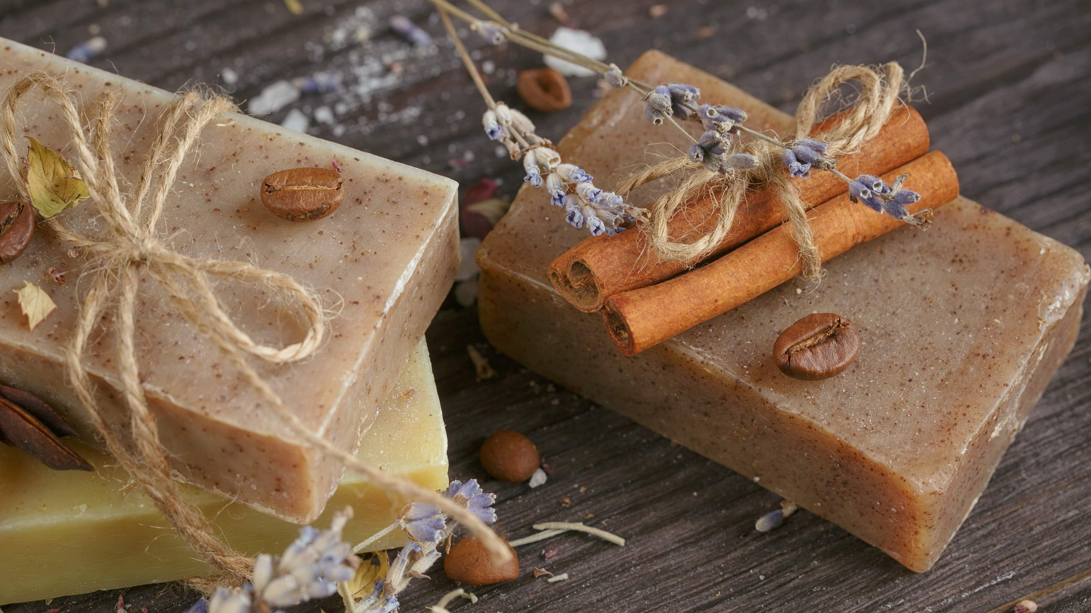
AUTHOR'S PERSPECTIVE
The Global Handmade Soap Market is witnessing significant growth in the near future.
Lye, palm, and oil are the fundamental raw ingredients for hot process soaps, and its derived products include glycerin, potassium hydroxide, sodium hydroxide, and/or caustic soda.
Handmade soaps are used for a variety of applications, including face washes, bath products, and laundry detergent compositions.
Customers may also test and compare perfumes and other product ingredients at these marts, which is fueling segment growth.
Lye soap, also known as cold process soap, is ideal for persons with sensitive skin or skin diseases such as eczema because it has less chemicals and scents.

Slide 8

KEY PLAYERS

Slide 9


Contact us
For Full Report
COGNITIVE MARKET RESEARCH
Tel: + 1 312 - 376 - 8303 | + 44 020 - 8123 - 0732
India: ( + 91 ) 983 - 496 - 8611
sales@ cognitivemarketresearch. com
Access the Full Report : http://tinyurl.com/4rpfjuue
Please visit our website:
https://www.cognitivemarketresearch.com

