Slide 1

GLOBAL
HAND FANS
MARKET REPORT
2024
Global,Regional,CountryAnalysis

Slide 2

INTRODUCTION
A hand fan is a tool utilized to enhance air circulation for individuals in hot weather. It comprises a slender, flat object, typically crafted from paper, wood, or metal, which is affixed to a handle. By gripping the handle and oscillating it, the fan generates airflow. The rising disposable income of the population, coupled with the growth of urbanization, is fueling an expansion in the number of individuals exposed to elevated temperatures and humidity. Consequently, the demand for hand fans is on the rise.

Slide 3


KEY INSIGHTS
CAGR
6.00%
2023- 2030

Slide 4

REVENUE MARKET SHARE BY SEGMENTS 2022
  Silk
  Nylon
Type Segment
  Jewelry Shop
  Supermarket
  Lifestyle Store
Application Segment

Slide 5

Global Hand Fans Market Revenue share for 2024
Asia Pacific
36%

Slide 6
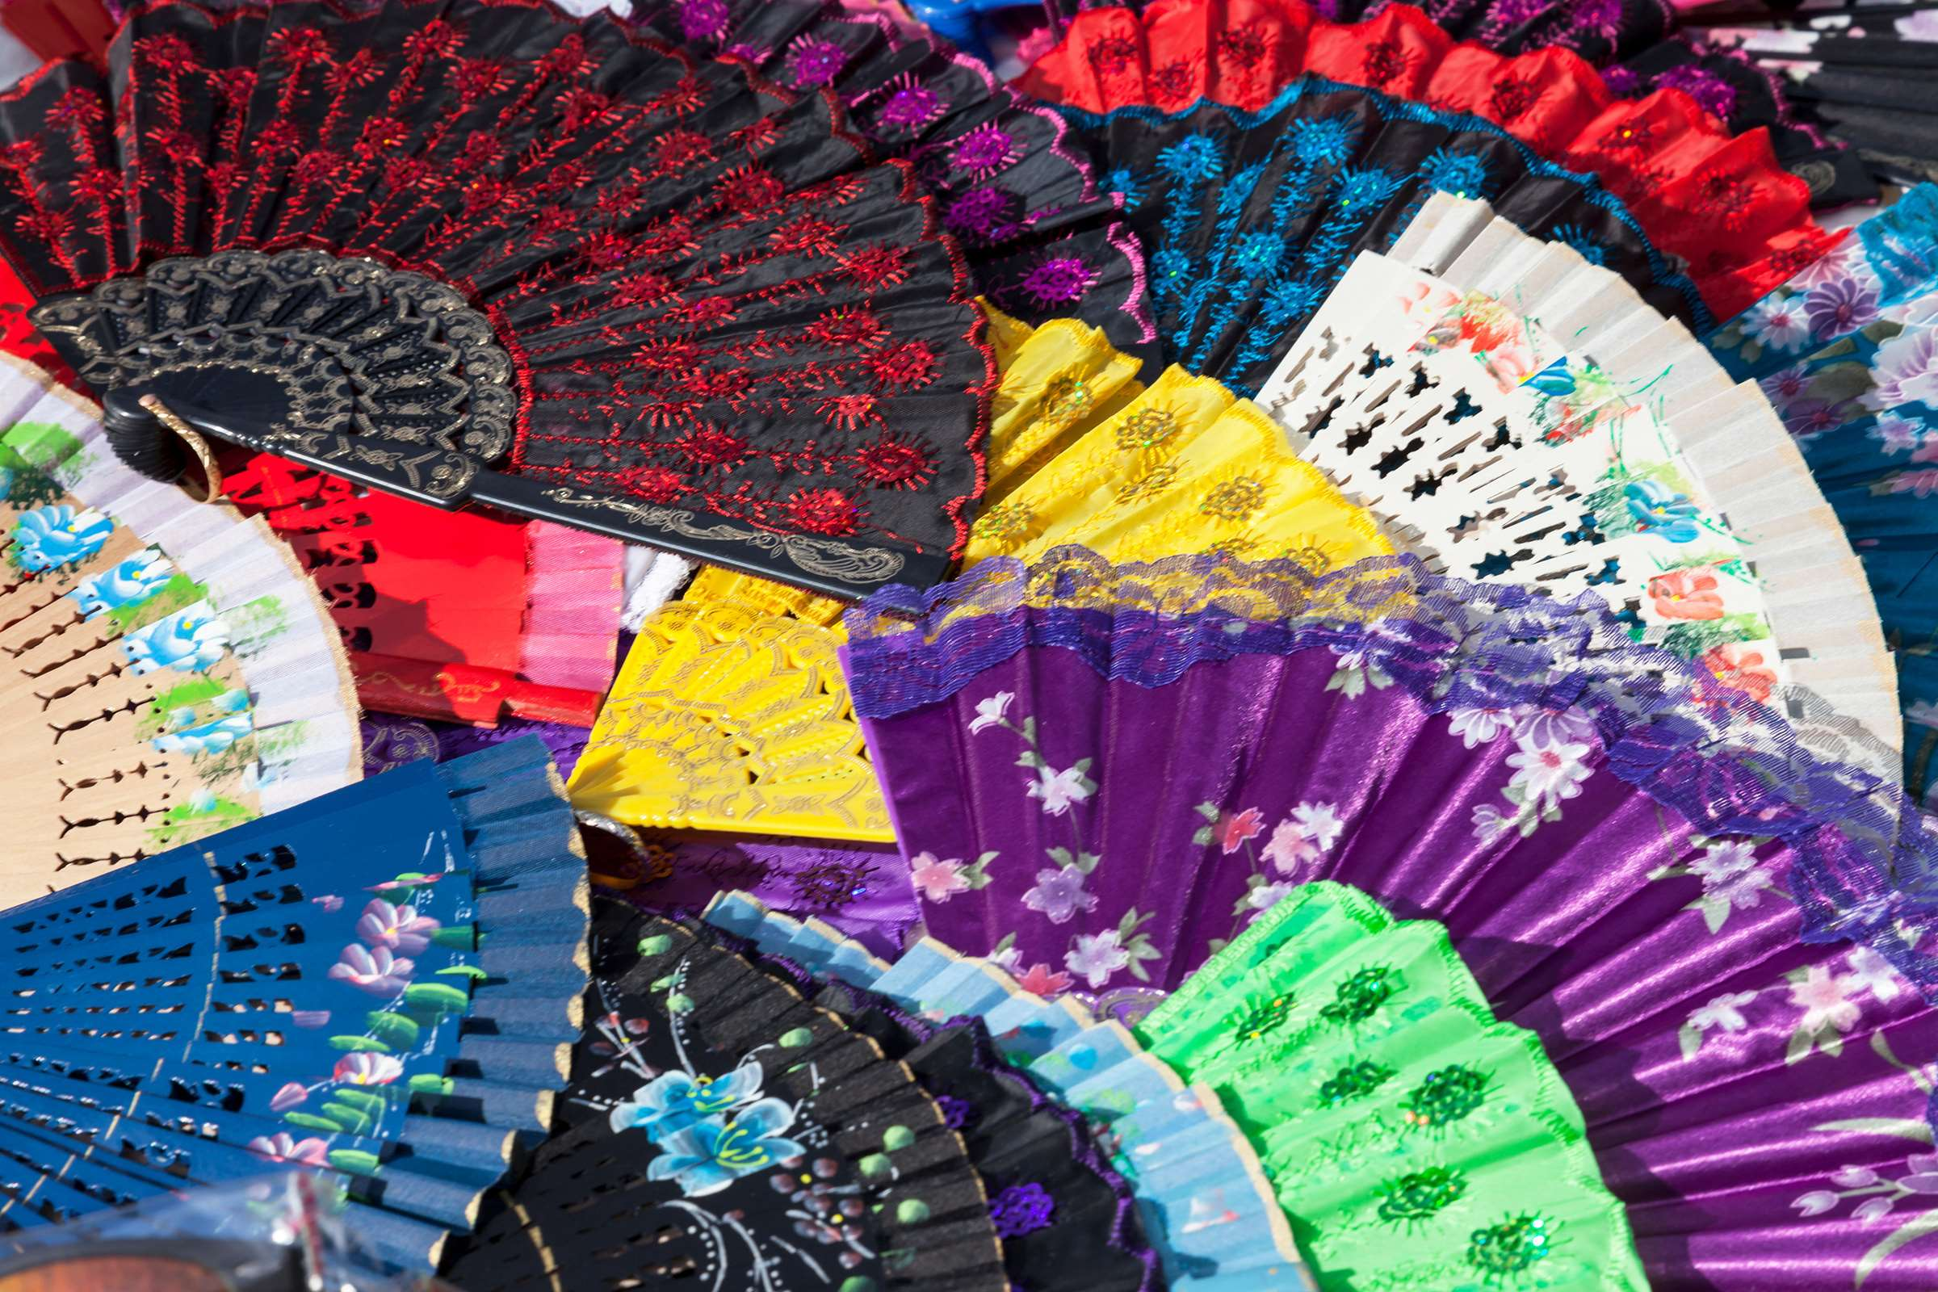
Technological Advancements and Customization to Propel Market Growth
Drivers
Supply Chain Disruptions Amidst Global Uncertainties to Hinder Market Growth
Restraints

Slide 7

AUTHOR'S PERSPECTIVE
  The Global Hand Fans Market is witnessing significant growth in the near future.
  Silk, being a luxurious and lightweight fabric, enhances the aesthetic appeal of hand fans.
  Nylon, being a robust and lightweight material, ensures that these fans are sturdy and long-lasting, making them ideal for everyday use.
  The contemporary aesthetic, coupled with affordability, positions nylon hand fans as a popular choice among modern consumers seeking stylish and functional cooling solutions.
  Hand fans in jewelry shops are often made from fine materials like silk, adorned with delicate embroidery, and sometimes feature handles encrusted with jewels.
  The aura of exclusivity surrounding these fans makes them coveted collectibles among fashion enthusiasts and collectors.

Slide 8










KEY PLAYERS

Slide 9


For Full Report
Contact us
COGNITIVE MARKET RESEARCH
Tel: +1 312-376-8303 | +44 020-8123-0732
India: (+91) 983-496-8611
sales@cognitivemarketresearch.com
Access the Full Report : https://tinyurl.com/46ywyyyv
Please visit our website:
https://www.cognitivemarketresearch.com

